Slide 1
La ropa
Clothes

Slide 2
La ropa
We are going to start a new topic all about clothes, la ropa. All of KS2 and KS1 are doing the same topic so if you have siblings, you can help each other.
This week, I would like you to look through the slides and try to say the words in Spanish. Remember, you pronounce the words as they appear, there are no tricks (well very few) when it comes to Spanish pronunciation.
When you have done that you can do the worksheet. Y5/6 to do the sheet with 3 Twinkl stars. Y3/4 to do the sheet with 2 Twinkl stars. Answers are on the last page, no peeking!
If you don't have access to a printer, you could write the answers left to right in your home learning book.

Slide 3
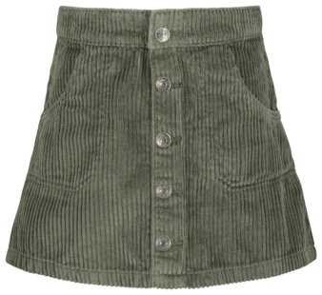
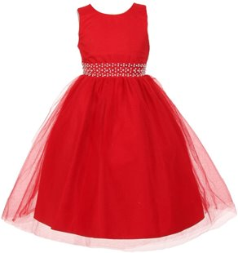
La ropa
una falda
un vestido

Slide 4
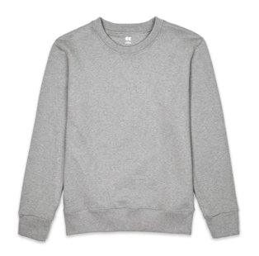
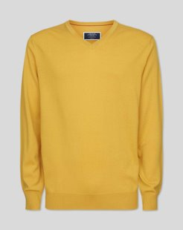
La ropa
un jersey
una sudadera

Slide 5
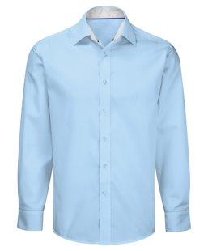
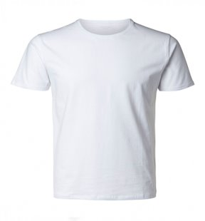
La ropa
una camisa
una camiseta

Slide 6
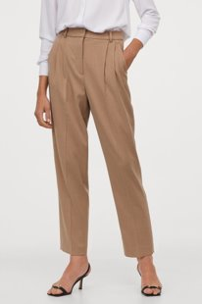
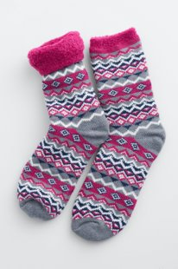
La ropa
unos pantalones
unos calcitines

Slide 7
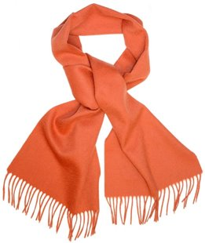
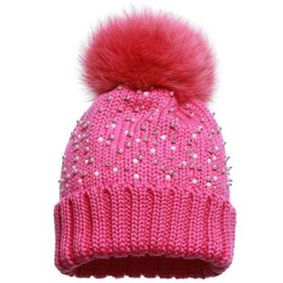
La ropa
una bufanda
un gorro de lana

Slide 8
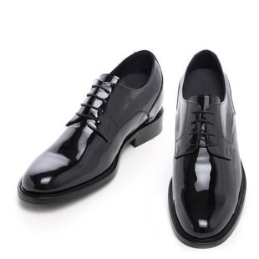
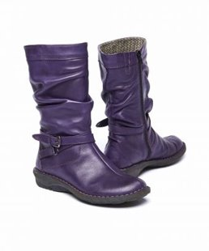
La ropa
unos zapatos
unas botas

Slide 9
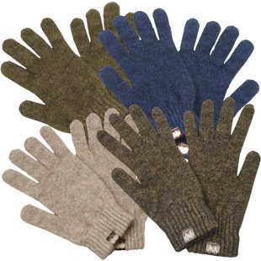
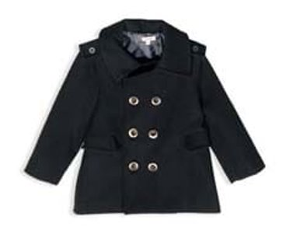
La ropa
unos guantes
un abrigo

