Slide 1

Action Words
whisper
dance
play
wander
joke
laugh
exercise
frighten
argue
bake
scream

Slide 2
What are we learning?
Today we are going to learn about action words called verbs. We will practise recognising them in our reading and look at how to use interesting verbs to improve our writing.

Slide 3
Activities
After reading the slides, complete the worksheet which is in the folder.
Additional activity – complete the activity on verbs in your CGP Grammar, Punctuation and Spelling workbook (pages 4 and 5).

Slide 4
What is a verb?

Slide 5
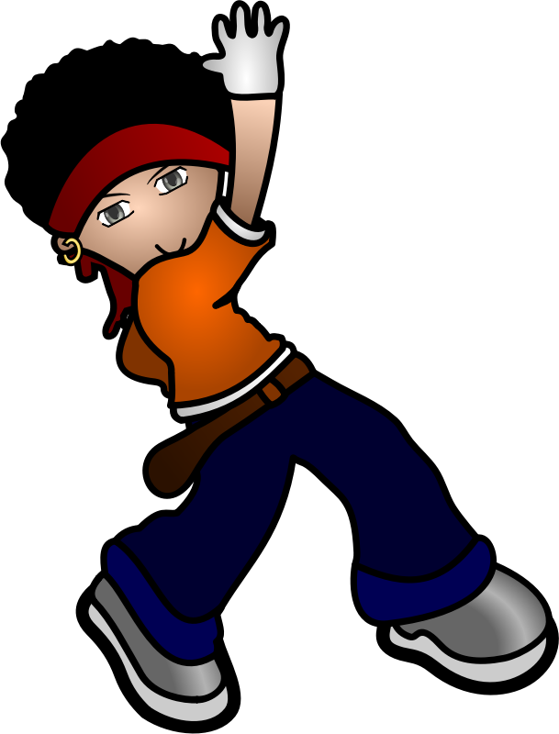
A verb is an action word. It tells us what someone or something is doing…
Alex dances well.

Slide 6


The fish swim in the sea.

Slide 7

The choir sing beautifully.

Slide 8
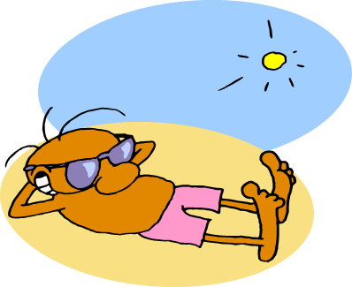
I relaxed on the beach.

Slide 9
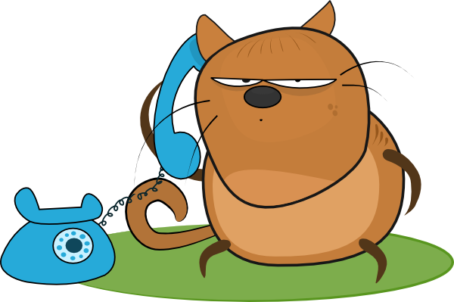
Cyril likes to chat.

Slide 10
Can you think of any other verbs? Go around the class and see how long you can make a ‘verb chain’ before you run out of words.

Slide 11
Below are some of the things I can do. They are all verbs.
sleep
jump
think
argue
play
smile
skip
swim
worry
shout

Slide 12

Can you identify the words on the following slide that are verbs? Click on the word to reveal the right answer.
Copyright 2015 Online Teaching Resources Ltd www.Teacher-of-English.com

Slide 13


more
laugh
beautiful
bake
wander
whisper
strong
joke
guitar
verbs
frighten
exercise
argue
food
scream
goal
dance
impossible
dinosaur

Slide 14
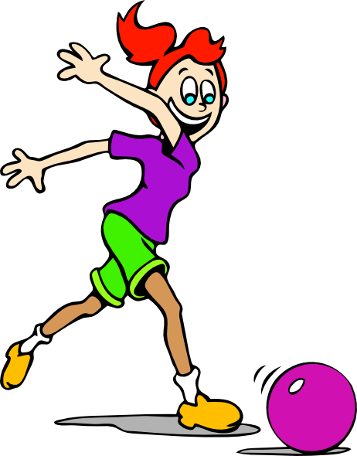
The verb is the most important word in a sentence. It tell us what is being done in the sentence…
Josie kicked the ball.
The verb ‘kicked’ tells the reader what the subject of the sentence (Josie) is doing.

Slide 15
Read the sentence on each slide and identify the verb. Click on the word to reveal the correct answer.
Copyright 2015 Online Teaching Resources Ltd www.Teacher-of-English.com

Slide 16
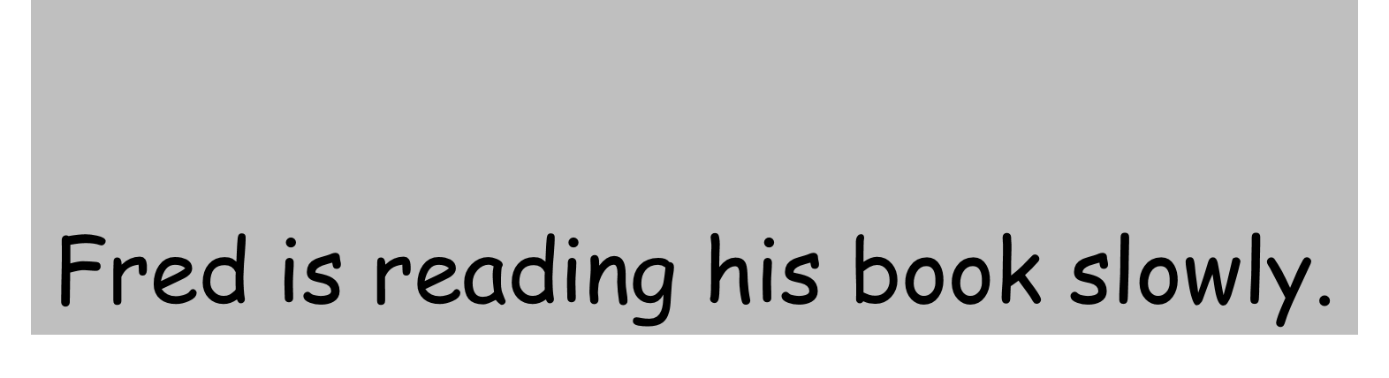


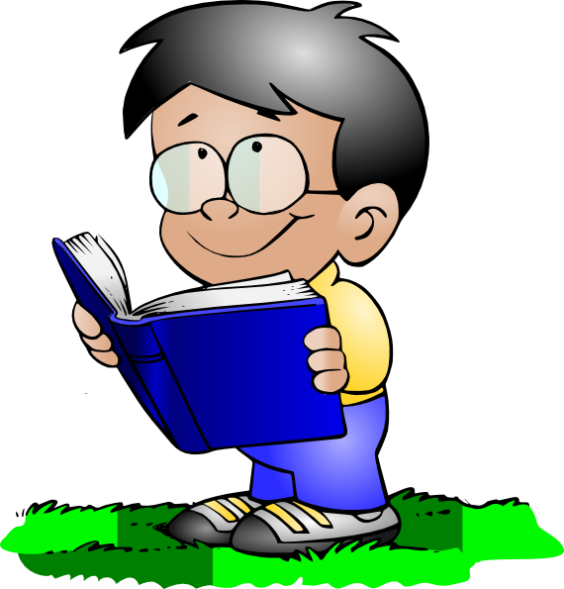
Fred is reading his book slowly.

Slide 17


The vicious bear growled.

Slide 18
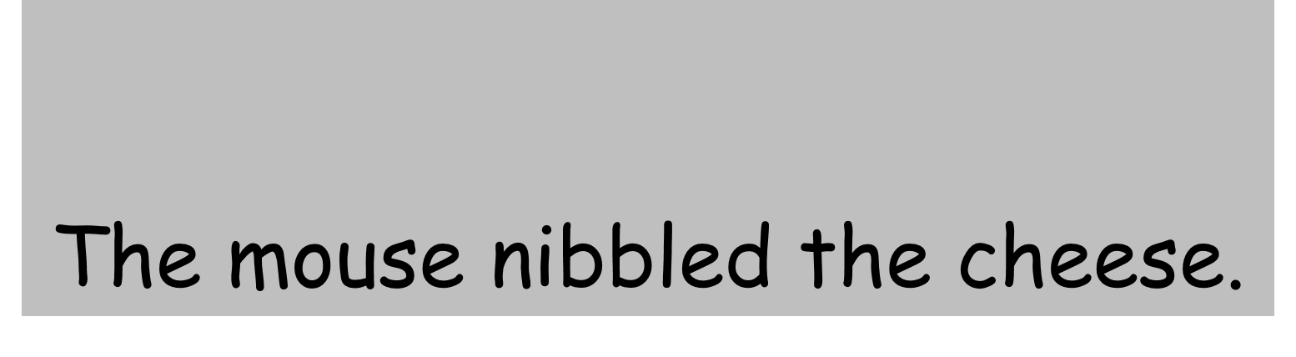


The mouse nibbled the cheese.

Slide 19





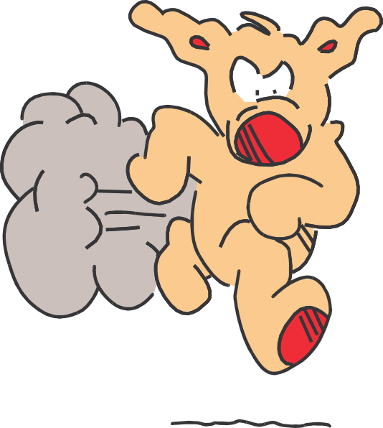
Charlie ran as fast as lightning.

Slide 20




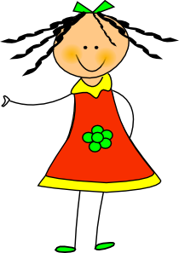

Lucy posted a letter to her friend.

Slide 21
When writing it is important to use interesting verbs to make our sentences clearer and more exciting for the reader…
The mouse ran away.
becomes…
The mouse scurried away.
By changing the verb ‘ran’ to ‘scurried’ the reader has a clearer picture of the action of the mouse and the sentence becomes more interesting.

Slide 22
Can you match up the verbs with similar meanings on the following slides? Click on the word to reveal the correct answer.
Copyright 2015 Online Teaching Resources Ltd www.Teacher-of-English.com

Slide 23


stroll
Try again
walk
open
Try again
drive

Slide 24
Try again
argue
Try again
speak
disappear
vanish

Slide 25
Try again
dive
run
race
Try again
ride

Slide 26
Try again
roar
Try again
push
break
shove

Slide 27
groan
moan
Try again
fall
Try again
grow

Slide 28
Read the sentence on each slide and replace the verb with a more interesting one. Click on the verb to reveal an answer but any suitable verb will be acceptable.
Copyright 2015 Online Teaching Resources Ltd www.Teacher-of-English.com

Slide 29

Imran vanished from the haunted house.
disappeared

Slide 30

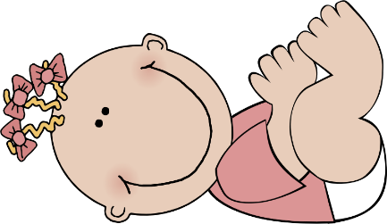

The baby hurled her teddy out of the pram.
threw

Slide 31

The stack of plates crashed to the floor.
fell to the floor.

Slide 32


‘Please, help me,’ I screamed.

Slide 33

Gerry grinned from ear to ear.
smiled

Slide 34
Choose an interesting verb to complete each sentence. Remember: a verb is a doing word.
1. The boy ________ home from school.
2. The clown _______ the children in the audience.
3. Sally _______ her lunch quickly.
4. I ________ into the river.
5. The builder ________ the nail into the wood.

