Slide 1
LC: How do Christians pray?

Slide 2
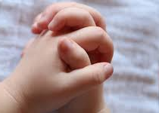
Prayer
Last week we learnt about what prayer is.
Just as we talk to our families and friends, Christians like to talk to God.
This is called praying.

Slide 3
Prayer
Prayer is about spending time enjoying God's company, a bit like you would do with your best friend:
Asking questions
Talking about your family and friends
Saying sorry
Saying thank-you
Listening to what they have to say
Just being glad to be with them.

Slide 4
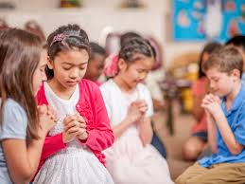
Christian Prayer
Last week we also learnt that people pray anywhere!
Some people might pray in their bedrooms.
Some people might pray on their way to school.
Sometimes Christians pray together in churches.

Slide 5
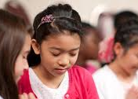
How do Christians pray?
When Christians say prayers, they sometimes close their eyes.
Why do you think they might do that?

Slide 6
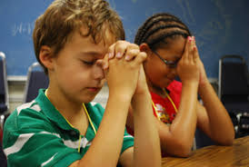
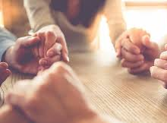
How do Christians pray?
Sometimes Christians put their hands together when they say prayers.
If a group of people are praying together, they may join their hands with each other.

Slide 7
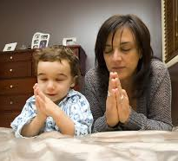
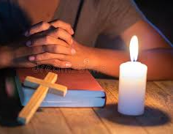
How do Christians pray?
We know that people can pray anywhere, but sometimes people might choose to kneel when they say their prayers.
Some people stand.
Some people like to sing.
And some people like to light a candle which helps them think about God.

Slide 8

What did Jesus teach people about prayer?
The Bible is a special book for Christians.
There are many stories about Jesus’ life.
In the Bible, Jesus prays in many different places:
The Temple
The countryside
In people’s homes
And in a garden

Slide 9
Activity: Today we would like you to write your own, short prayer.
Last week, you drew round your hand and wrote about what you might say a prayer for:
Thank you for…
I’m sorry I..
Please help…
Please look after..
Look at some of the following examples and try to write your own.

Slide 10



