Slide 1

Lesson 5

Slide 2
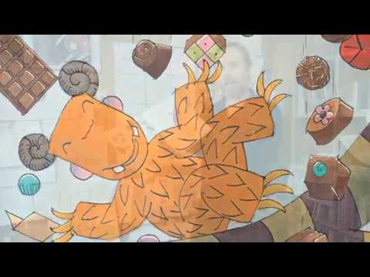
Lesson 5
Let’s combine all our hard work on:
-conjunctions
-feelings / emotions
-time words
In addition to our ‘Writer’s ToolKit’
If you need a little reminder about the story or any of the vocabulary types we have discussed so far, return to the slides used in previous lessons.
For ease, a repetition of the story follows in this ppt.

Slide 3
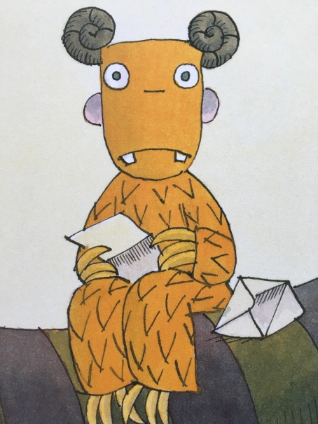
Lesson 5
Task:
To write 1 or 2 sentences about each of the main events on our story plans and retell the same story in our own words.
Make sure that you have your story plan with the pictures in the correct sequence/order in front of you.
You are writing 1 or 2 sentences about each of these pictures. Remember you are retelling the story and writing about the events taking place in that picture and not just writing about and describing what you can see in the picture.
Use the time word you have already decided on to start each sentence.
Include some of the feeling/emotion words and conjunctions.

Slide 4
Lesson 5
https://vimeo.com/169782031

Slide 5
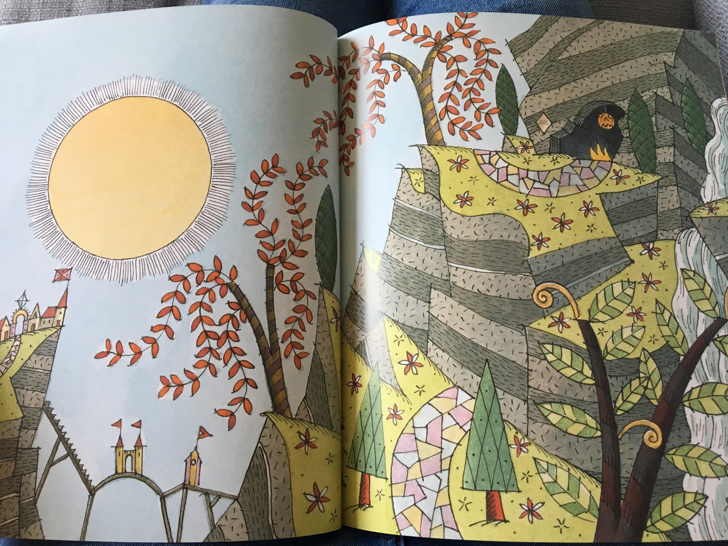

Slide 6
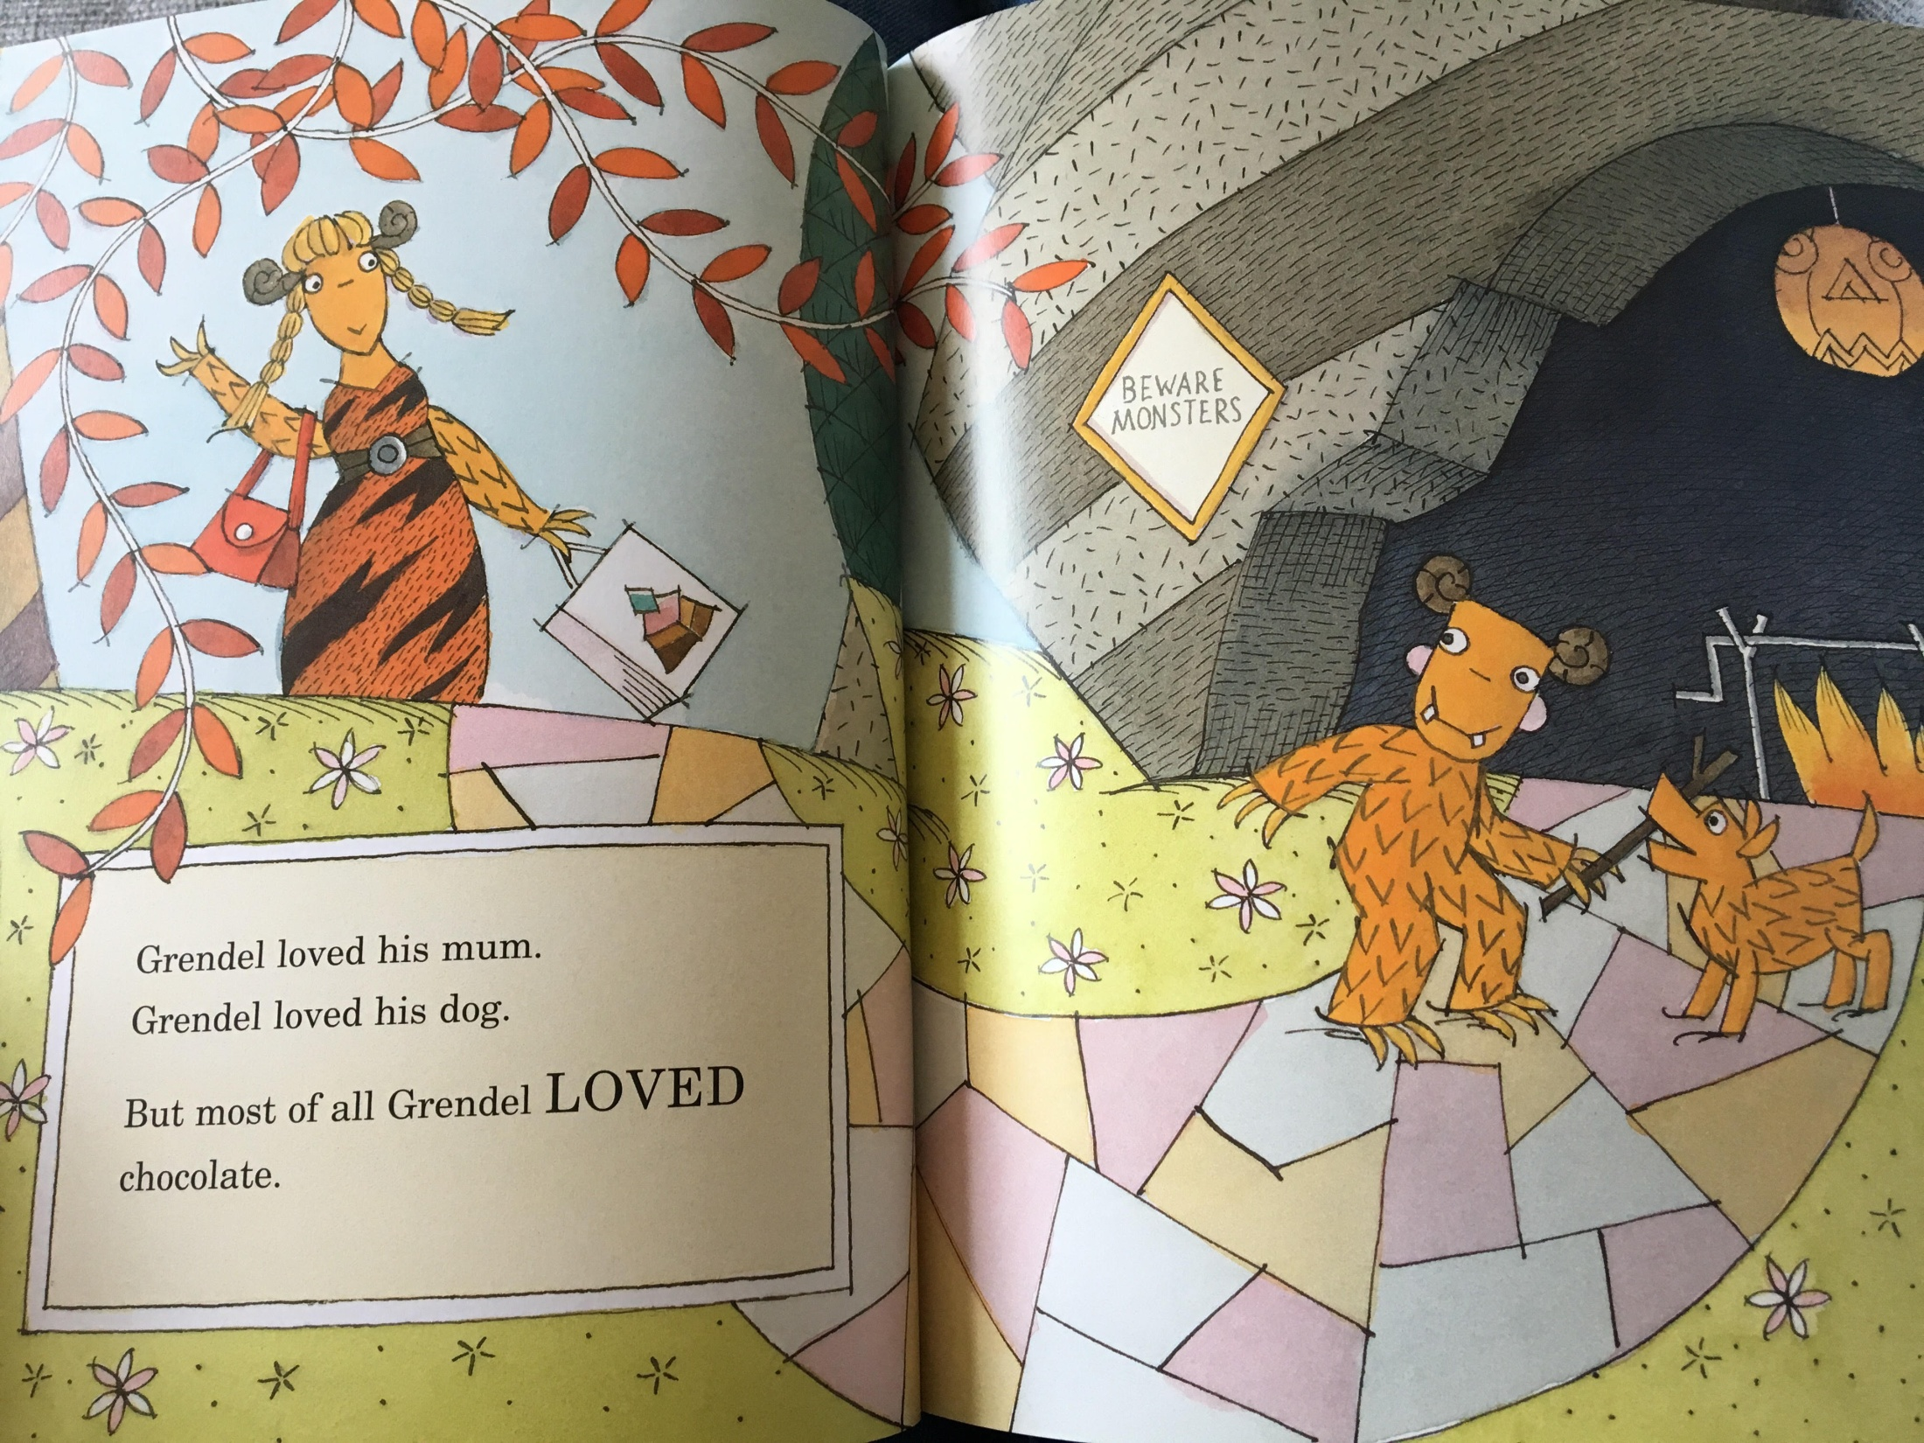

Slide 7
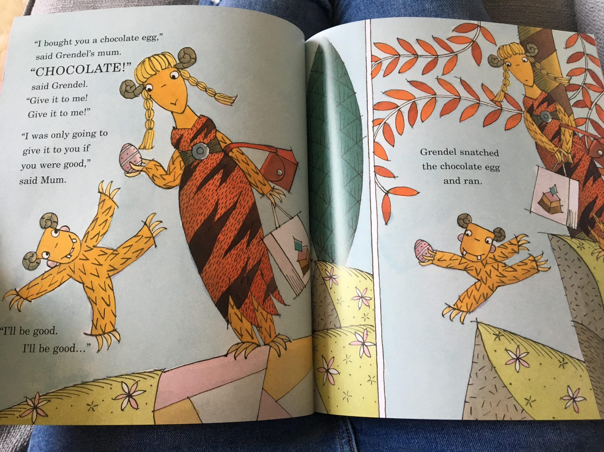

Slide 8
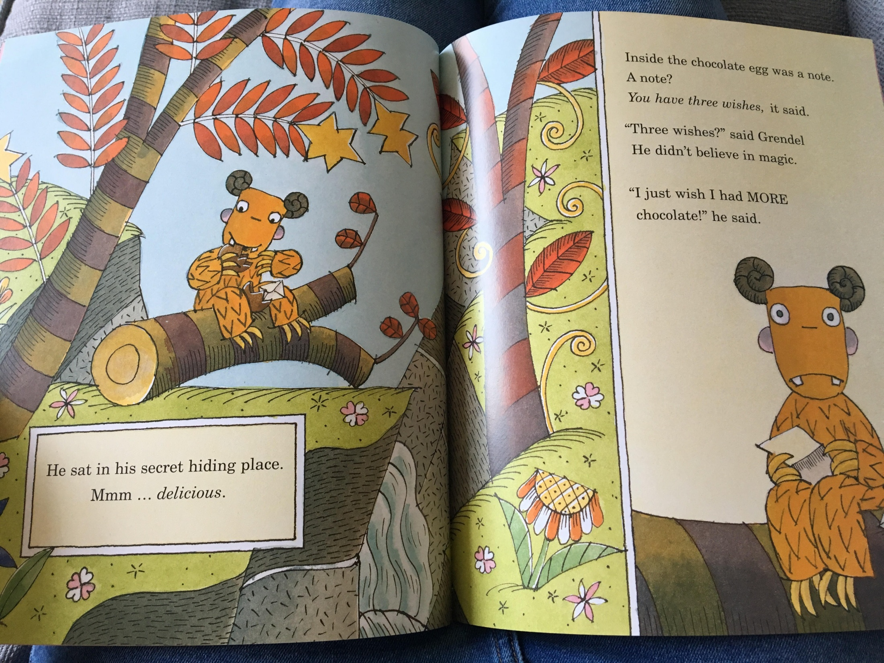

Slide 9
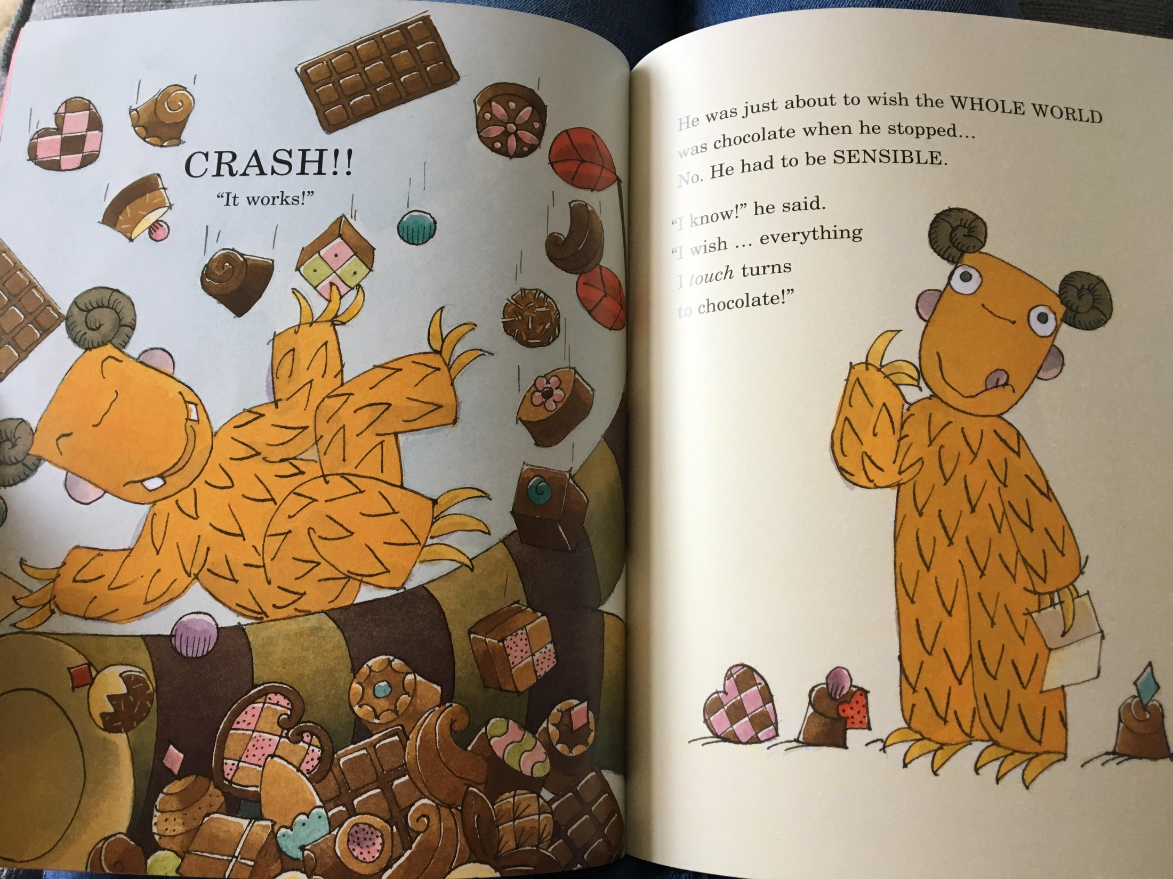

Slide 10
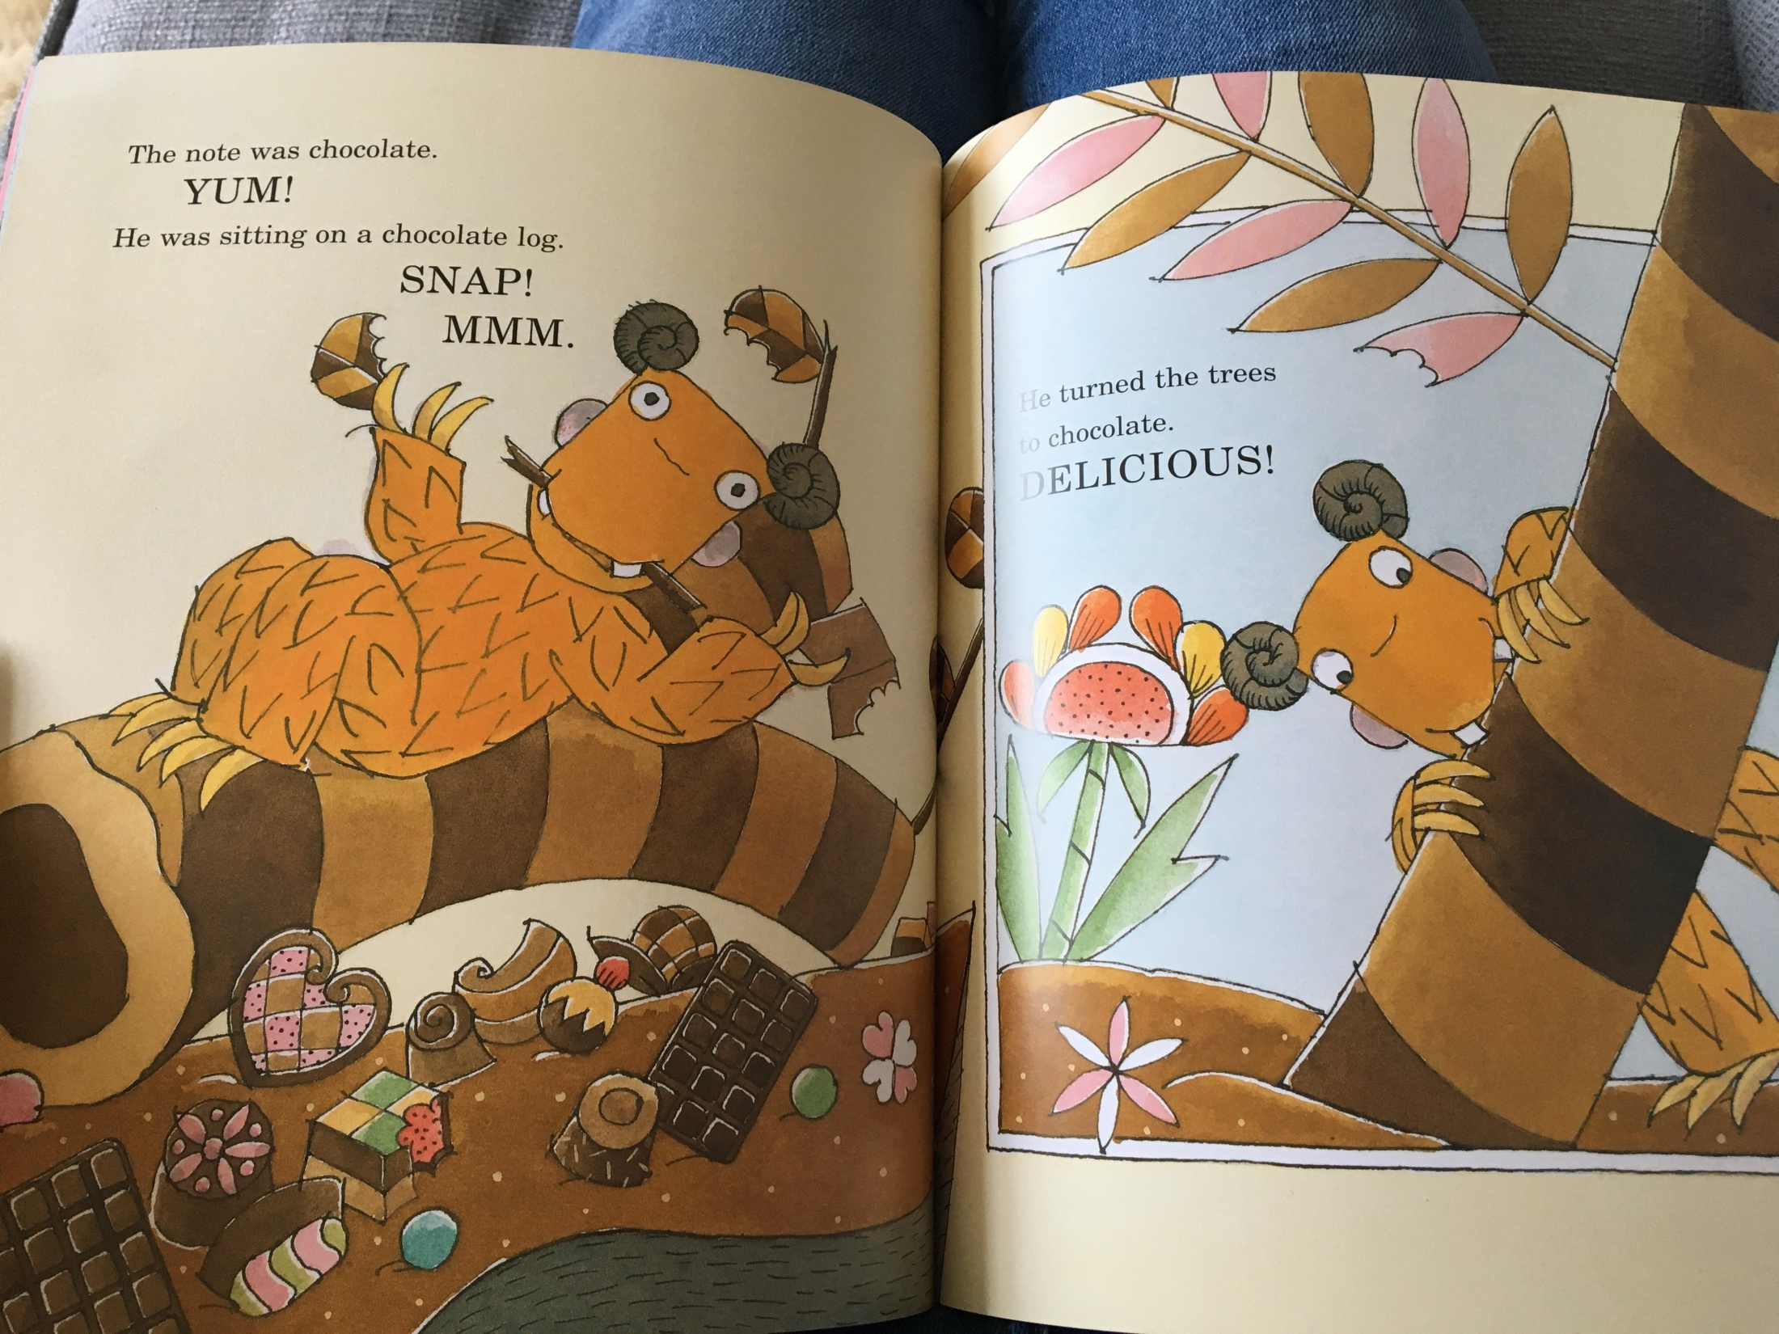

Slide 11
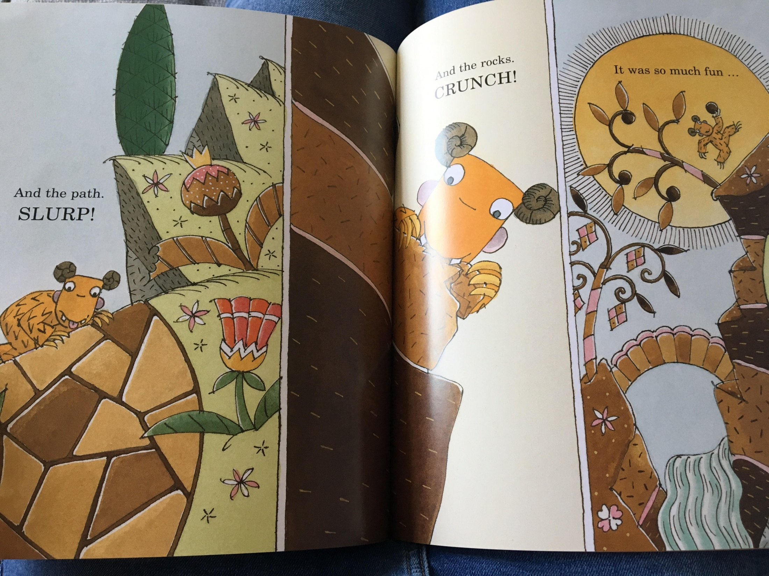

Slide 12
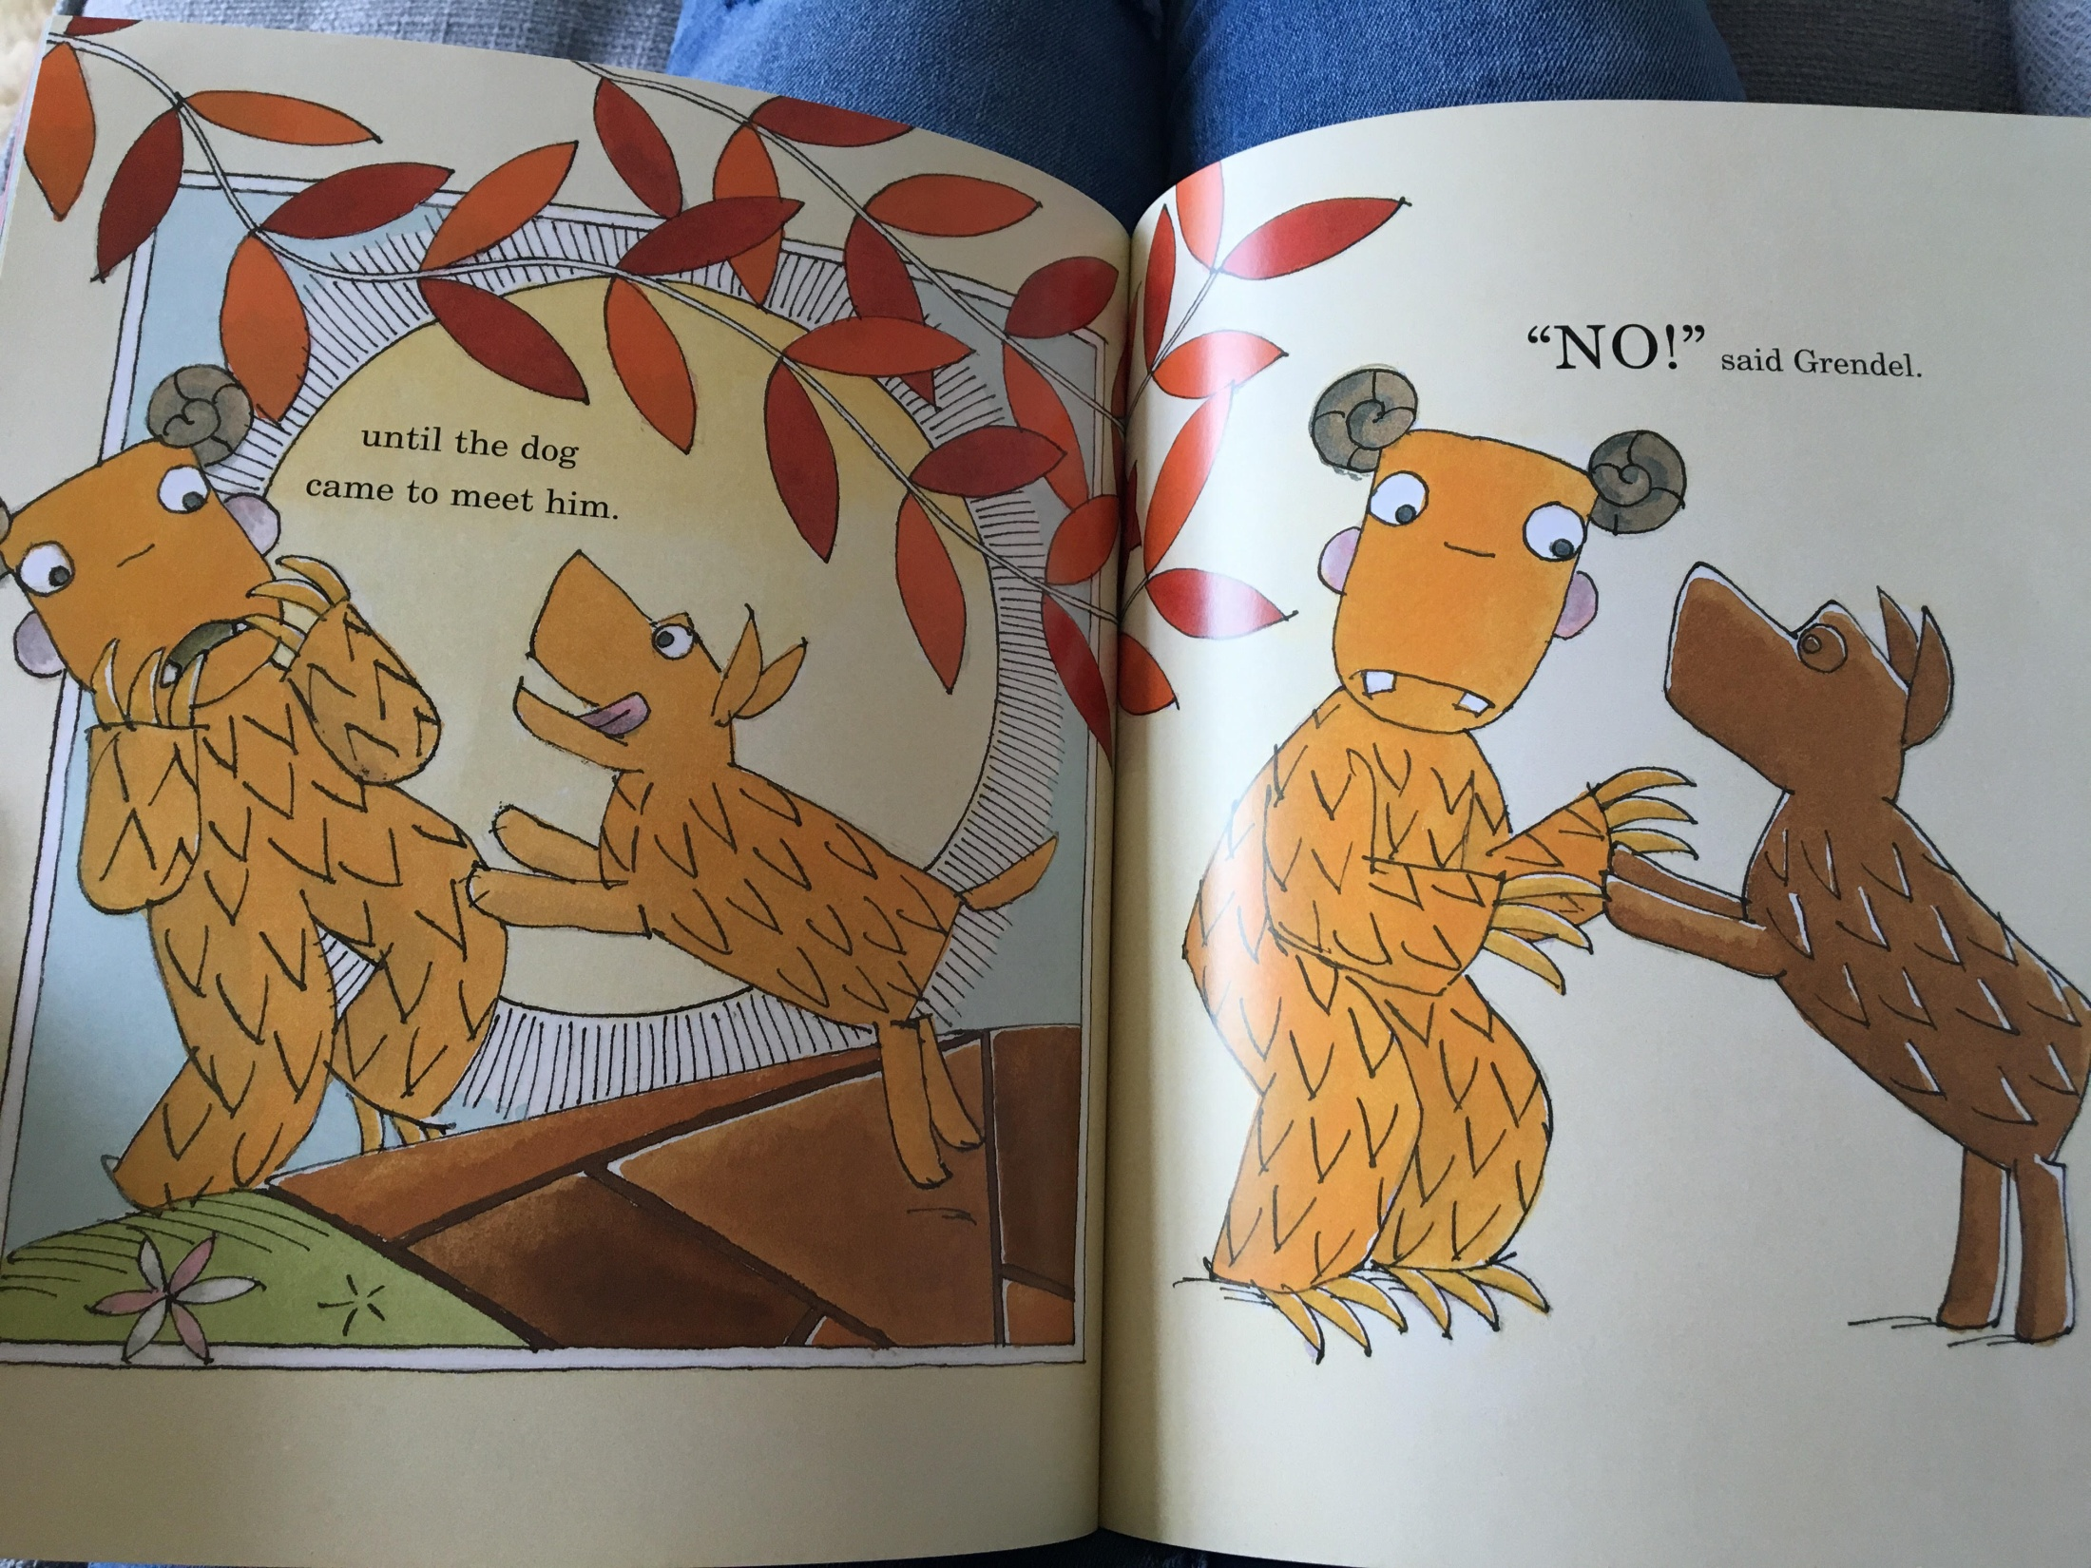

Slide 13
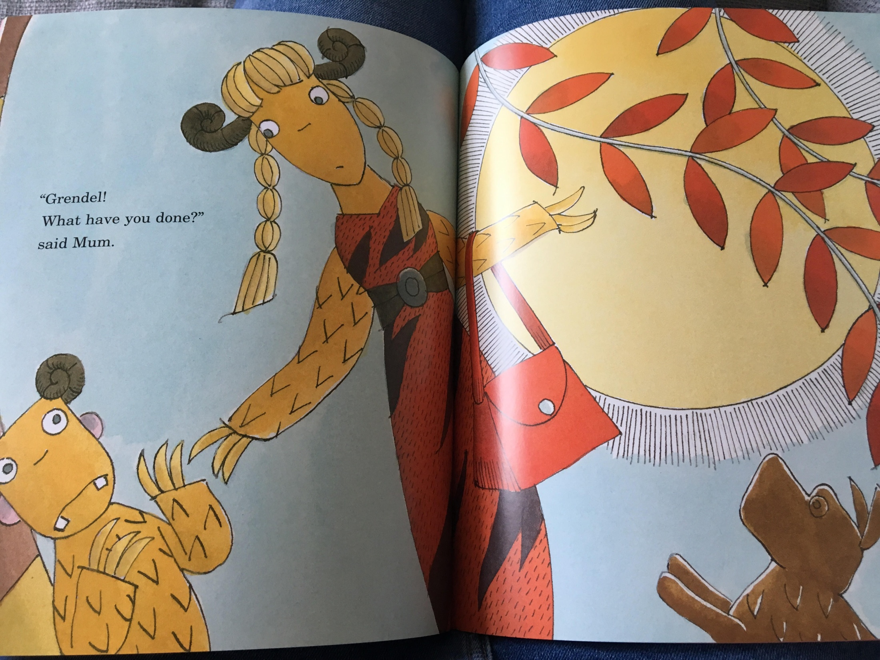

Slide 14
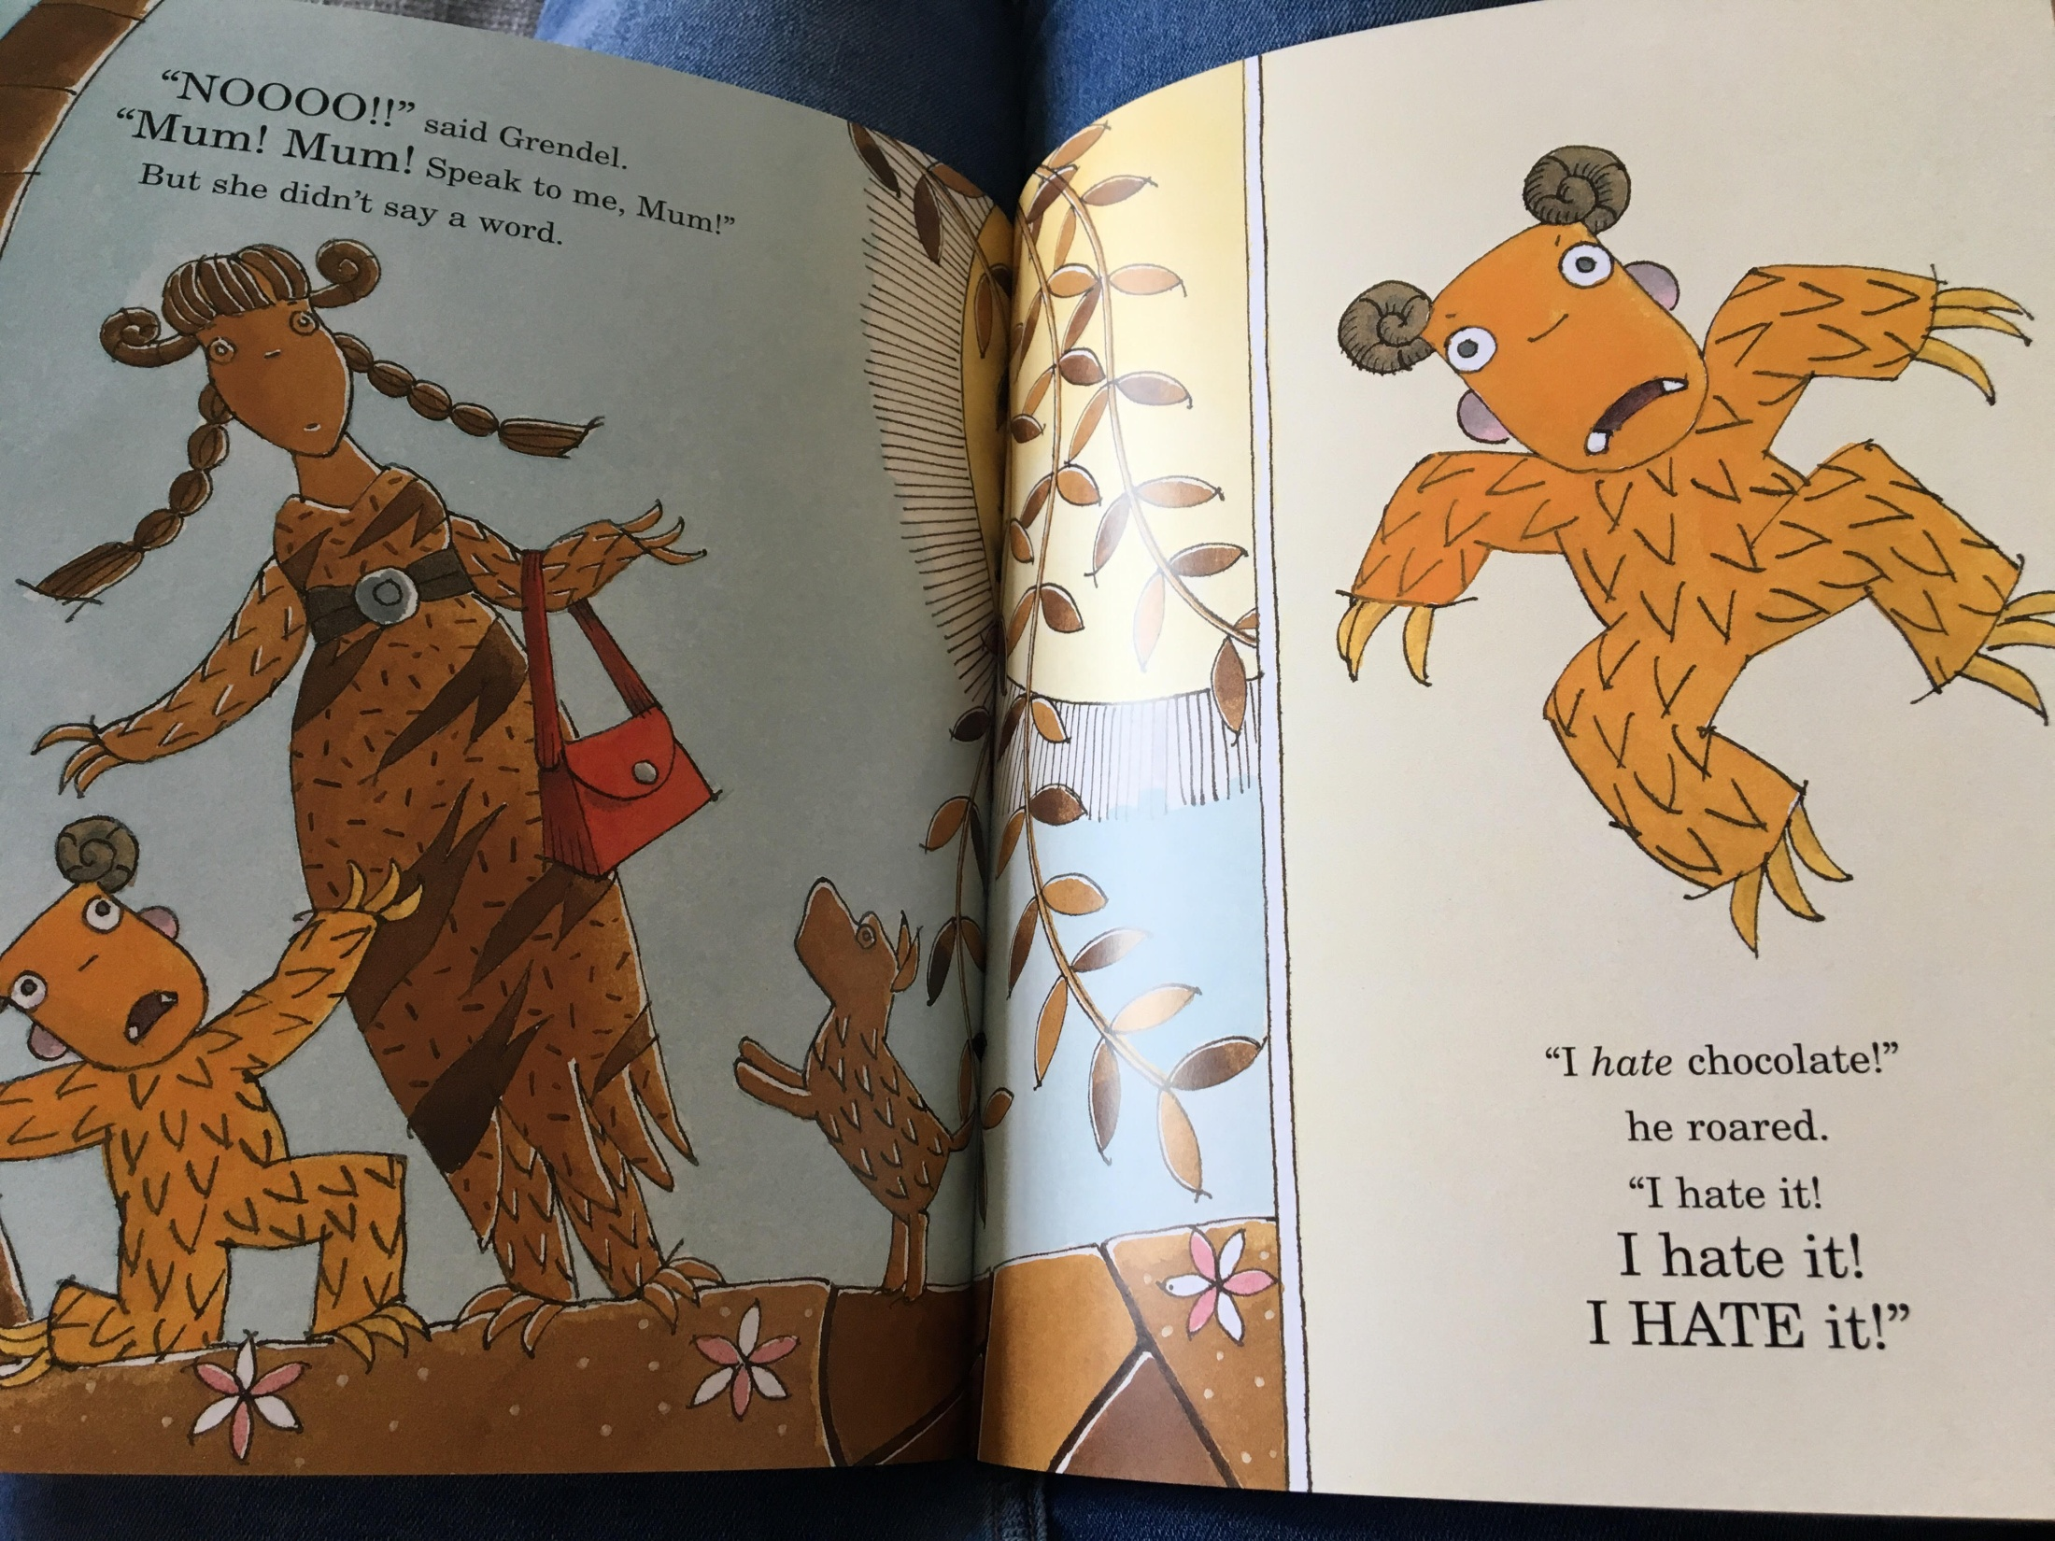

Slide 15
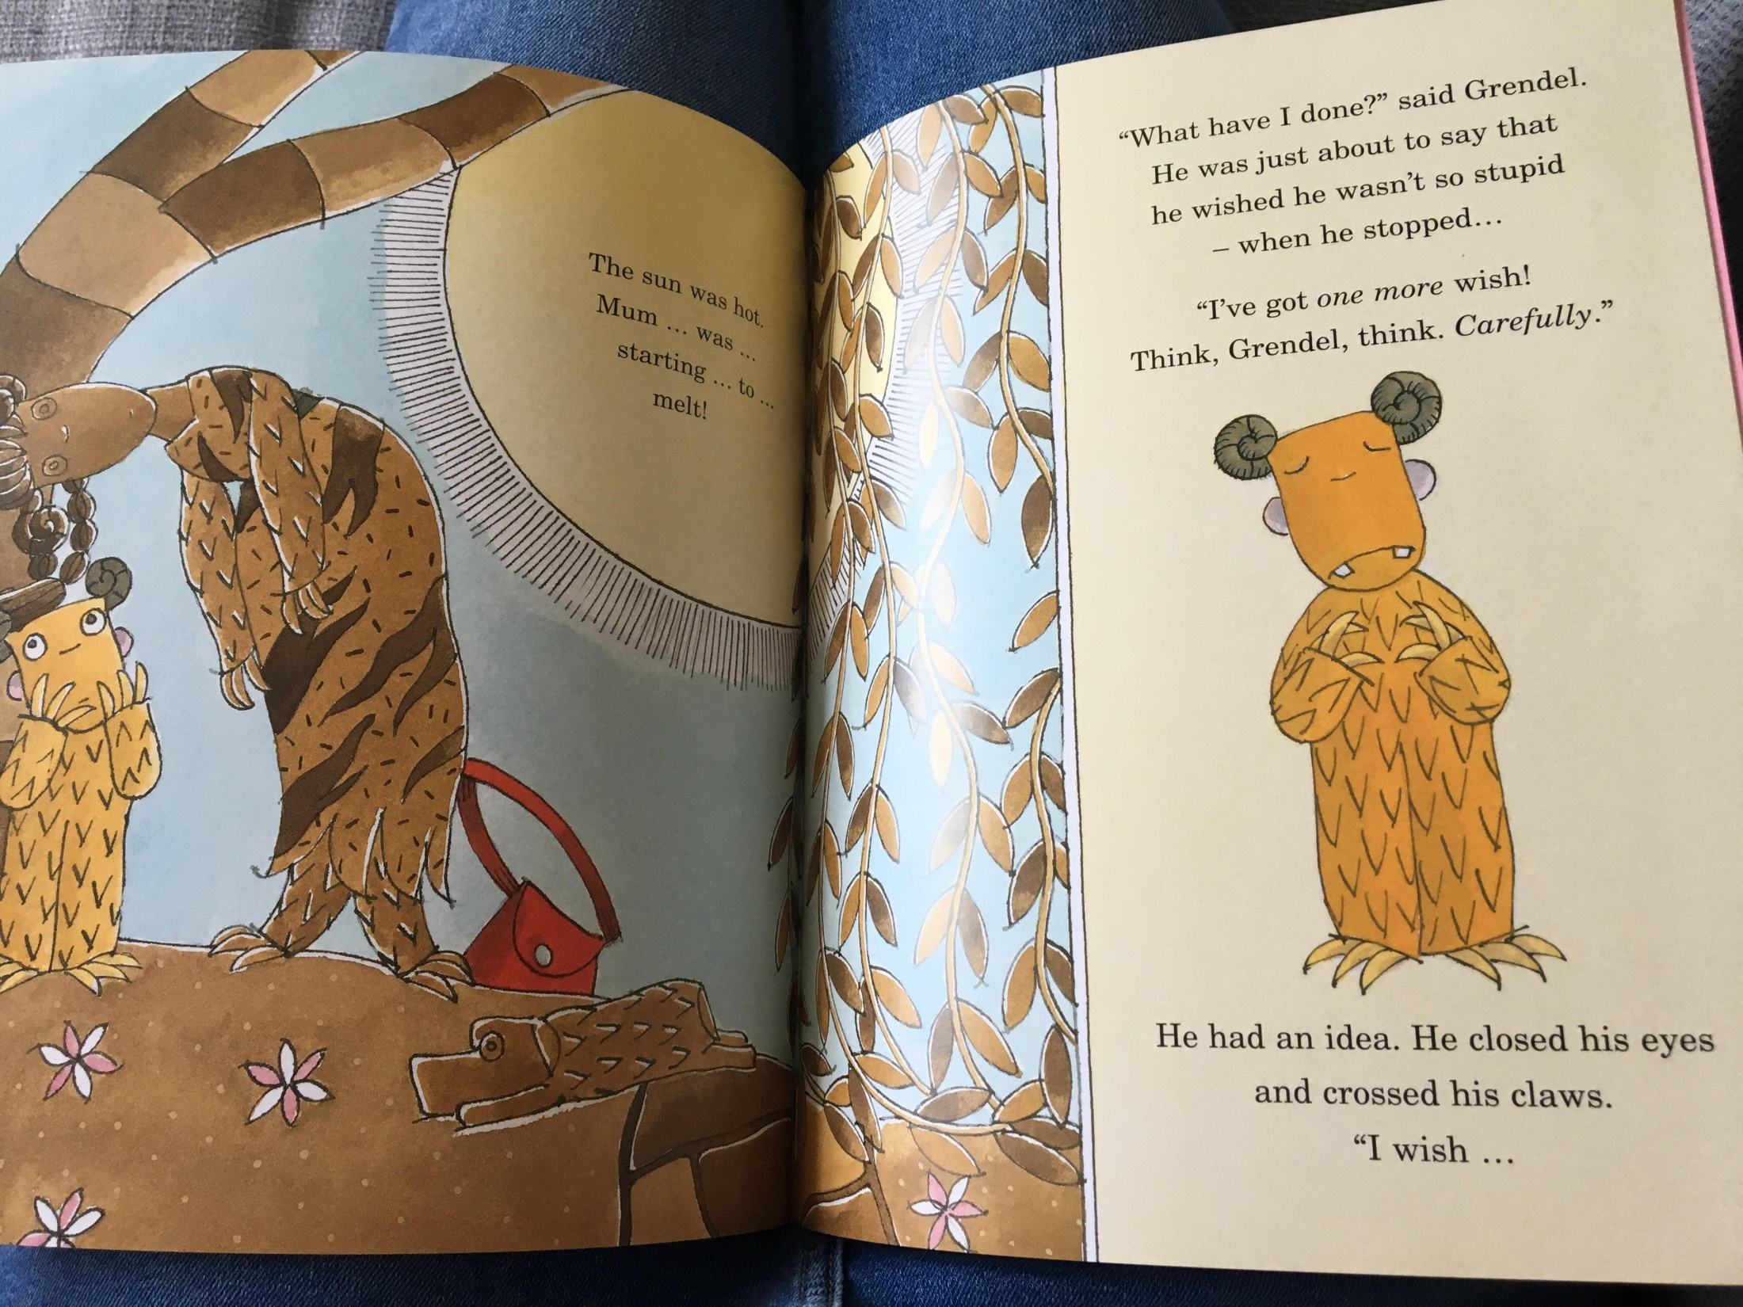

Slide 16
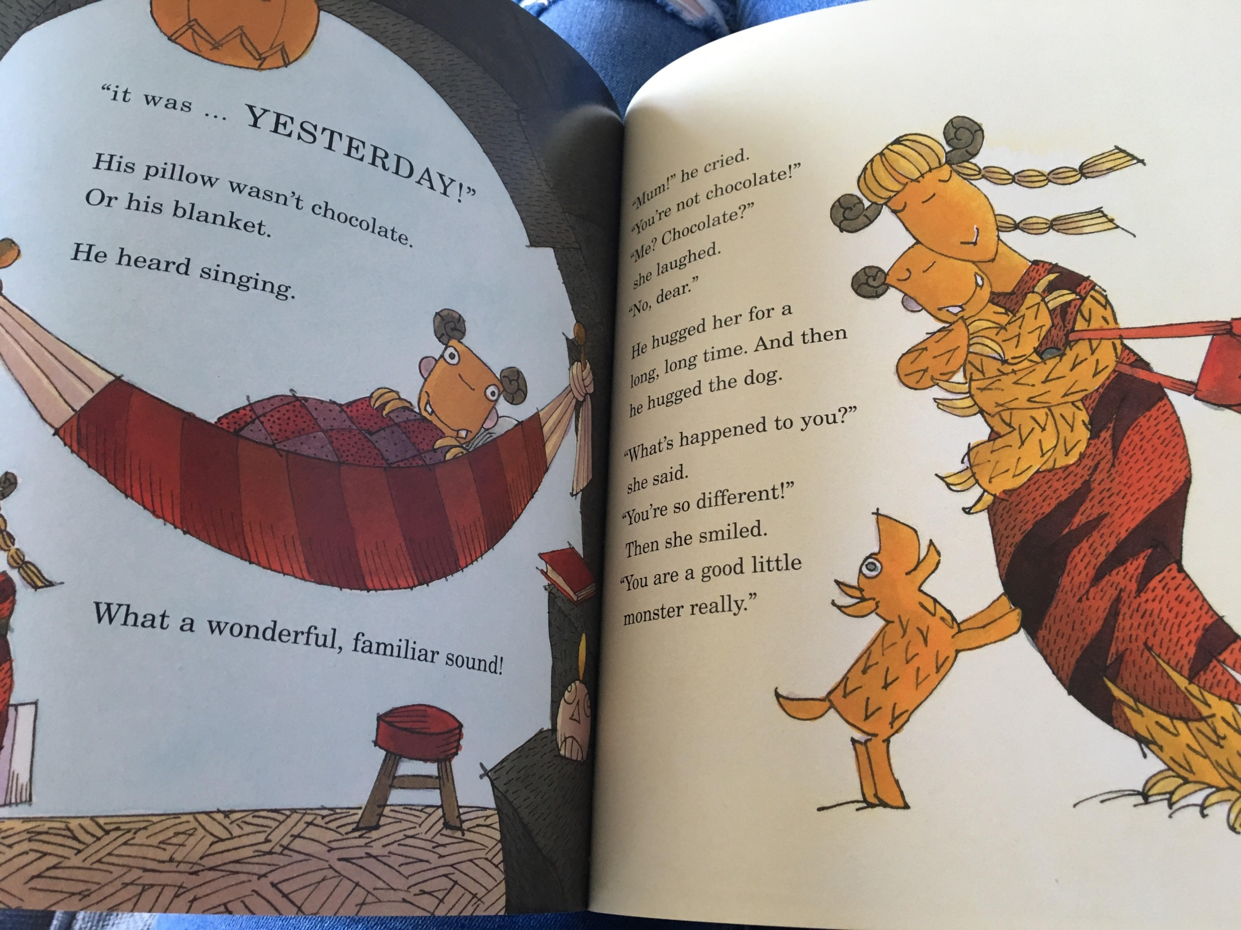

Slide 17
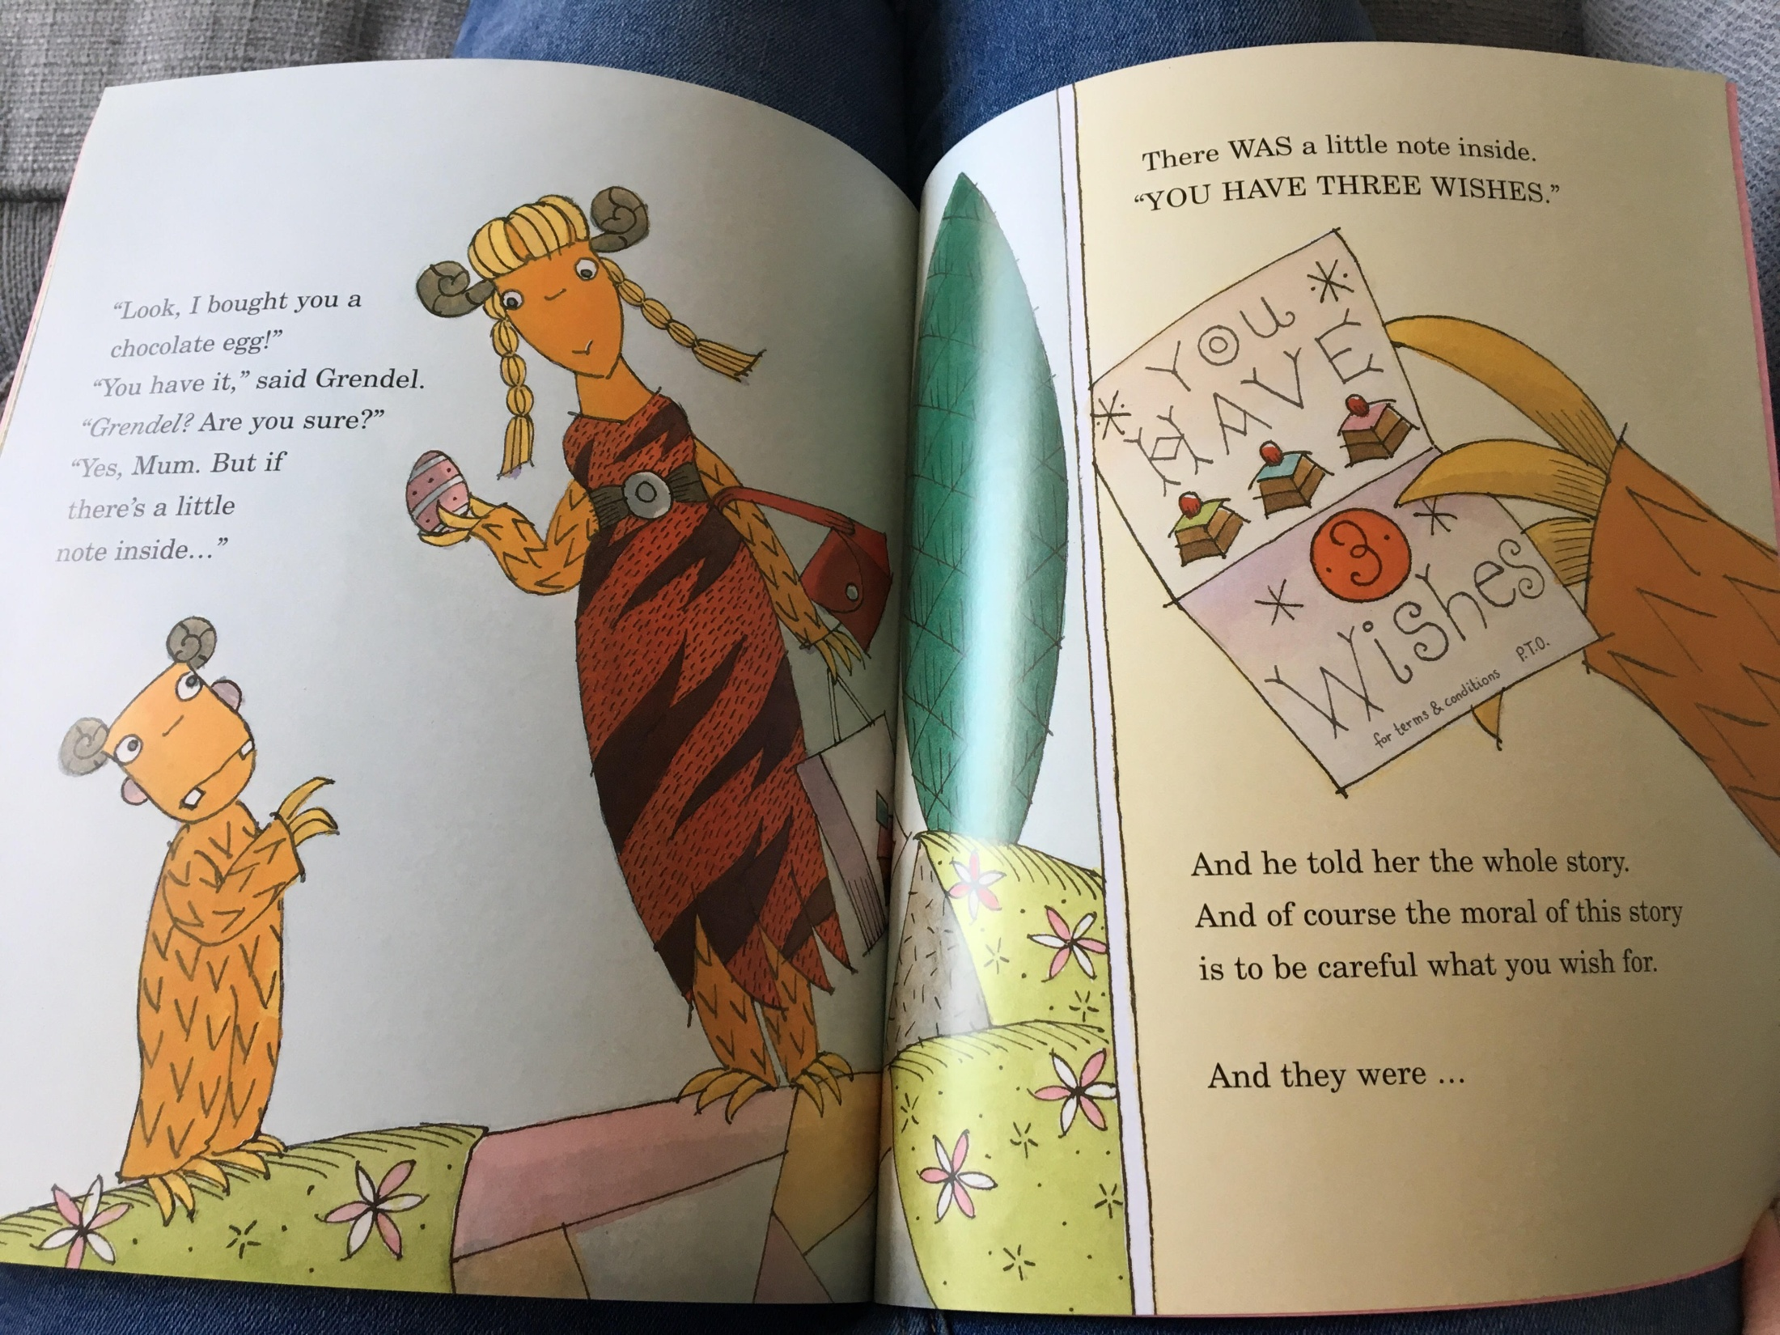

Slide 18


