Slide 1
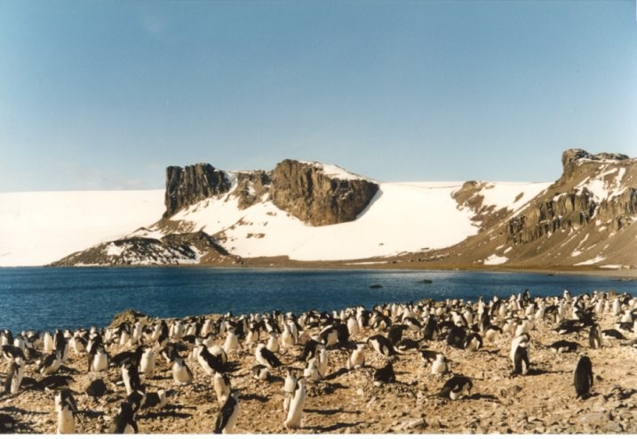
The Antarctic

Slide 2

Have you listened to the story 'Poles Apart' yet? You may have missed the link in the weekly overview so here it is again:
https://www.youtube.com/watch?v=9YG2DZidhQg
The Pilchard Brown family, who are penguins and live at the South pole.
We will focus our time on the South Pole and the Antarctic.

Slide 3
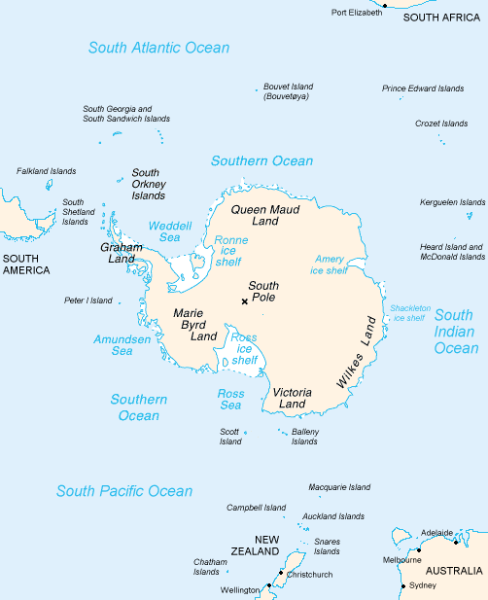
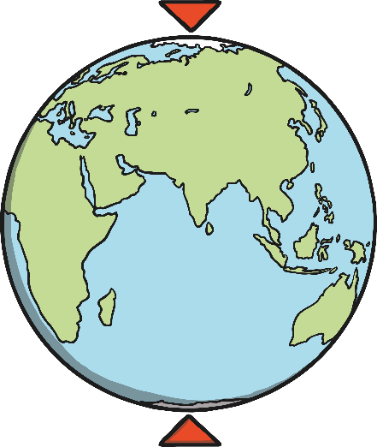
The Antarctic is a polar region around the South Pole.
It is opposite the Arctic region, which is around the North Pole on the other side of the earth.
North Pole
South Pole

Slide 4
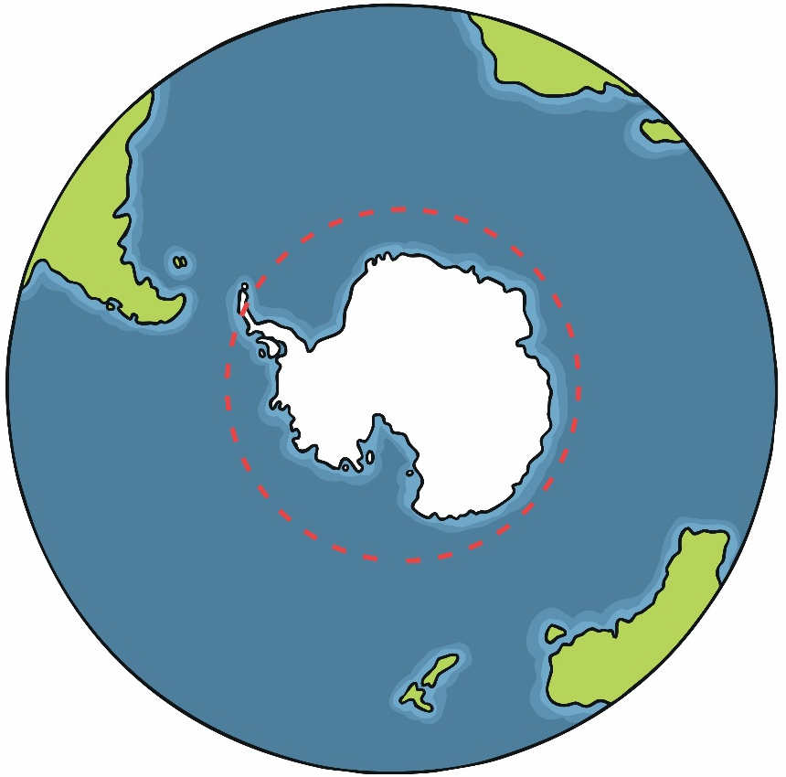
Antarctica
Antarctica is at the bottom of the Earth. It includes the areas around the South Pole. Unlike the Arctic, Antarctica is actually a continent. This is because Antarctica is an area of land, covered in ice.
Antarctica isn’t officially owned by anyone, so it is not called a country. It has no government and no towns or cities.
ANTARCTIC CIRCLE
Madagascar
Falkland
Islands
It is looked after by a special agreement called The Antarctic Treaty. This means that the environment is protected and Antarctica can only be used for peaceful purposes. More than 50 countries have agreed to the treaty, including Russia, China, the UK and the USA.
Antarctica
SOUTH
POLE
Tasmania
New Zealand
Australia

Slide 5
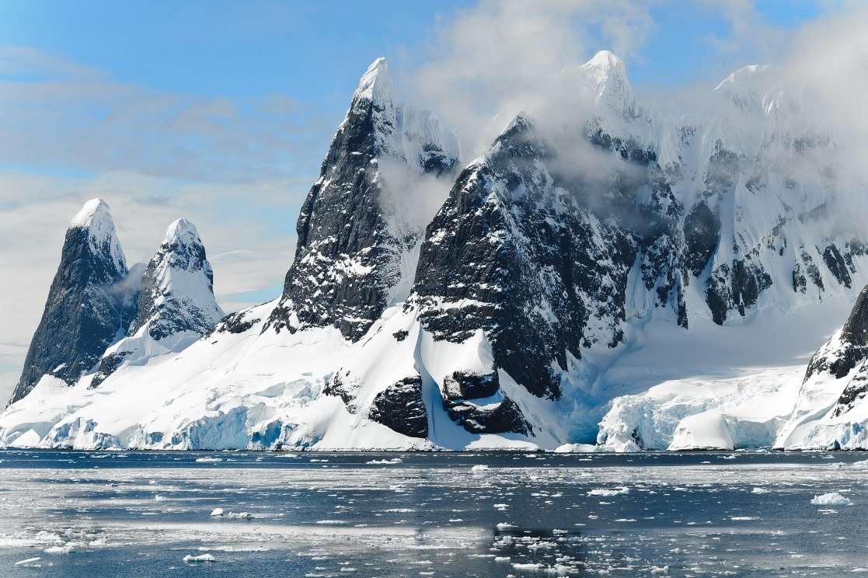
Antarctic Region
The Antarctic covers the continent of Antarctica and some ice shelves and islands in the Southern Ocean.
These islands include Scott Island, the South Orkney Islands, Balleny Islands, South Shetland Islands and many more!

Slide 6
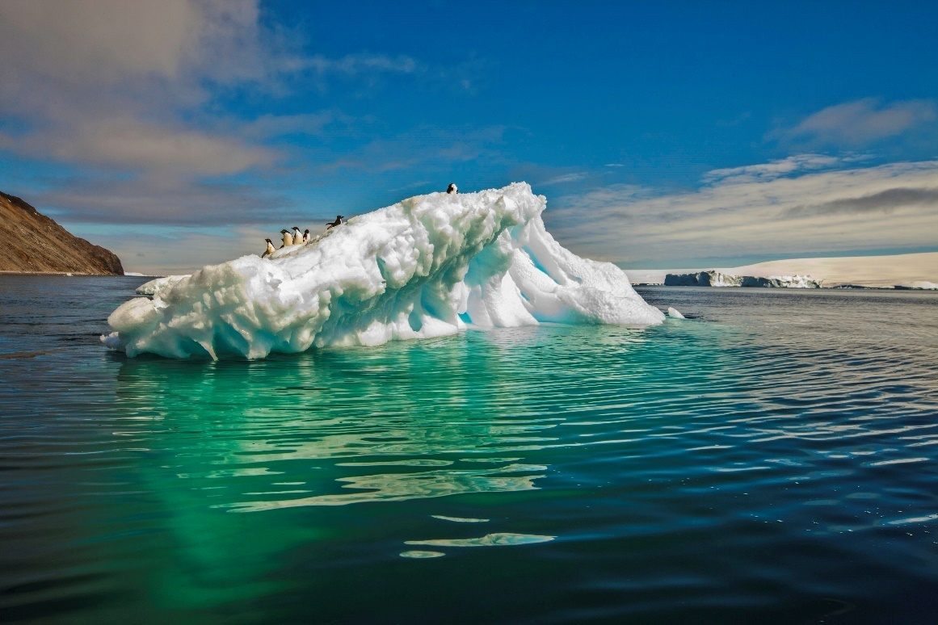

Slide 7
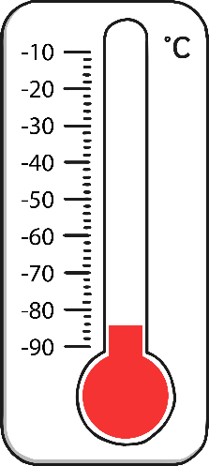
Antarctic Region
Most of the land is covered all the time by snow and ice.
Only 1% of the land is showing!
There are icebergs in the Southern Ocean.
Icebergs are pieces of ice which have broken off and are floating in the ocean.
The world’s coldest temperature
ever recorded was in the Antarctic.
It reached -89.2°C in 1983!
Antarctica is the coldest continent on earth!

Slide 8


Climate in Antarctica
Antarctica is the coldest and windiest place on Earth. The lowest temperature ever recorded here was -89ºC! The average temperatures range from about 10ºC in the summer to -60ºC in the winter. Antarctica’s winter also lasts for 8 months.
Because it is so cold, over 98% of Antarctica is permanently covered in ice. The average thickness of this ice is about one mile! Antarctica is also home to the driest place on Earth. There are places in Antarctica which haven’t had rain or snow in over 2 million years!
What do you think -89ºC would feel like?

Slide 9
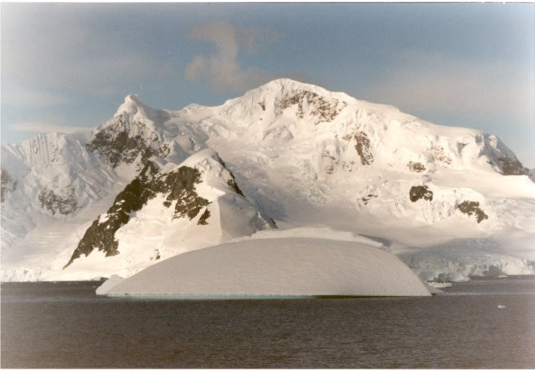
The mountains are covered in snow and ice.

Slide 10
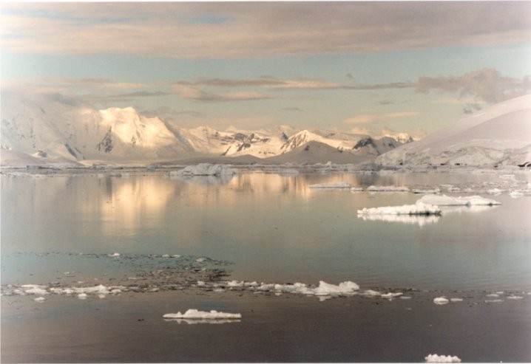
Ice floats on the sea.

Slide 11
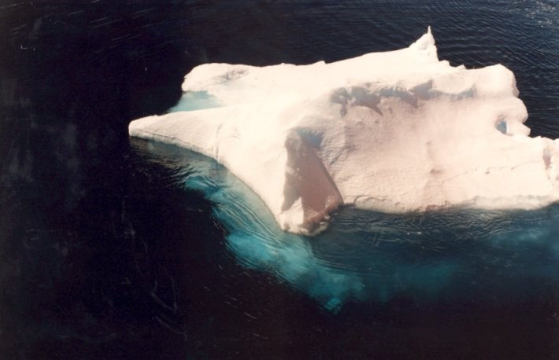
This is an iceberg.
Most of an iceberg is under the water.

Slide 12
What animals do you think live in the Antarctic?

Slide 13
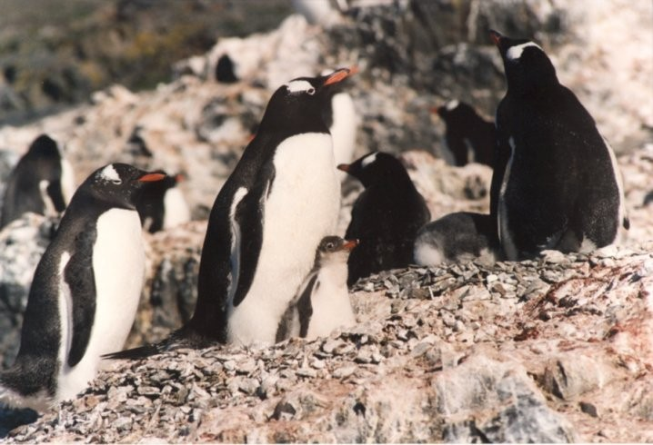
Penguins
There are no penguins at the North Pole.

Slide 14
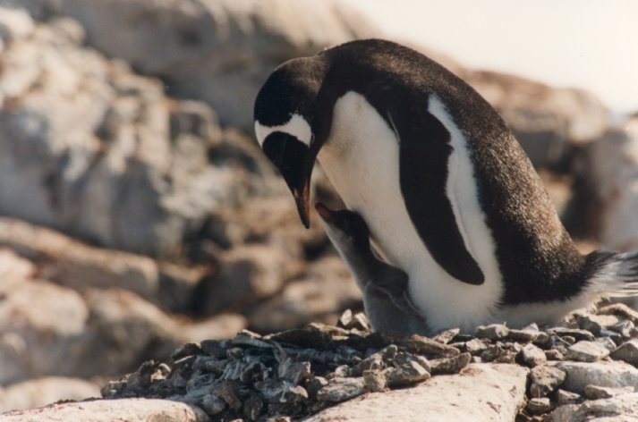
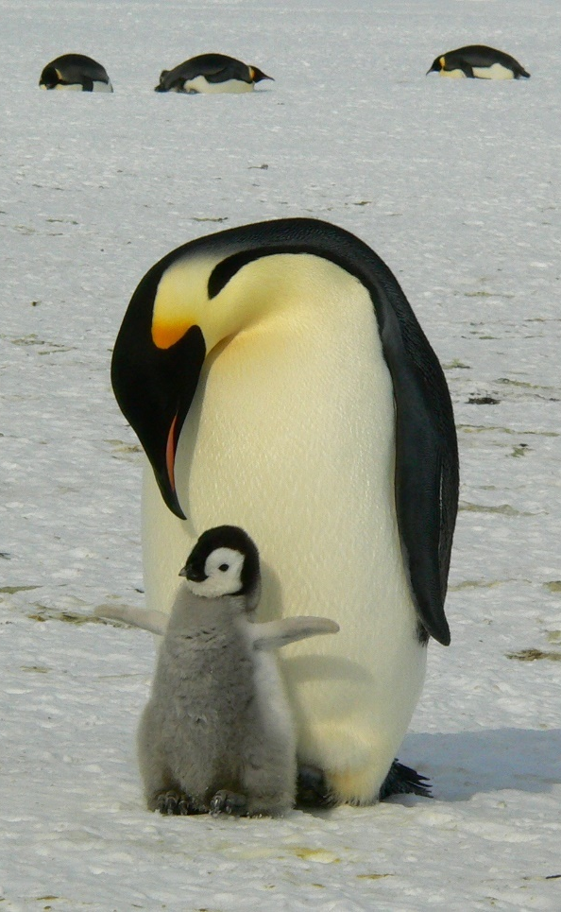
Emperor Penguin
The Mummy and Daddy penguins eat fish and then feed it to their baby.

Slide 15
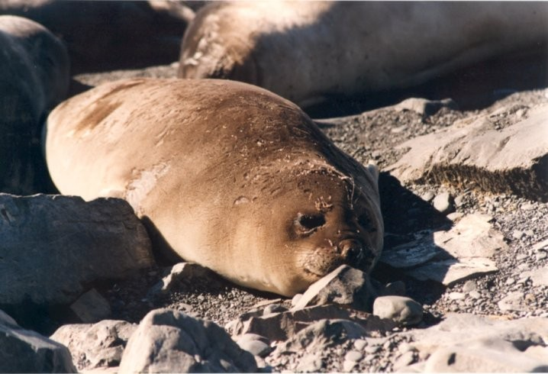
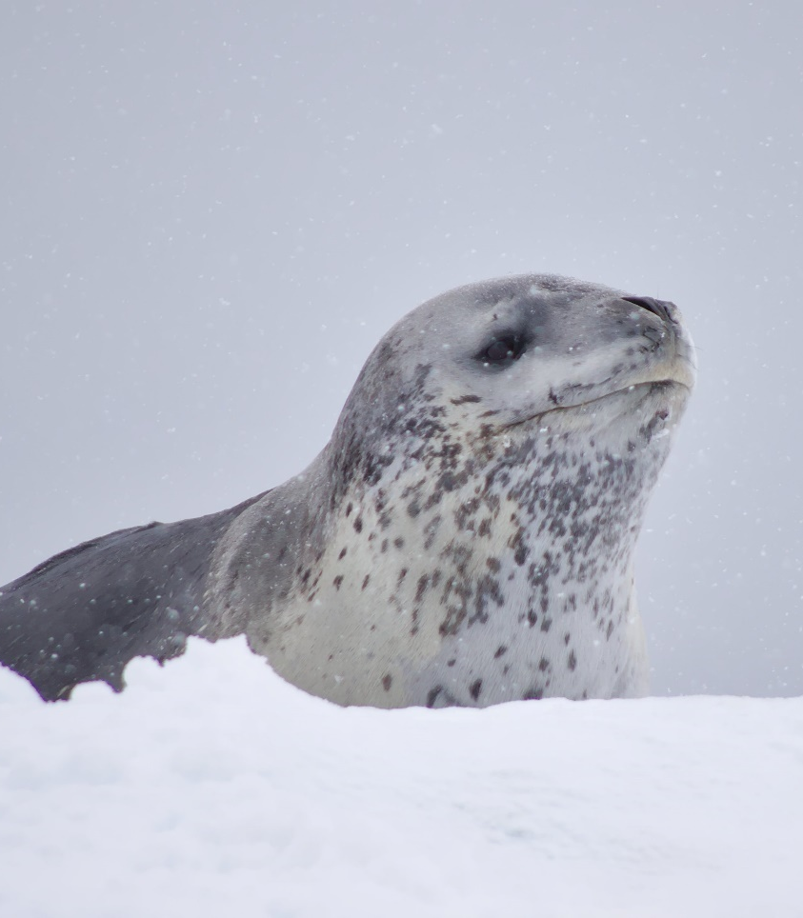
Seal
They have fat under their skin
to keep them warm.

Slide 16
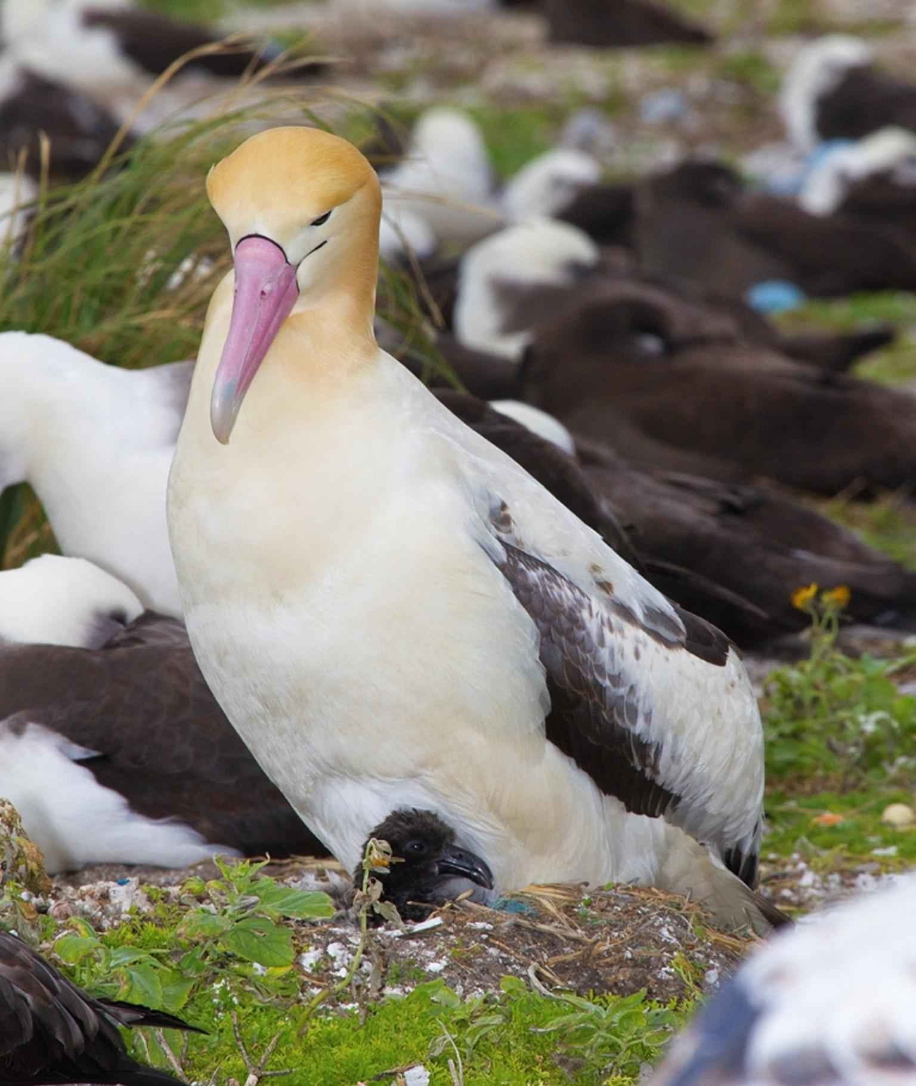
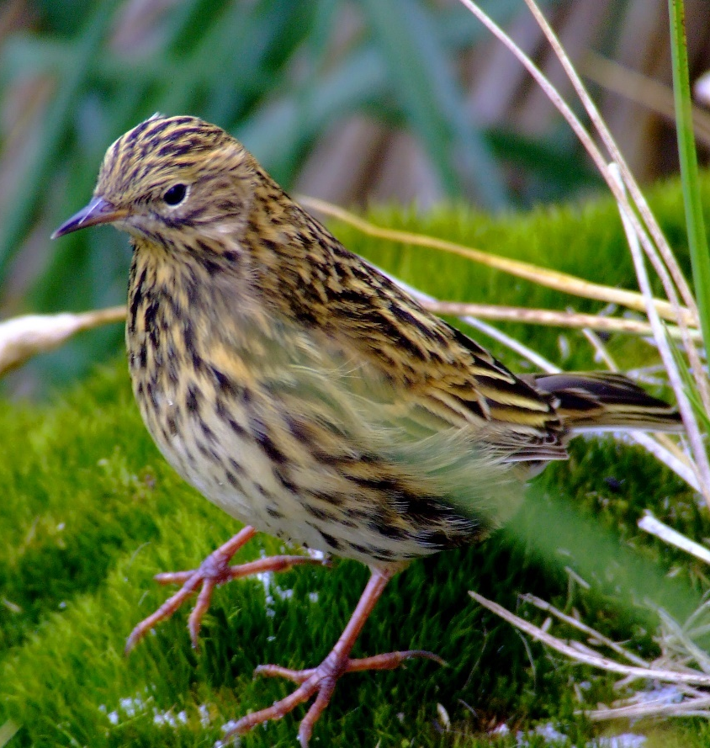
albatross
South Georgia pipit

Slide 17
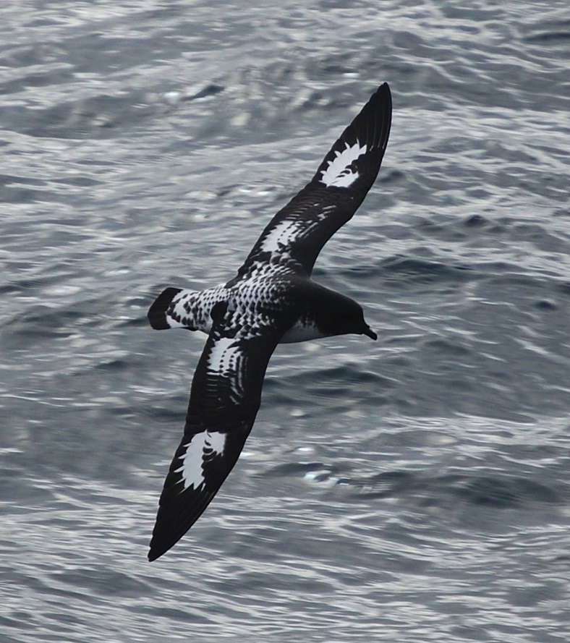
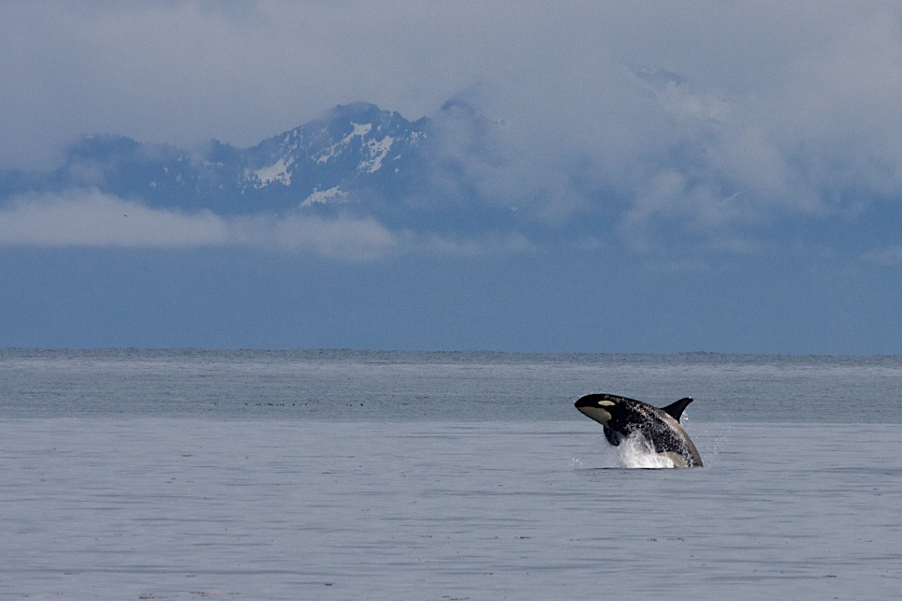
Antarctic petrel
orca (killer whale)

Slide 18
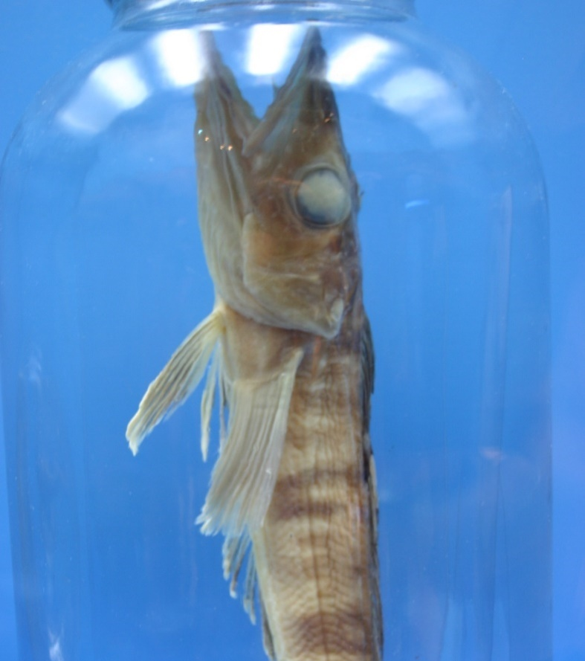
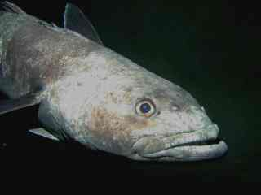
Antarctic toothfish
Antarctic icefish

Slide 19
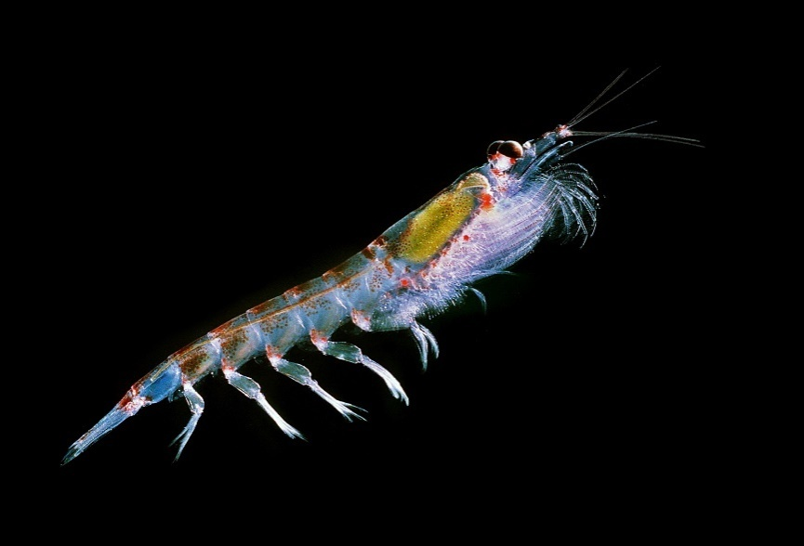
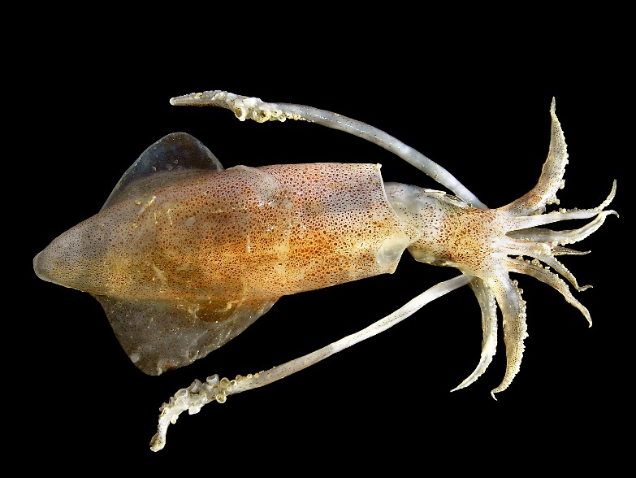
squid
Antarctic krill

Slide 20
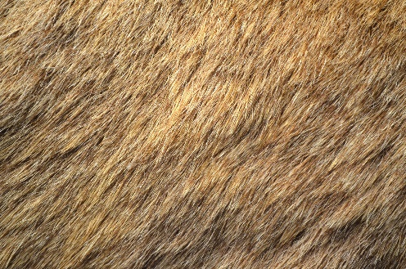
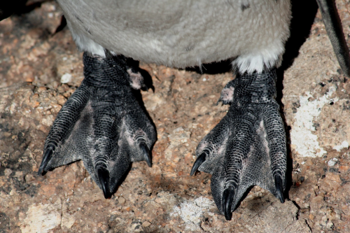
Polar Adaptations
There are lots of different animals that live in the polar regions. They all have special adaptations (skills or features they have developed) which allow them to live in such cold temperatures.
a reindeer’s thick coat
Many of these animals, such as seals and penguins, have a special layer of fat under their skin, called blubber. This helps to insulate their bodies and keep the heat in. They may also have thicker layers of fur.
a penguin’s sharp claws and webbed feet
Some of them have special adaptations on their feet, such as fur or sharp claws, to help them grip the slippery ice. They may also have wide or webbed feet to keep them from sinking in the snow.
“Penguin Feet” by Jon Rawlinson is licensed under CC BY 2.0

Slide 21
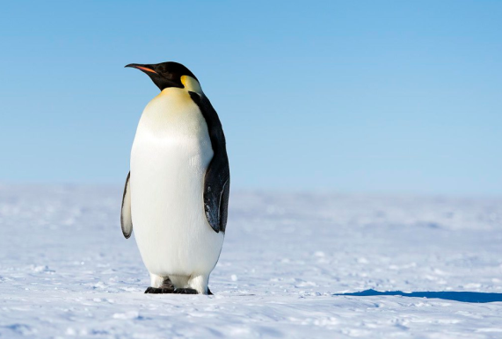
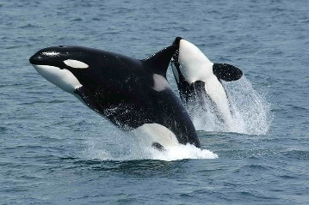
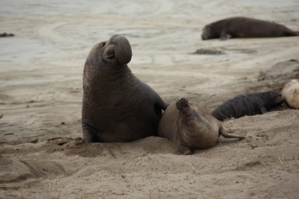
Antarctic Animals
Emperor penguins are the biggest penguins in the world. They have a special flap of skin above their feet where they keep their egg (and then their chicks) warm and off of the cold ground.
Orcas are one of the fiercest predators in the sea. They eat seals, sea lions, penguins, squid, sea turtles, whales and even sharks. They have a thick layer of blubber to protect them from the cold water.
Elephant seals are the largest of all the seals. They can dive over 4900 metres and can stay underwater for more than two hours.
“Emperor Penguins” by Christopher Michel is licensed under CC BY 2.0
“Killerwhales jumping” by Robert Pittman is licensed under CC BY 2.0

Slide 22
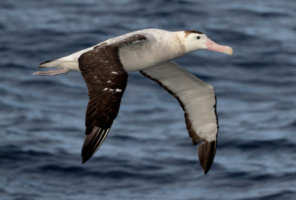
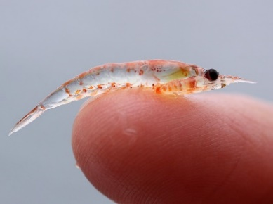
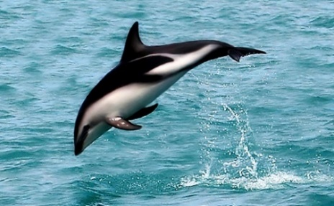
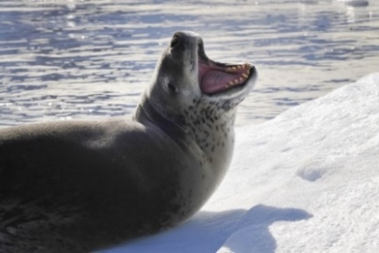
Antarctic Animals
Albatrosses have the largest wingspan of any bird in the world. Their wingspan can measure over three metres! They can soar through the air for several hours at a time without needing to flap their wings.
Krill are very small shrimp-like creatures. Krill are able to shrink their bodies and go for long periods of time without eating, which helps them survive the winter months.
Dusky dolphins are very social and playful. They have a curved dorsal fin (the fin on their back) which helps them to change direction quickly to swim away from predators.
Leopard seals have a thick layer of fat to keep them insulated in cold water. They can dive underwater for up to 15 minutes.
“Wandering Albatross” by Ed Dunens is licensed under CC BY 2.0
“Krill” by Sophie Webb/NOAA is licensed under CC BY 2.0
“A wild dusky dolphin named "Nox"” by AllenMcC is licensed under CC BY 2.0

Slide 23
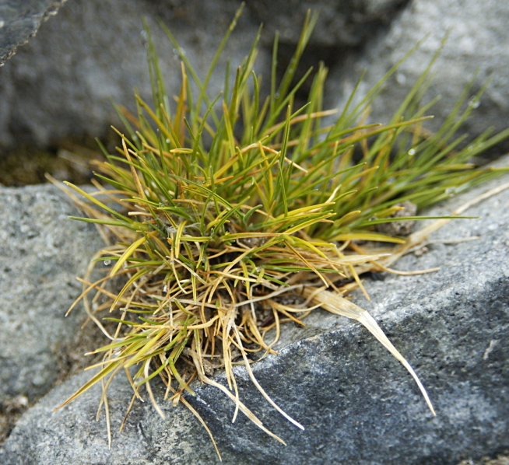
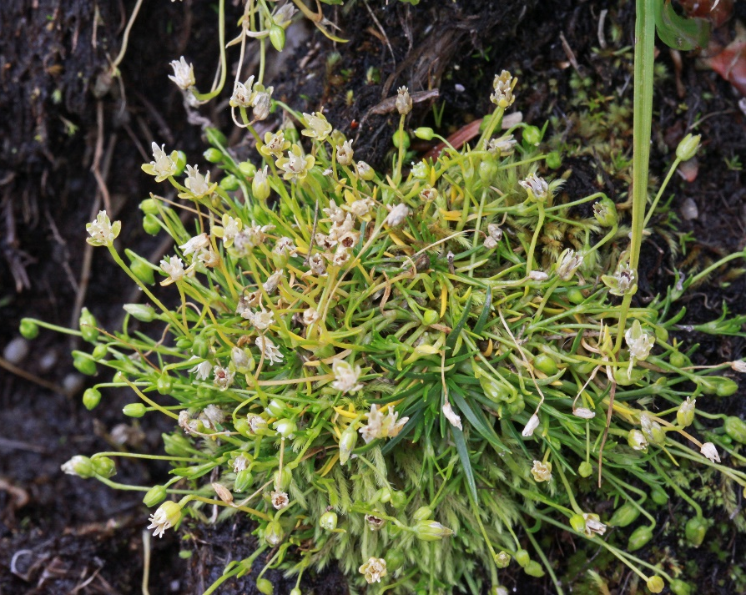
What Grows in the Antarctic?
There are two types of flowering plant:
Antarctic hair grass
Antarctic pearlwort
There are also types of lichens, mosses, macrofungi and liverworts.

Slide 24
Do you think that
people live in
The Antarctic?

Slide 25
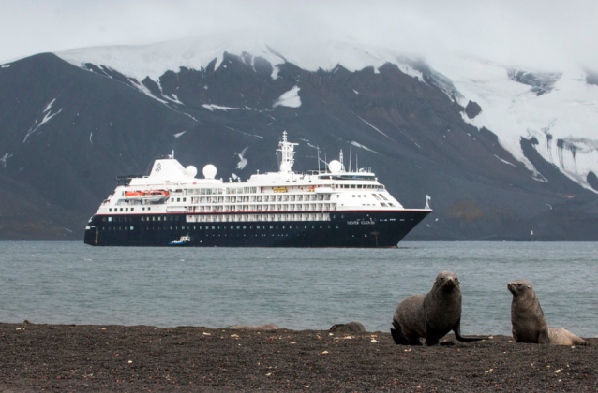
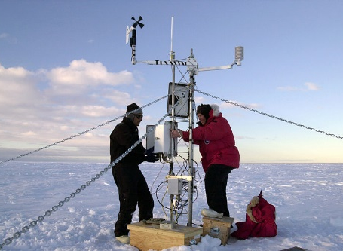
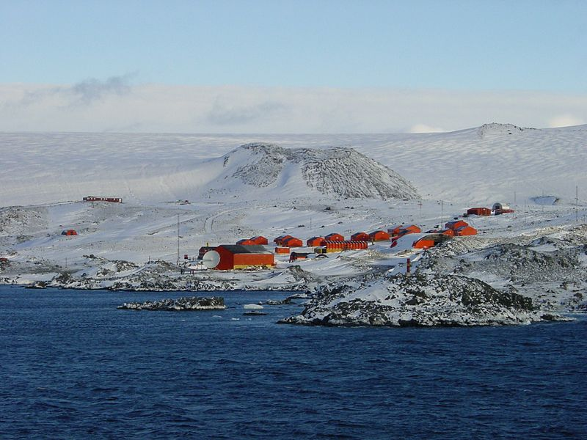
Humans in Antarctica
No people permanently live in Antarctica because it is too cold for them to live there for a long time. Scientists take turns living there for short periods of time to study the ice and the animals. Tourists also sometimes visit in the summer. There are no towns or cities in Antarctica.
research stations for scientists to work in
an Antarctic cruise ship
a weather experiment
“Whalers Bay Deception Island Antarctica Fur Seal Silversea Silver Cloud 3 ” by Gary Bembridge is licensed under CC BY 2.0
“Iceberg B-15A weather instrument” by NSF/Josh Landis, employee 1999-2001 is licensed under CC BY 2.0
“Esperanza Station anta0060” by NOAA Photo Library is licensed under CC BY 2.0
What do you think it would be like to live in Antarctica?

Slide 26
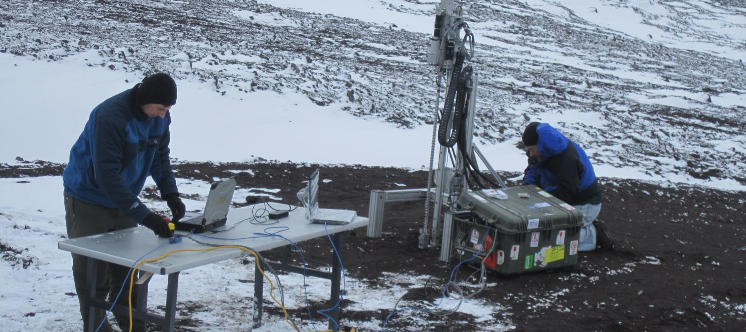
No one has their permanent home in the Antarctic.
Only scientists and other people working at research stations stay there.

Slide 27
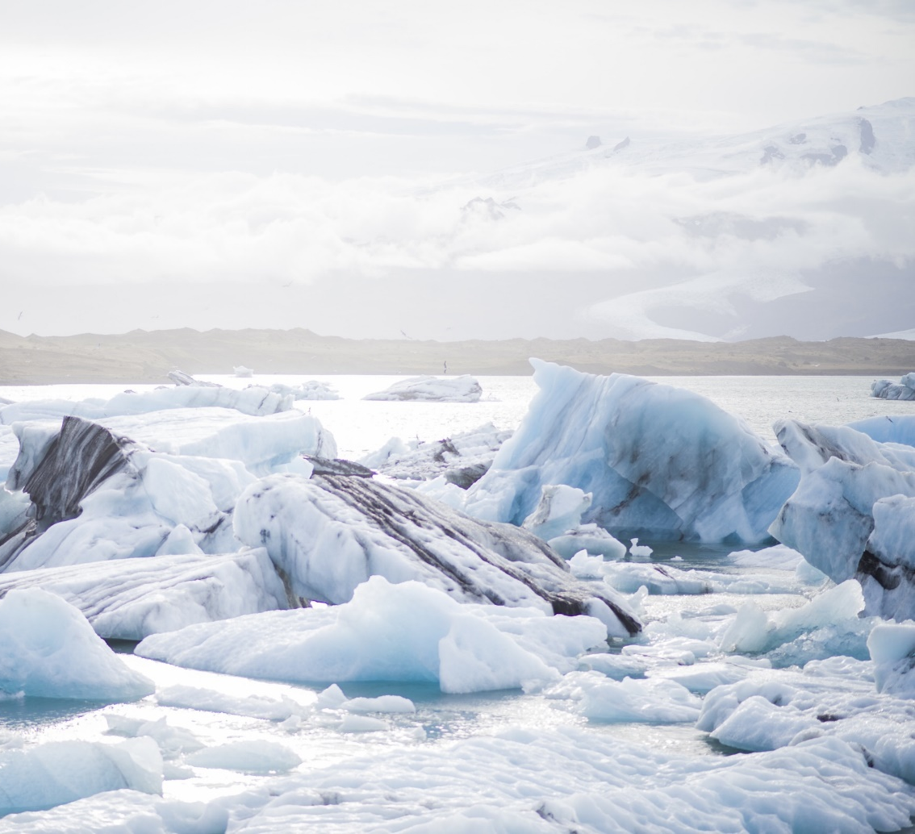
What Do Scientists Do There?
Scientists work in Antarctica to discover new things, measure and test the ice, monitor the effects of global warming, research light, study animals and lots more.

Slide 28
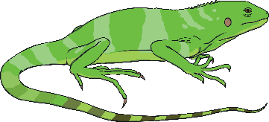

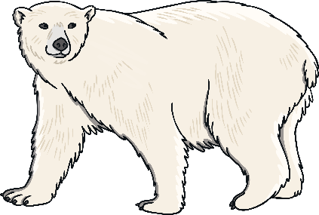
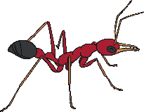
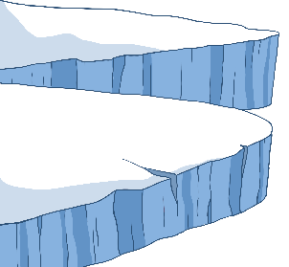

Quick Facts About Antarctica
Antarctica is the fifth-largest continent in the world and is about 50 times the size of the UK.
70% of Earth’s freshwater and 90% of its ice is in Antarctica.
Antarctica is the only continent without any reptiles.
There are no polar bears in Antarctica. They only live in the Arctic.
The largest recorded iceberg in Antarctica was bigger than the size of Jamaica!
Antarctica is one of the few places on Earth where you won’t find any ants.
Antarctica is called a desert. This is because it has very little rain.

Slide 29
Here are some OPTIONAL videos to help you with your research and learning.
https://www.youtube.com/watch?v=X3uT89xoKuc
https://www.youtube.com/watch?v=ydFZdu98oVc
https://www.bbc.co.uk/teach/class-clips-video/pshe-eyfs-ks1-go-jetters-continent-of-antarctica/zj9c382

Slide 30
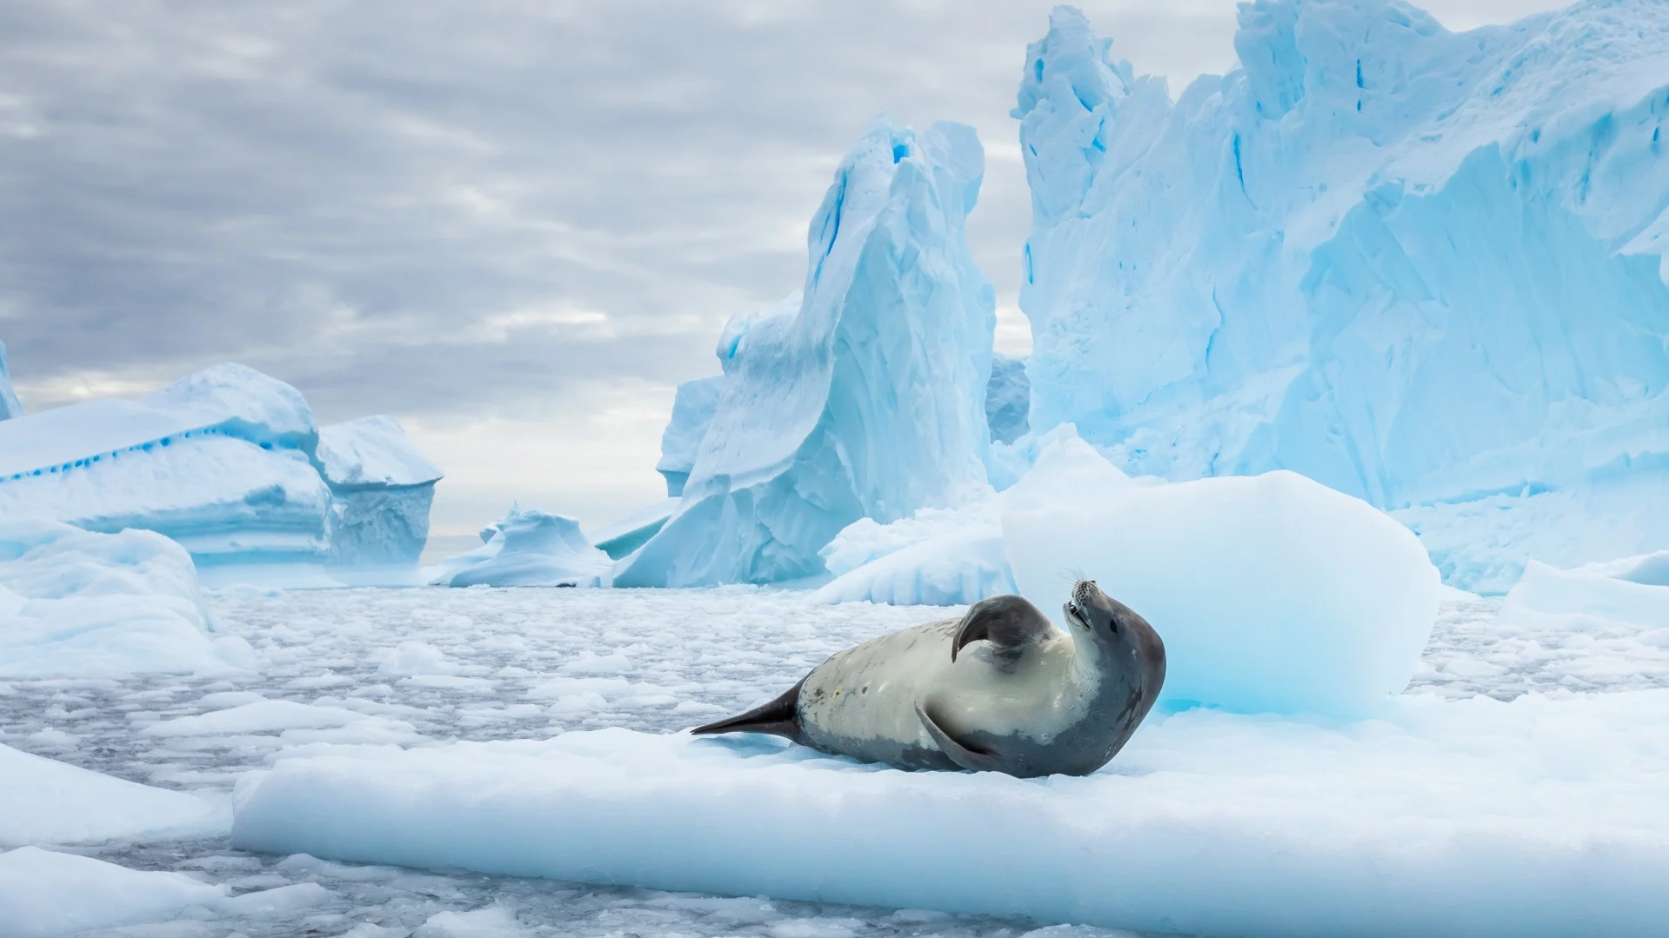
Task: Complete the fact sheet (you will find this in your folder) about The Antarctic or create your own design and way of presenting what you have learnt about?

