Slide 1

Lesson 4

Slide 2
Today we will be looking at:
Can you use feelings (emotions) words and conjunctions to write about how Grendel was feeling at different stages of the story and to provide supportive reasons why.
Lesson 4
LC. Can you use conjunctions to write compound sentences (about Grendel)?
LC. Can you use ‘feelings’ words to write about a character in a story (Grendel)?

Slide 3

Lesson 4
but | because | until
so that | so | if
however | although | therefore

Slide 4

Lesson 4
The conjunction is often used like a jigsaw piece to ‘join’ 2 simple sentences together and make a longer (compound)sentence.
Grendel was worried. He had turned his mum into chocolate.
Grendel was worried because he had turned his mum into chocolate.

Slide 5
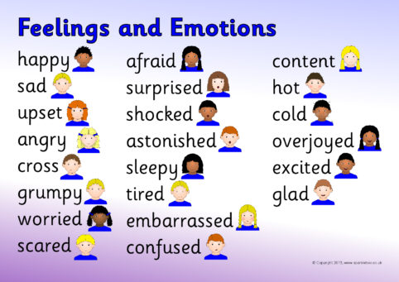
Feelings (emotions)
Lesson 4

Slide 6
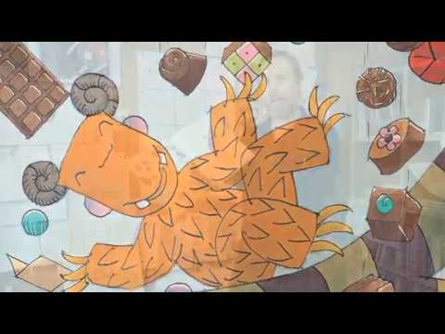
Task: Use feelings words and conjunctions to write about how Grendel was feeling at different stages of the story and to provide supportive reasons why.
Lesson 4
Complete the ‘feelings’ sheet (found in the folder) OR in your workbook is fine too!.
Use proper, full sentences.
Remember your ‘Writer’s Toolkit’.
(finger spaces, capital letters, full stops, cursive letter formations etc)
Give reasons using conjunctions.

Slide 7
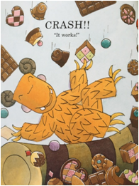
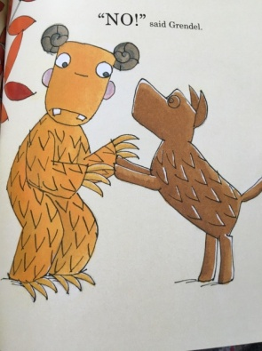
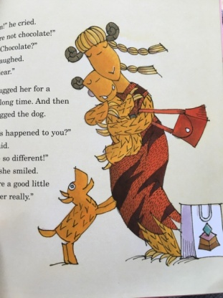
Lesson 4
Think about / discuss: What is happening at these different stages of the story?
How do you think Grendel is feeling at these times?
BEGINNING:
Now, consider ‘why’ he is feeling these different feelings?
Can you give a reason for your choice of feeling using the conjunction ‘because’.
Maybe you have thought of a feeling he has ‘until’ something happens or ‘when’.
Maybe consider how he will feel ‘if’...
MIDDLE:
END:

