Slide 1
The Elements of Music
Follow the Music directions Use your voice, Clap your hands and stamp your feet.

Slide 2
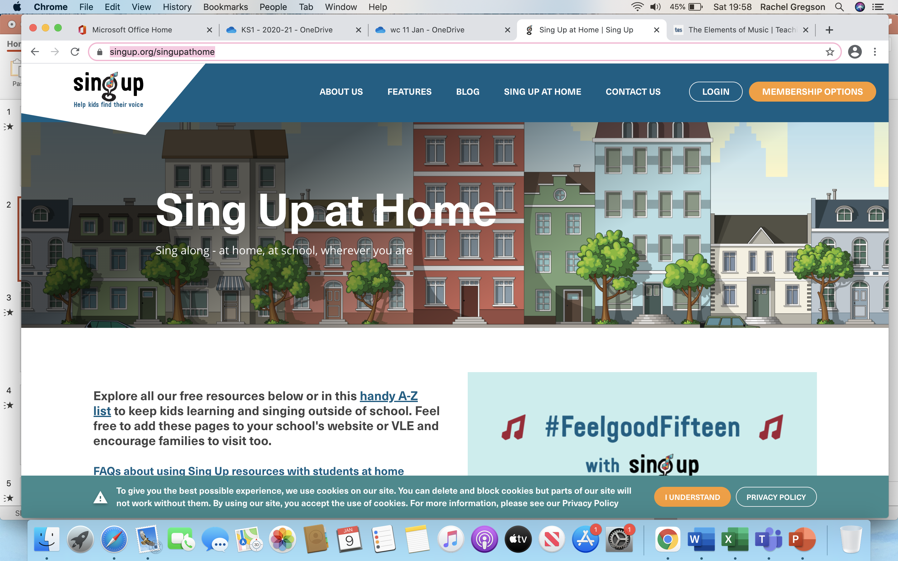
Additional resources for Music so you can sing at home.
https://www.singup.org/singupathome
Friday Afternoon Music from Leeds ArtForm.
To watch the performance at school or at home, click on the link below from Friday (8th) at 1.30pm (please note that the video will not show before this time):
https://youtu.be/RTE5Ic6YI9k

Slide 3
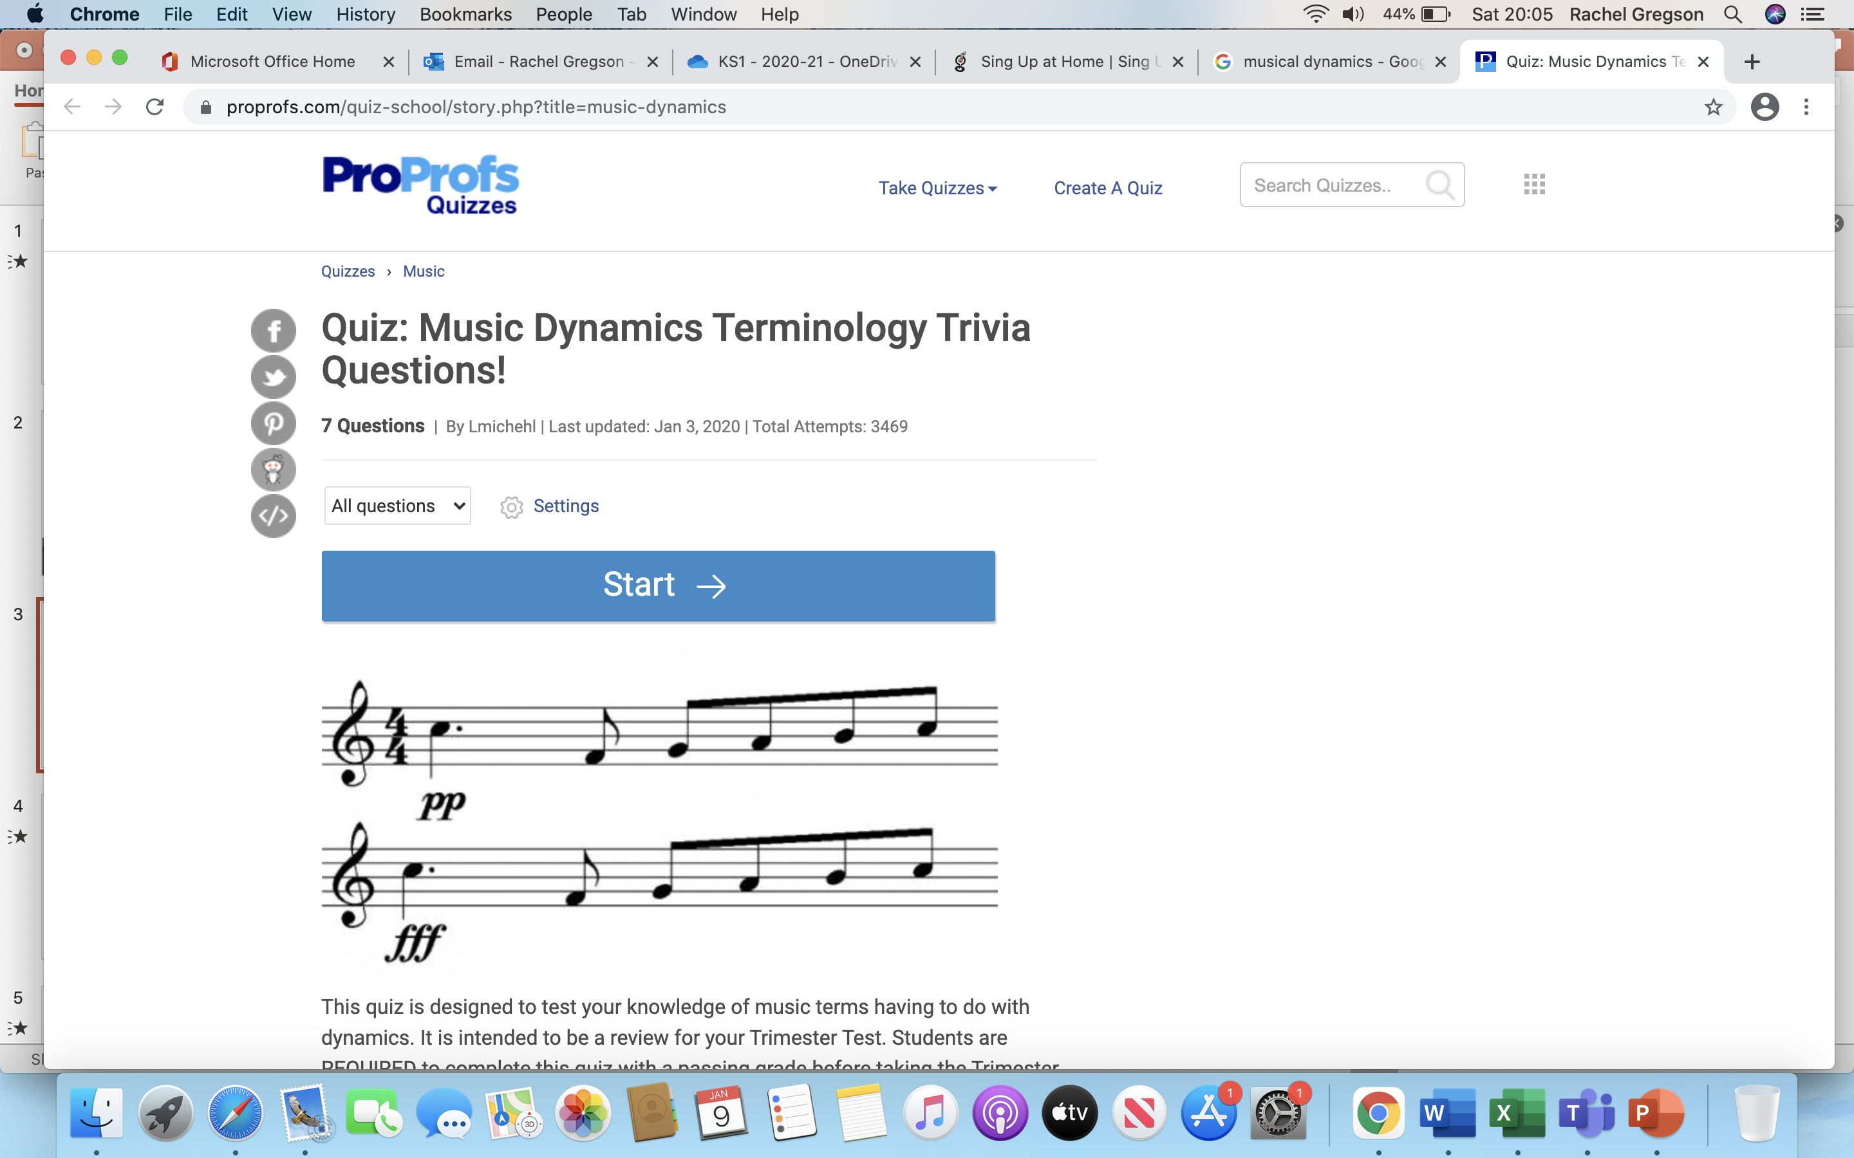
Can we remember what dynamics are?
Dynamics means how quietly or loudly a piece of music should be played.

Slide 4

Pitch
PITCH means how high or low a sound is.

Slide 5
Tempo
TEMPO means how fast or slow the music is .
Music can even change its tempo part way through

Slide 6
Dynamics
DYNAMICS means the loudness or the Quietness of the music. Sometimes this is called the volume.

Slide 7

Silence
Sometimes we need Silence in Music.
Why do you think this is?
It gives listeners time to think
It can be dramatic ... Think of the Shark!
It makes music interesting
Try acting out the sounds on the next slides.

Slide 8
Loud

Slide 9
Slow

Slide 10
High

Slide 11
Quiet

Slide 12
Fast

Slide 13
Low

Slide 14
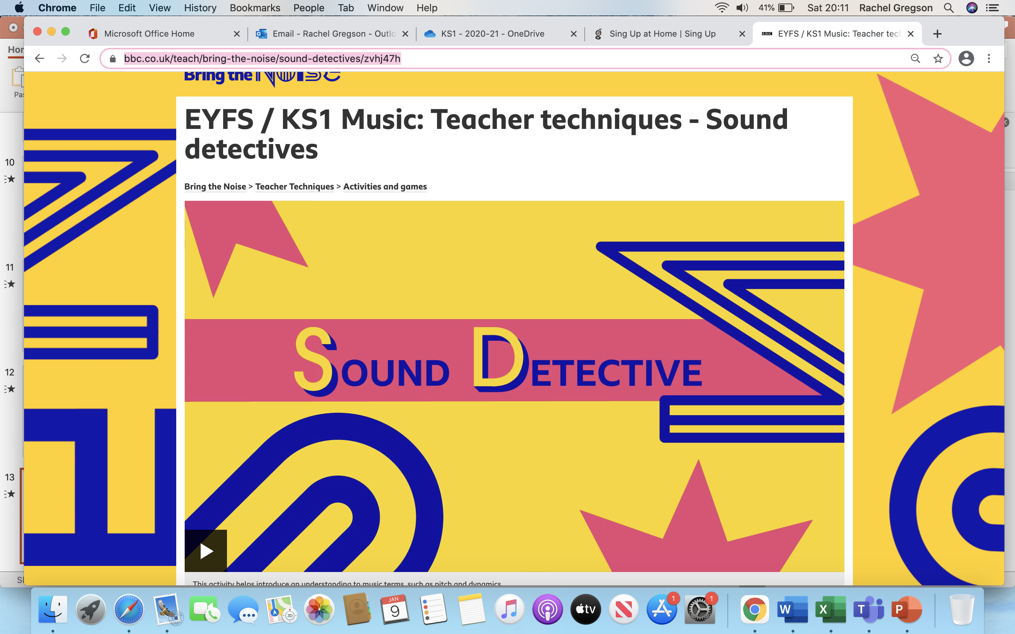

Slide 15
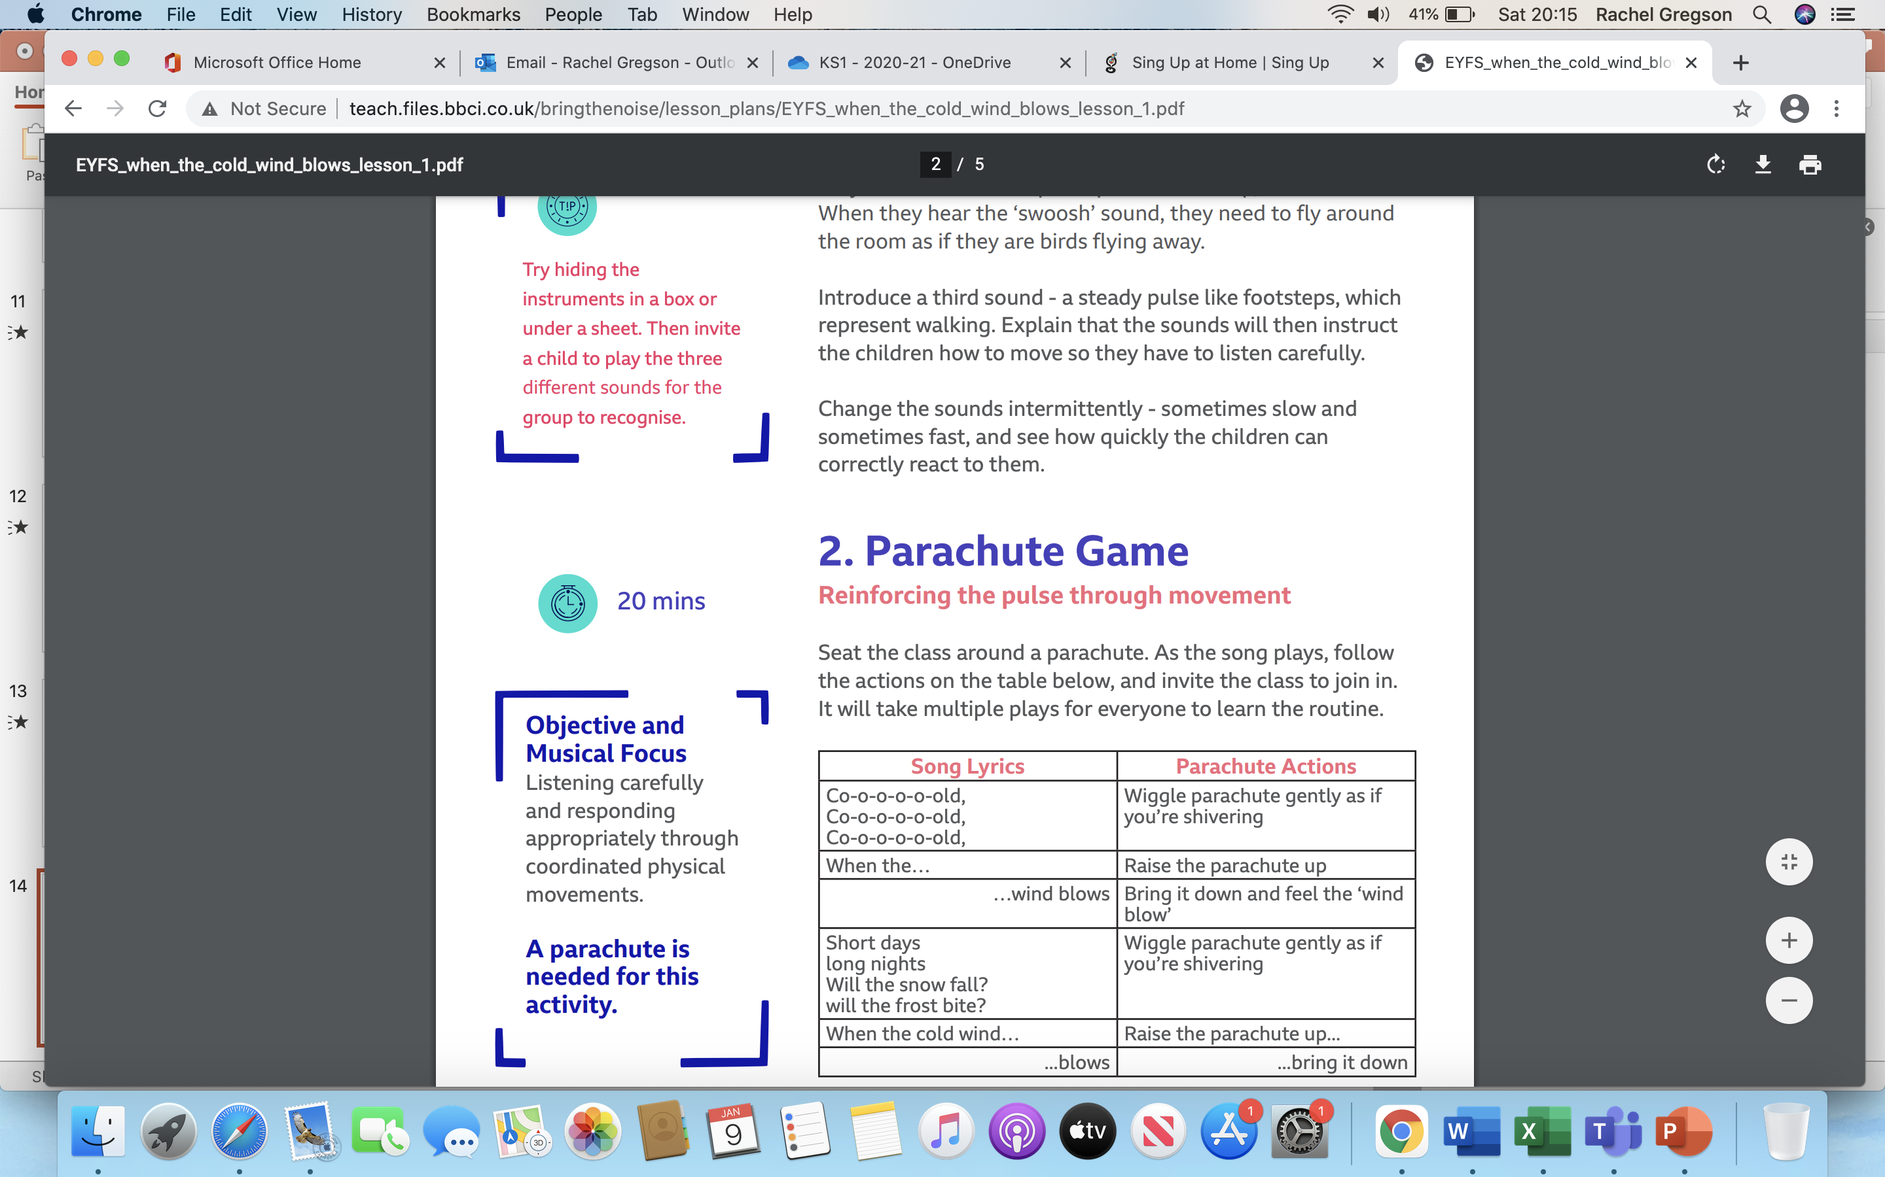
Activity: Act out the action to the song. Can you create your own song with actions? Write down your ideas and draw pictures.

Slide 16


