Slide 1

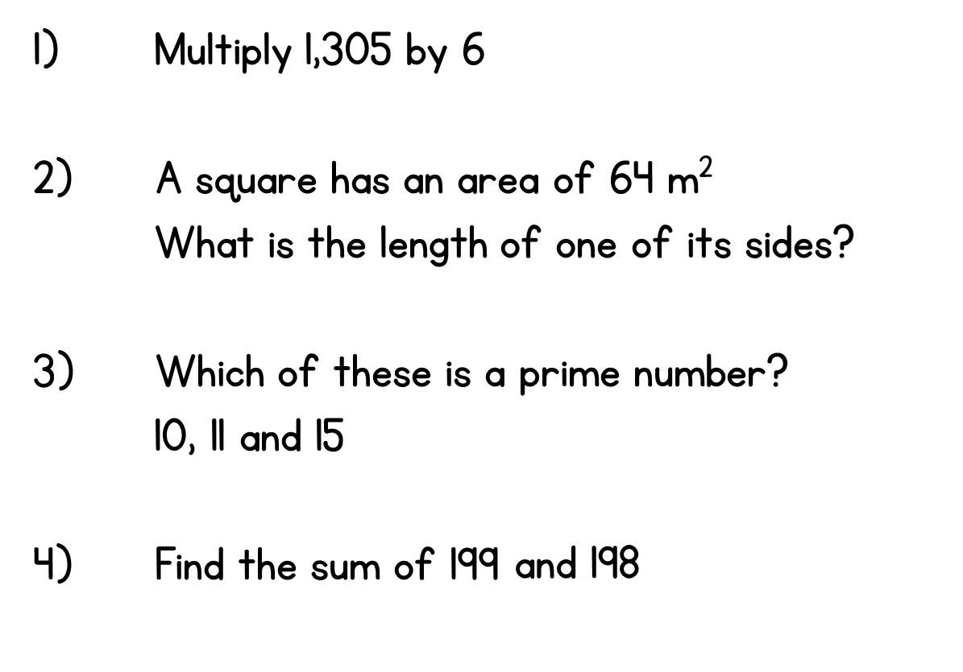
Year 5 | Week 1 | Day 4

