Slide 1


Slide 2
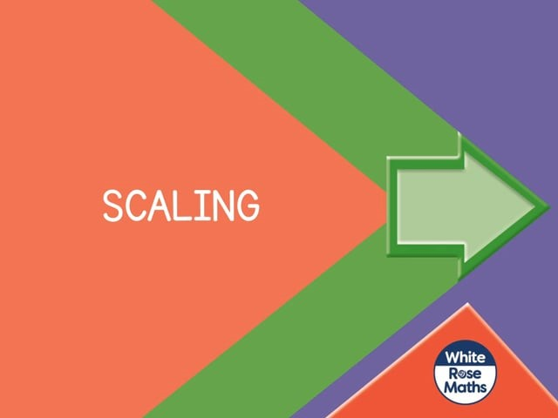

Slide 4
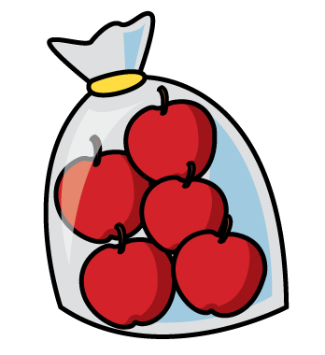
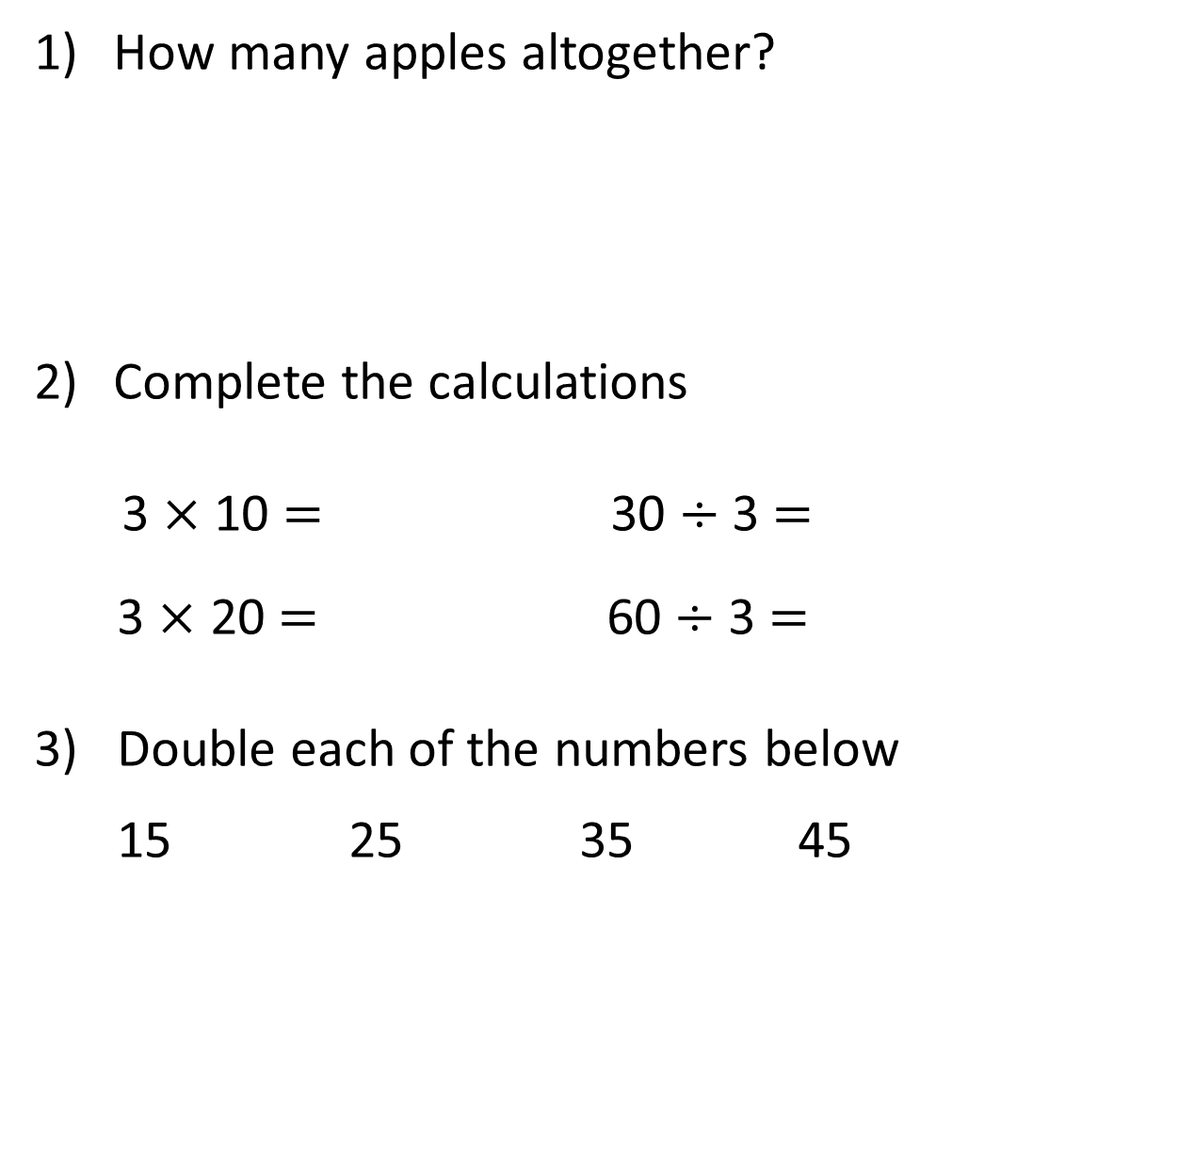
How many apples altogether?
Complete the calculations
3 $×$ 10 $=$ 30 $÷$ 3 $=$
3 $×$ 20 $=$ 60 $÷$ 3 $=$
3) Double each of the numbers below
15 25 35 45

Slide 5
How many apples altogether?
Complete the calculations
3 $×$ 10 $=$ 30 $÷$ 3 $=$
3 $×$ 20 $=$ 60 $÷$ 3 $=$
3) Double each of the numbers below
15 25 35 45
30
30
10
60
20
30
50
70
90

Slide 7
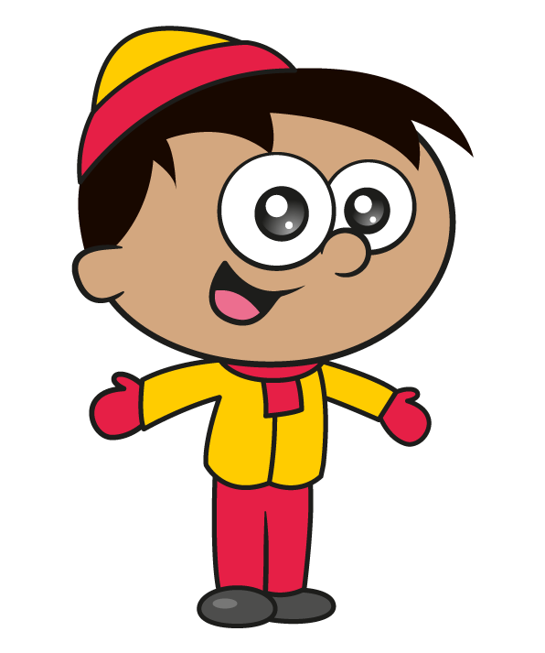
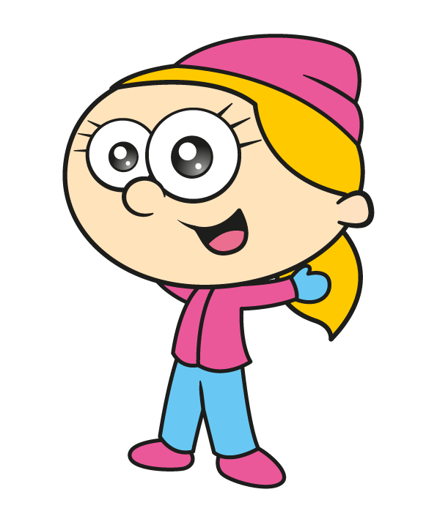
The children are making snowballs.
Do you agree with Eva?
I have twice as many snowballs as you!

Slide 8
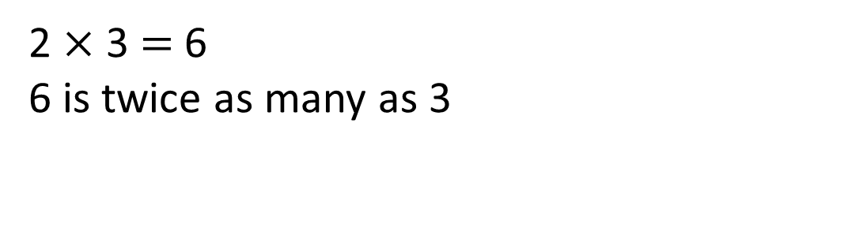
Does Eva have twice as many snowballs as Amir?
Amir has 3 snowballs.
Eva has 6 snowballs.
2 $×$ 3 $=$ 6
6 is twice as many as 3

Slide 9
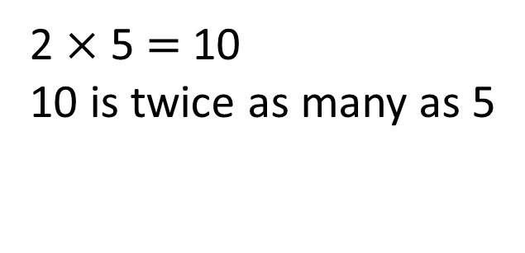
Amir now has 5 snowballs.
If Eva makes twice as many snowballs, how many will she have?
Eva has 10 snowballs.
2 $×$ 5 $=$ 10
10 is twice as many as 5

Slide 10

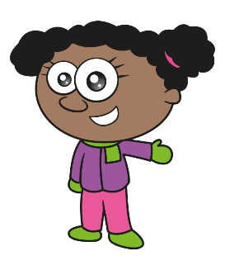
Eva has 10 snowballs
Have a think
I have made three times as many snowballs as you!
How many snowballs has Whitney made?

Slide 11
Eva has 10 snowballs.
Whitney has three times as many snowballs as Eva.
10
10
10
10
Whitney has 30 snowballs.
How many snowballs does Whitney have?

Slide 12
What else can you see from the bar model?
20
Have a think
10
40
10
10
10
Whitney has 20 more snowballs than Eva.
Eva has 20 fewer snowballs than Whitney.
The girls have 40 snowballs altogether.

Slide 13



Here is a bar model to represent how children in Class 3 travel to school.
Use the bar model to complete the sentences.
Have a think
Twice
______ as many children travel by car as by bus.
5 times
_______ as many children walk as travel by bus.

Slide 14
Have a go at questions
1 – 6 on the worksheet

Slide 15

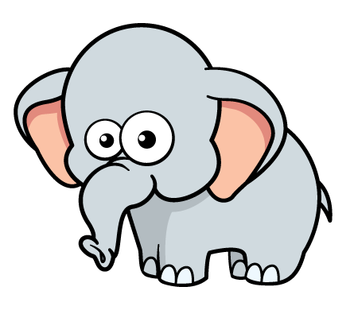
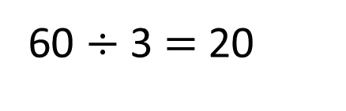
Here are 2 toys.
The giraffe is 3 times as tall as the elephant.
How tall is the elephant?
60
Have a think
60 $÷$ 3 $=$ 20
20
20
20
20
The elephant is 20 cm tall.
60 is 3 times greater than 20
60 cm
20 is 3 times smaller than 60
?

Slide 16



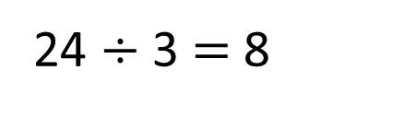
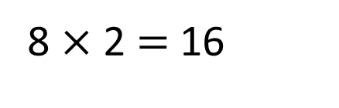
Amir and Ron have some playing cards.
Amir has twice as many cards as Ron.
Altogether there are 24 cards.
How many cards does each boy have?
Have a think
8
24 $÷$ 3 $=$ 8
24
8
8
8 $×$ 2 $=$ 16
Ron has 8 cards.
Amir has 16 cards.

Slide 17
Have a go at the rest of the questions on the worksheet

