Slide 1


Slide 2
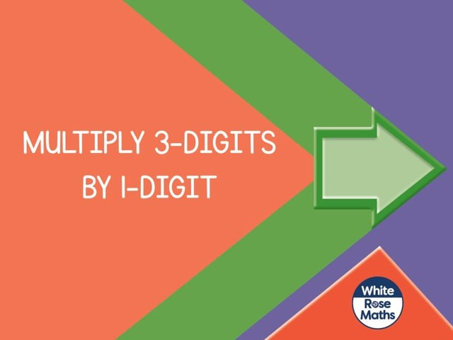

Slide 4
1) 2 × 2 =
2) 40 × 2 =
3) 2 × 300 =
4) 342 × 2 =

Slide 5
1) 2 × 2 =
2) 40 × 2 =
3) 2 × 300 =
4) 342 × 2 =
4
80
600
684

Slide 7



Hundreds | Tens | Ones
243
4 times
243 × 4 =
9
7
2

Slide 8

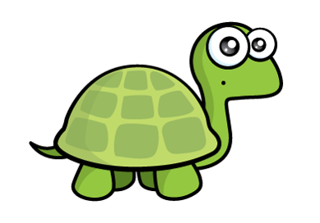
Have a think
Hundreds | Tens | Ones
150 × 3 =
450
I think the answer is 45

Slide 9
Have a go at questions
1 and 2 on the worksheet

Slide 10

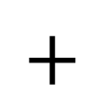
123 × 4 =
492
H | T | O
1 | 2 | 3
 |  | 4
Hundreds | Tens | Ones
$$×$$
1 2
(3 × 4)
8 0
(20 × 4)
$$+$$
4 0 0
(100 × 4)
4
9
2

Slide 11
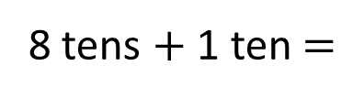
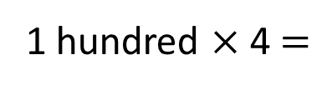
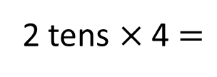
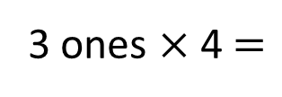
123 × 4 =
492
H | T | O
1 | 2 | 3
 |  | 4
Hundreds | Tens | Ones
$$×$$
4
9
2
1
3 ones × 4 $=$
12 ones
2 tens × 4 $=$
8 tens
8 tens + 1 ten $=$
9 tens
1 hundred × 4 $=$
4 hundreds

Slide 12

103 × 4 =
412
H | T | O
1 | 0 | 3
 |  | 4
3 × 4 =
12
0 × 4 =
0
100 × 4 =
400
$$×$$
Hundreds | Tens | Ones
4
1
2
1
103
100
3
0

Slide 13

153 × 7 =
1,071
 | H | T | O
 | 1 | 5 | 3
 |  |  | 7
Th
3 × 7 = 21
50 × 7 = 350
$$×$$
100 × 7 = 700
1
0
7
1
153
3
2
5 tens × 7 = 35 tens
100
3
50
35 tens + 2 tens = 37 tens
1 hundred × 7 = 7 hundreds
7 hundreds + 3 hundreds = 10 hundreds

Slide 14
Have a go at questions
3 - 5 on the worksheet

Slide 15
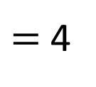
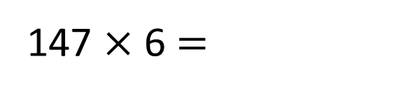
7
× 6
$=$ 4
2
147 × 6 $=$
?
The answer will have 2 ones.
3
× 2
= 6
383 × 2 =
?
The answer will have 6 ones.

Slide 16
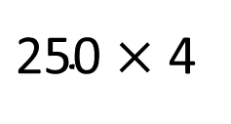
$\text{250}$ × 4
= 1,000
247 × 4 =
1,088
The answer must be less than 1,000

Slide 17
Have a go at the rest of the questions on the worksheet

