Slide 1
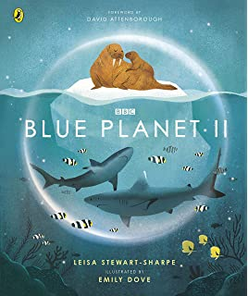
LC: Can I show my understanding of vocabulary within a text?
What did we learn about the coral reefs?
What other habitats might we learn about in this book?​
What habitats would we not learn about in this book?
​
​
​
​
​
​

Slide 2
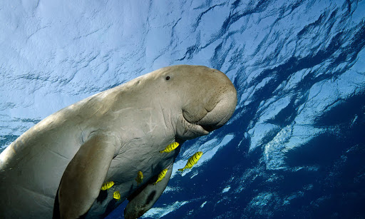
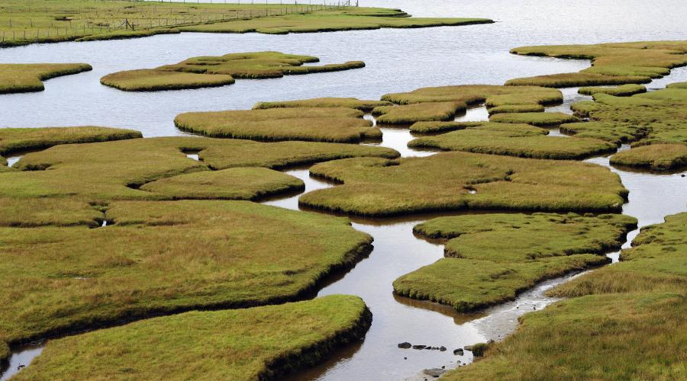
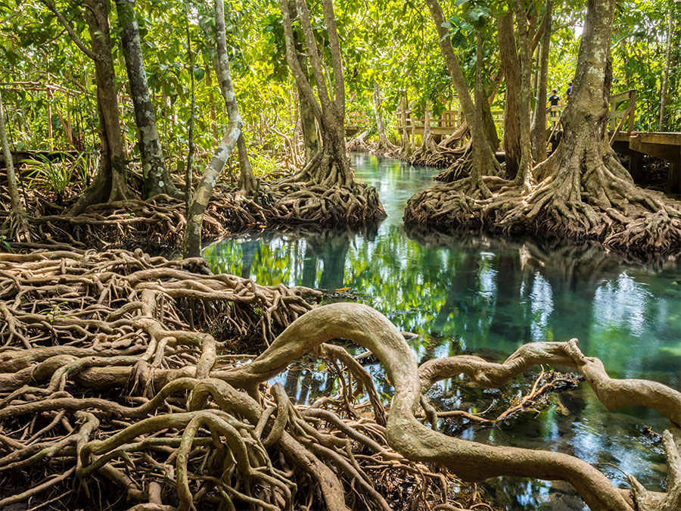
Vocabulary
ecosystems – is a group of living organisms that live in and interact with each other in a specific environment
canopy – the uppermost branches of the trees in a forest
dugongs –
saltmarshes –
mangroves -
Now read through the text.

Slide 3
Let’s remind ourselves of what genre of text this is.
Now read this extract:
In cold, shallow waters, green fronds drift in a delicate underwater ballet.
Is this the style of vocabulary you would expect to see in non-fiction?
Why do you think it has been written in a descriptive manner?

Slide 4

Remember: For your questions today, we want you to use your highlighters to locate vocabulary within the text.

Slide 5
Questions: Me
Find the simile which describes the kelp.

Slide 6
Answers: Me
As tall as a tower block.
How does this help you understand what the kelp forests are like?

Slide 7
Questions: You
Which adjective has been used to describe the seagrass meadows?

Slide 8
Answers: You
Flowering

Slide 9
Questions
Which verb is used to describe how the manatees trim the grasses?
Find and copy a word which shows how busy with life this habitat is.
How does the author describe what the seagrass meadows look like?
How is the kelp in the kelp forests described?
Name some of the animals you will find in the ‘green seas’.
Chilli Challenge
Why has the author decided to describe this habitat as the green seas?
Where will you find the saltmarshes? How do you know?
Why is the book called the ‘Blue Planet’?

Slide 10
Answers
Munch
Crowded
Prairie grasslands
Thick golden, brown kelp
Fur seal, rock lobster, pyjama shark
Chilli Challenge
They have been described as green seas as they have been compared to the green forests on land.
They are on the coast because they are described as coastal saltmarshes.
The book is all about different underwater habitats/habitats in the ocean and the ocean is blue so it is called the blue planet. It is all about the underwater world.

