Slide 1
History
The Maya Civilisation
Lesson 2

Slide 2
Welcome to lesson 2 on The Maya.
Last week, we learnt about where in the world the ancient Maya lived and when they existed.
This week you are going to learn about their gods and religion.

Slide 3
LC: Can I explain the religious beliefs of the Maya people?
Toolkit:
understand the important aspects of Maya religion.
create a fact file containing information about Maya gods

Slide 4
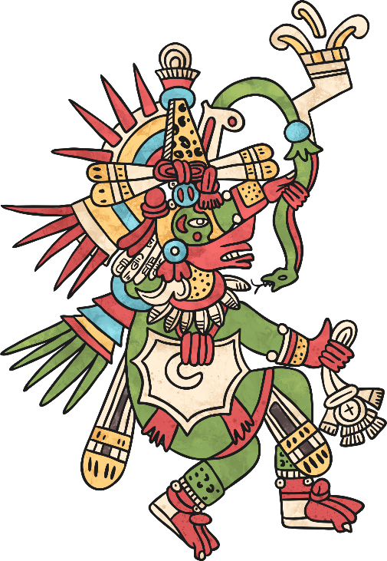
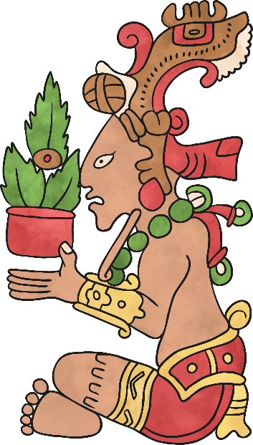
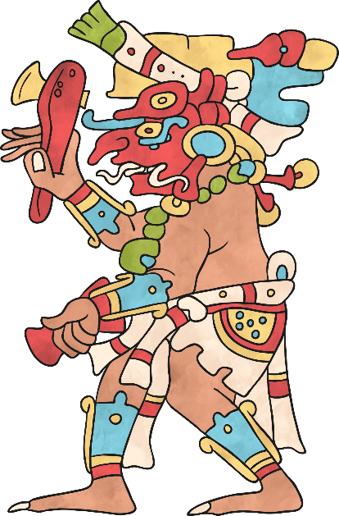
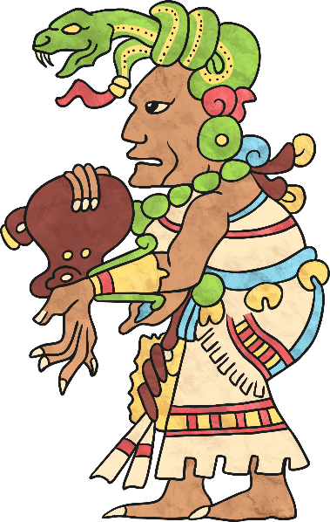
A Central Belief System
Religion was an integral part of the ancient Maya culture, intertwined with all other aspects of society.
The Maya believed in and worshipped a number of different gods. They believed that the gods had a good side and a bad side and that they could help or hurt them. The Maya would dance, sing and sometimes make offerings of blood to the gods to demonstrate their respect and loyalty.

Slide 5

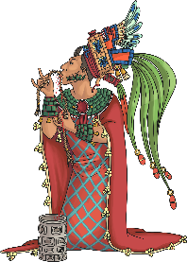
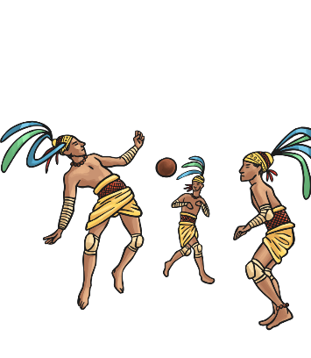
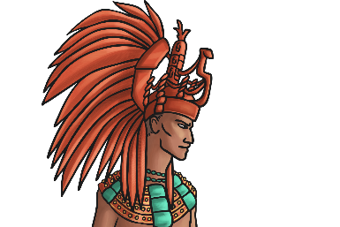
Religious Rituals
The Maya people performed many different religious rituals. These rituals were often performed during festivals or special ceremonies and they were a way of appealing to the gods.
Can you match up these rituals to their purpose?
Blood letting.
To represent a battle between the gods.
Playing a ball game.
To nourish the gods.
Priests wearing masks and costumes.
To scare away demons.

Slide 6

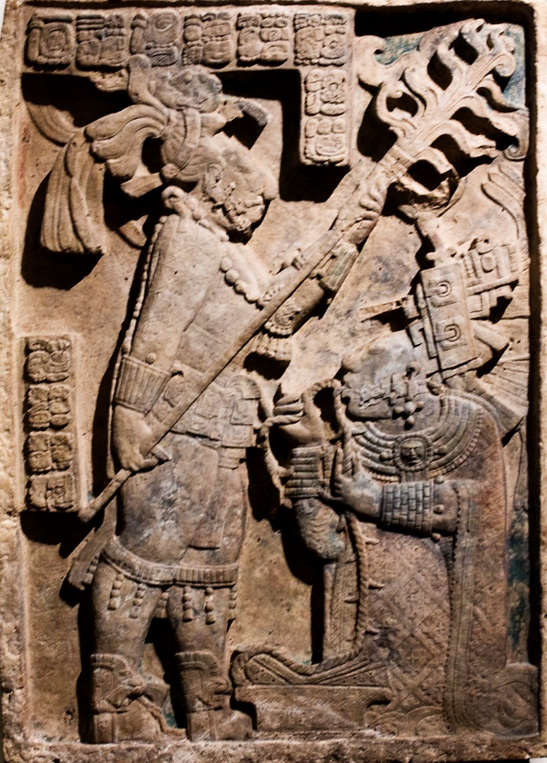
Blood Letting
Stone carvings show rulers and nobles giving blood sacrifices.
The Maya believed that the gods gave their own blood to create humans, so on special occasions the rulers would return the favour by offering their blood to the gods.
Why do you think the Maya people thought the gods needed their blood?
Can you think of any other civilisations that did this, or can you think of any stories about giving blood for the gods?
Photo courtesy of vintagedept (@flickr.com) - granted under creative commons licence - attribution

Slide 7
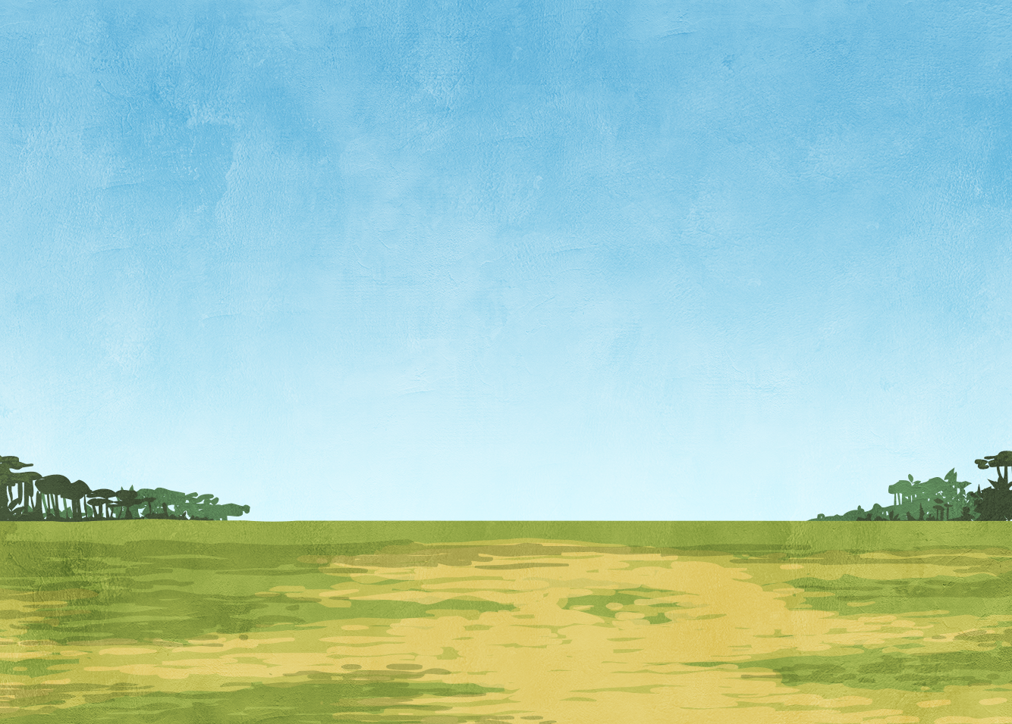
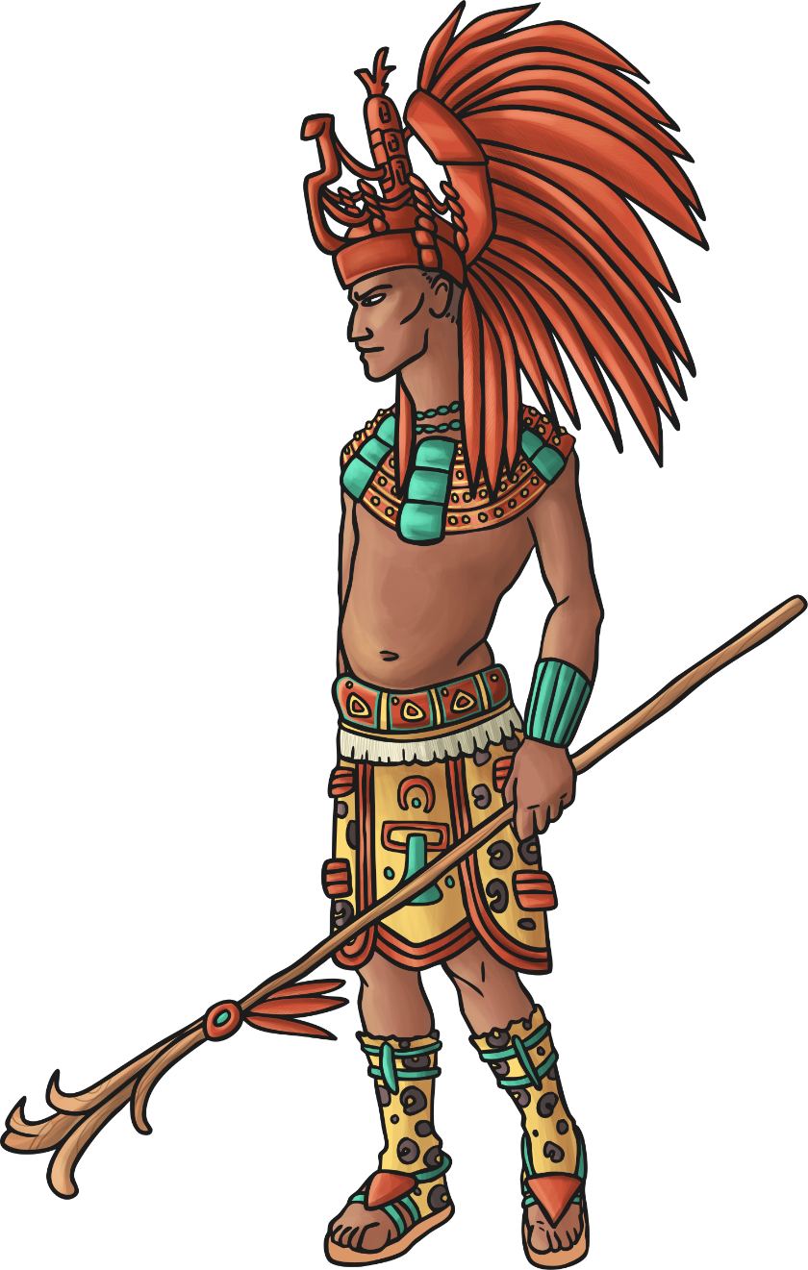
Maya Priests
Priests were very important in Maya society as it was believed that they could communicate directly with the gods. The priests were responsible for leading rituals of worship and sacrifice, and telling the people what the gods wanted them to do. They would tell the people when to plant crops, who to marry and what sacrifices they should make. The people did all these things because they believed that the priest was speaking the wishes of the gods.

Slide 8
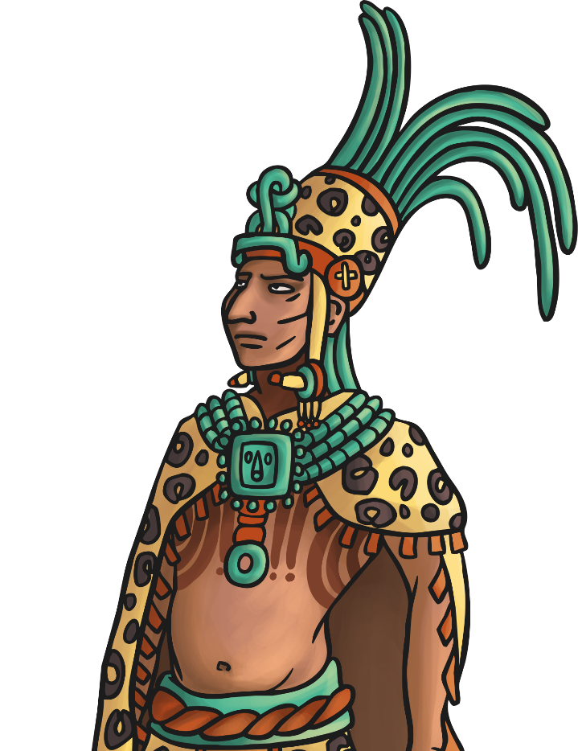
Festivals
During festivals, the priests would dance, sing, bang drums and make lots of noise on the steps of the temples while wearing brightly coloured clothing and headdresses containing the feathers of exotic birds. This ritual dance was thought to scare away demons and demonstrate the priest’s power and authority to the gods.
Questions to answer in your book
Would you like to have been a Maya priest? Why/why not?
Do you think people ever refused to do what the priest said? What do you think happened to them if they did not follow orders?

Slide 9
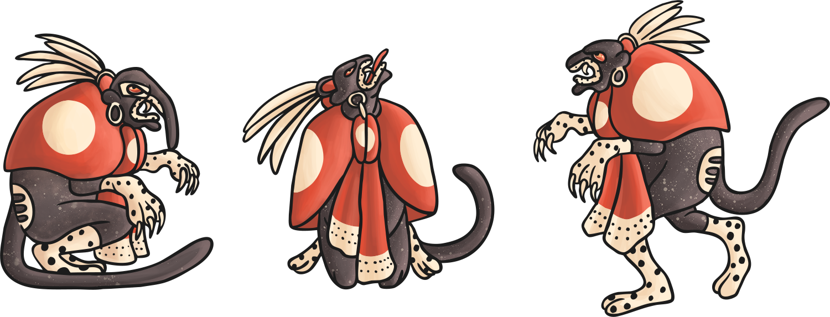
The Maya World
The Maya people believed that the earth, which they called the Middleworld, was large and flat and resting on the back of a creature (like a turtle or crocodile).
On the Middleworld grew a tree whose branches reached up into the heavens (the Uppeworld) and whose roots grew down into Xibalba (the Underworld) which was guarded by gods of death who looked like jaguars.
The Maya believed that after they died, their souls would travel through a series of caves and tunnels to Xibalba (which means ‘place of fear’) but the rulers and noblemen believed there was a chance of them getting to the Upperworld.
Questions to answer in your book
Why do you think the Maya believed most people went to the Underworld after they died?
Why do you think the gods of death are depicted like jaguars?

Slide 10
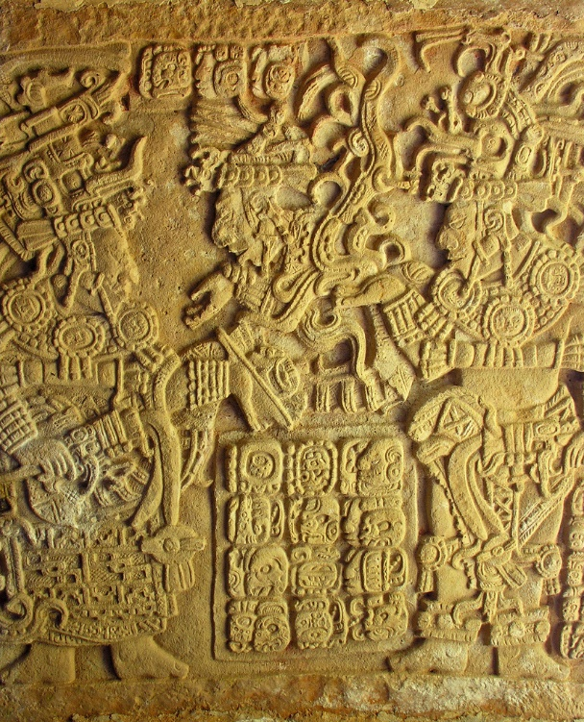
Maya Gods
The Maya people worshipped a number of different gods, many of whom had overlapping roles and names. Some had human form, some took the form of an animal and some were a phenomena of nature.
Historians have discovered a lot about the Maya gods from carvings and codices (Maya books).
Read the information about some Maya gods on the following slides.
Take notes on the gods’ names and meanings, appearances and other facts/features so you can write a Maya Gods Fact File of your own.
Photo courtesy of archer10 (Dennis) (@flickr.com) - granted under creative commons licence - attribution

Slide 11
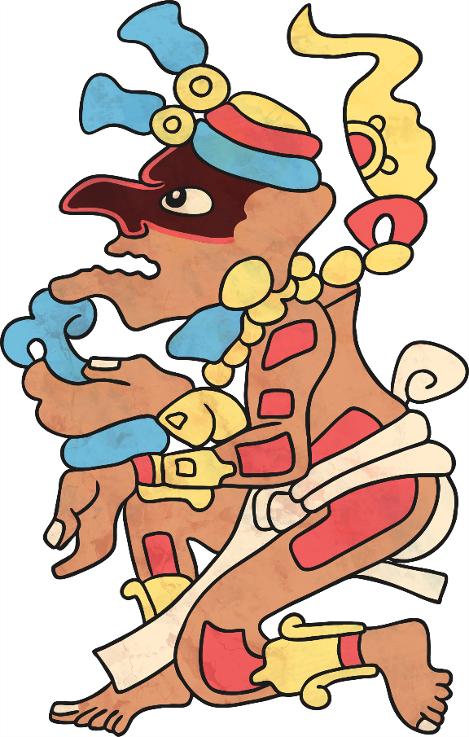
Maya Gods
Itzamna
One of the creator gods.
Inventor of writing.
Patron of learning.
Portrayed in human form as an old man with no teeth and a large nose.

Slide 12

Maya Gods
Ix Chel
Wife of Itzamna.
Goddess of childbirth, healing, weaving and the Moon.
Portrayed in human form wearing a headdress of snakes entangled in her hair, and toes and fingers that looked like jaguar claws.
Capable of causing floods and destruction.
The mother of many gods.

Slide 13
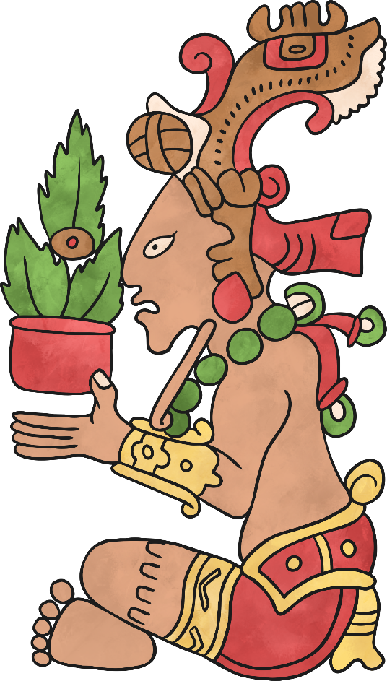
Maya Gods
Maize God
From his head sprouted an ear of maize.
Was important because the diet of the Maya was 80% maize and they relied on the harvest being successful.
Also important because humans were created from maize dough by the gods.

Slide 14
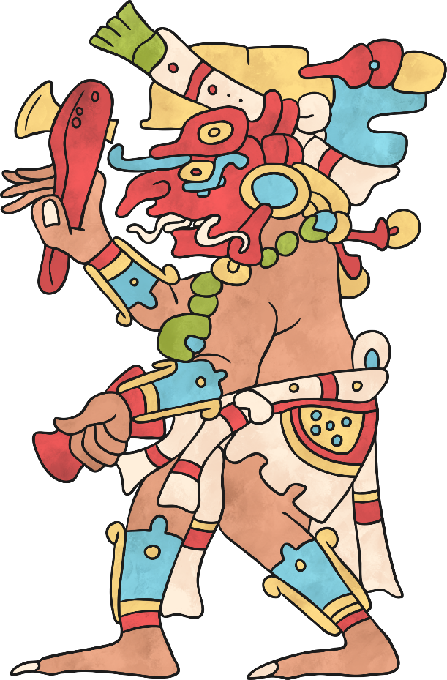
Maya Gods
Chac
Brought the rain needed to make crops grow.
Created storms, thunder and lightning.
Caused wars and human sacrifice.
Portrayed as a human with a curling snout and reptile fangs.

Slide 15
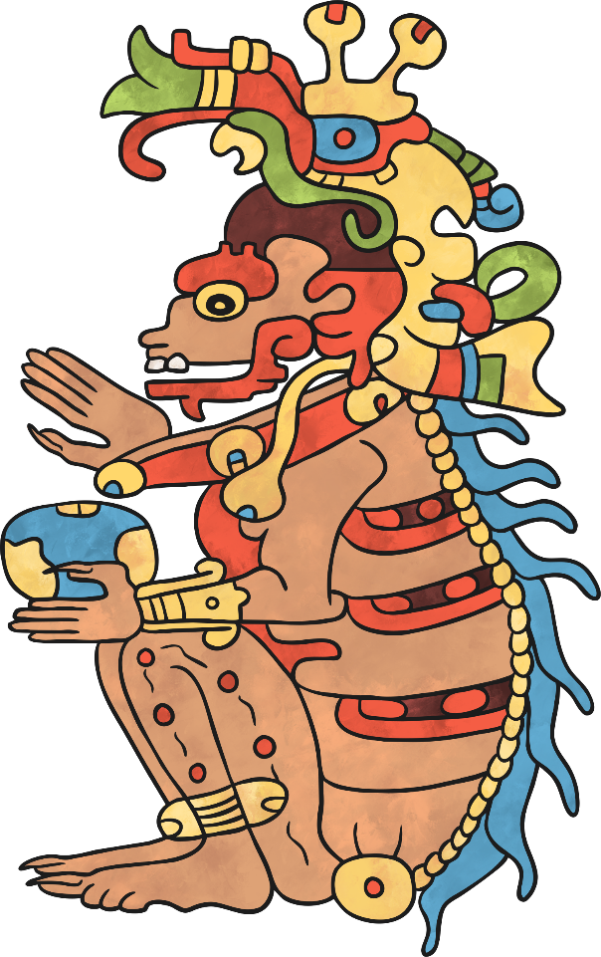
Maya Gods
Kimi
Death god.
Portrayed as a human with a skeletal nose, jaw and spine along with a body covered in hideous spots.

Slide 16

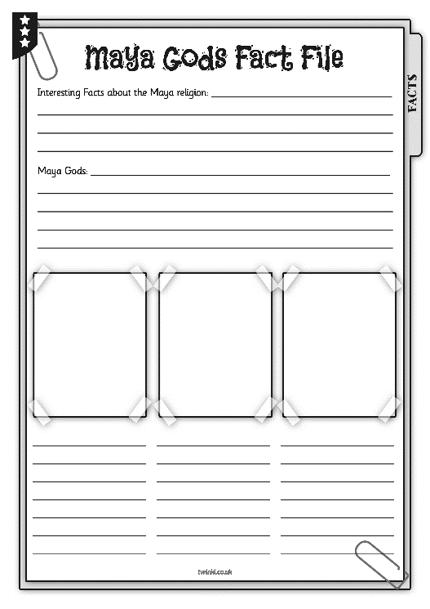
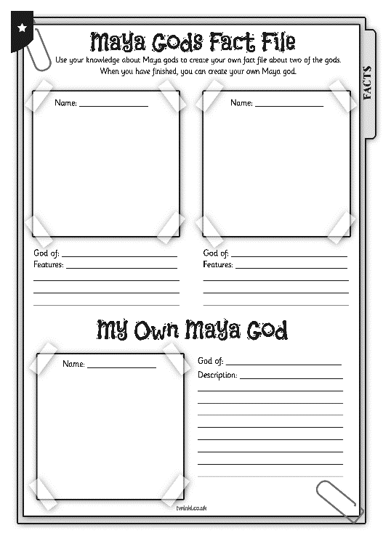
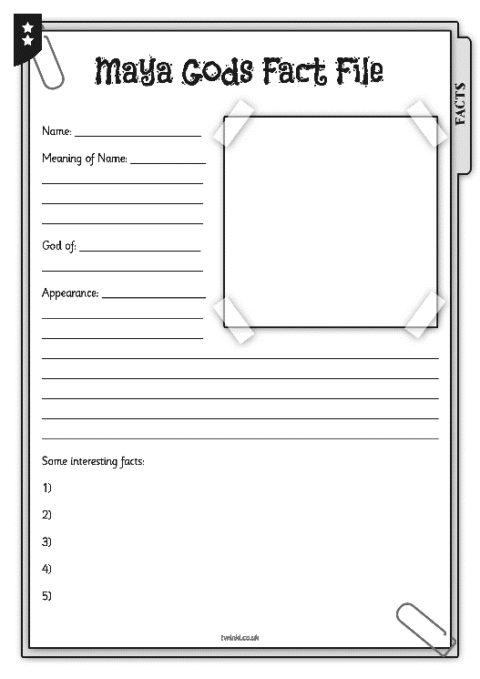
God Fact Files
Using the information you have learnt, your challenge is to create a fact file about Maya gods.
Make sure your information is clear and accurate and the pictures are bright and colourful. Use the below as an idea as to how your fact files could look.

Slide 17


Maya Gods and
Religion Quiz
What have you learnt about Maya gods and religion? Can you correctly answer these 5 questions?
Why did the Maya perform blood letting rituals?
Who was the supreme god?
Who guarded the Underworld?
Name 3 priestly jobs.
Who could go to the Upperworld after they did?
How many did you get right?
Can you think of 3 of your own Maya gods and religion quiz?

