Slide 1


Slide 3


Slide 4
Complete the number tracks.
Complete the part whole models.
10 | 20
3 | 6
39
42
42
30
40
30

Slide 5
Complete the number tracks.
Complete the part whole models.
10 | 20
30
40
50
60
70
80
90
100
3 | 6
9
12
15
18
21
24
27
30
39
42
42
30
9
40
2
30
12

Slide 7




There are 4 counters in each group.
But the counters have different values. The value of each group must be equal too.

Slide 8
39 ÷ 3 =
13
Tens | Ones

Slide 9

84 ÷ 4 =
21
Have a think
Tens | Ones

Slide 10
42 ÷ 3 =
14
But those groups aren’t equal!
Tens | Ones

Slide 11
96 ÷ 4 =
24
Have a think
Tens | Ones

Slide 12
51 ÷ 3 =
17
Have a think
Tens | Ones

Slide 13
Have a go at questions
1 - 4 on the worksheet

Slide 14
39 ÷ 3 =
13
42 ÷ 3 =
14
39
42
30
30
9
40
2
12
÷ 3
÷ 3
÷ 3
÷ 3
10
3
10
4
10 + 3 =
13
10 + 4 =
14

Slide 15
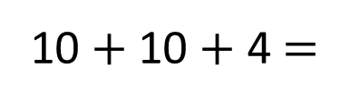
51 ÷ 3 =
17
96 ÷ 4 =
24
Have a think
51
96
96
40
16
30
21
80
40
16
÷ 4
÷ 4
÷ 3
÷ 3
÷ 4
÷ 4
÷ 4
10
4
10
7
20
10
4
10 + 7 =
17
24
10 $+$ 10 + 4 =
24
20 + 4 =

Slide 16
Have a go at the rest of the worksheet

