Slide 1
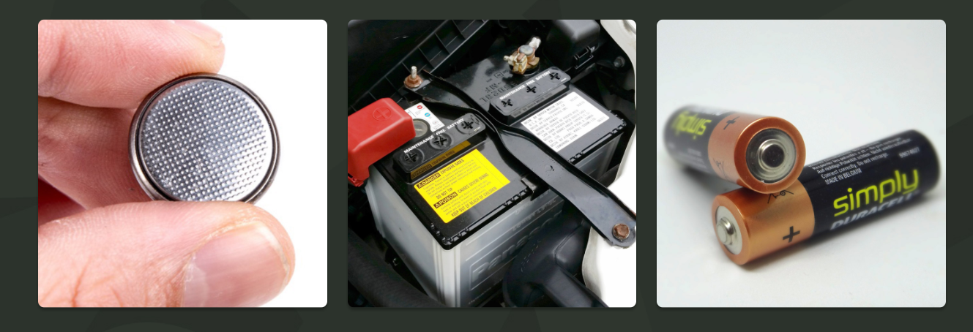
ODD ONE OUT
Today’s warm up is about identifying similarities and differences. These are all types of batteries but they are all different. What do you notice?

Slide 2

Quick Warm up
Click each answer box to reveal the answers!
Can you give an example of how electricity is found naturally?
Lightning, static electricity and bioelectricity.
What is 'current electricity'?
The flow of electrical charge through a material.
Mains electricity is one type of electrical current. Can you name another type?
Battery powered electricity.
Can you name a non-renewable method of generating electricity?
Burning fossil fuels such as coal, oil or natural gas.

Slide 3


LC: Can I understand how a simple electrical circuit is made?
By the end of the lesson you should:
Be able to see when a circuit is complete or incomplete.
Understand the main parts of a simple circuit.
NOTE: We will do this practically when you are back in school.

Slide 4
LC: Can I understand how a simple electrical circuit is made?
Do you know what we need for a simple circuit?
Have a think and then put your hand up if you have an idea.
We develop our scientific knowledge
We are curious
We use scientific vocabulary

Slide 5
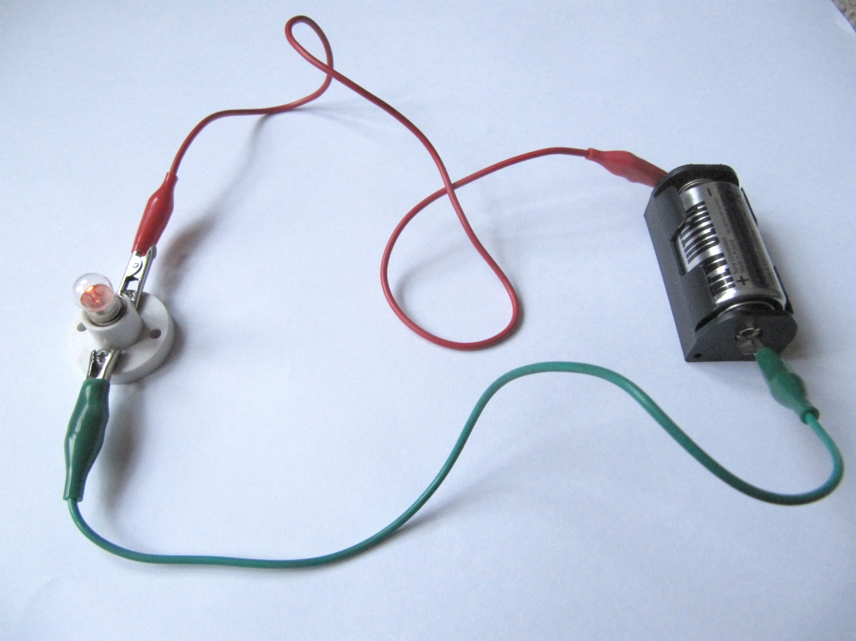
This is a simple circuit.
Wire
Cell in holder
Bulb in holder

Slide 6
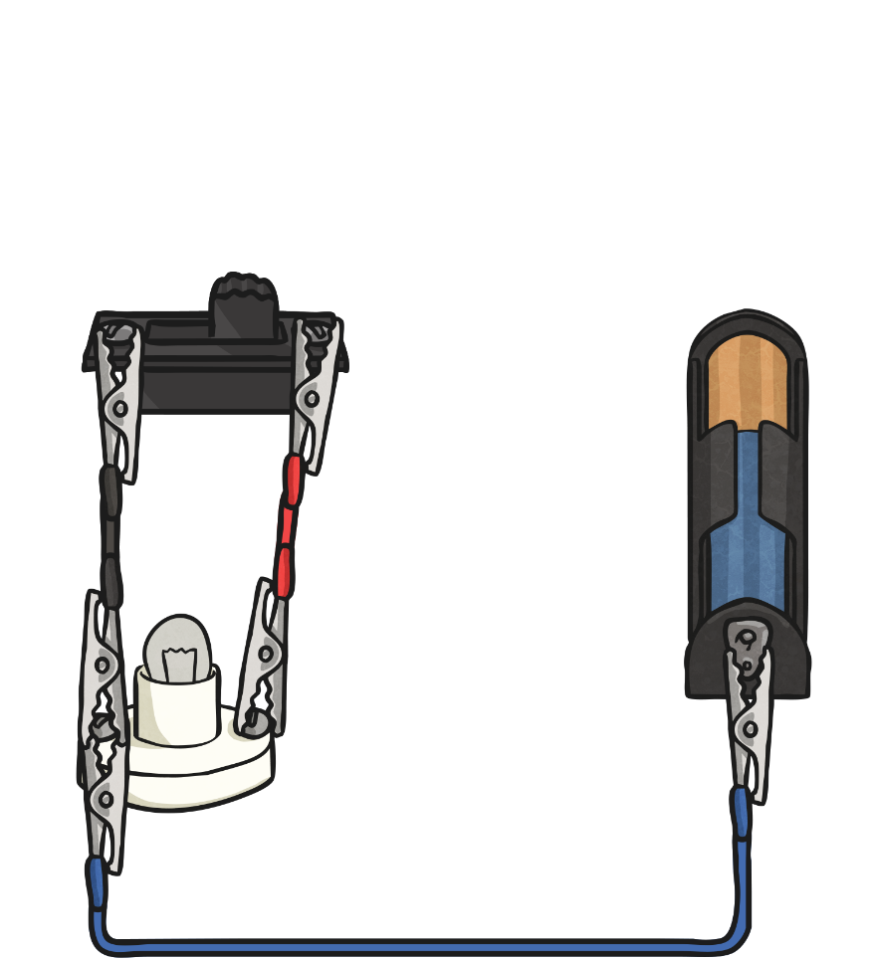
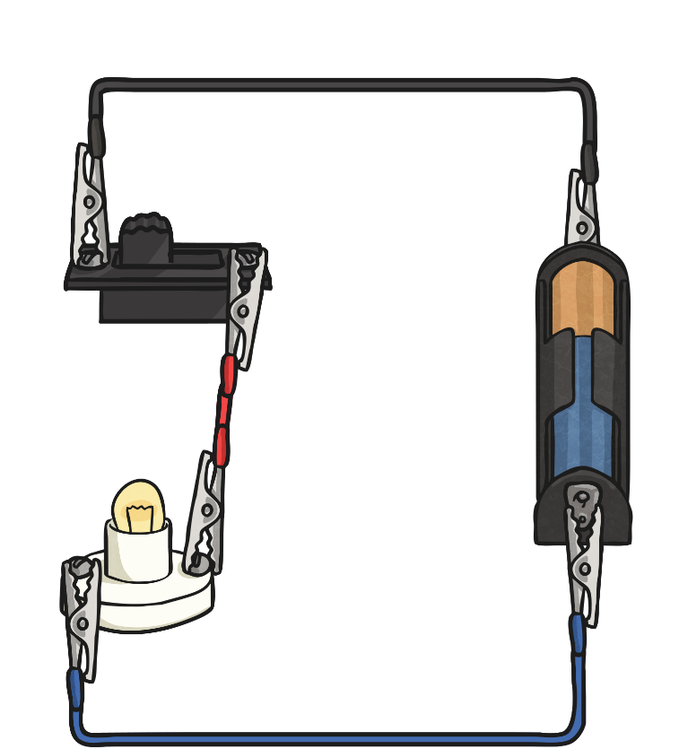
Complete and Incomplete Circuits
An electrical circuit can be complete or incomplete. What do you notice about the incomplete circuit?
Incomplete Circuit
Complete Circuit

Slide 7
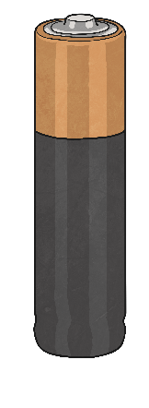
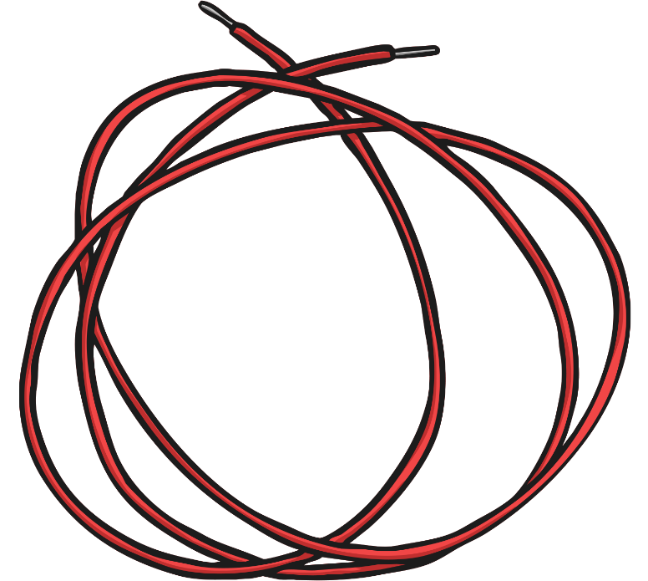
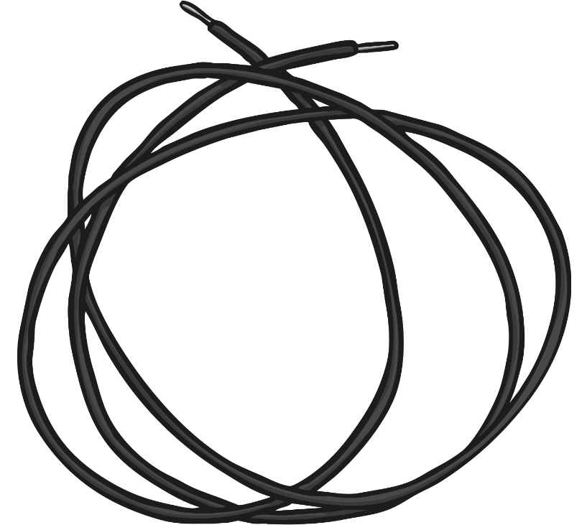
Complete and Incomplete Circuits
Current electricity is the flow of electrical charge though materials.
Every complete circuit must have a power supply. The power supply could be the mains, or it could be a battery.
For a circuit to be complete, there must be wires connected to both the positive and negative ends of the power supply.
Electricity can only flow around a complete circuit that has no gaps.

Slide 8
Complete and Incomplete Circuits
Incomplete Circuit
This circuit is incomplete.
There is a gap in the circuit, so the electrical current cannot flow around it.
The wires do not connect to the positive and negative ends of the power supply (the battery).

Slide 9
Complete and Incomplete Circuits
Complete Circuit
This is a complete circuit.
There is a power supply (the battery).
There are no gaps anywhere, so the electrical current can flow around the entire circuit.
The wires connect to both the positive and negative ends of the battery.

Slide 10

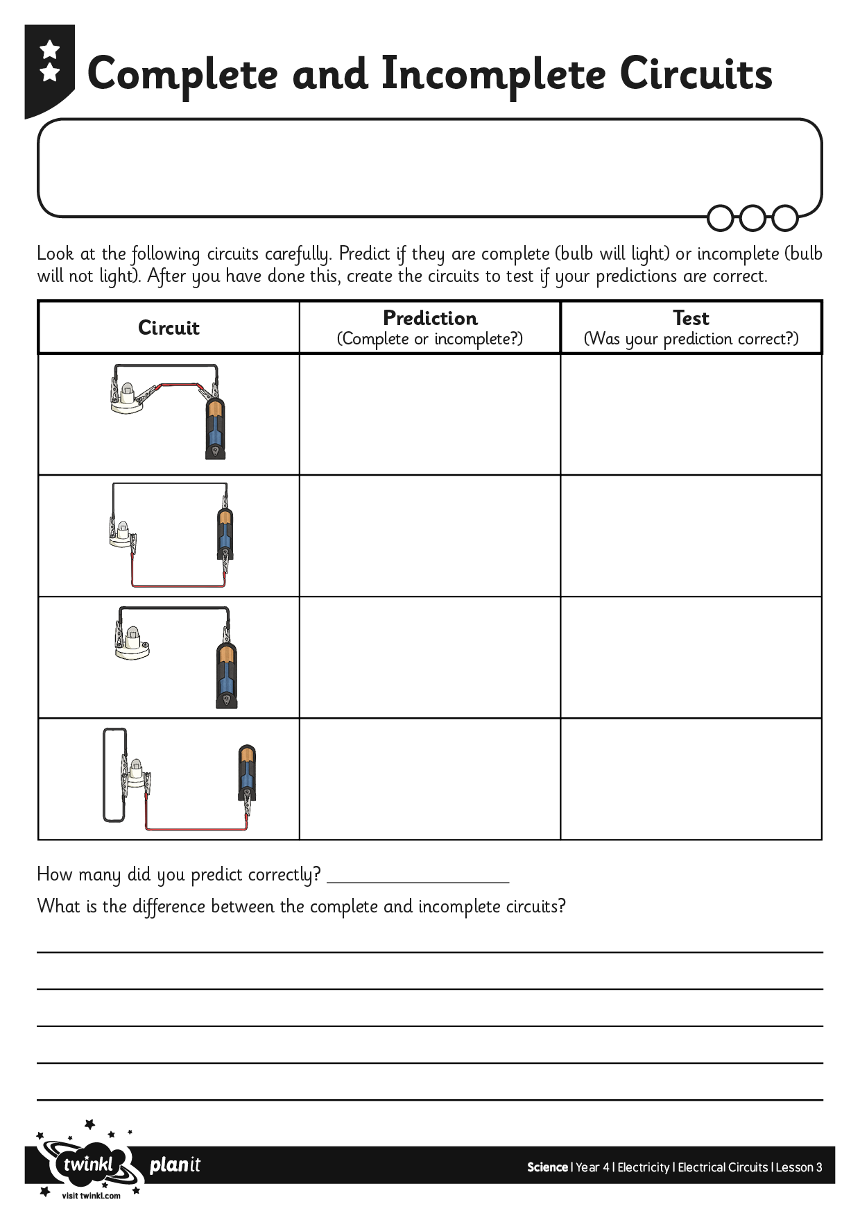
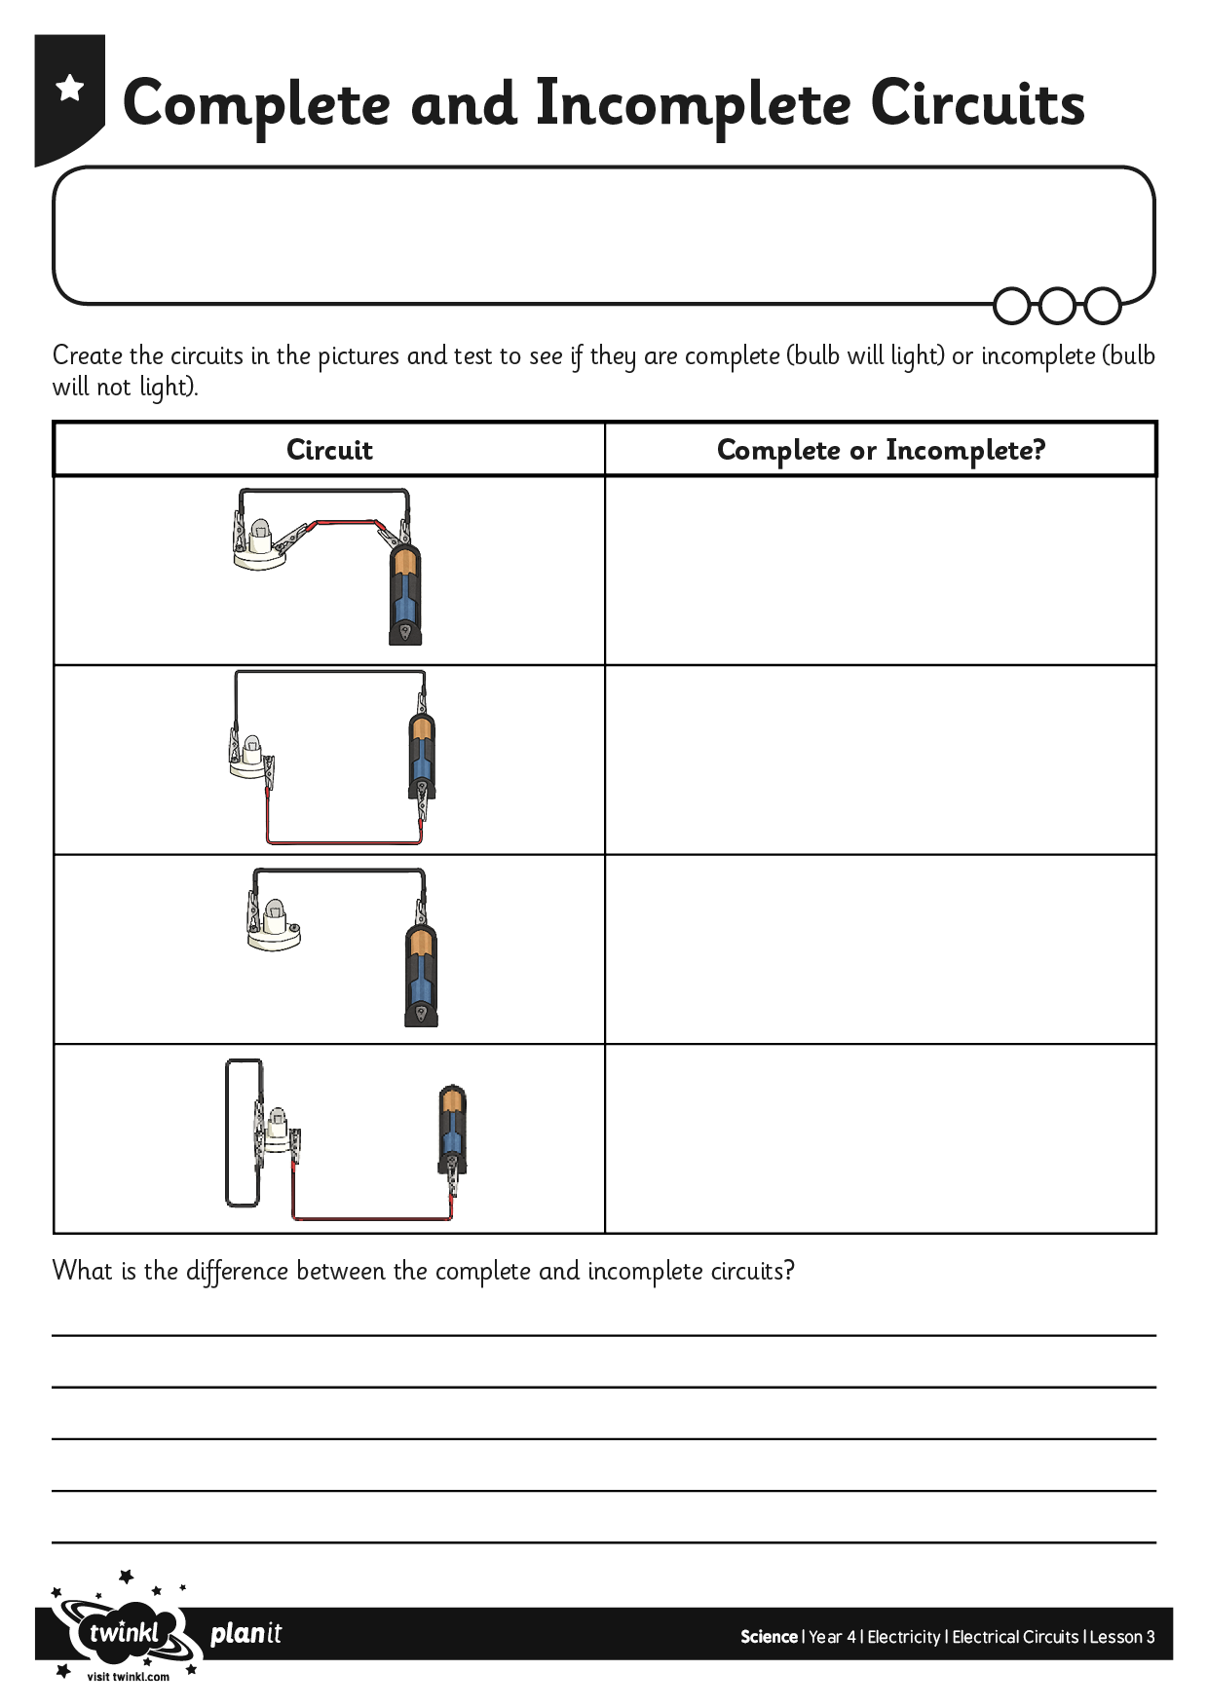

Complete or
Incomplete Circuit?
Task Instructions:
On your activity sheets, you will see pictures of circuits.
You will need to first predict if you think the circuit will be complete or incomplete.

Slide 11
The following are the diagrams you will see on your sheet.
In your book you could draw the diagrams and then explain if they are complete or incomplete. Try to explain how you know.
Or you can complete the sheet that has the circuit diagrams on.

Slide 12

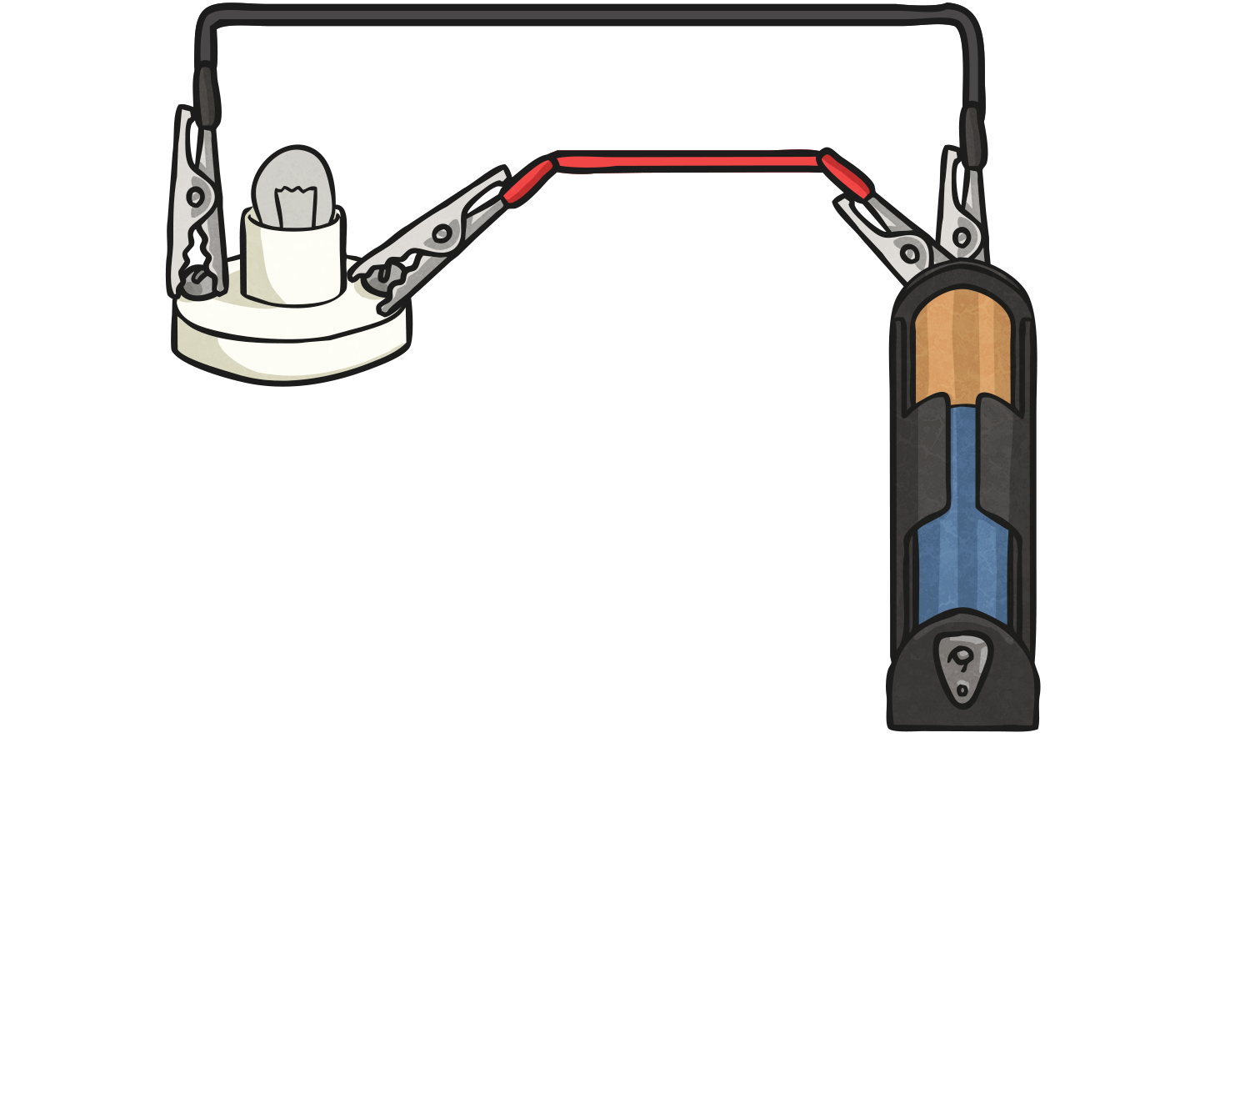
Complete or Incomplete?

Slide 13
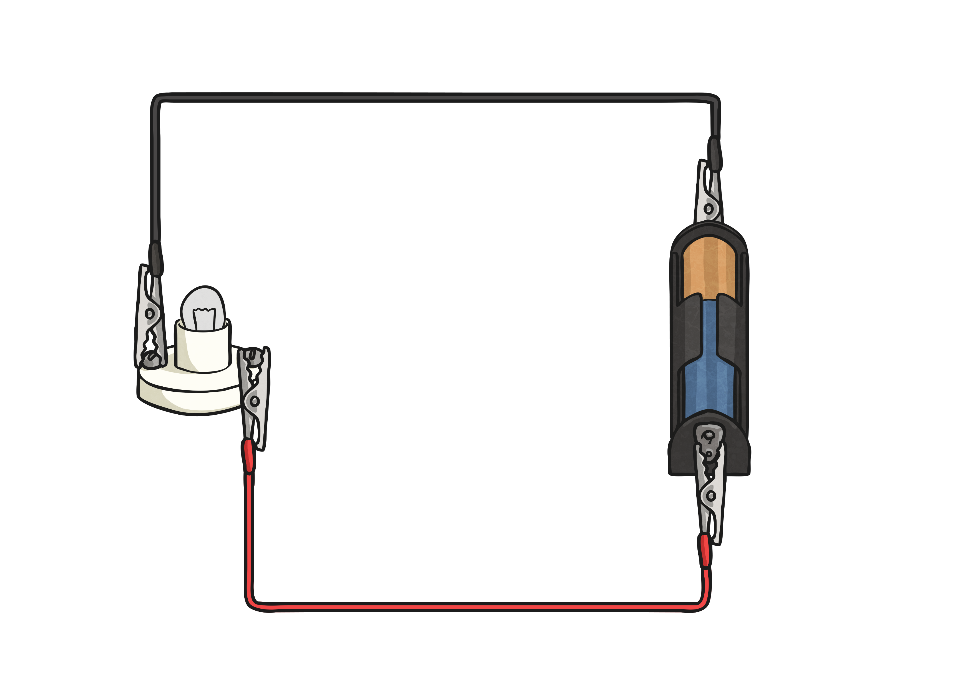
Complete or Incomplete?

Slide 14
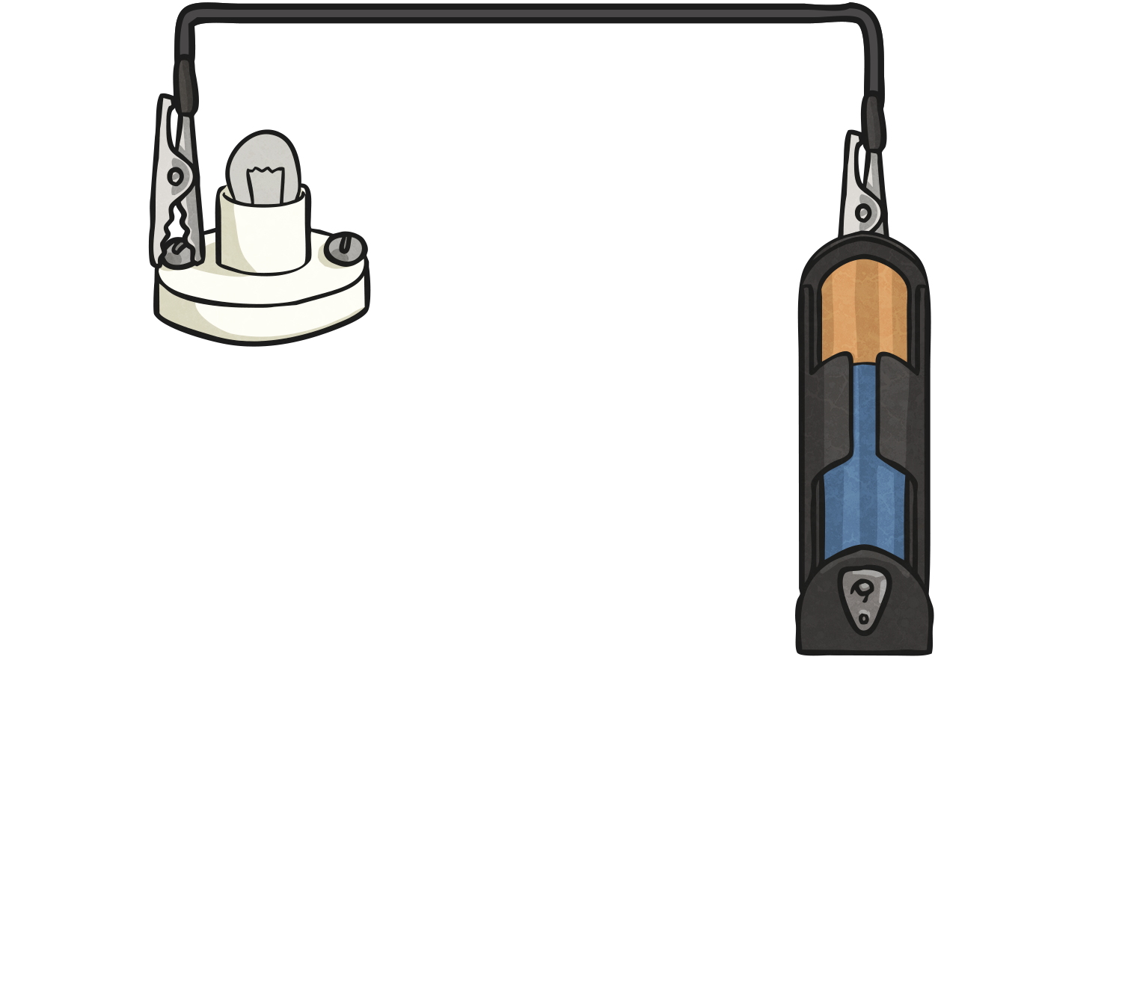
Complete or Incomplete?

Slide 15
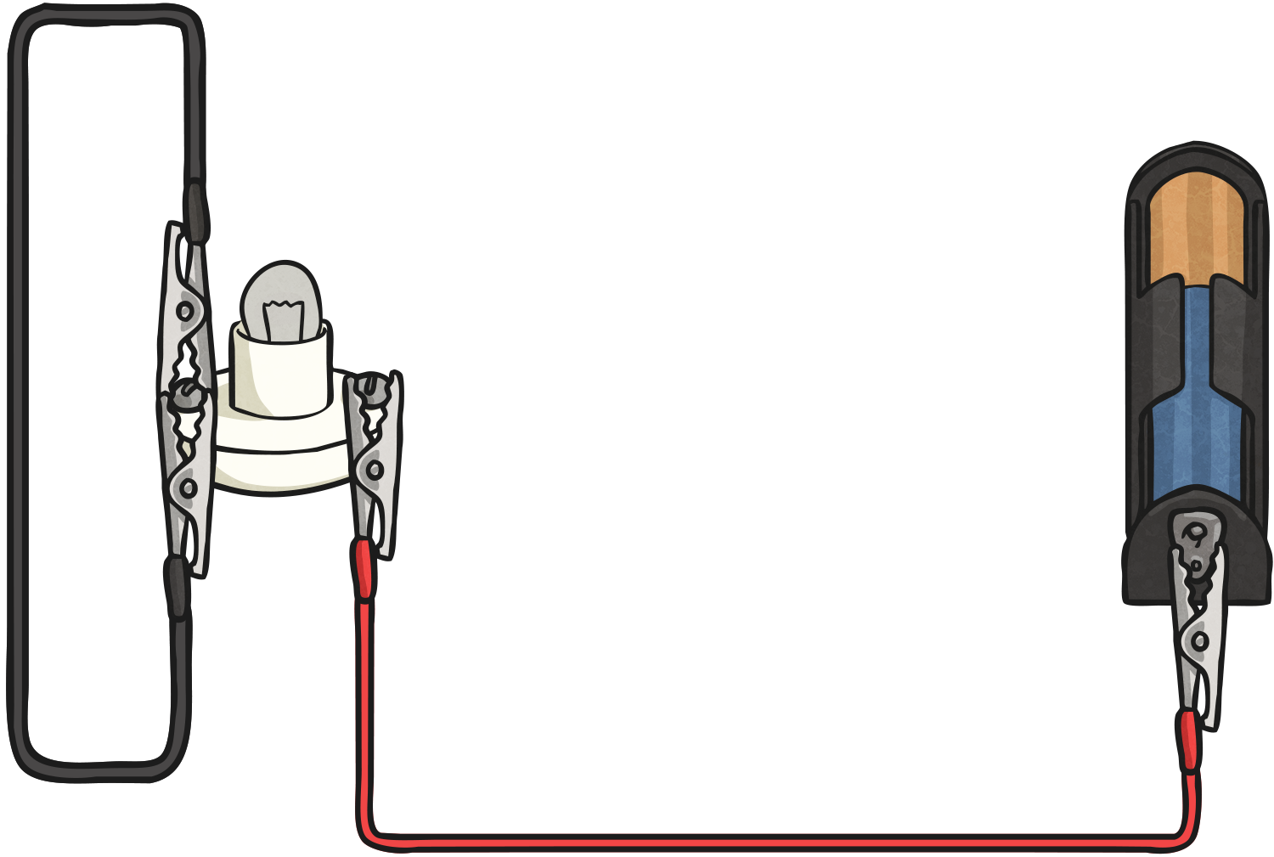
Complete or Incomplete?

