Slide 1
Warm up. Can you think of a good headline for one of these pictures?

Slide 2
Friday LC: Can I investigate online reports?

Slide 3
Last week, we explained that news can be read in lots of different ways.
Newspapers

Slide 4
News magazines

Slide 5
Newspapers with content online.

Slide 6
Today, we would like you to think about the differences between online articles and those in printed papers and magazines.
What differences do you think there might be?

Slide 7
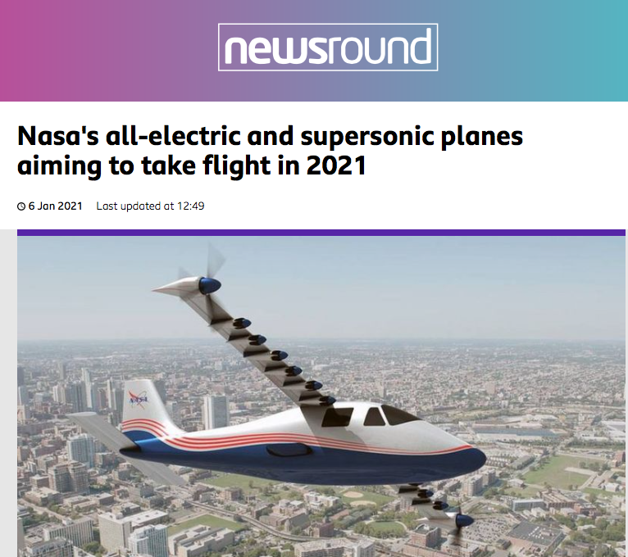
Let’s look at this online article to find out more.
This online article has a title, picture, caption and content just like a newspaper report

Slide 8
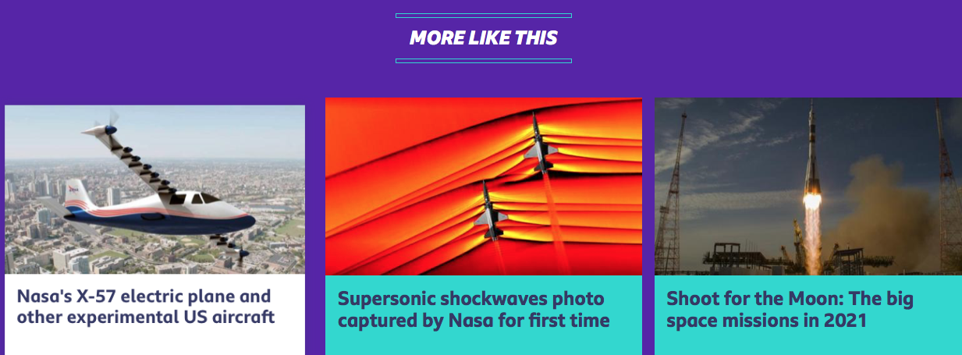
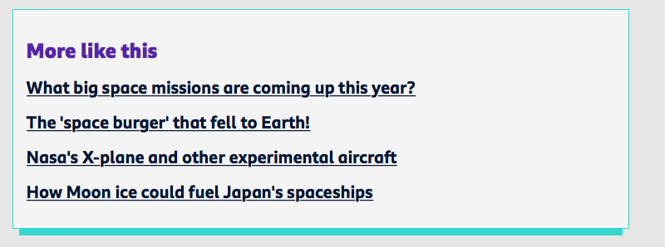
But it also has some links to take you to other similar articles or quizzes.

Slide 9

It also contains links to video content which might be interesting. E.g. today’s episode of Newsround.

Slide 10
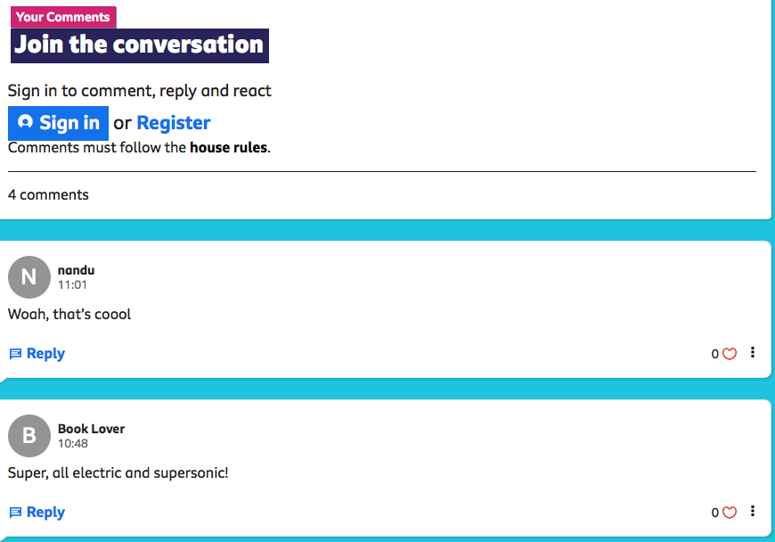
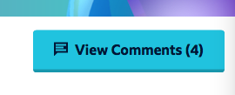
People reading the content online can post comments about what they think of the article too.

Slide 11
Friday : LC: investigate online reports.
Toolkit:
Spend 15 minutes on the Newsround website looking at the articles. Newsround web page link
Then either:
Add some of the features: e.g. links, comments page, quiz etc. to your article.
OR
Write a paragraph in your books to explain whether you prefer online news content or traditional news reports.
THIS PIECE OF WORK WILL BE DISCUSSED AT THE AFTERNOON CATCH UP

