Slide 1


Slide 2


Slide 4


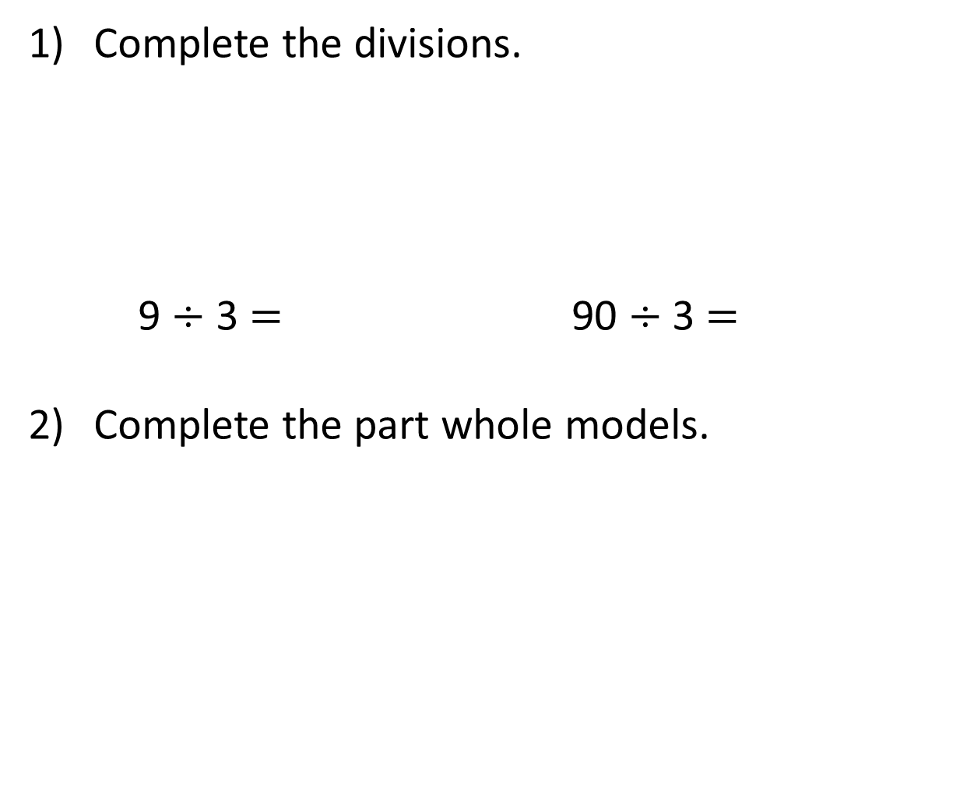
Complete the divisions.
9 $÷$ 3 $=$ 90 $÷$ 3 $=$
Complete the part whole models.
39
42
42
30
40
30

Slide 5
Complete the divisions.
9 $÷$ 3 $=$ 90 $÷$ 3 $=$
Complete the part whole models.
3
30
39
42
42
30
9
40
2
30
12

Slide 7



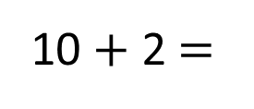
48 ÷ 4 =
12
48
Tens | Ones
40
8
÷ 4
÷ 4
10
2
10 + 2 $=$
12

Slide 8

42 ÷ 3 =
14
But those groups aren’t equal!
Tens | Ones
42
40
30
12
2

Slide 9

96 ÷ 4 =
24
Have a think
Tens | Ones

Slide 10
51 ÷ 3 =
17
Have a think
Tens | Ones

Slide 11
Have a go at questions
1 - 4 on the worksheet

Slide 12
39 ÷ 3 =
13
42 ÷ 3 =
14
39
42
30
30
9
40
2
12
÷ 3
÷ 3
÷ 3
÷ 3
10
3
10
4
10 + 3 =
13
10 + 4 =
14

Slide 13
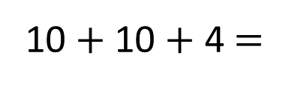
51 ÷ 3 =
17
96 ÷ 4 =
24
Have a think
51
96
96
40
16
1
40
30
21
16
50
11
80
40
÷ 4
÷ 4
÷ 3
÷ 3
÷ 4
÷ 4
÷ 4
10
4
10
7
20
10
4
10 + 7 =
17
24
10 $+$ 10 + 4 =
24
20 + 4 =

Slide 14
Have a go at the rest of the worksheet

