Slide 1
LC: How did Islam start?
This will include looking at:
- Where and when the religion of Islam was founded.
- The role of Muhammad (pbuh) and who he was.
- The story of his life.
This week you will learn a little more about the origins (how it started) of Islam.
There is a video to watch and actiivities to complete as you do it.
Complete this in your home learning book. Don't forget the LC and the date.

Slide 2
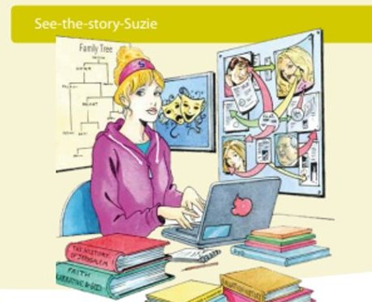
Today we will be See- the- story-Suzie.
Remember, she looks at stories to see how religions are shaped and why a religion chooses to do certain things.

Slide 3
Watch the video and answer the questions as you go along.
This video is from the Oak National Academy with a specialist RE teacher. Use the link and follow the instructions.
https://classroom.thenational.academy/lessons/how-did-the-religion-of-islam-begin-74vk2r

Slide 4


