Slide 1
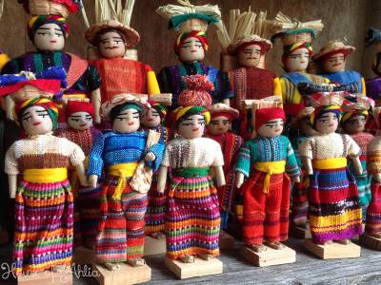
Guatemalan Worry Dolls

Slide 2
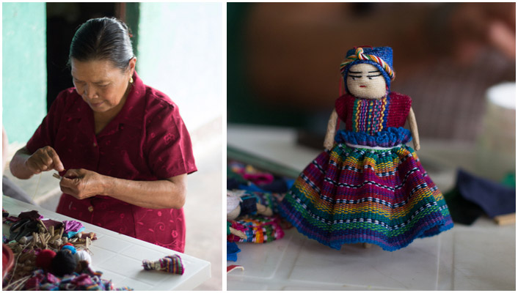
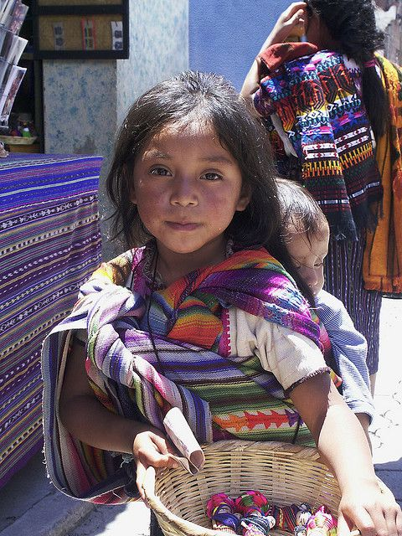
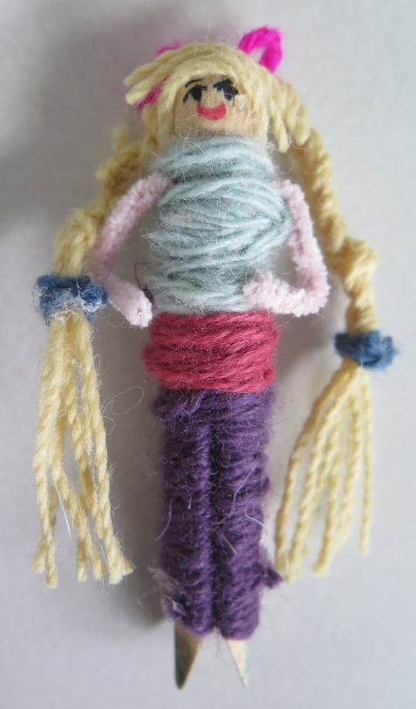
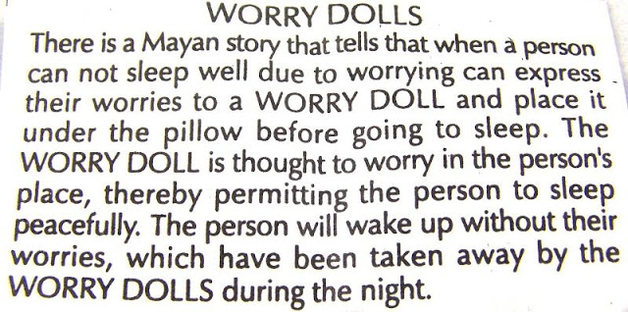
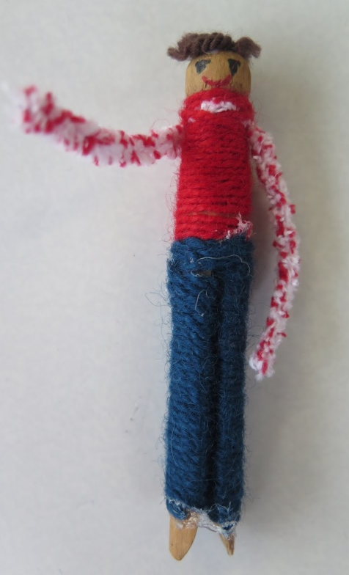

Slide 3
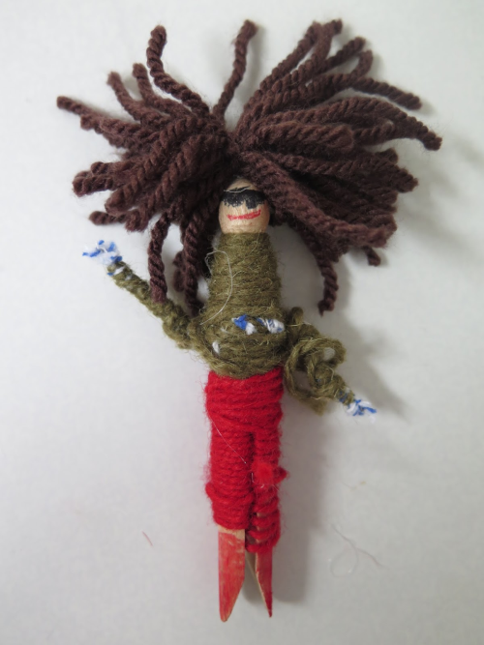
L.C. Can I design my own Guatemalan Worry Doll?
Take a look at the photos of Guatemalan worry dolls.
What do you like? What don’t you like?
What do you notice about the colours, clothes, hair, expressions etc?
Design your own in your sketchbooks (or on paper if at home).
Think about overall design but also how you’re going to physically create your doll and attach different elements, hair etc.
Does your doll have a name and a back-story? What is their personality like?
Think about what challenges you might come across and how you can plan to overcome them.
At school you will have access to a peg for your doll’s body, pipe cleaners, wool in a variety of colours,
PVA glue and I have a glue gun for hair if needed.
If you’re working from home you can make a doll using all sorts of bits, twigs,
lollipop sticks etc. There are examples HERE, or you could just design one for
now
Remember to be creative in your sketchbook and show
YOUR ideas YOUR way.
Have a look at the following examples as inspiration…

Slide 4
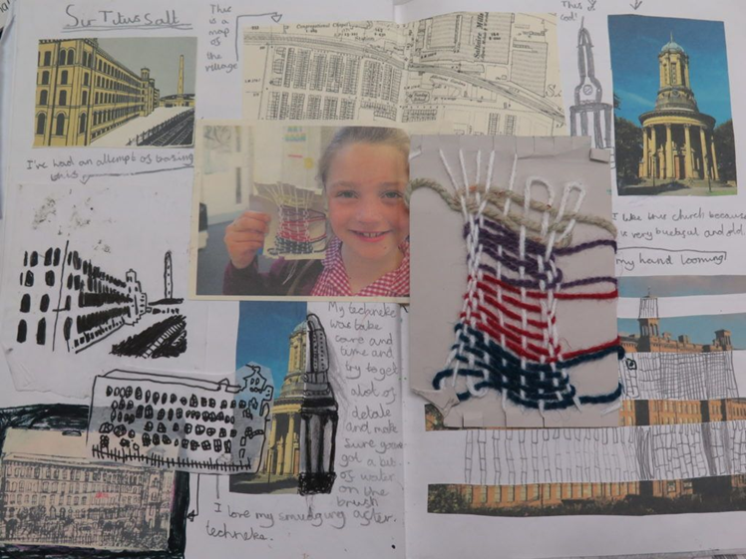
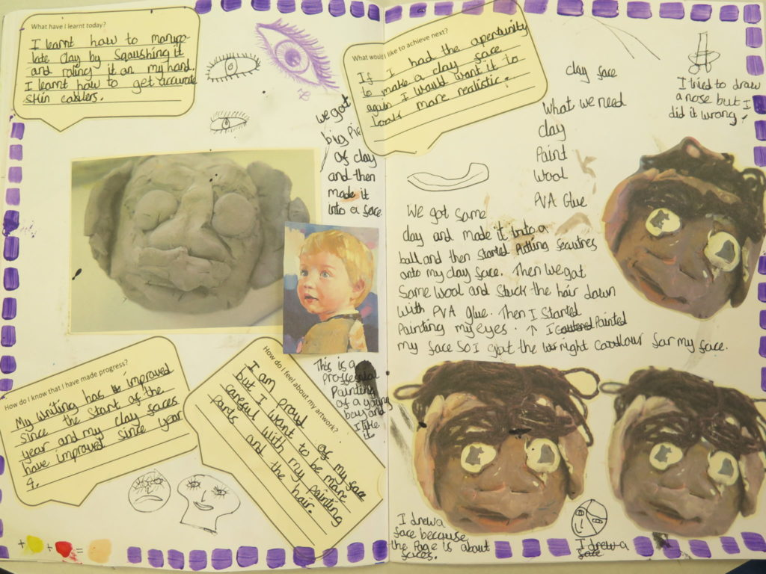
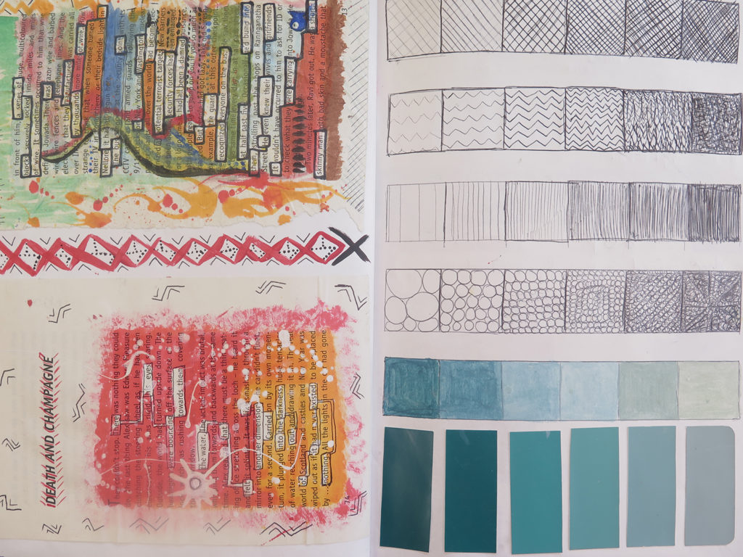
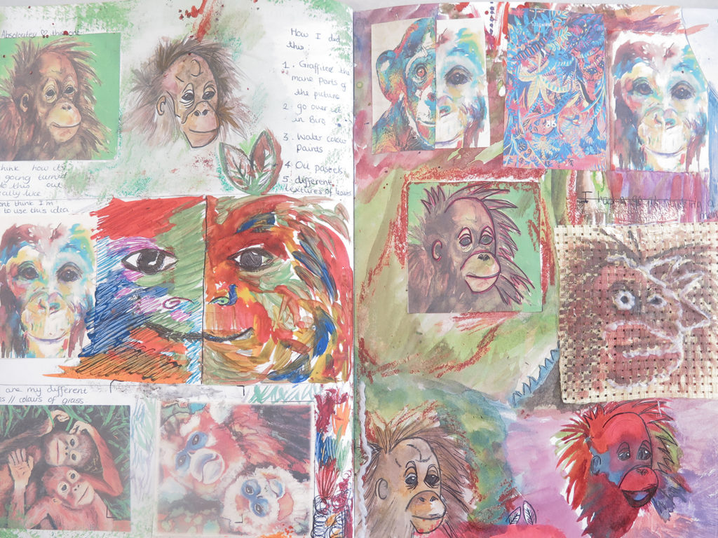

Slide 5
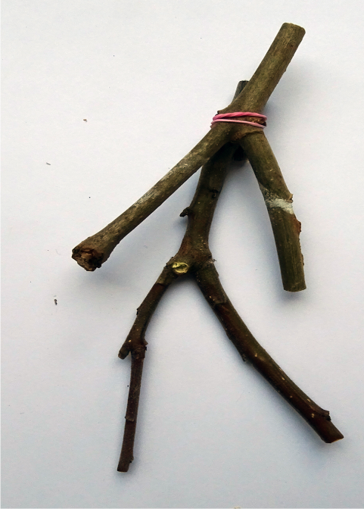
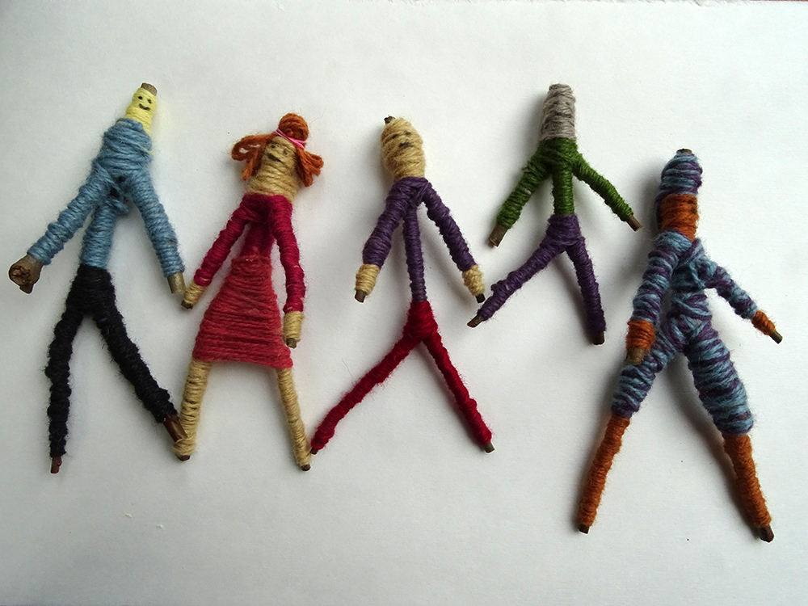
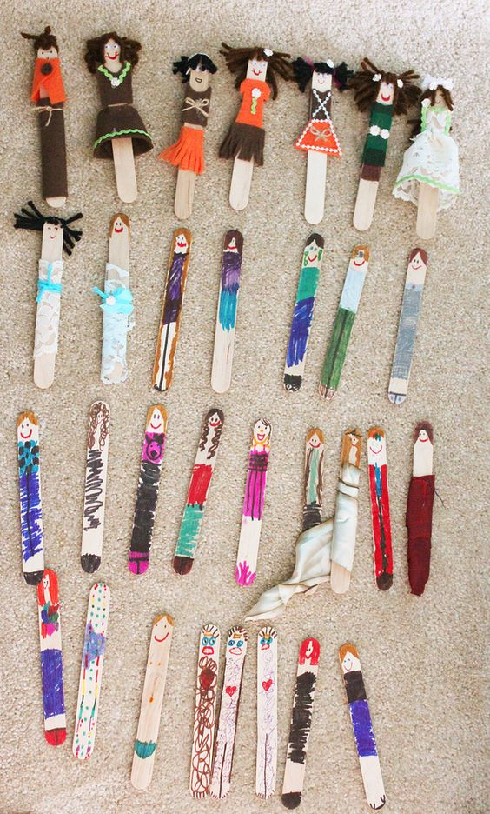
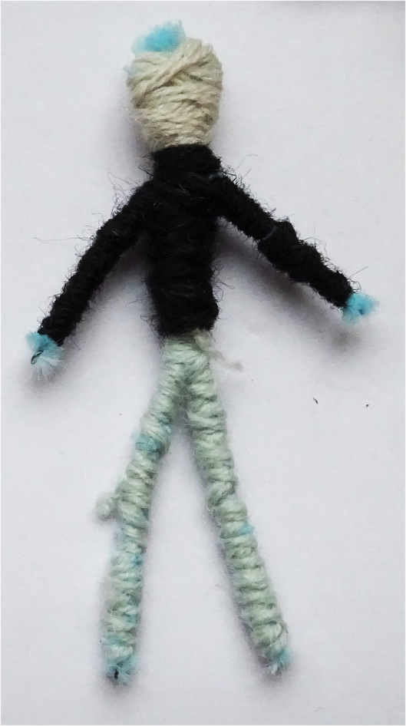
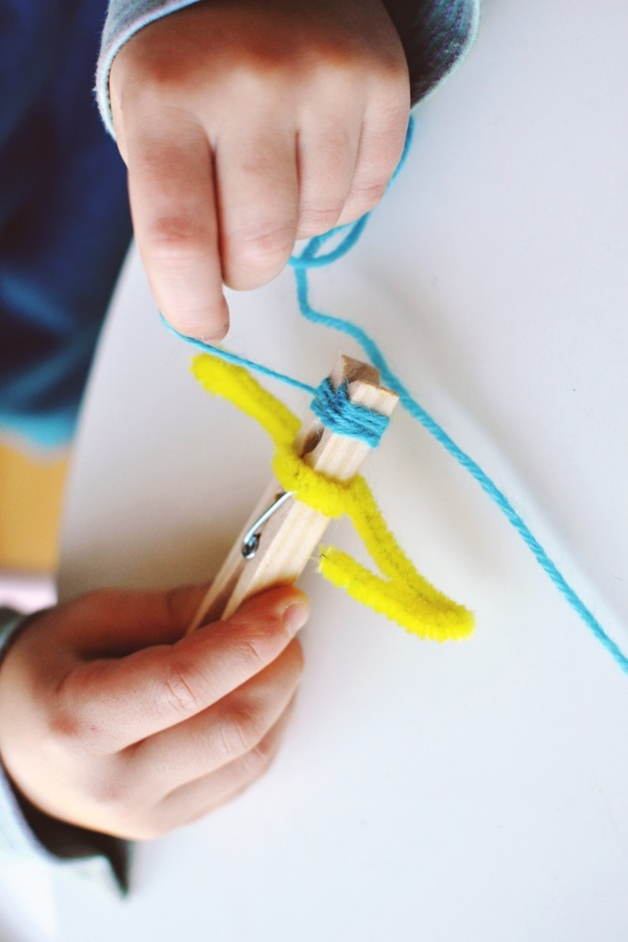
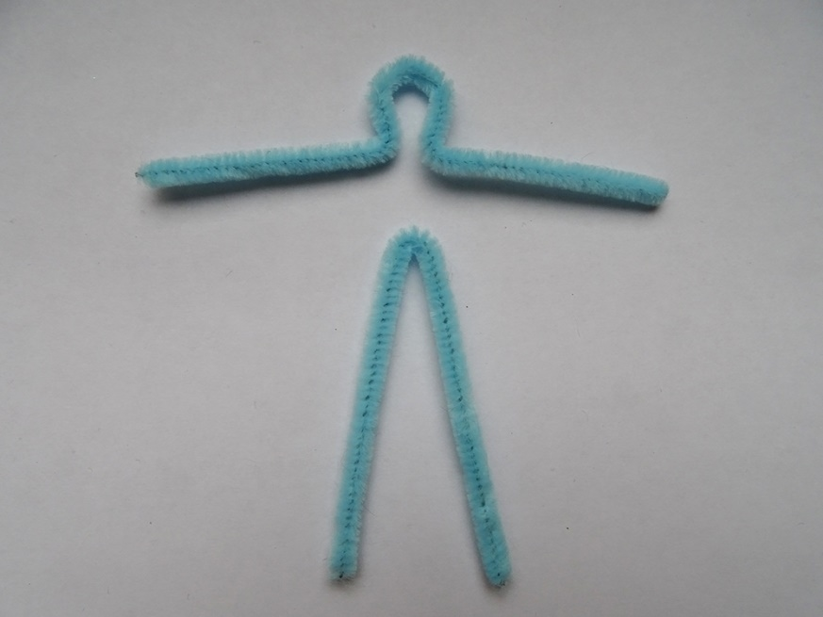
Back to slide 3…

Slide 6
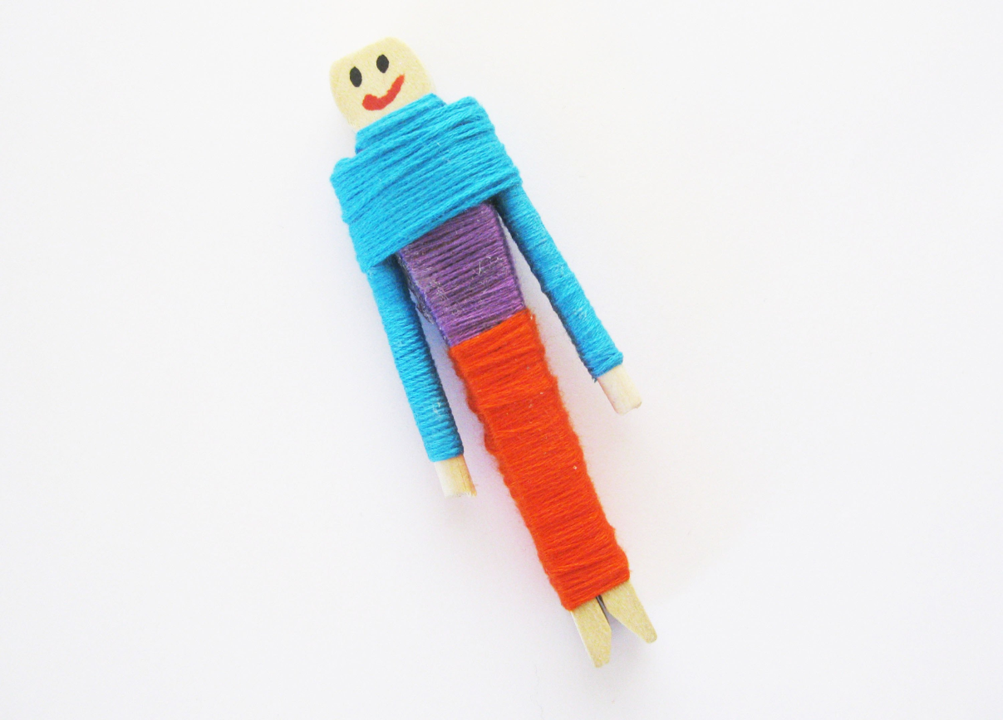
Evaluation
Once you have designed and made your worry doll, consider and answer the following questions…
What did you enjoy about making your worry doll?
What did you find difficult?
How did you solve any problems?
What would you do differently next time?
What have you learnt?
Challenge…
Can you create a story for your doll and
act it out?

