Slide 1
ear sound
Today’s sound is a trigraph.
It has 3 letters in this sound.
Geraldine is going to start by introducing the sound:
https://www.youtube.com/watch?v=EneZ1UubxSA
This video also provides a good introduction to our sound:
https://www.youtube.com/watch?v=9eIe4BHR4_s

Slide 2
Have a go at reading these ‘ear’ words.
Can you identify where the different sounds are to help you to sound out?
ear

Slide 3
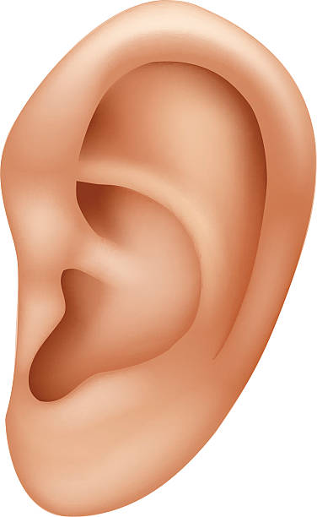
ear

Slide 4
ear
Notice how this is the sound and a word!

Slide 5

hear

Slide 6
hear

Slide 7
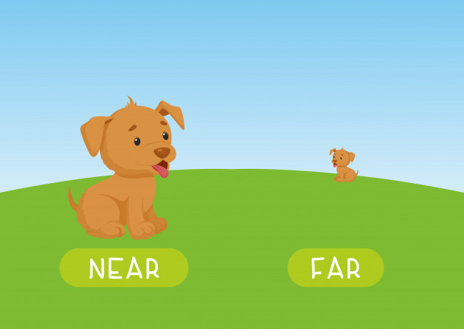
near

Slide 8
near

Slide 9

fear

Slide 10
fear

Slide 11

dear

Slide 12
dear

Slide 13

gear

Slide 14
gear

Slide 15
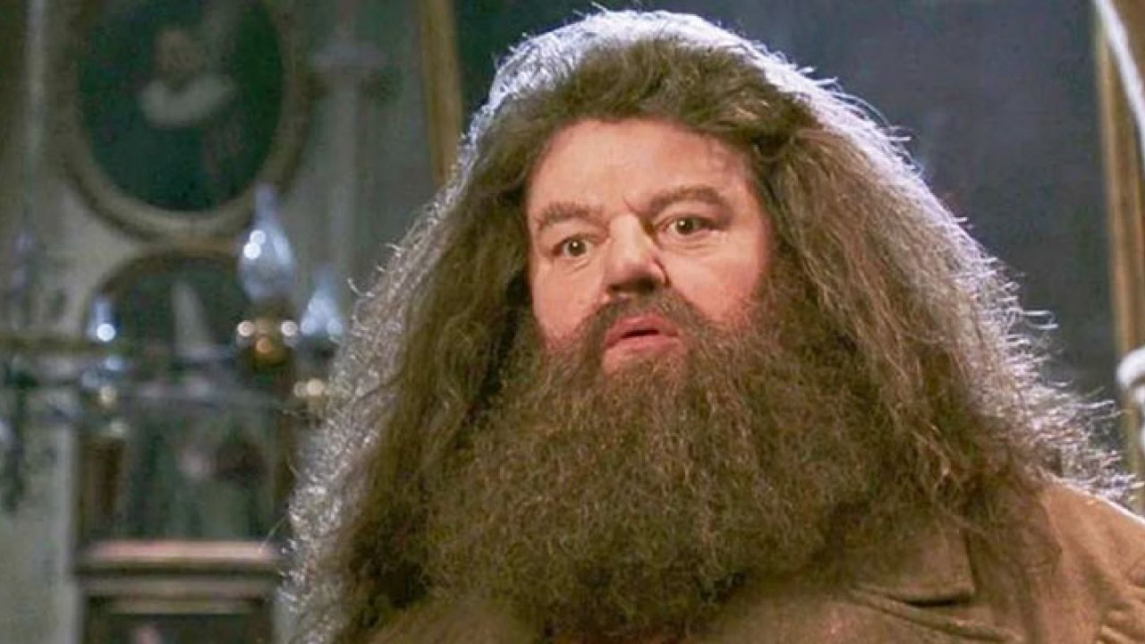
beard

Slide 16
beard

Slide 17
Now have a go at spelling these words.
Remember to really sound out each sound
Remember cursive letter formations
Think about your pencil grip
Have a try at joining the trigraph ‘ear’
e
https://www.youtube.com/watch?v=gU9RRdCfCrE
https://www.youtube.com/watch?v=x1nnOO2OFVI
a
r https://www.youtube.com/watch?v=knhBaLebVq4

Slide 18
Can you spell this word?

Slide 19
ear

Slide 20
Can you spell this word?

Slide 21
hear

Slide 22
Can you spell this word?

Slide 23
near

Slide 24
Can you spell this word?

Slide 25
fear

Slide 26
Can you spell this word?

Slide 27
dear

Slide 28
Can you spell this word?

Slide 29
gear

Slide 30
Can you spell this word?

Slide 31
beard

Slide 32
Tasks...
In your folder there is an ‘ear’ roll the dice sheet and a ‘phoneme spotter’.
Use the phoneme spotter sheet to:
Read the story.
Underlie the ‘ear’ words and/or add sound buttons to these words.
Use the roll dice sheet for a range of reasons:
Roll a die – sound out and read the word – place a counter/colour – how many throws does it take to complete a line (like Bingo).
Roll the die – practise writing that word in cursive letters
Invent your own game and activity e.g. If you have a sibling who can play along, maybe you could compete for a line.
Don’t forget, the most important learning is your 5 ‘ear’ spellings and practising writing these in neat, cursive letter formations.

