Slide 1
La ropa
Clothes

Slide 2
W/C 11.1.21
We are continuing to learn the vocabulary for clothes; la ropa.
Can you remember any of the Spanish words from last week?
Eg skirt, dress, sweatshirt, jumper, shirt, T-shirt, trousers, socks, scarf, woolly hat, shoes, boots, gloves, coat?
Have another look through the slides and try to say the Spanish words as you go. Remember, words in Spanish are pronounced as they are written, there are no tricks (well very few).

Slide 3
Activity
Activity: Can you draw some clothes on the snowman and label them in Spanish? A hat, a scarf, some gloves and a coat.
If you don't have access to a printer, you could draw your own snowman.

Slide 4
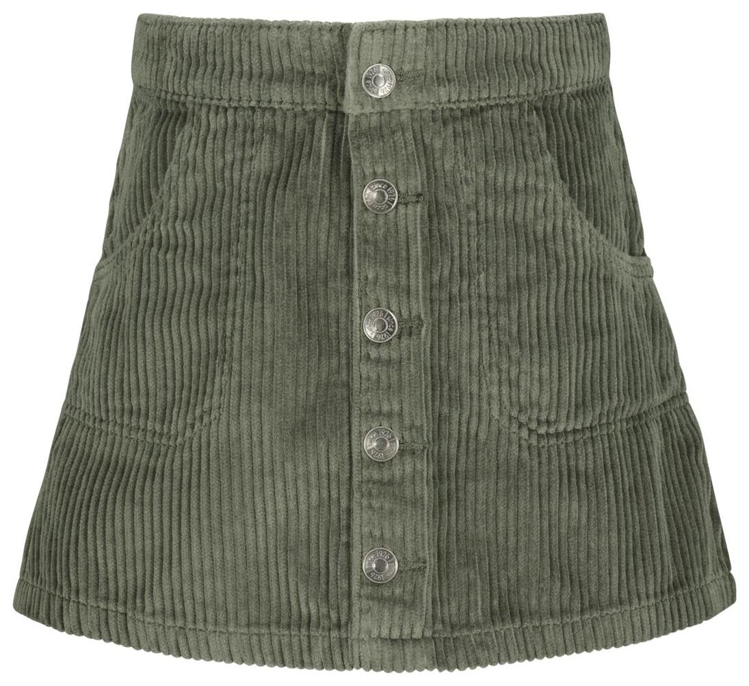
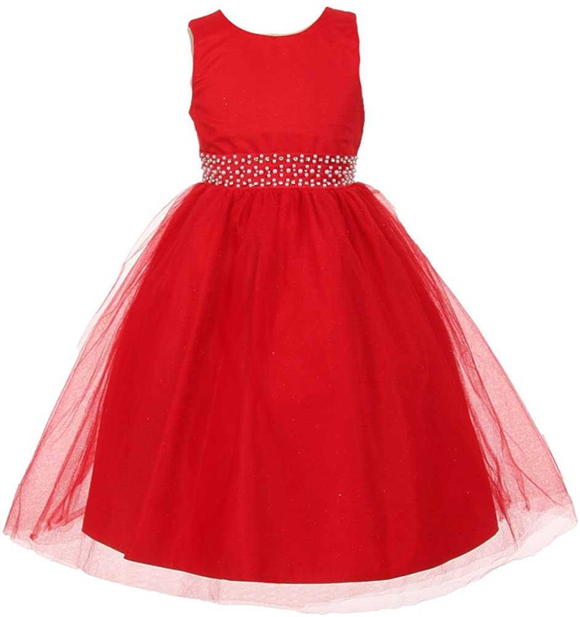
La ropa
una falda
un vestido

Slide 5
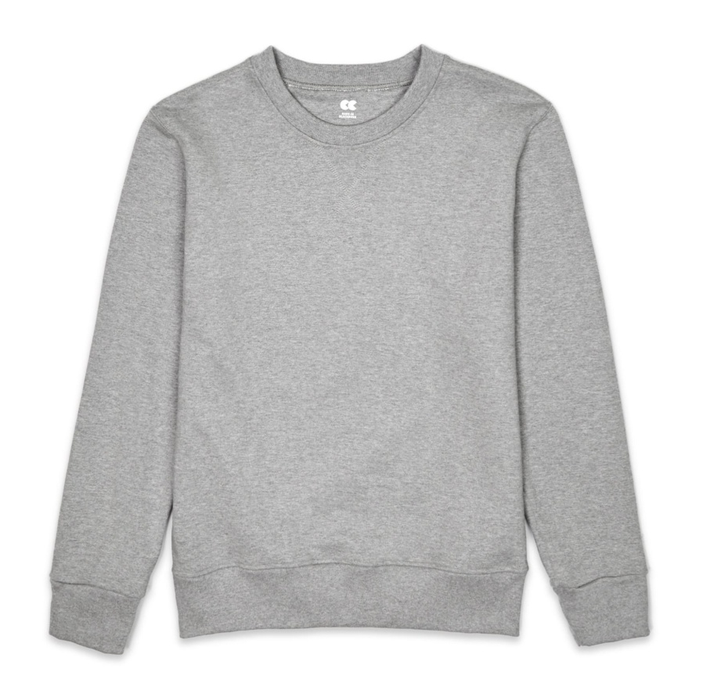
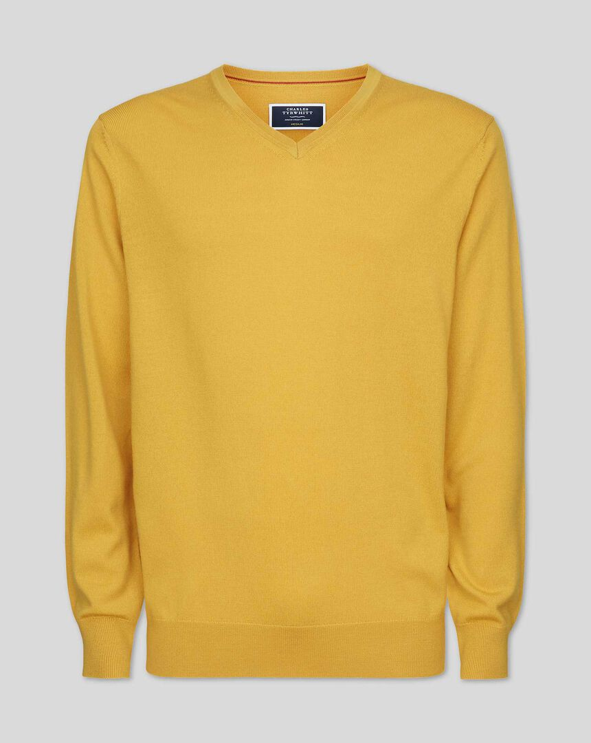
La ropa
una sudadera
un jersey

Slide 6
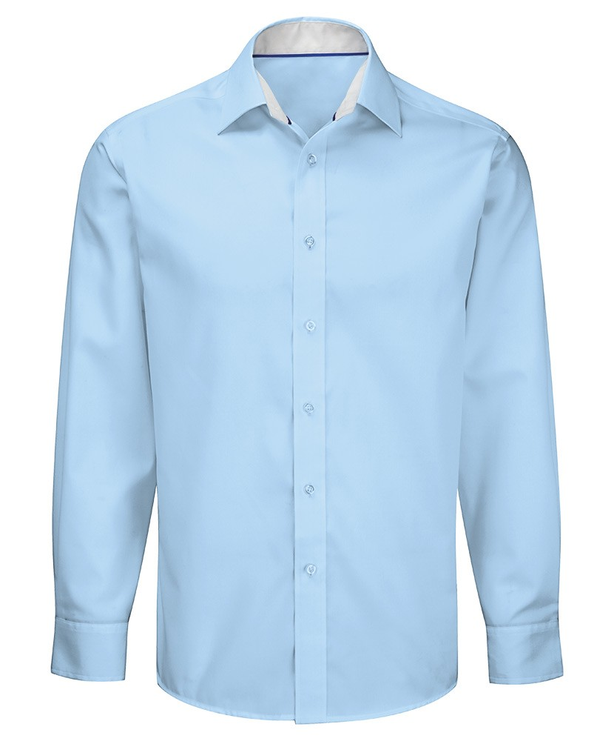
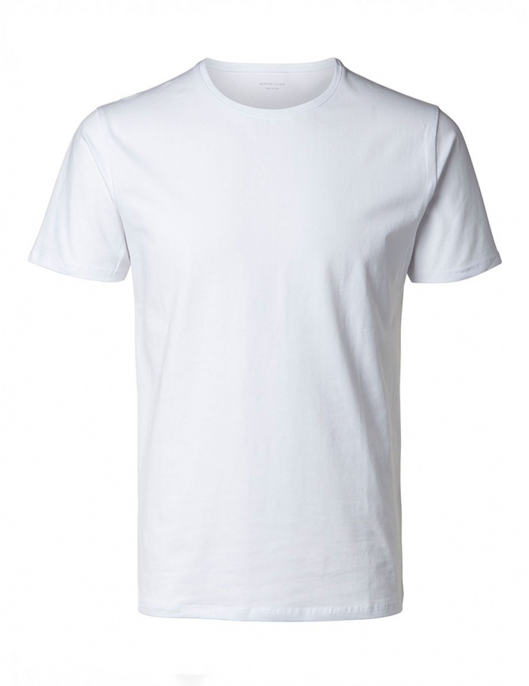
La ropa
una camisa
una camiseta

Slide 7
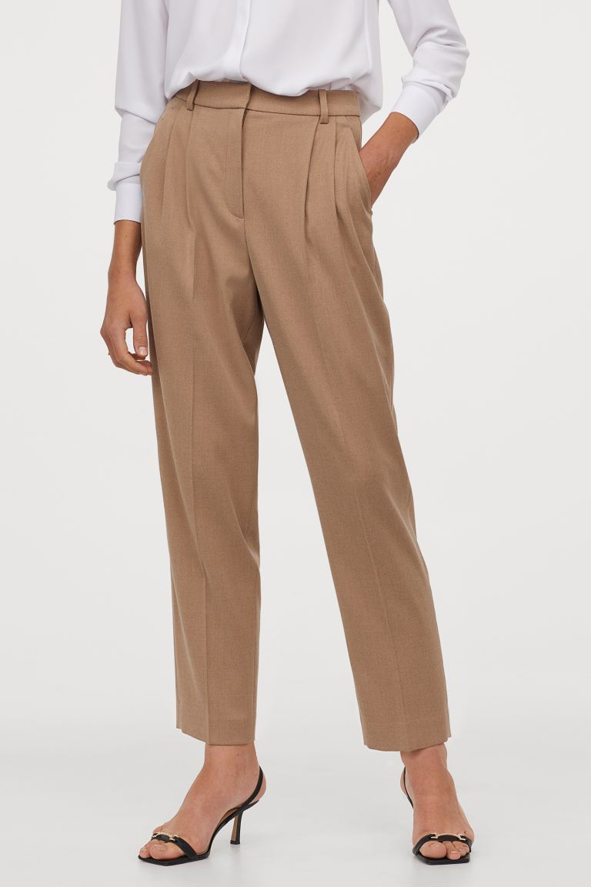
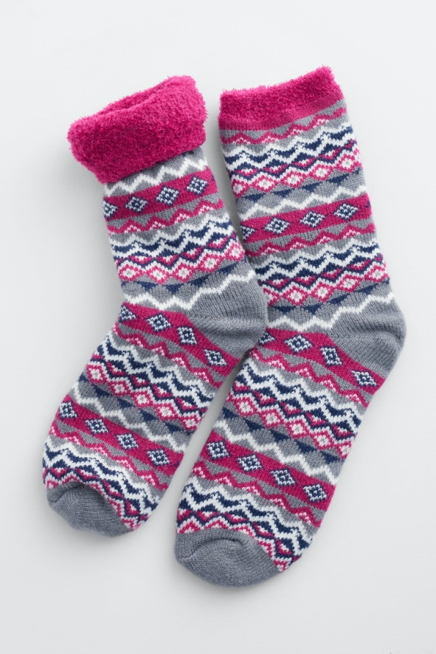
La ropa
unos pantalones
unos calcitines

Slide 8
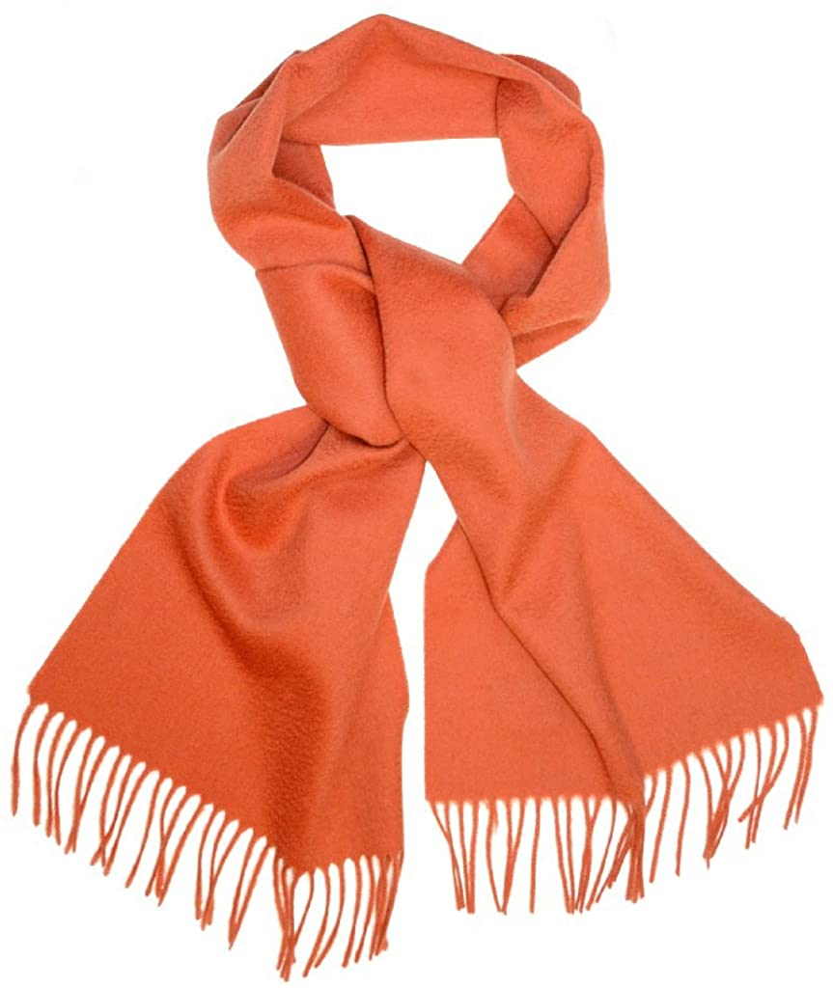
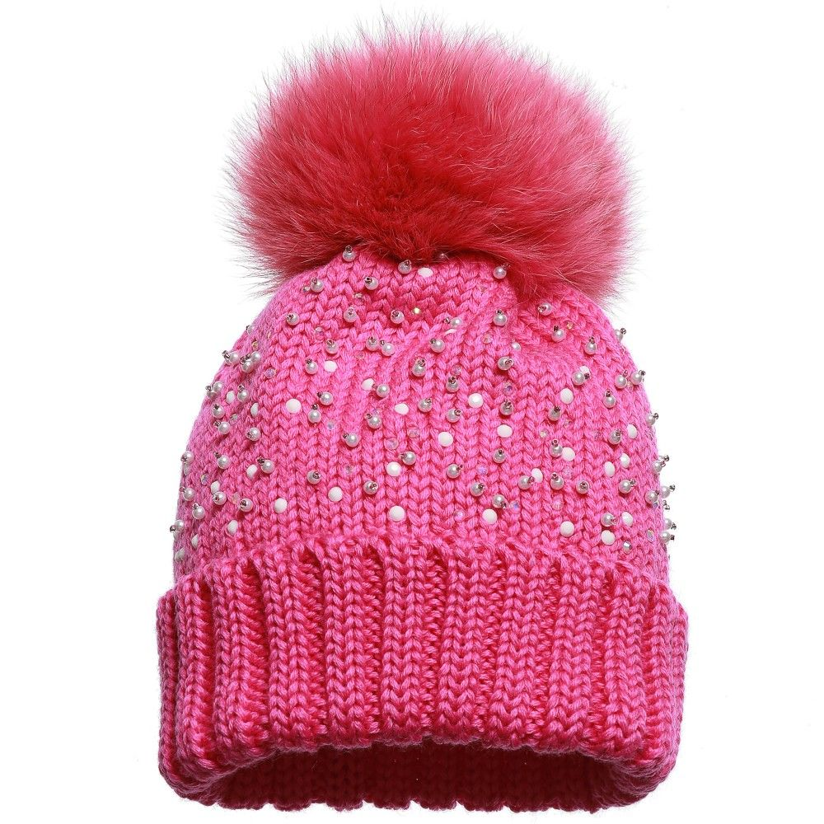
La ropa
una bufanda
un gorro de lana

Slide 9
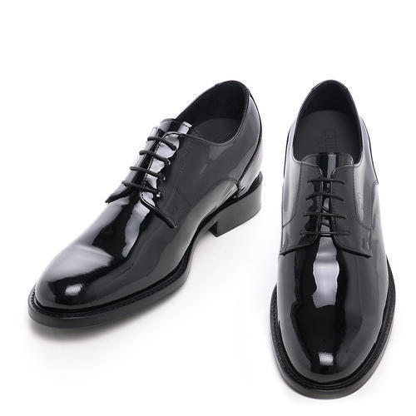
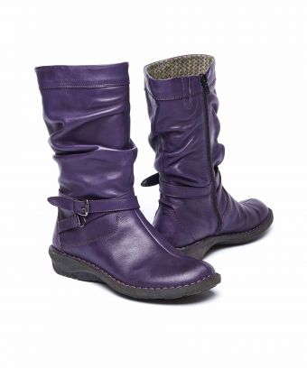
La ropa
unos zapatos
unas botas

Slide 10
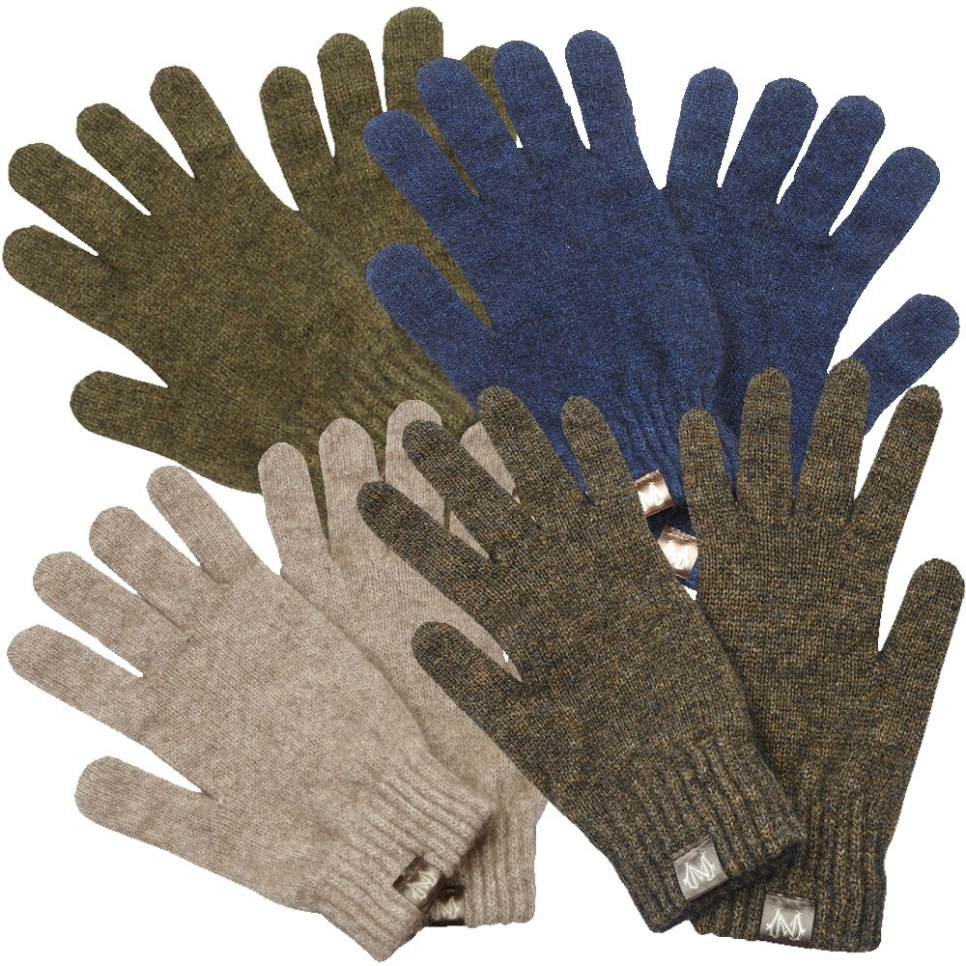
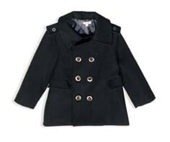
La ropa
unos guantes
un abrigo

Slide 11
La ropa
This week we are starting a new topic, starting to learn vocabulary for clothes.
We could revise colours at the same time.
¿De qué color es? What colour is it?

