Slide 1

Lesson 2

Slide 2
Lesson 2
Yesterday you made some predictions about the text.

Slide 3
Blurb
Lesson 2
Grendel is a little monster who adores chocolate. So when he is presented with the opportunity of making three wishes
– guess what he does?
In this new take on the King Midas story, a wish that everything he touches would turn to chocolate has the inevitable consequences.
Helpful Vocabulary:
Inevitable: certain to happen; unavoidable.
Consequences: a result or effect, typically one that is unwelcome or unpleasant.

Slide 4
Lesson 2
Let’s see if your predictions were right?
Here are options to enjoy the story by reading or listening to it being read by the author, David Lucas.
https://vimeo.com/169782031

Slide 5
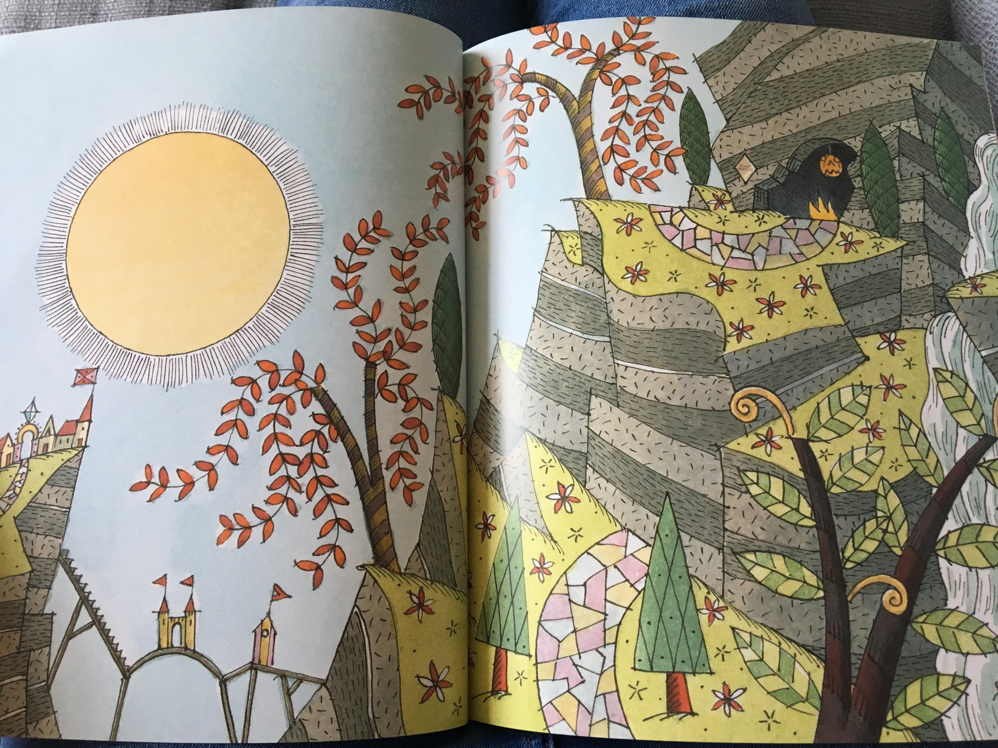

Slide 6
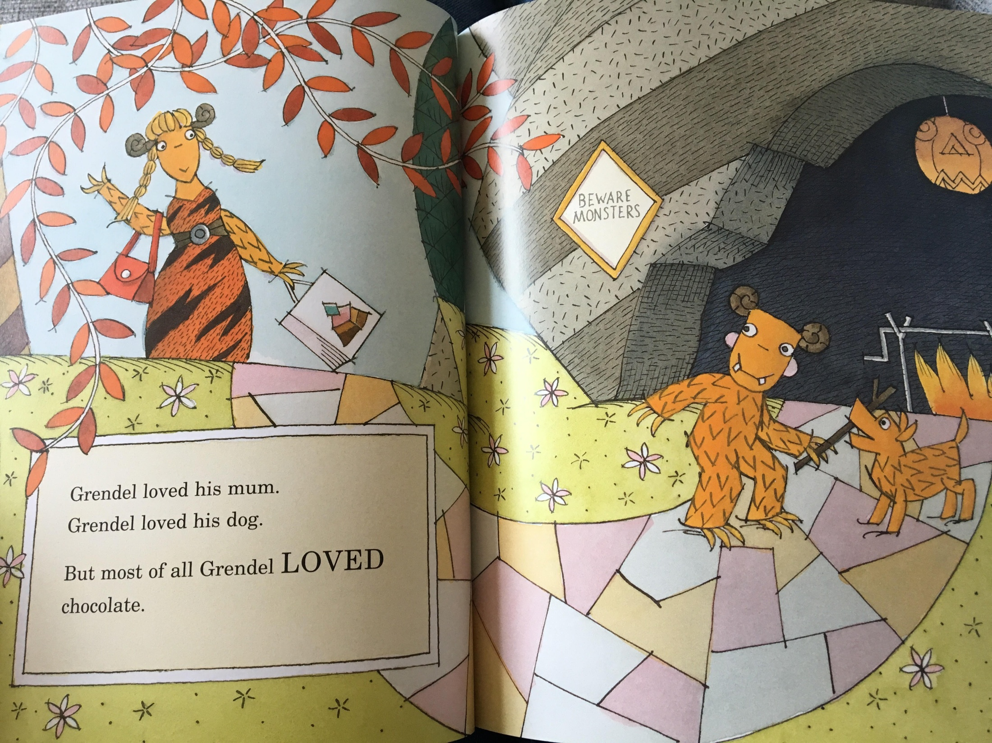

Slide 7
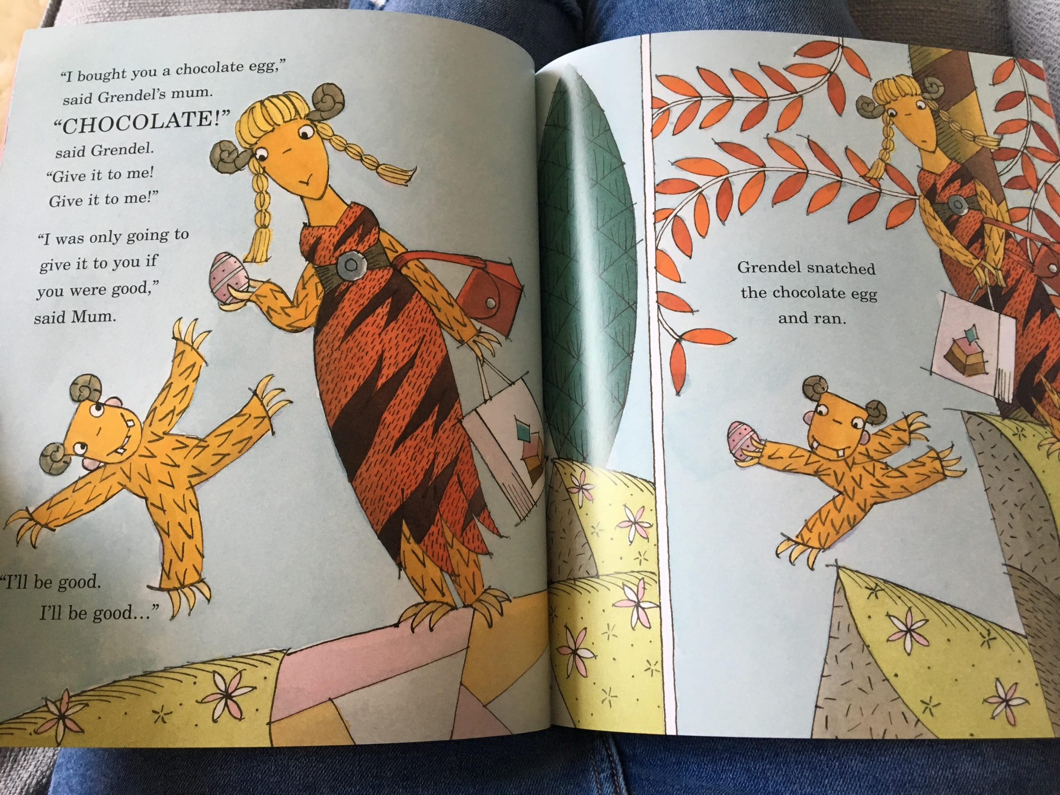

Slide 8
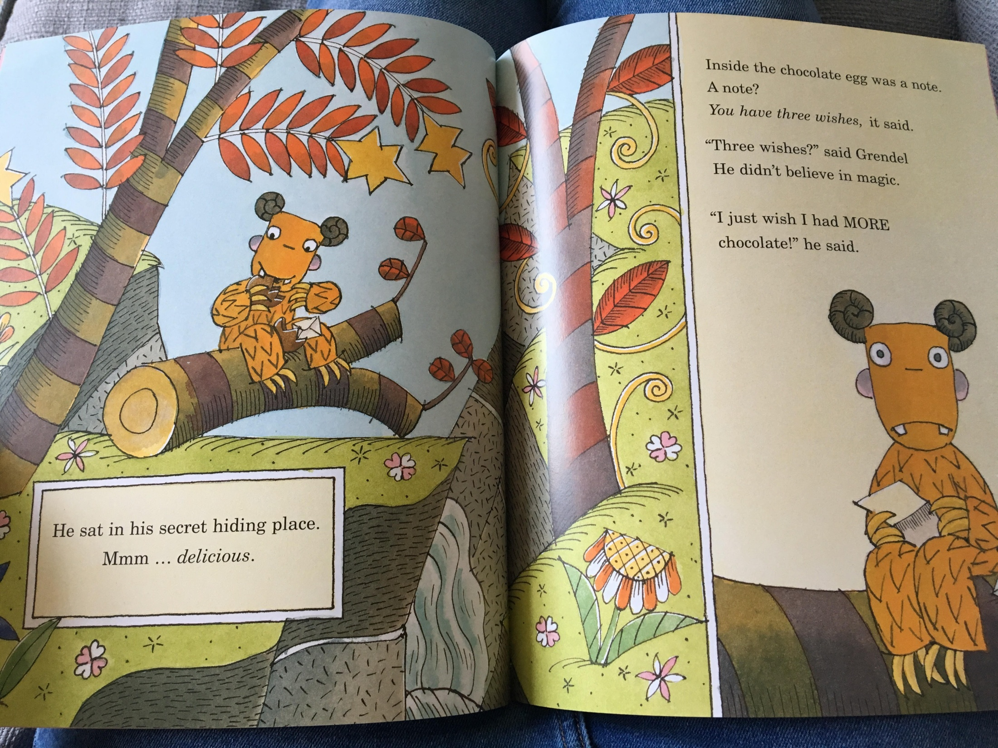

Slide 9
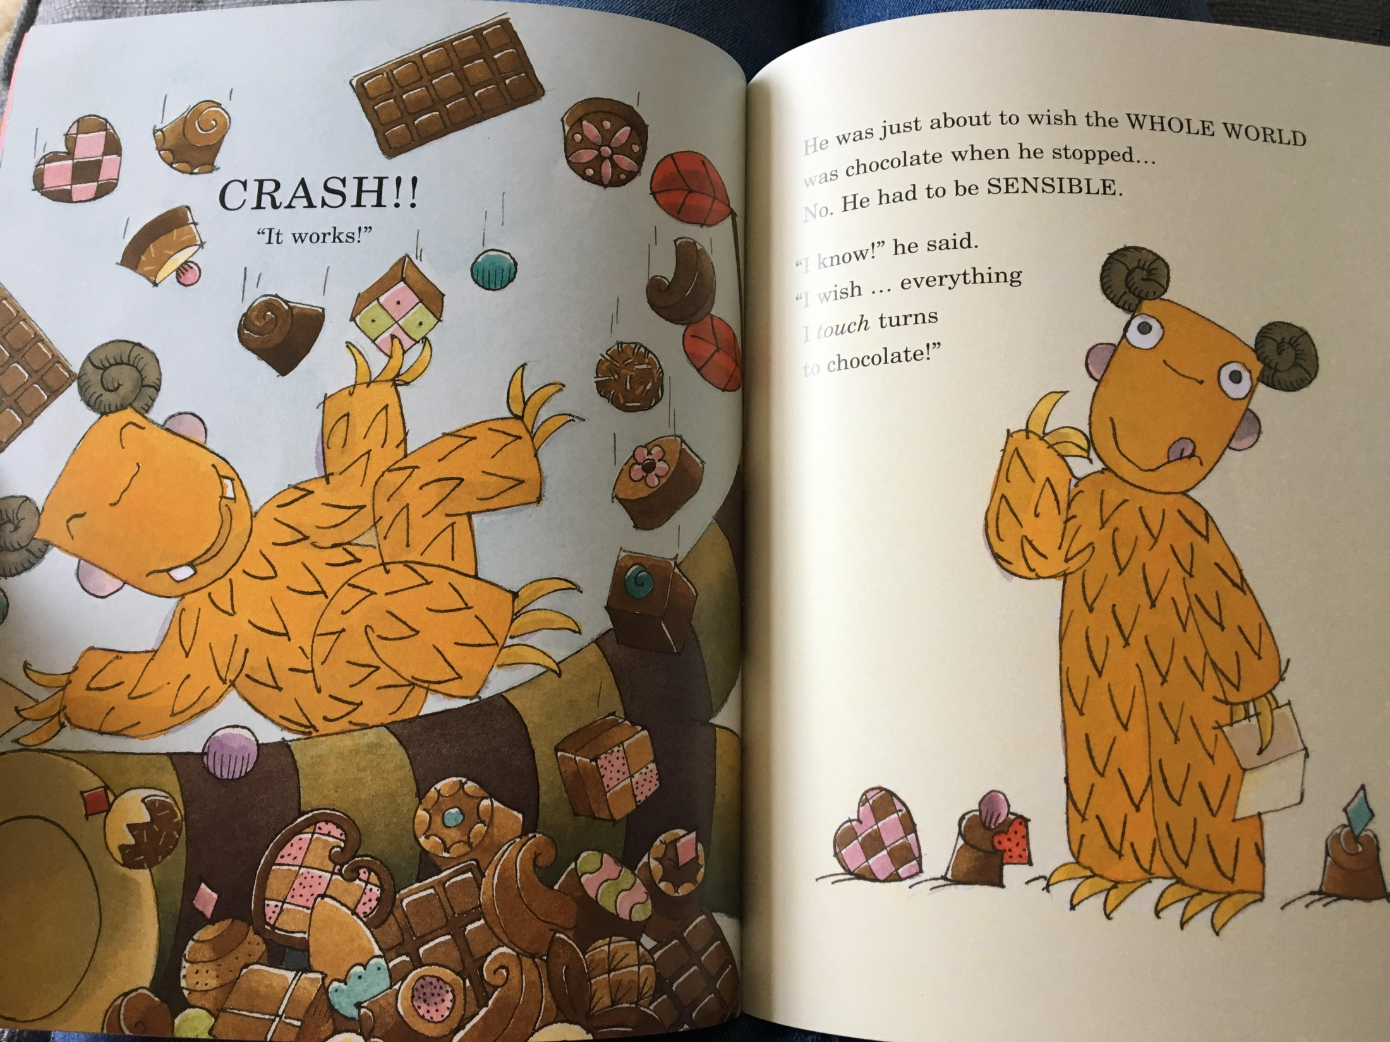

Slide 10
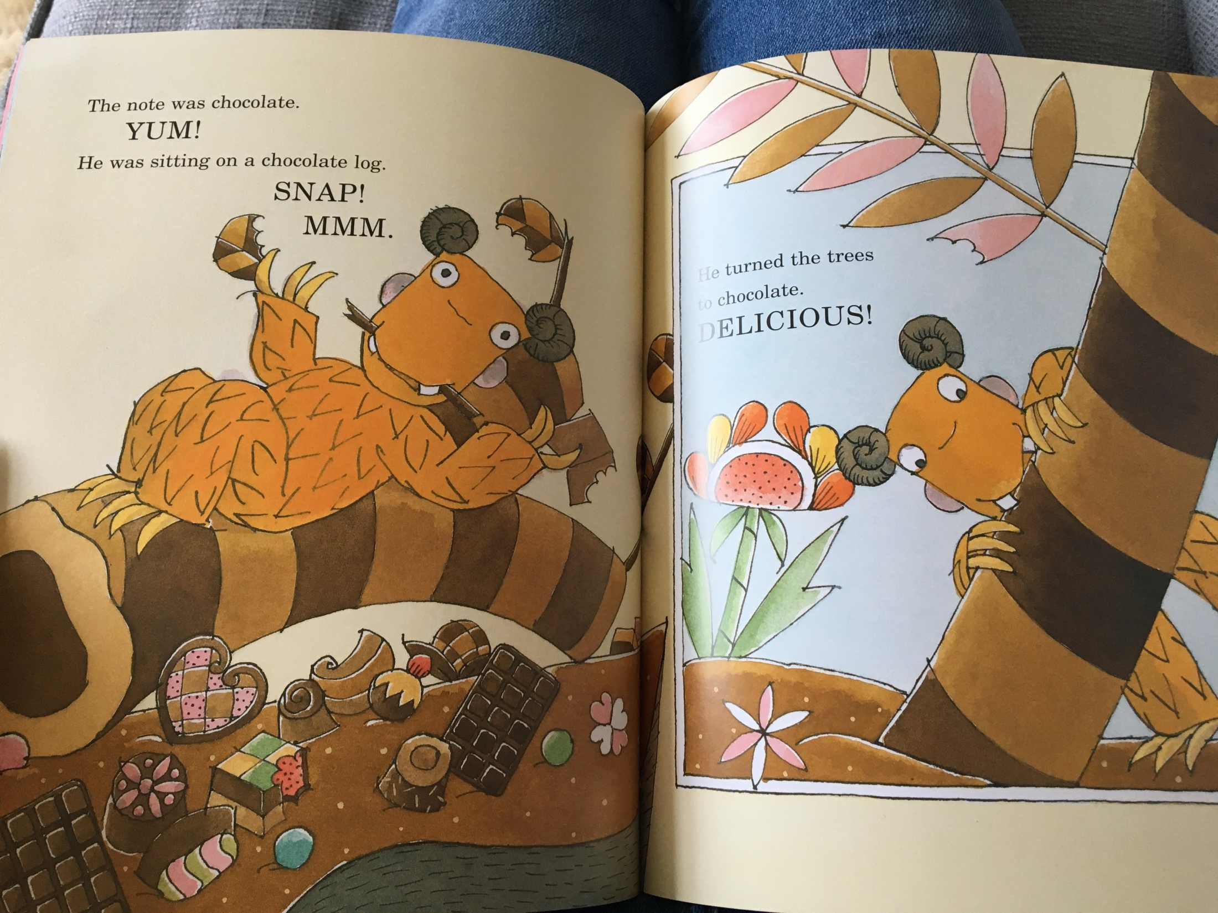

Slide 11
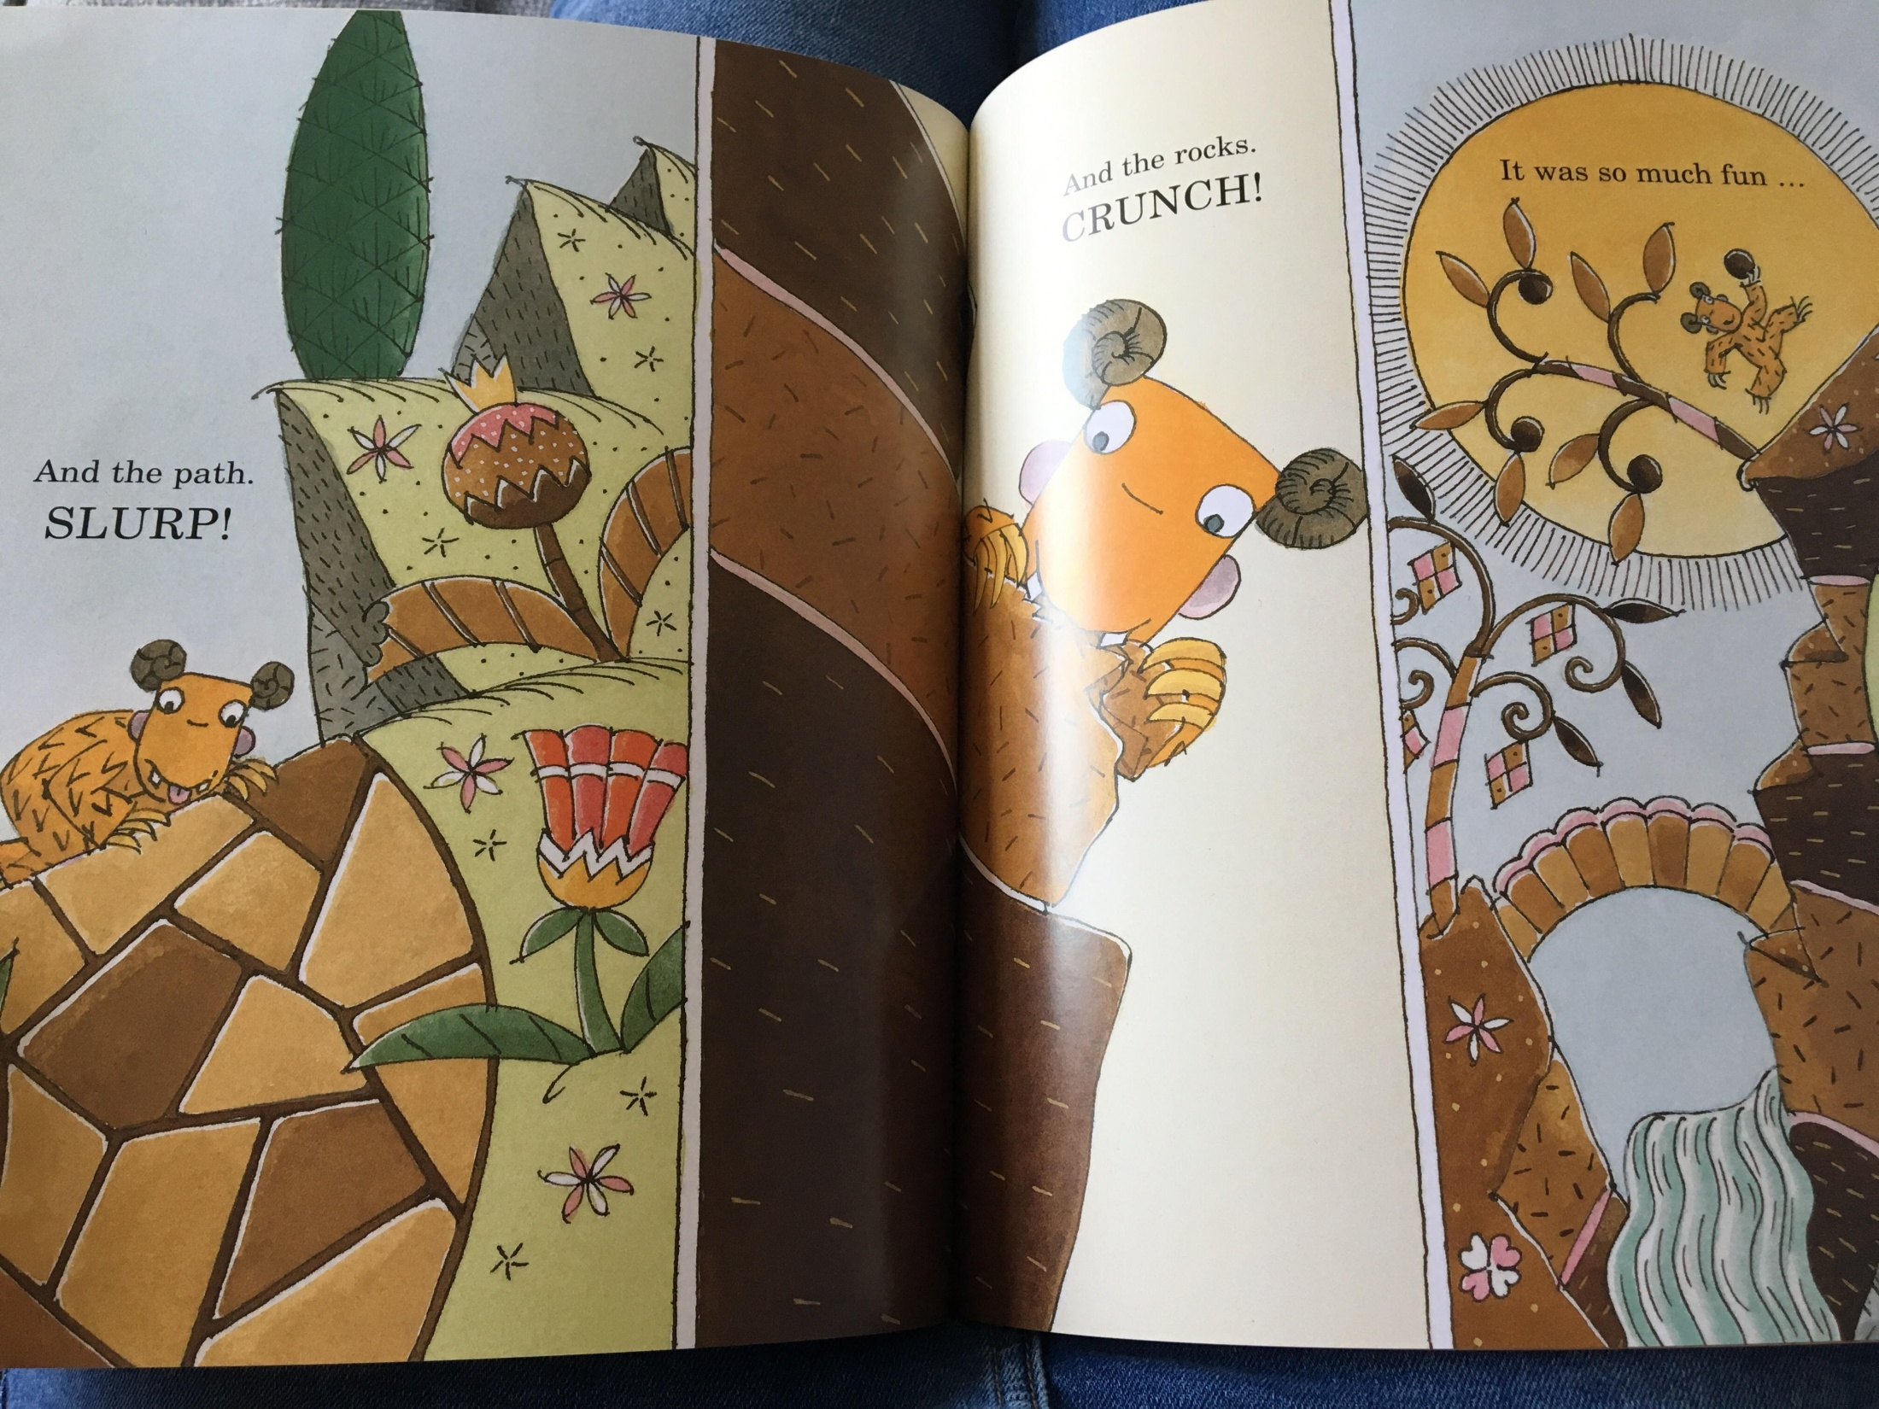

Slide 12
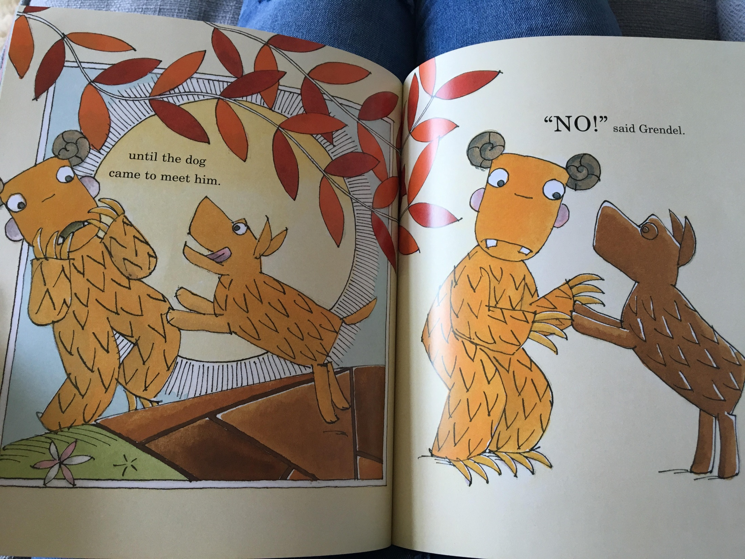

Slide 13
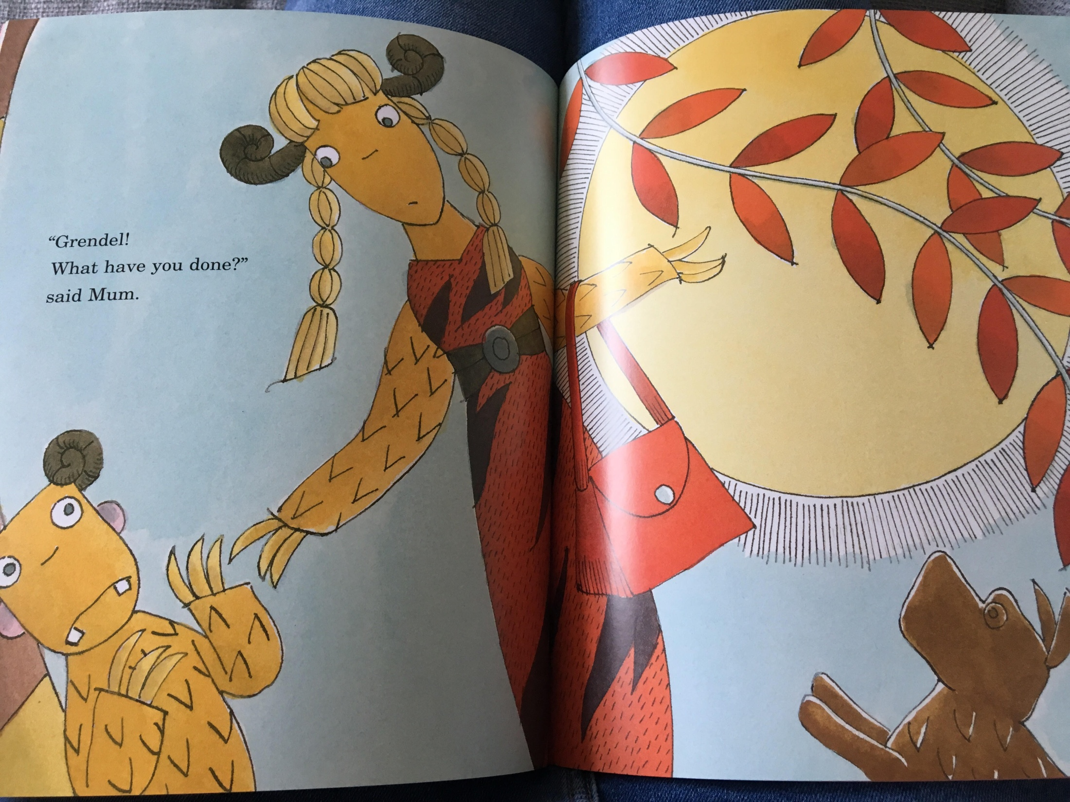

Slide 14
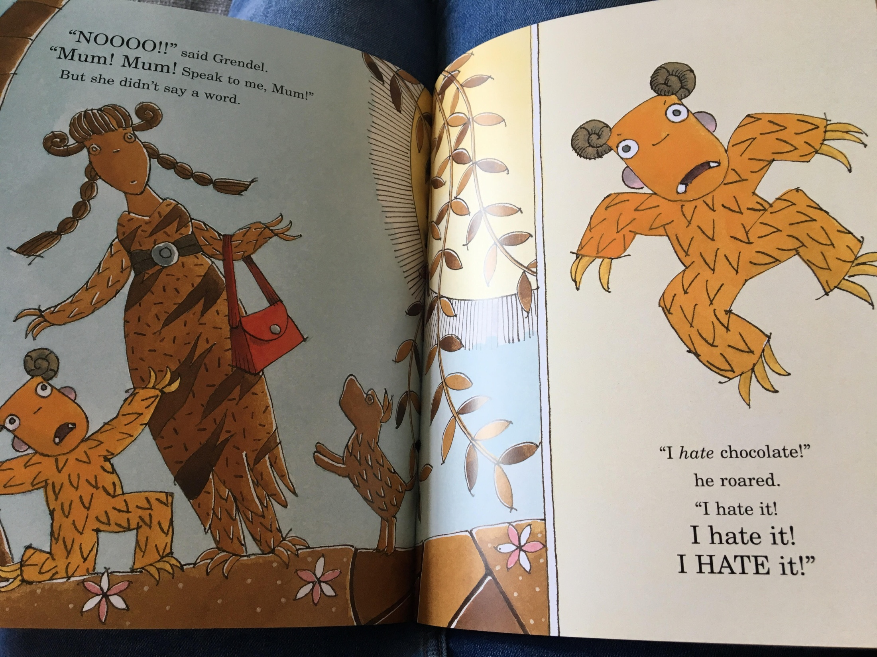

Slide 15
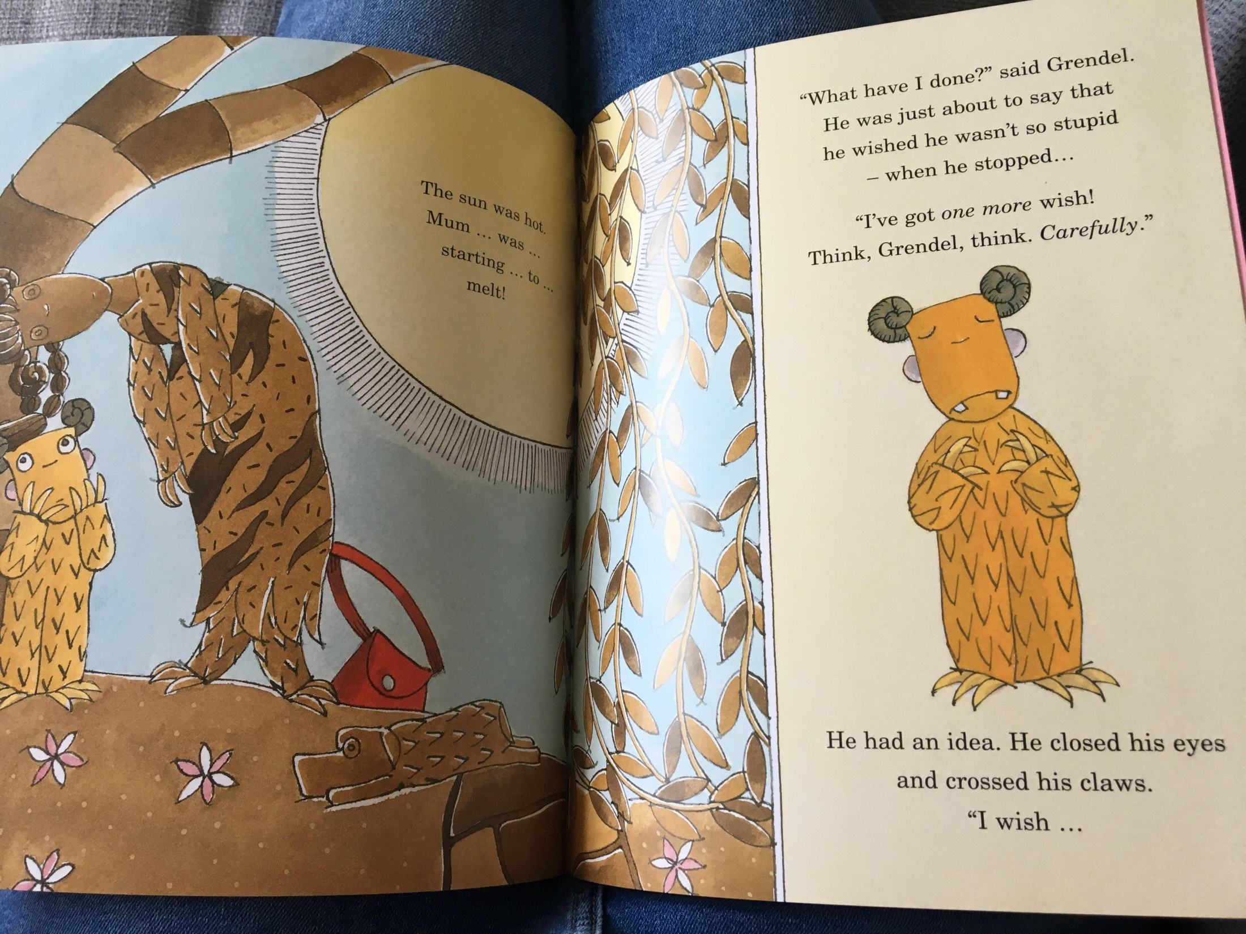

Slide 16
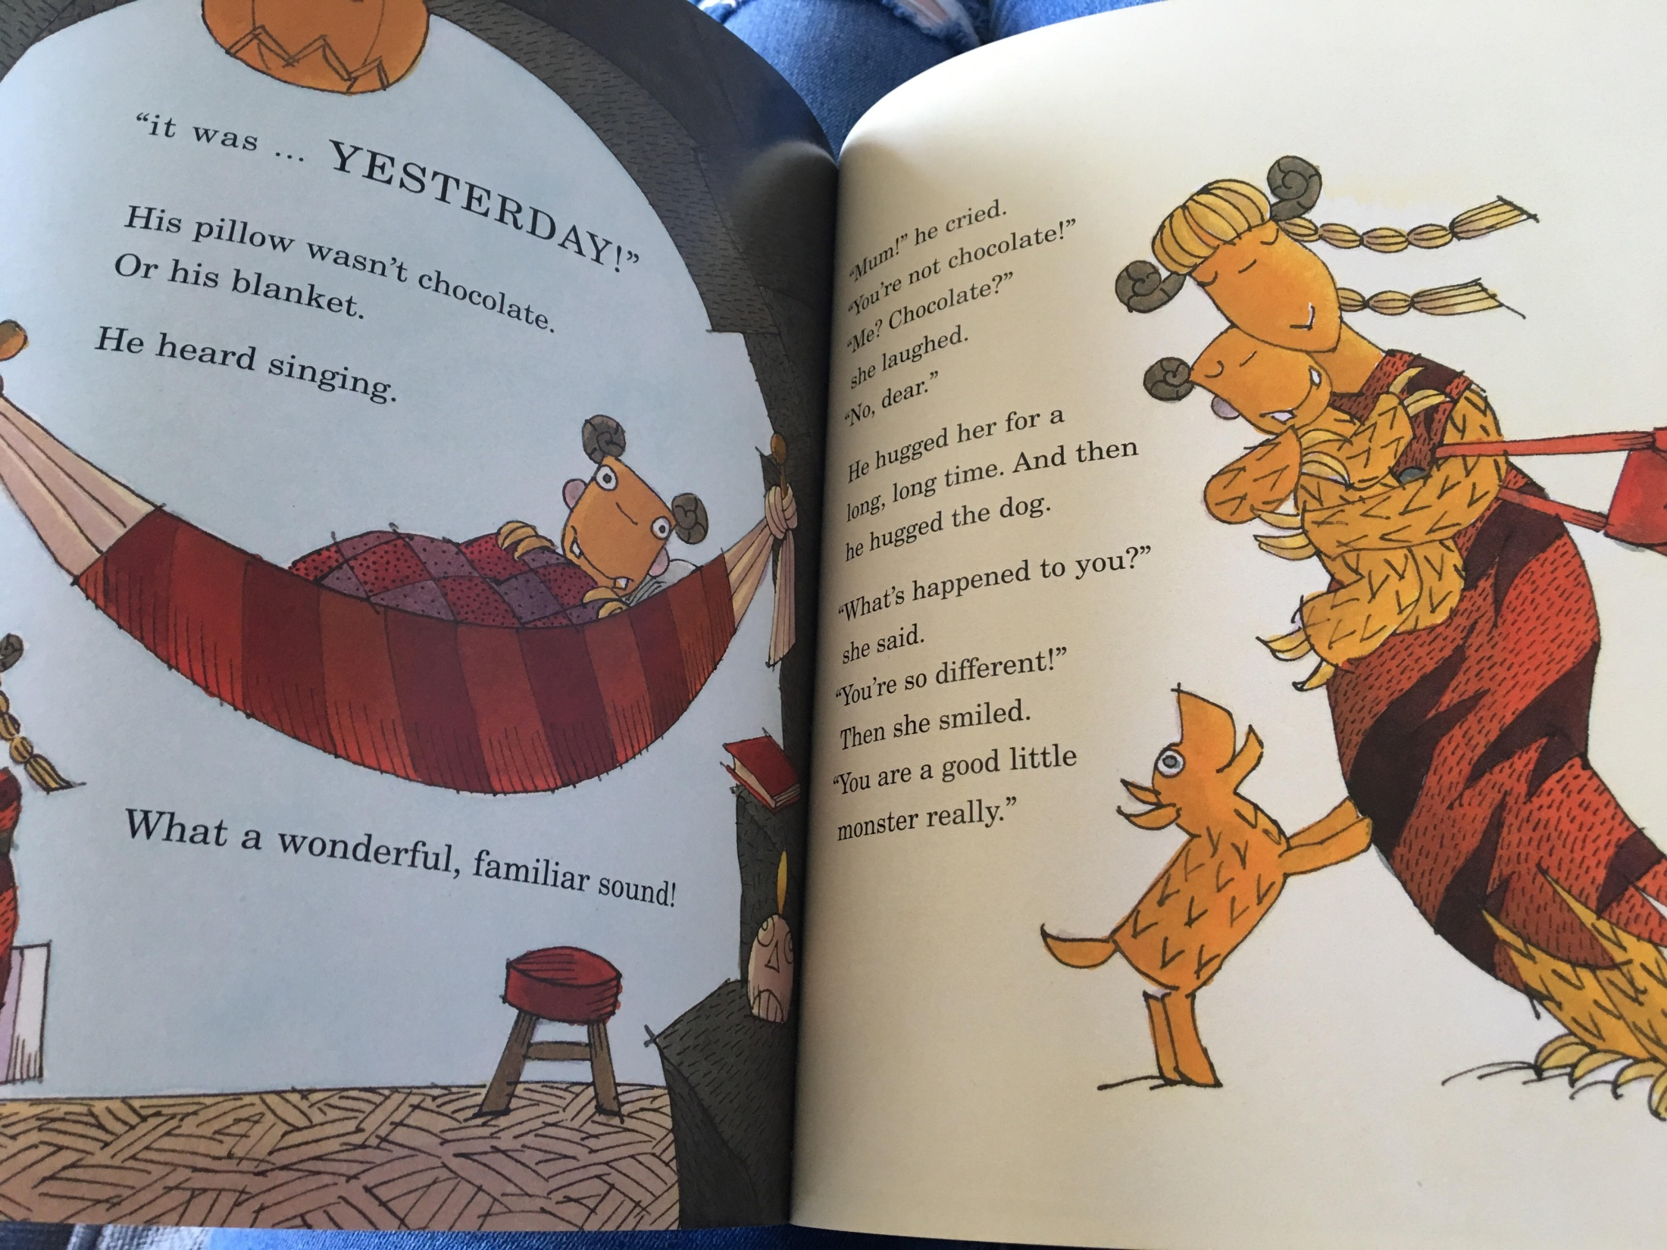

Slide 17
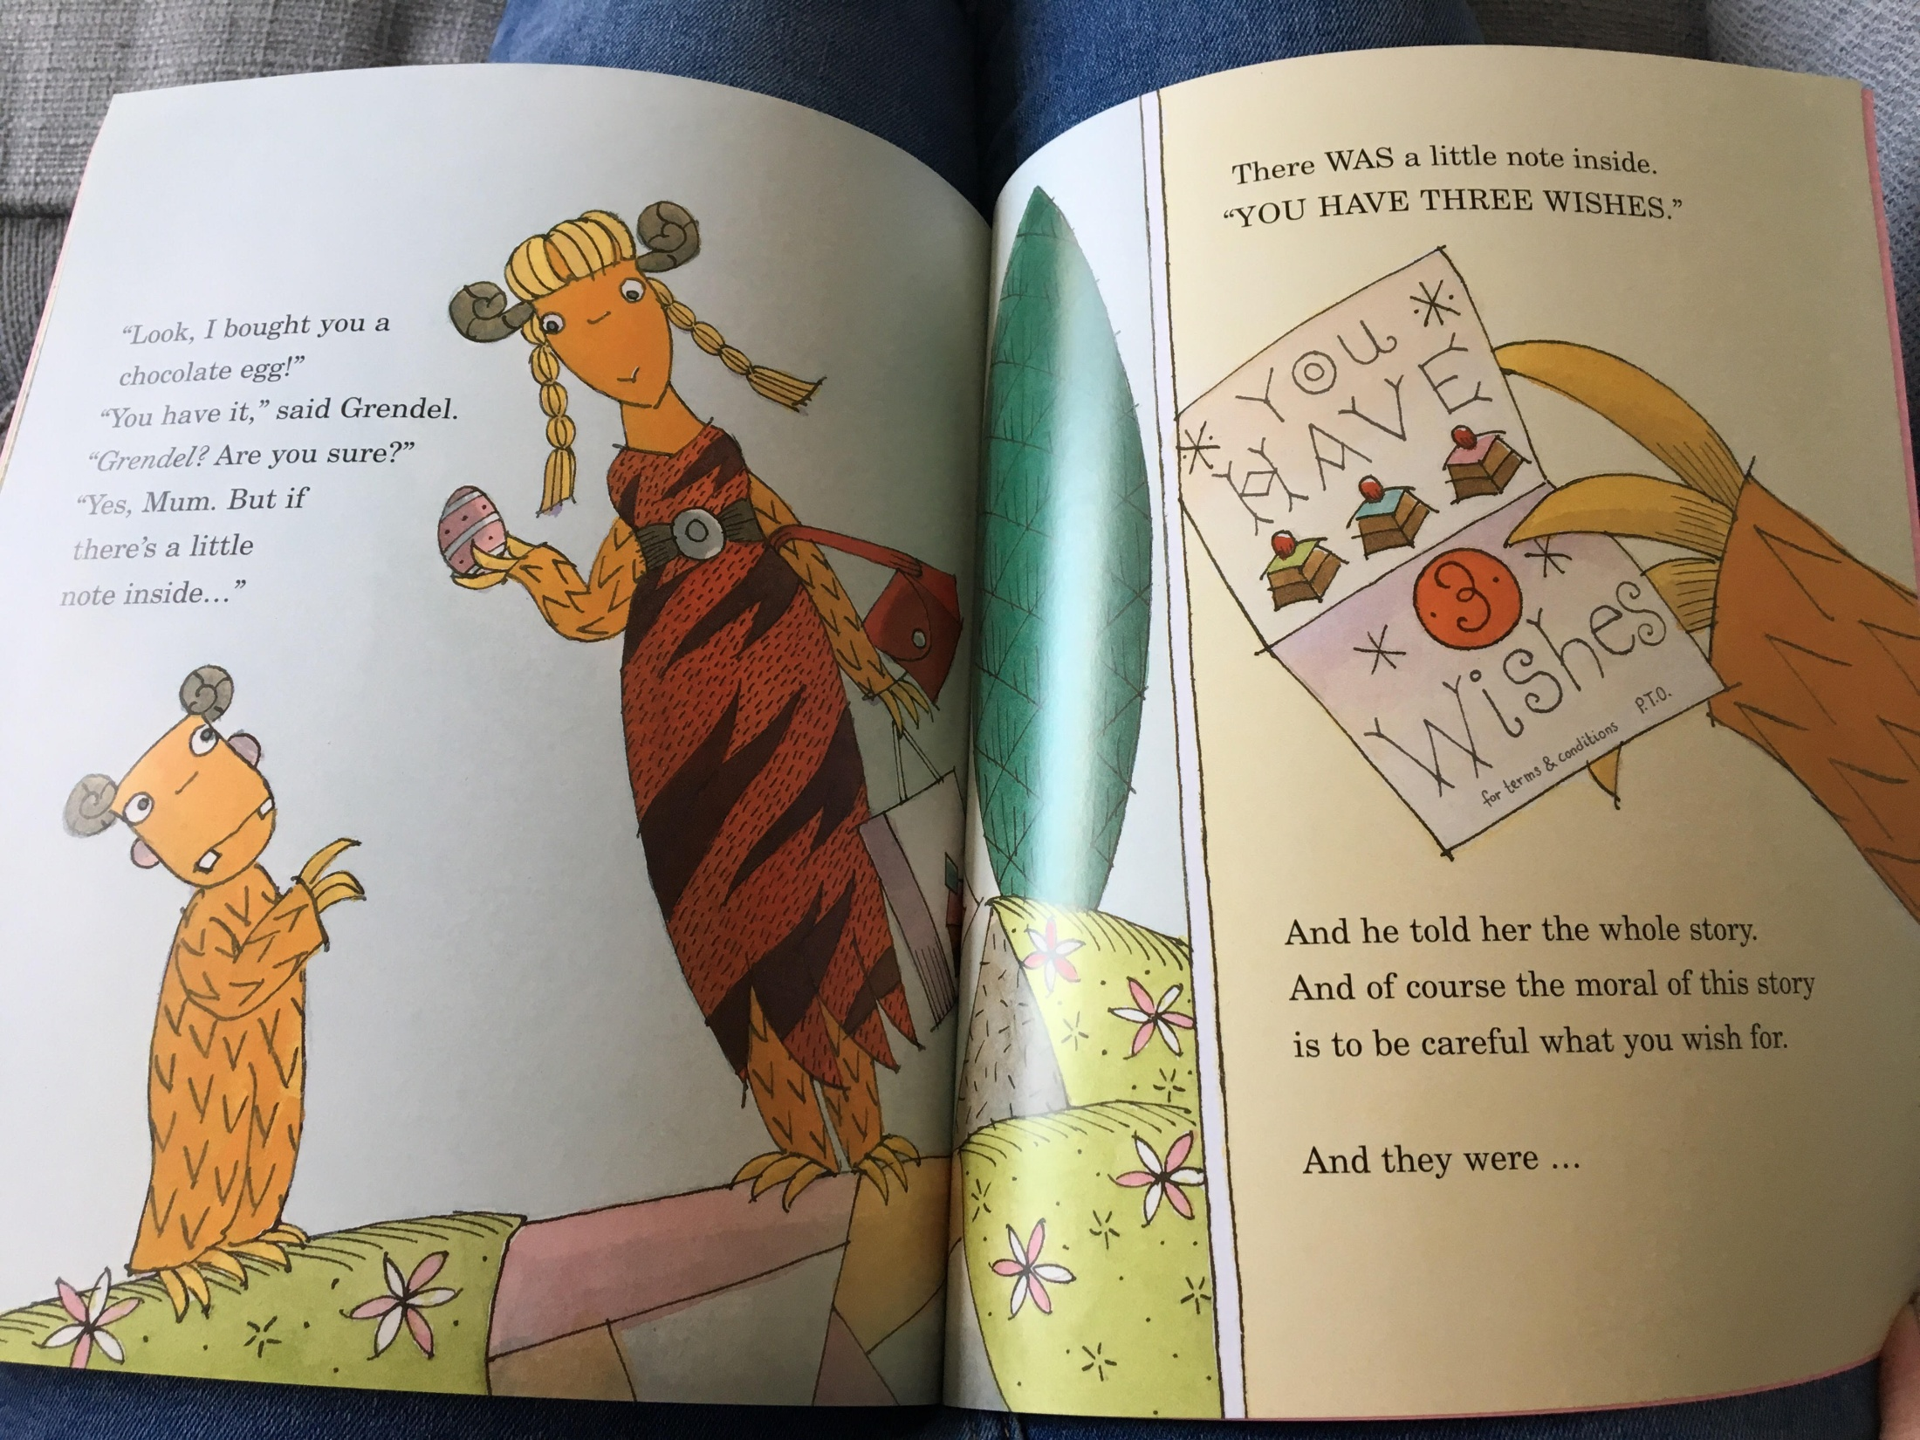

Slide 18
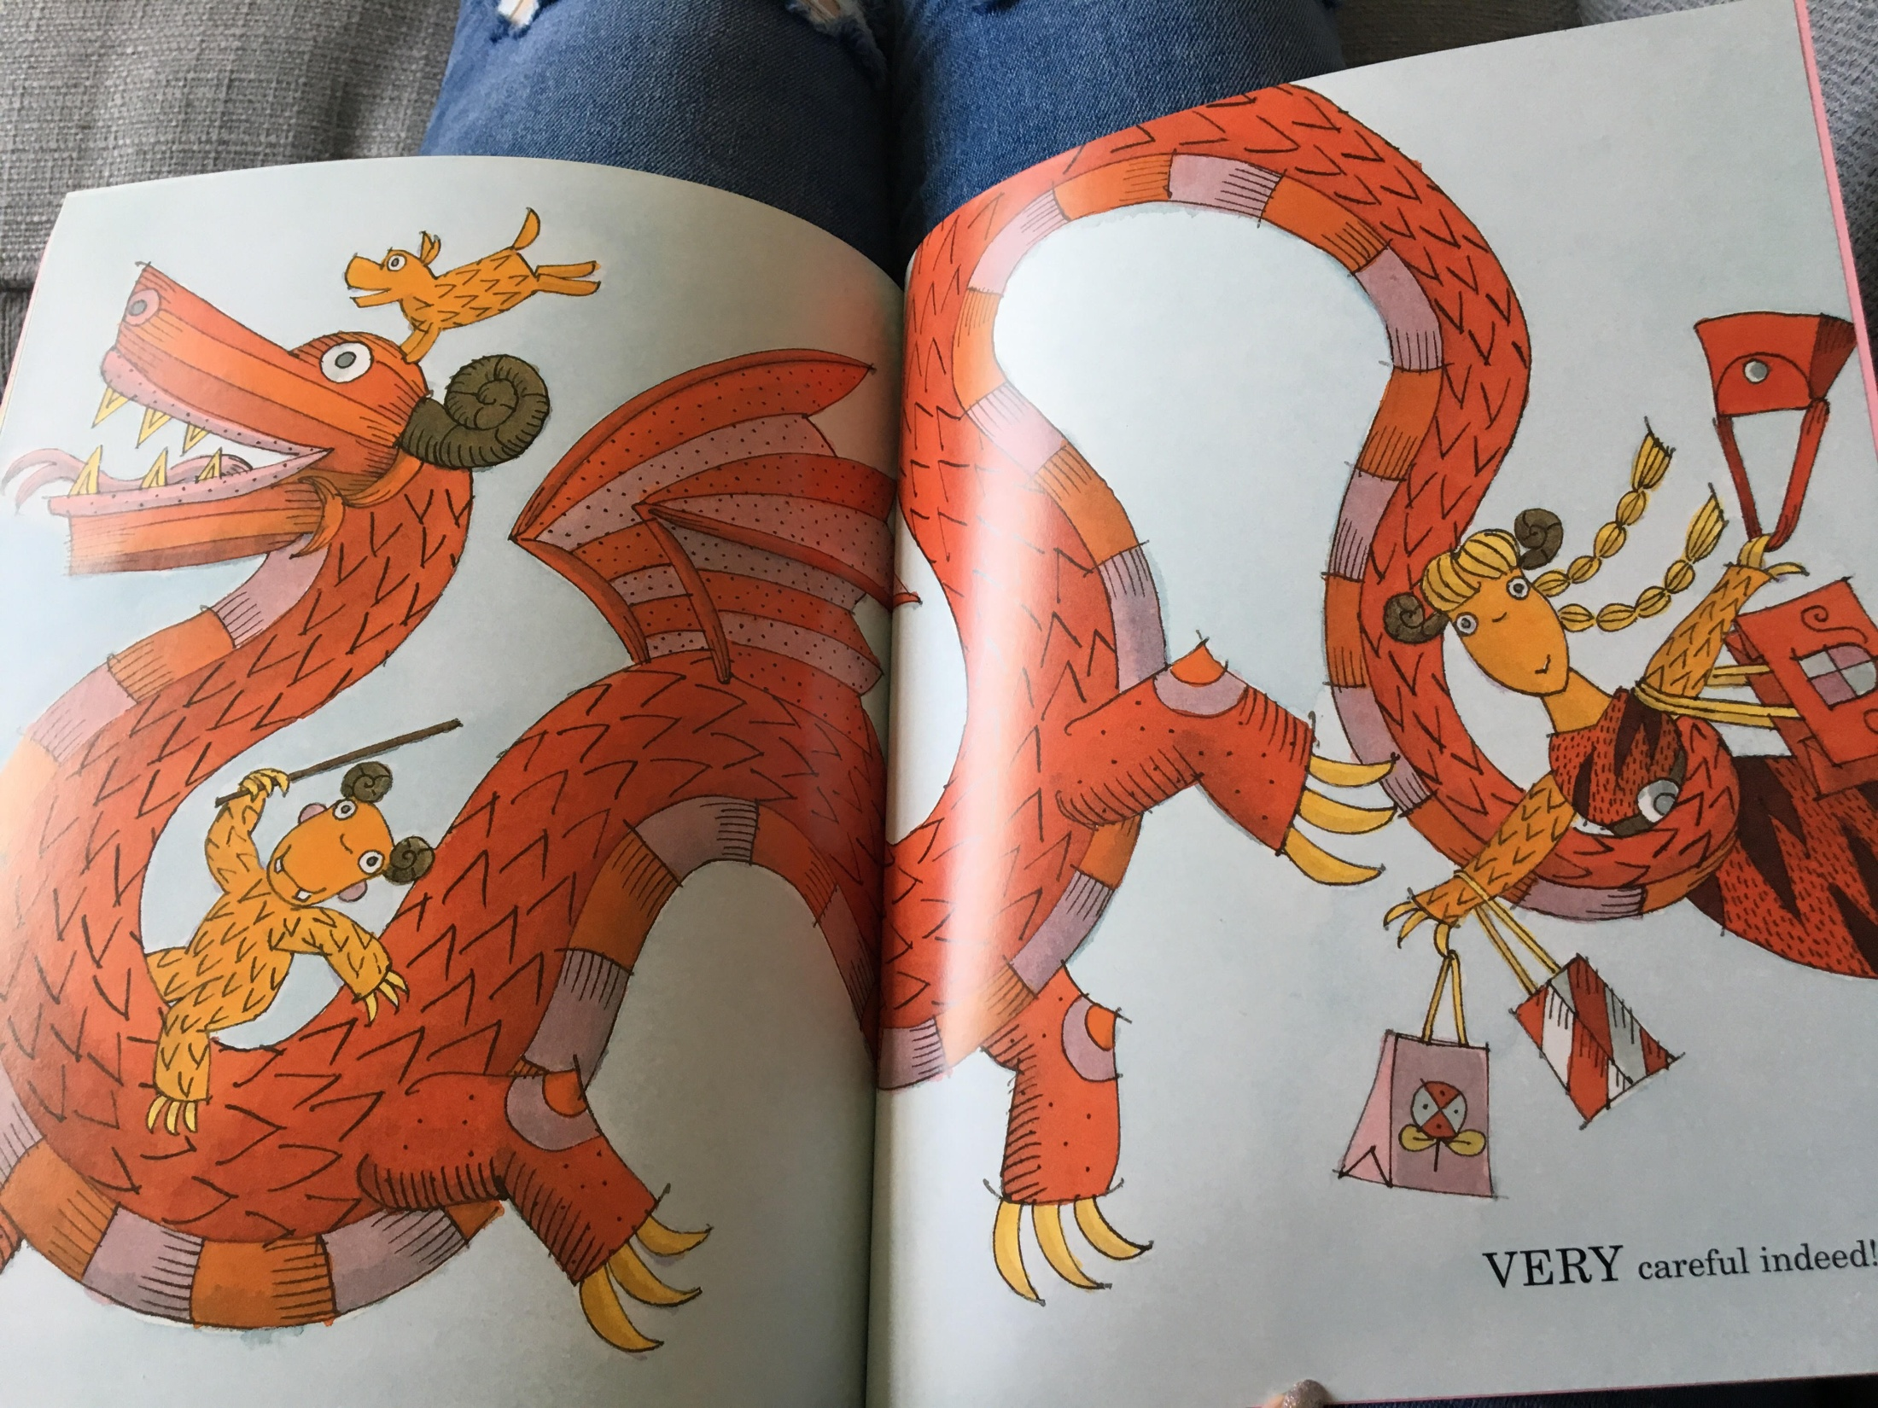

Slide 19
Lesson 2
LC Can you sequence the main events of the story of Grendel?
Task:
Re-read / re-listen to the story of Grendel, paying close attention to the order the main events in the story happen.
Can you organise the pictures of the story into the correct order in which they happened? You can use the pictures on the next slide or you will find a word doc. containing the pictures in your folder.
Check your ordering by thinking/talking through the events in each picture.
Were you correct? Adjust the pictures if you aren’t quite right!
It might be a good idea to number your pictures now.
Can you arrange your pictures, in the correct order, onto a story board or an S plan?

Slide 20
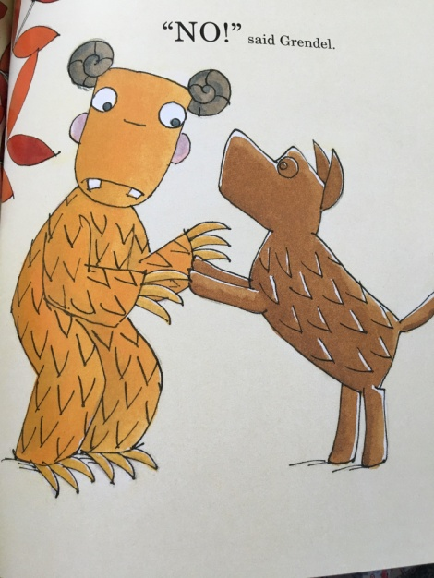
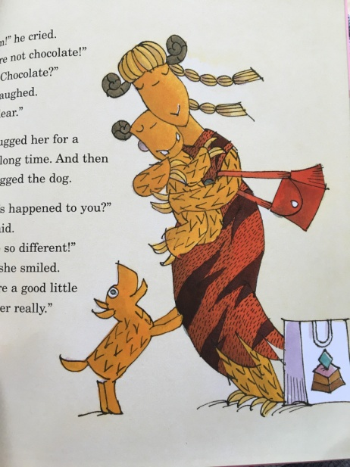
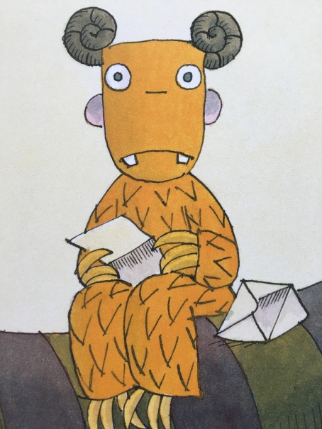
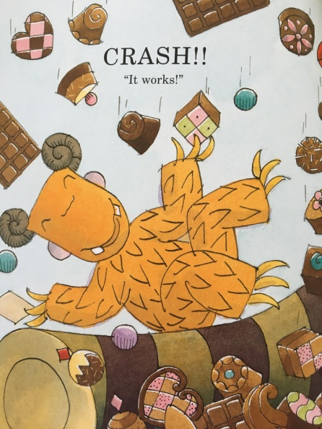
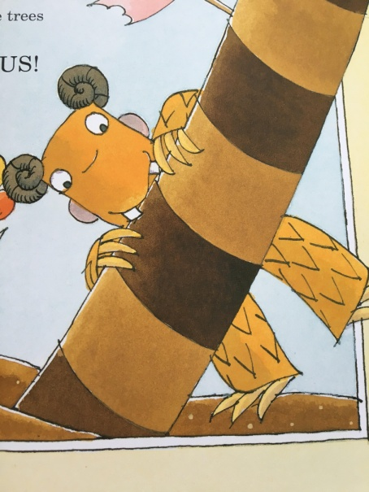
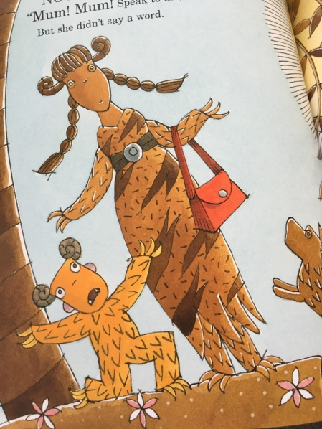
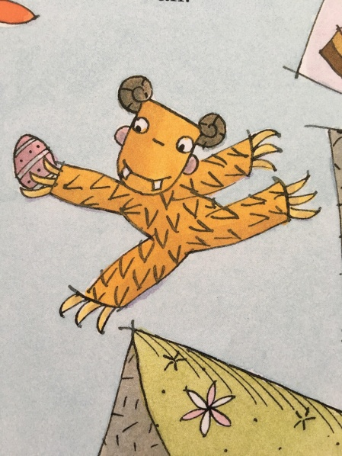
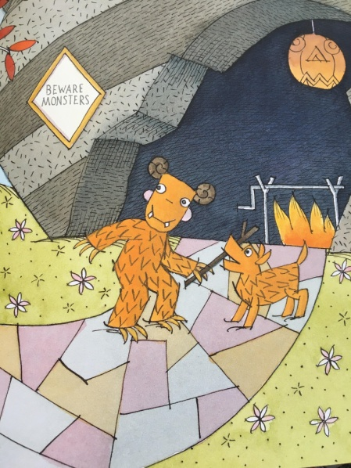
Lesson 2

Slide 21

Don’t peep at the next slide until you are ready to check your sequencing.
Lesson 2

Slide 22
Lesson 2
2
3
4
1
6
5
7
8

