Slide 1
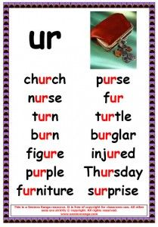
ur sound
Start today’s learning by watching this teaching video:
https://www.youtube.com/watch?v=pcNgbnrvWqo

Slide 2
Have a go at reading these ‘ur’ words.
Can you identify where the different sounds are to help you to sound out?
ur

Slide 3

fur

Slide 4
fur

Slide 5

turn

Slide 6
turn

Slide 7
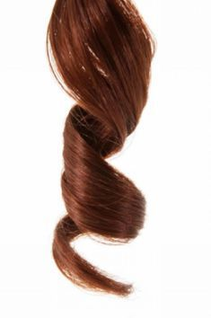
curl

Slide 8
curl

Slide 9
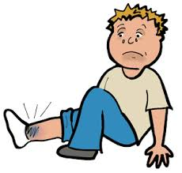
hurt

Slide 10
hurt

Slide 11

surf

Slide 12
surf

Slide 13

church

Slide 14
church

Slide 15
Now have a go at spelling these words.
Remember to really sound out each sound
Remember cursive letter formations
Think about your pencil grip
Have a try at joining the digraph ‘ur’
u
https://www.youtube.com/watch?v=2TXb8uoSXsU
r https://www.youtube.com/watch?v=knhBaLebVq4
‘ur’ https://www.youtube.com/watch?v=omqSvfy8CIE
(but include the ‘u’ entry also)

Slide 16
Can you spell this word?

Slide 17
fur

Slide 18
Can you spell this word?

Slide 19
turn

Slide 20
Can you spell this word?

Slide 21
curl

Slide 22
Can you spell this word?

Slide 23
hurt

Slide 24
Can you spell this word?

Slide 25
surf

Slide 26
Can you spell this word?

Slide 27
church

Slide 28
Extra bits..
We enjoy watching Geraldine Giraffe videos in our Phonics lessons:
https://www.youtube.com/watch?app=desktop&v=Q49YSWKPyVo
In your folder there is an ‘ur’ word search and a ‘real and nonsense’ sheet you can have a go at.
Don’t forget, the most important learning is your 5 ‘ur’ spellings and practising writing these in neat, cursive letter formations.

