Slide 1
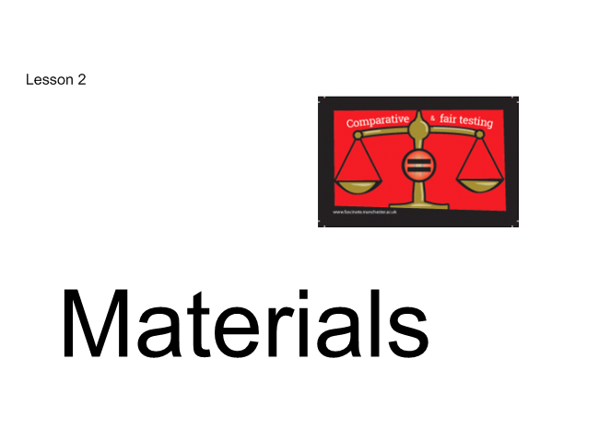

Slide 2
Last week, we began learning about Materials.
We learnt about the many different types of materials from which things can be made.
Can you name any of them?

Slide 3
Properties of Materials
Different materials have different features.
These are known as properties.
Some materials are hard or soft.
Some are dull or shiny.
Some can be rough or smooth.
And some can be waterproof or non-waterproof.

Slide 4
Properties
The properties of materials help us decide which materials to choose when we make objects.
Some materials are more suitable than others for particular uses or for manufacturing specific objects; for example, metal shoes wouldn’t be very comfortable, and a cardboard door wouldn’t be very strong!

Slide 5
Let’s have a look at some others
Think about the properties of the materials and say why they would be suitable or not.

Slide 6
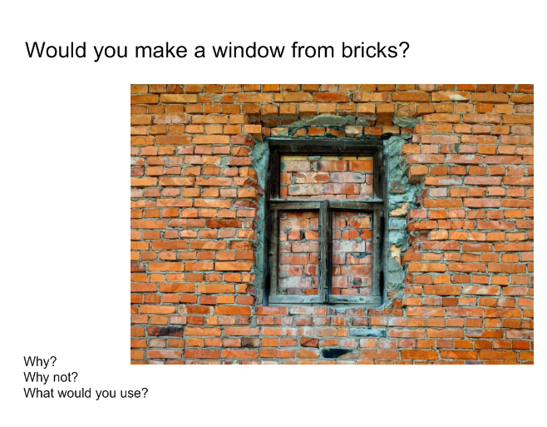

Slide 7
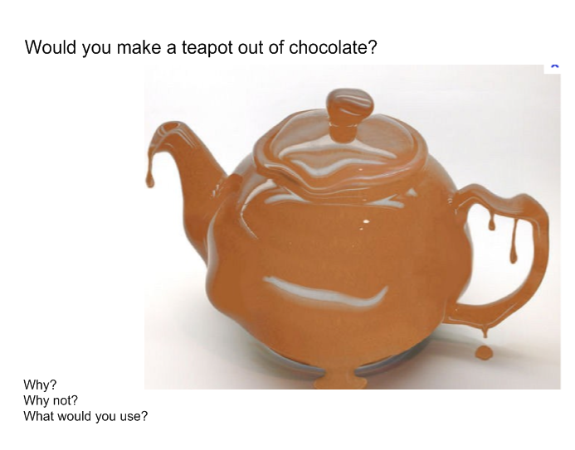

Slide 8
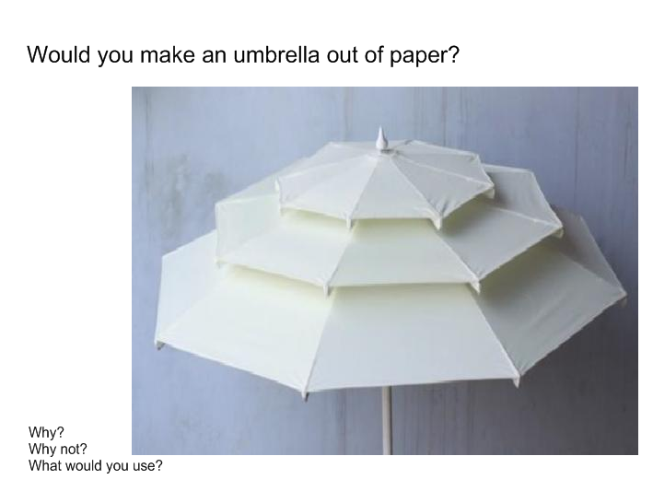

Slide 9
Good Choices?
We have been looking at which
materials are the best for certain
objects or purposes.
Which Traditional Tale explores this?
https://www.youtube.com/watch?v=CtP83CWOMwc

Slide 10
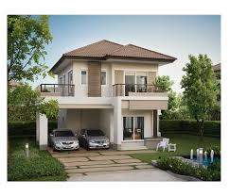
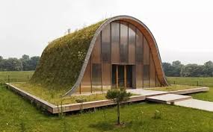
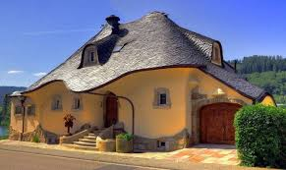
Activity: Can you design a house?
Think about which materials you would use.
Label the materials on your design.
Write some sentences explaining why you chose them.

Slide 11
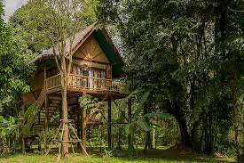
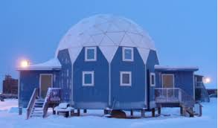
You could be creative with your design!!
Could you design a home in the rainforest?
What materials would you have available?
What about a home in the Polar Regions?

