Slide 1
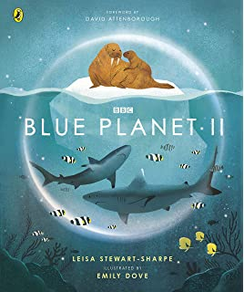
LC: Can I highlight and retrieve key information from a text?
What do you think the book might be about?​
​
What genre do you think the book is?​
​
What key information might you find in this book?​
​
​
​
​
​
​

Slide 2
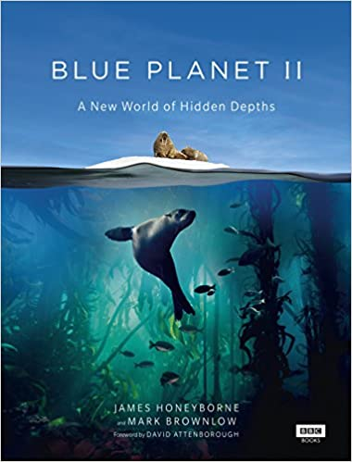
Compare these two book covers. What is the same and what is different?
Why do you think there are differences?

Slide 3
Read the blurb.
This is our Blue Planet: a beautiful blue marble suspended in a sea of stars.
Unlike billions of other worlds in the Milky Way, 71 per cent of our Blue Planet is covered by ocean. It's home to the greatest diversity of life on Earth but is our least explored habitat; we've better maps of Mars than of the ocean floor. With so much more to discover, take a deep breath . . . and dive into a wondrous world beneath the waves.
Explore coral reefs that shimmer in a kaleidoscope of colours. Venture to the bottom of the ocean where creatures beyond your wildest imagination live in the dark. Chase sea otters through kelp forest seas, and glide the open ocean with humpback whales.

Slide 4
Vocabulary
bustle - move in an energetic and busy manner
flamboyant - bright, colourful, and very noticeable
habitat - the natural home or environment of an animal, plant, or other organism
residence – a place where someone/something lives
Now read through the text.

Slide 5

Remember: For your questions today, we want you to use your highlighters to locate the answer in a text.​ Using highlighters help us pinpoint information and thinking about
what different sections of the text are about
help you to locate information quickly.

Slide 6

Questions: Me
What are coral polyps?
Where would I locate this information in the text?

Slide 7
Answers: Me
Coral polyps are tiny animals no bigger than a grain of sand.

Slide 8
Questions: You
Name two places that animals in the coral reef like to make their homes.
Where would you locate this information in the text?

Slide 9
Answers: You
Coral mounds and hideouts within the coral’s crevices.

Slide 10
Questions
Answer in your remote learning books.
How big are the coral mounds?
Where do coral polyps get their energy from?
What makes the coral reefs so colourful?
Which animals cruise higher up above the coral reef?
How much of all marine life lives in the coral reef?
Chilli Challenge (Optional)
How is hard coral made?
Why do coral reefs take millions of years to grow?
How does the algae and coral polyp work together?

Slide 11
Answers
Tall as houses
Algae
Flamboyant fish and bright corals
Sharks and manta rays
A quarter
Chilli Challenge
When the polyps absorb calcium carbonate from the water to make a skeleton.
Because the coral grow so slowly – some only grows 3mm a year and quickest only grows the width of an adult’s hand (100mm).
The algae feeds the polyp and the polyp provides a home for the algae.

