Slide 1
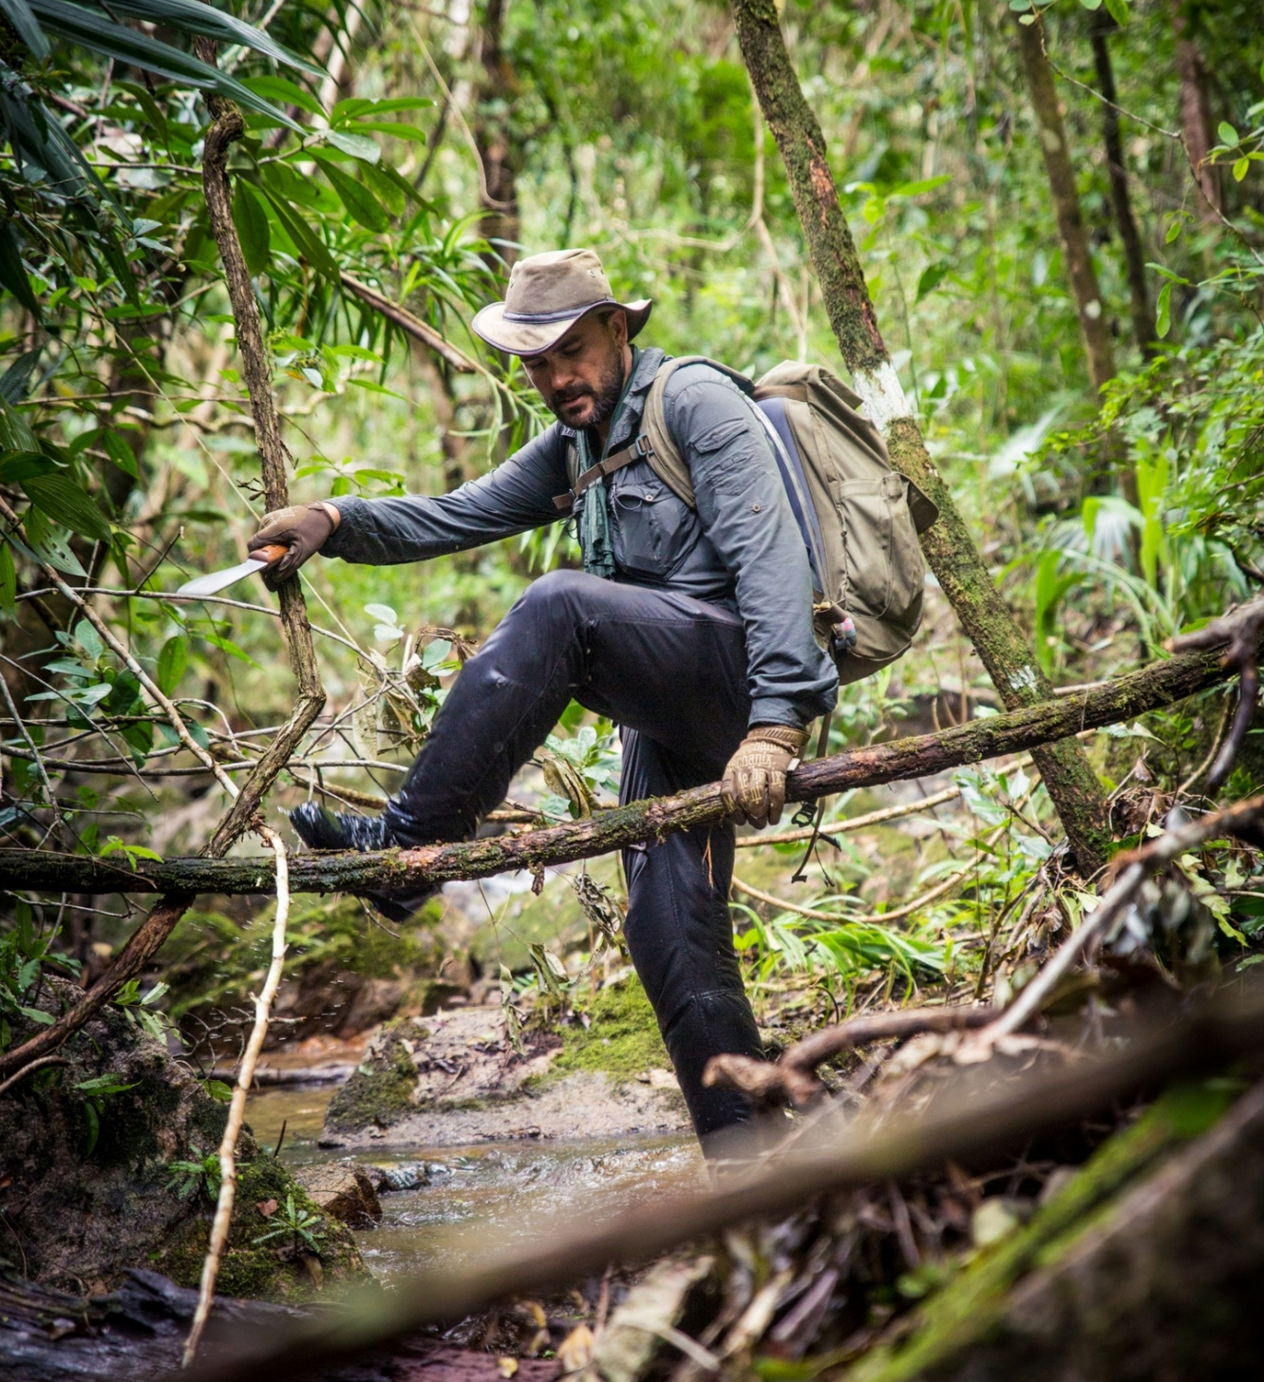
LC: Can I write an information text which gives advice about how to survive in the jungle?
Toolkit

Slide 2

Highlight all sentence openers, conjunctions and words / phrases which could be useful in your own writing today.
How formal do you think this text is? (language and sentence structure) Why?
Reread the text about the
Reread the text about scuba diving.
Highlight any sentence openers, conjunctions and words / phrases which could be useful in your own writing today.
How formal do you think this text is? (language and sentence structure) Why?
It is important that a text like this is written formally in order to give it credibility.

Slide 3
Modal verbs
Modal verbs change or affect other verbs in a sentence. They are used to show the level of possibility, indicate ability, show obligation or give permission. Modal verbs behave differently to ‘ordinary’ verbs.
The most common modal verbs are:
will
would
should
could
may
can
shall
ought to
must
Might
Why do you think that they would be good to use in this text type?

Slide 4
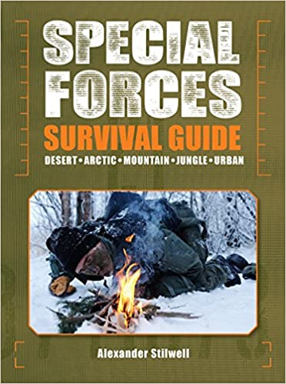
Task
Follow your plans and use the draft introduction notes you made in the last lesson to write a safety guide to trekking in a jungle. This is important as the most recent survival guide, written by A Stillwell, is more than fifteen years old and would be considered out of date in the eyes of any would-be explorer.
Once you have written your guide, reread the story to identify which areas of jungle survival you have neglected.

Slide 5
Possible Subheadings
Preparation
Trekking
Clothing
Sleeping
Animals and plants
Food and drink
Staying healthy

Slide 6
Word Bank
lightweight
rucksack
essential
hammock
waterproof
lightweight
hammock
environment
mosquito
humid
sun cream
insect repellent
sun protection
environment

Slide 7
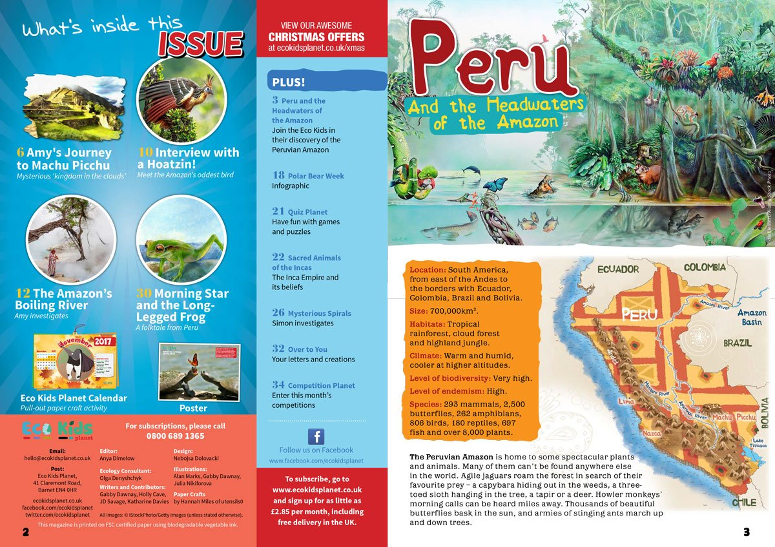
Present your leaflet
After you have drafted your information text, present it in an information leaflet. You can write it on paper or use a computer to type up your information.
Think about how you can make it appealing to the reader.

