Slide 1
LC: Can you find and make number bonds?
Lesson 4

Slide 3

1) How many?
2) These are number bonds for
3) If then
4) What number is this? thirteen
5 + 2 = ?
3 + 4 = ?
5 + 2 = 7
15 + 2 = ?

Slide 4
1) How many?
2) These are number bonds for
3) If then
4) What number is this? thirteen
8 + 2 = 10
7
5 + 2 = ?
3 + 4 = ?
5 + 2 = 7
15 + 2 = ?
17
13

Slide 6
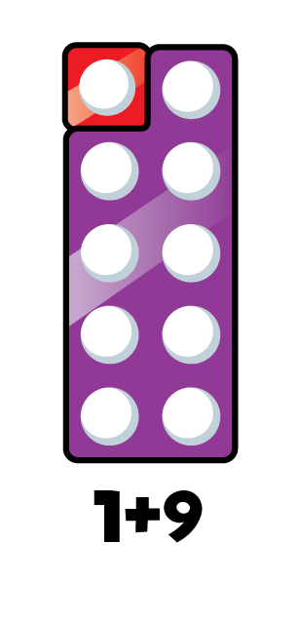

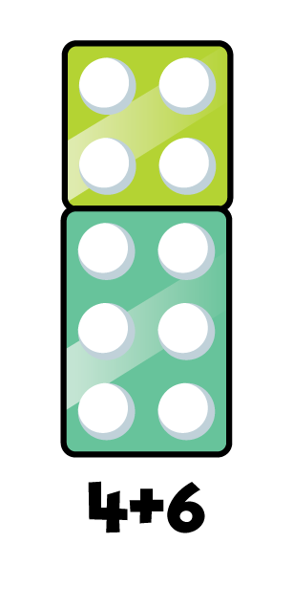
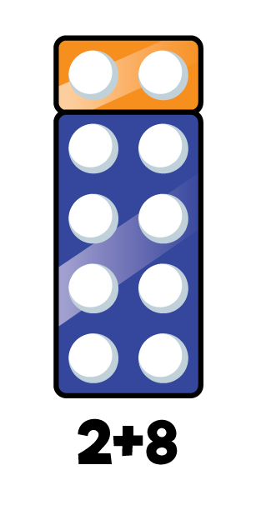

Number bonds to 10
1 + 9 = 10
2 + 8 = 10
3 + 7 = 10
4 + 6 = 10
5 + 5 = 10

Slide 7



If
8 + 2 = 10
Then
18 + 2 = 20
8 + 12 = 20

Slide 8



If
Have a think
3 + 7 = 10
Then
13 + 7 = 20
3 + 17 = 20

Slide 9
Have a go at questions 1 and 2 on the worksheet

Slide 10



6 + 4 = 10
10
10
6
4
6
4

Slide 11

6 + 4 = 10
Have a think
16 + 4 = 20
20
20
10
6
4
20
10
6
4
16
4

Slide 12
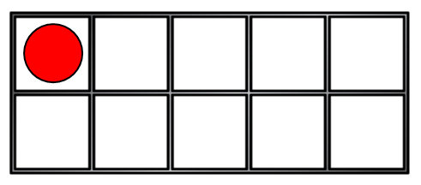

1 + 9 = 10
Have a think
11 + 9 = 20
20
20
10
1
9
10
9
20
1
11
9

Slide 13
Have a go at question 3 on the worksheet

Slide 14

I am going to practise my number bonds to 20 by using my number bonds to 10!
1 + 9 = 10
2 + 8 = 10
3 + 7 = 10
4 + 6 = 10
5 + 5 = 10

Slide 15
Have a go at question 4 on the worksheet

