Slide 1


Slide 3
1) How many counters?
2) How many counters?
3) Which representations show 6?

Slide 4
1) How many counters?
2) How many counters?
3) Which representations show 6?
5
10

Slide 6
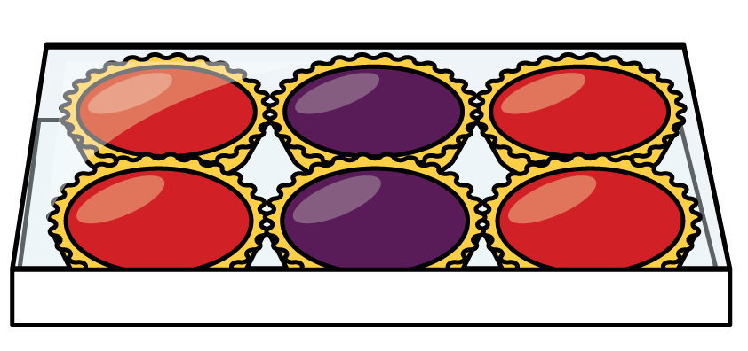
How many tarts?
3
3
2 2 2

Slide 7
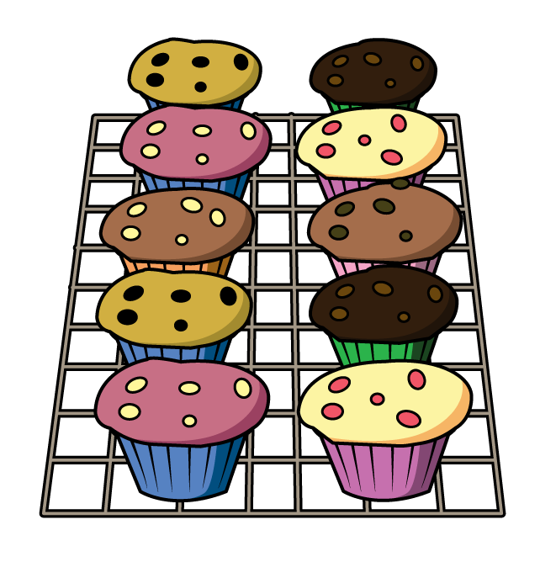
How many cakes?
2
2
2
2
2
5 5

Slide 8

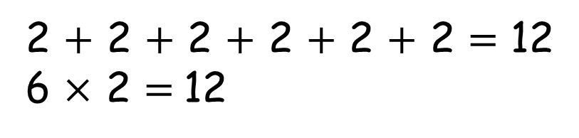
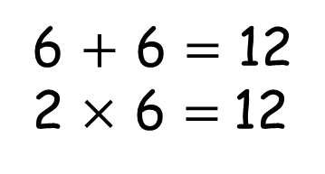
What is an array?
6 columns
2 rows
6 $+$ 6 $=$ 12
2 $×$ 6 $=$12
2 $+$ 2 $+$ 2 $+$ 2 $+$ 2 $+$ 2 $=$ 12
6 $×$ 2 $=$12

Slide 9


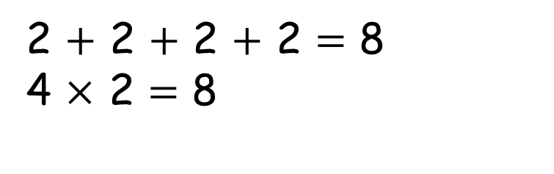
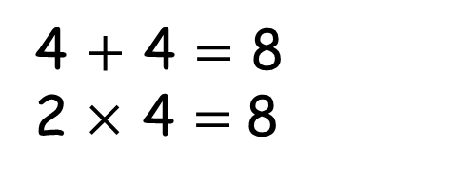
Have a think
4 $+$ 4 $=$ 8
2 $×$ 4 $=$8
2 $+$ 2 $+$ 2 $+$ 2 $=$ 8
4 $×$ 2 $=$ 8

Slide 10

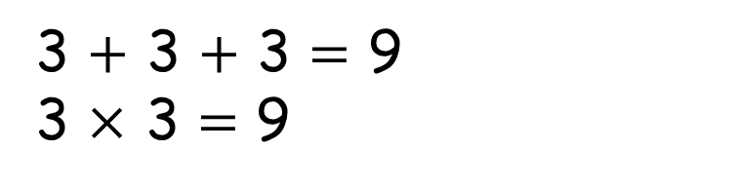
Have a think
You can’t make an array because 9 is an odd number
3 $+$ 3 $+$ 3 $=$ 9
3 $×$ 3 $=\text{9}$

Slide 11
Activity:
Can you write the repeated additions and multiplications for each image.
(Rows and columns)

