Slide 1
https://www.youtube.com/watch?v=FJXT9a17YbQ&feature=youtu.be
Close your eyes as you listen to the noises of the jungle.
How does it make you feel?

Slide 2
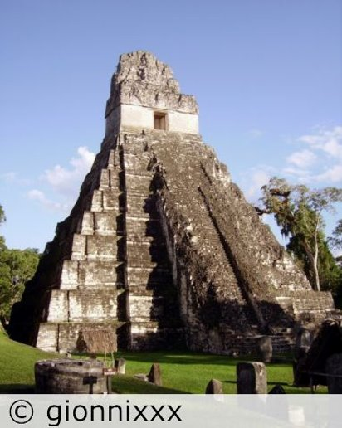
Tikal Pyramid 1 Guatemala
The noises you were listening to was an actual recording of howler monkeys in the jungle at night-time near the Maya city of Tikal.
The Maya people live in these jungles in Mesoamerica and have done for thousands of years

Slide 3
The Maya Civilisation
Overall enquiry question:
Why should we remember them?

Slide 4
In this unit you will
Understand when and where the Maya lived
Discover how we know about the Maya civilization through exploration and archaeology
Look at Maya cities and design your own replica
Compare the achievements of the Maya civilization comparing them to the Anglo Saxon period of British History
Compare the end of the Maya civilization and Anglo Saxon period by looking at the Spanish invasions and Norman invasion
Compare and contrast the legacies left behind by the Maya and Anglo Saxons and the impact they have on the modern world

Slide 5
Think back to our previous unit on Ancient Egypt....
What do these terms mean?
Civilisation
Significance
Achievements
- society organised by a system of government and social strata with shared culture such as writing, language
- events / person which have influenced great change
- an accomplishment which has helped a civilisation become successful

Slide 6
Before we continue, an important word about language....
Quite often we hear and see references on websites, and in books, to a civilisation called the Mayans. This is incorrect. The correct name is Maya.
Mayan is also (incorrectly) used as an adjective to describe aspects of Maya life eg Mayan temples, Mayan food, Mayan clothing, Mayan writing. This is wrong it is Maya temples, Maya food, Maya writing
The ONLY time the word Mayan should be used to describe anything is for language eg Mayan language.

Slide 7
LC: Can I find out where and when the Ancient Maya lived?
I can say where the Maya lived (and still live) today
I can place the Maya on a timeline and place them in context of world and British periods of history

Slide 8
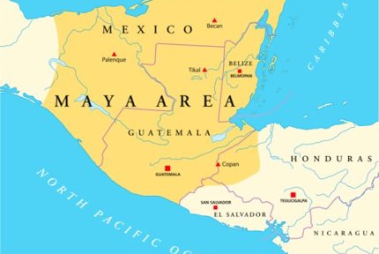
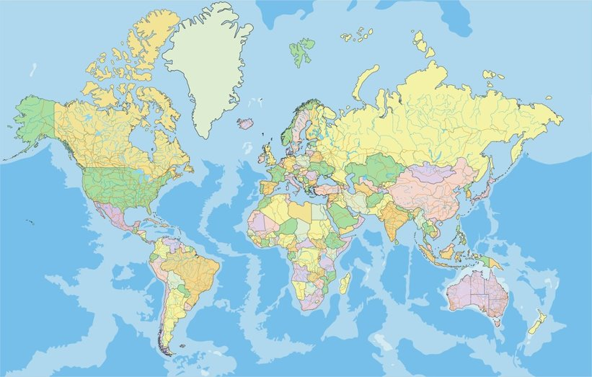
Where is the Maya civilisation?
Which modern day countries is it located in?
Which continent is the civilisation located in?

Slide 9
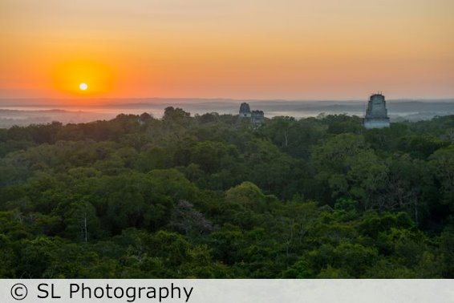
The Rainforest
What do you already know about the rainforest?
What vegetation would you find there?
What animals live there?
What is the climate like?
What is life like for the people that live in the area?

Slide 10
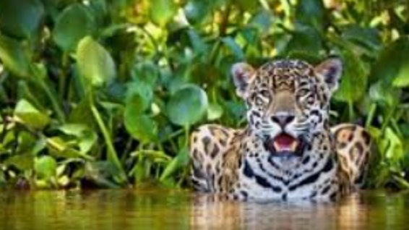
Listen to Dr Dianne Davis, an archaeologist who specialises in the Maya, talking about the Maya rainforest.
https://youtu.be/mthj0rre2IM

Slide 11
Chronology - When did the Maya exist?
Key vocabulary – can you remember what these words mean?
Sequence
Scale
Duration
Concurrent
BC and BCE
AD and CE

Slide 12
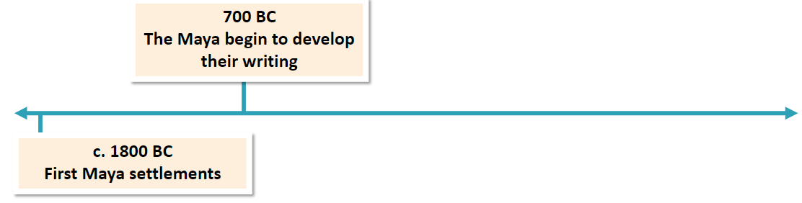
Maya timeline
Using the resources, annotate a Maya timeline in your book (double page spread)
Sequence the key dates chronologically.
There is 2700 years between the first and last event – can you create an accurate scale e.g ?cm = 100 years (ask for help if you need to)

Slide 13
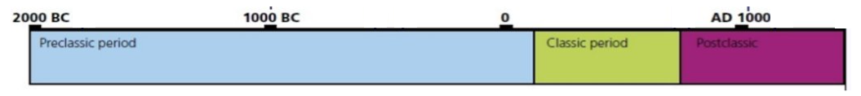
Historians recognise three major periods in the history of Maya civilisation:
The Preclassic (2000 BCE – CE 300)
The Classic (CE 300-900)
the Postclassic (CE 900-1550)
The above only covers the period before the Europeans arrived in Central America, implying that the Maya became extinct after this. The Maya have continued to develop and adapt through the historic periods of European Colonisation and still survive into modern times.

Slide 14
Meet the Maya
In the rainforests and hills of Central America, lie the ruins of a society that has fascinated historians for decades - the Maya. By around AD 900, the Maya were an astonishingly advanced society with their own ways of doing everything from farming to maths.
When they arrived in Central America's jungles around 12,000 years ago, they were hunter gatherers. They didn't live in one place but travelled around to find food. Over time, they learnt how to farm and this allowed them to stay in one place and begin building permanent settlements such as El Mirador, Caracol and Tikal.
Between AD 250 and AD 900, the Maya developed their own style of architecture and filled their cities with grand stone buildings and stepped pyramids.
Around AD 900, some cities were suddenly abandoned. Historians aren't sure why this happened although lots of weird and wonderful theories have been put forward. Not all Maya cities were abandoned though – cities in the north continued to grow for hundreds of years. In AD 1500, Maya society was still thriving, but it was about to change forever – Spanish invaders arrived.

Slide 15
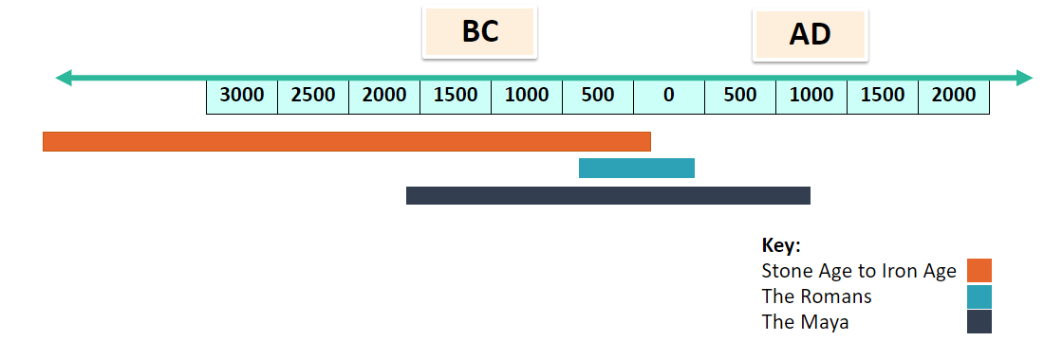
Where do the Maya fit with what you've already studied in KS2?
Where would you place the Ancient Egyptians and Ancient Greeks on this time-line?

Slide 16
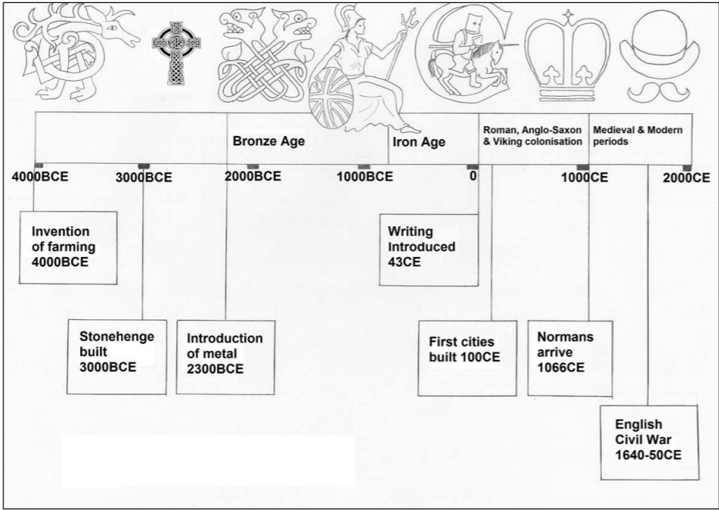
Refer to the events on your Maya timeline and compare with what was happening in Britain at the same time
British History

Slide 17
Can you add some observations underneath your time-line detailing what was happening in Britain at the same time as some of the significant Maya events?
Consider:
Farming
Building materials
Writing

Slide 18
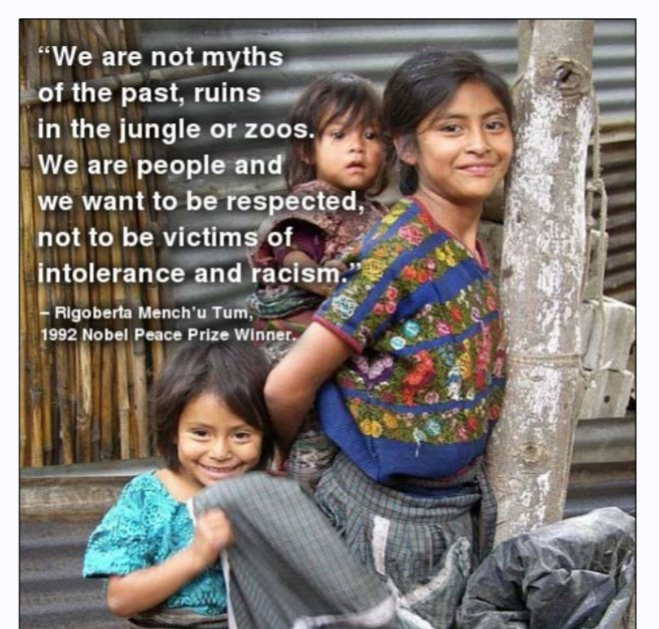
The end of the Maya?
In AD 900, many of the Maya cities were suddenly abandoned. However, this was not the end of this fascinating civilization.

Slide 19
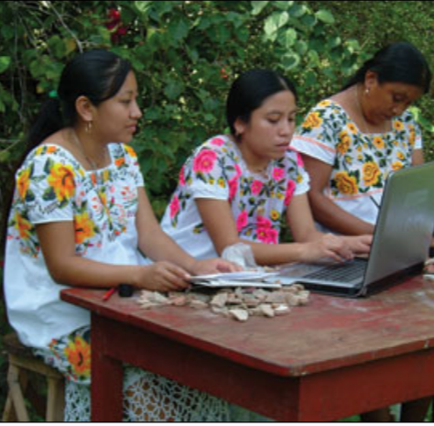
There are more than 6 million Maya living today in Guatemala, Mexico and Belize.

Slide 20
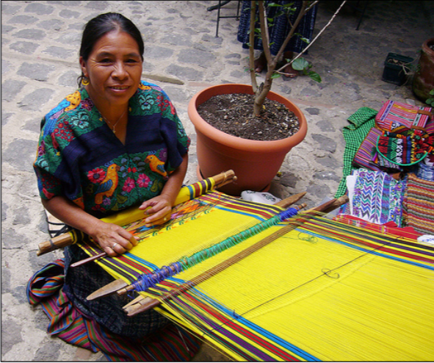
The Maya people have continued to hold on to their unique way of life. They still worship the old gods as well as Christianity, they farm in the same way and weave clothing in a similar way.

Slide 21
The abandoned Maya cities were left undiscovered, hidden by thick jungle, until the 19th century and discoveries are still being made today.
Think about castles, palaces, temples, mosques, churches left behind by your ancestors in Britain, Europe and the rest of the world.
Are you proud of them or not interested in them at all? Do you think they should be preserved or left to fall down?
Do you think studying history and heritage is important? Why?
Key question: Why should we remember the Maya?

