Slide 1


T | O | tth | hth
1) What number is represented in the place value chart? Write it in words and numerals.
2)
What fraction is represented on the bar model? Can you write it as a decimal?
3) What is the value of the digit 5? 46.95

Slide 2
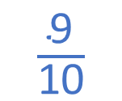
T | O | tth | hth
1) What number is represented in the place value chart? Write it in words and numerals.
2)
What fraction is represented on the bar model? Can you write it as a decimal?
3) What is the value of the digit 5? 46.95
0.32
thirty-two hundredths
$\frac{\text{9}}{\text{10}}$
0.9
5 hundredths

Slide 3
L.C. Can I write decimals as fractions?
Toolkit

Slide 4

zero point one
one tenth
0.1
$$\frac{\text{1}}{\text{10}}$$
one out of 10

Slide 5

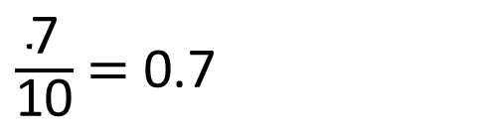
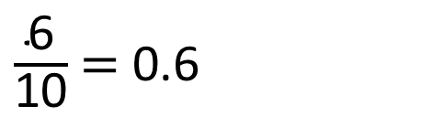
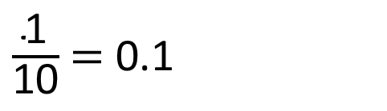

Have a think
$$\frac{\text{1}}{\text{10}}$$
0.1 | 0.1 | 0.1 | 0.1 | 0.1 | 0.1 | 0.1 | 0.1 | 0.1 | 0.1
$\frac{\text{1}}{\text{10}}$ $=$ 0.1
$\frac{\text{6}}{\text{10}}$ $=$ 0.6
$\frac{\text{7}}{\text{10}}$ $=$ 0.7

Slide 6

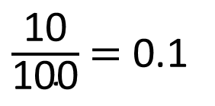
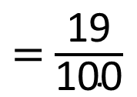
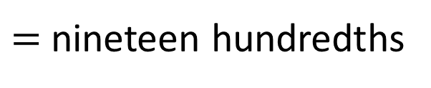
$=$ nineteen hundredths
$=$ $\frac{\text{19}}{\text{100}}$
$=$ $\text{0.19}$
$\frac{\text{10}}{\text{100}}$ $=$ 0.1
0

Slide 7
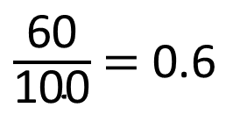
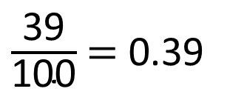
Have a think
$\frac{\text{39}}{\text{100}}$ $=$ 0.39
$\frac{\text{60}}{\text{100}}$ $=$ 0.6
0

Slide 8
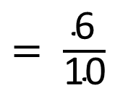
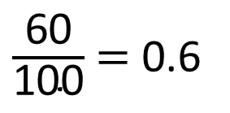
$\frac{\text{60}}{\text{100}}$ $=$ 0.6
$= \frac{\text{6}}{\text{10}}$

Slide 9
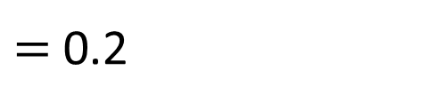


$$\frac{\text{1}}{\text{10}}$$
0.1 | 0.1 | 0.1 | 0.1 | 0.1 | 0.1 | 0.1 | 0.1 | 0.1 | 0.1
0.2 | 0.2 | 0.2 | 0.2 | 0.2
0.2
$$\frac{\text{1}}{\text{5}}$$
$=$ 0.2

Slide 10
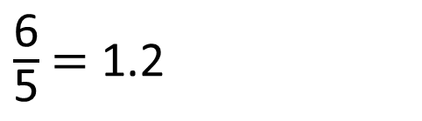
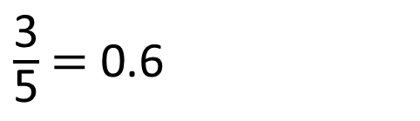
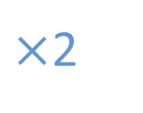
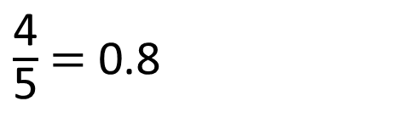

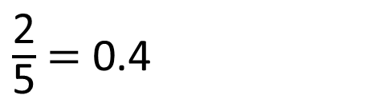


Have a think
0.2 | 0.2 | 0.2 | 0.2 | 0.2
0.2 | 0.2 | 0.2 | 0.2 | 0.2
0.2 | 0.2 | 0.2 | 0.2 | 0.2
$\frac{\text{2}}{\text{5}}$ $=$ 0.4
$\frac{\text{3}}{\text{5}}$ $=$ 0.6
$×$2
$×$2
$×$2
$×$2
$\frac{\text{4}}{\text{5}}$ $=$ 0.8
$\frac{\text{6}}{\text{5}}$ $=$ 1.2

Slide 11
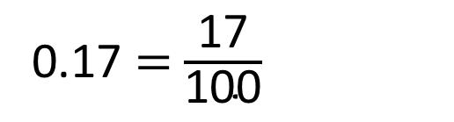
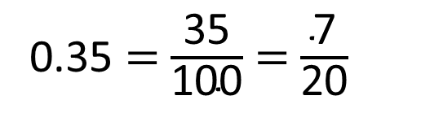
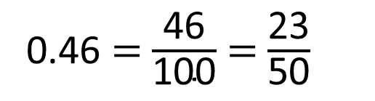
Fill in the missing numbers.
0.46 $=$ $\frac{\text{46}}{\text{100}}$ $=$ $\frac{\text{23}}{\text{50}}$
0.35 $=$ $\frac{\text{35}}{\text{100}}$ $=$ $\frac{\text{7}}{\text{20}}$
0.17 $=$ $\frac{\text{17}}{\text{100}}$
Have a think

Slide 12

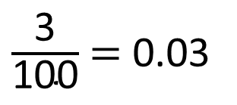
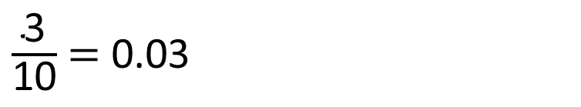
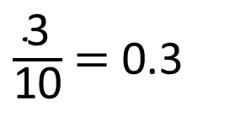
Have a think
$\frac{\text{3}}{\text{10}}$ $=$ 0.03
Draw a diagram to show that Tiny is incorrect.
$\frac{\text{3}}{\text{100}}$ $=$ 0.03
$\frac{\text{3}}{\text{10}}$ $=$ 0.3
0

