Slide 1

Survivors
Extraordinary tales from the wild and beyond
Day One

Slide 2
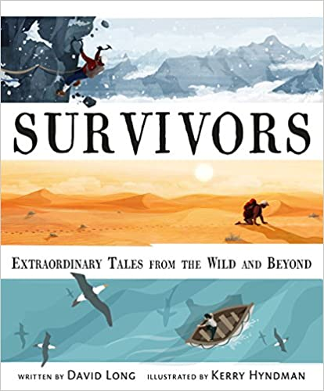
This half-term’s new book.
Have you read it?
Do you know what it is about?

Slide 3
Winner of the Blue Peter Book Award 2017 - Best Books with Facts
‘this wonderful anthology is a treat for all,’
‘Be shocked and amazed by these incredible real-life stories of extreme survival,’
‘The attractive design features a full-page or double-page-spread color illustration depicting a pivotal moment in each well-told story. ... A great collection of harrowing, true survivor stories.’
5/5Toppsta 4.3/5Goodreads 5/5Waterstones
Anthology- noun- a published collection of stories or poems.

Slide 4
Do you have what it takes to be a survivor?
What do you think the book will be about?
What things can you see on the front cover?
What is the genre of this text?
Why do you think the author wanted to write a book about survivors?
Who might be interested in reading this book and why?

Slide 5
LC: Can I produce a blackout poem?
Toolkit
Careful word selection

Slide 6
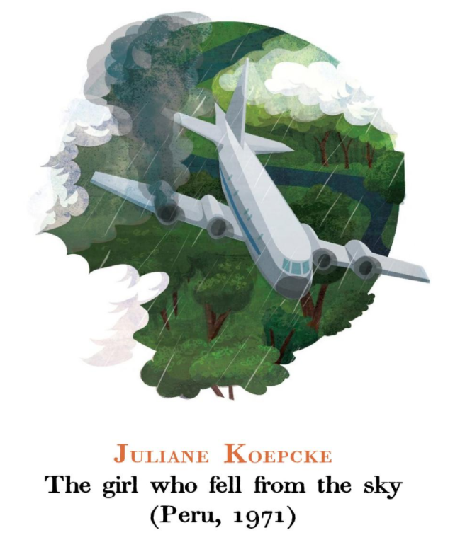
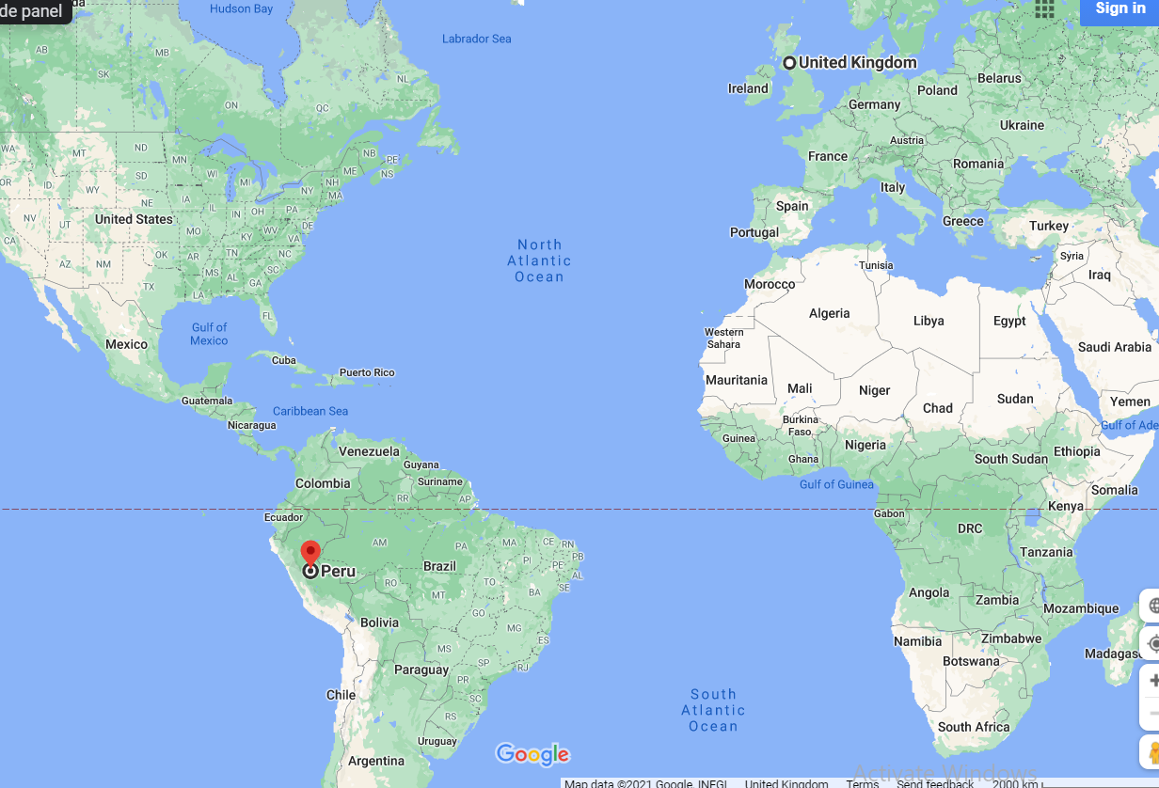
This is a true story from Peru, imagine what may have happened and how?

Slide 7
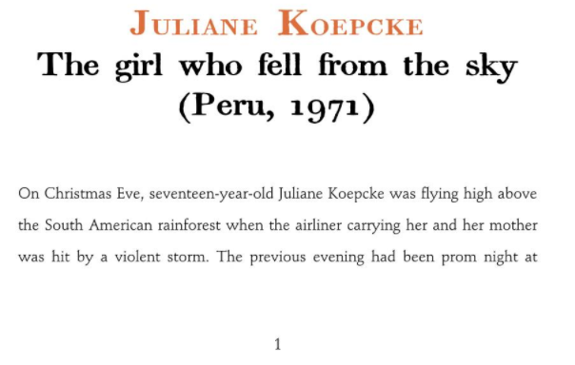

Slide 8
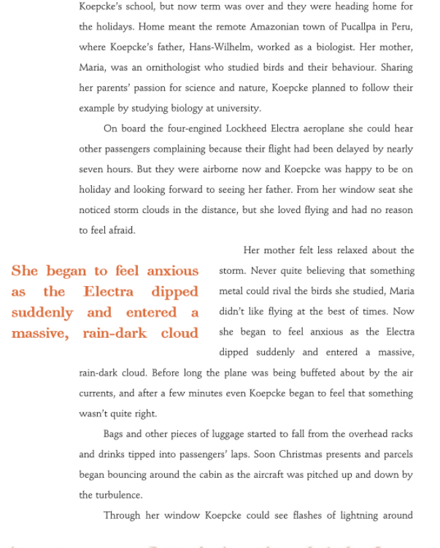
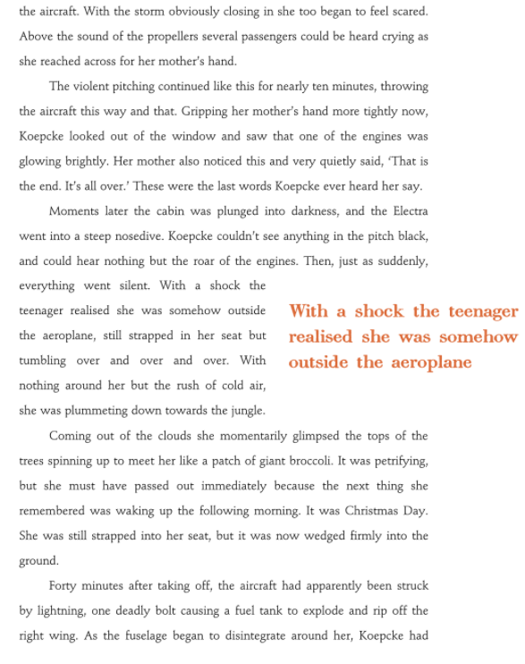
Pages 2 and 3

Slide 9
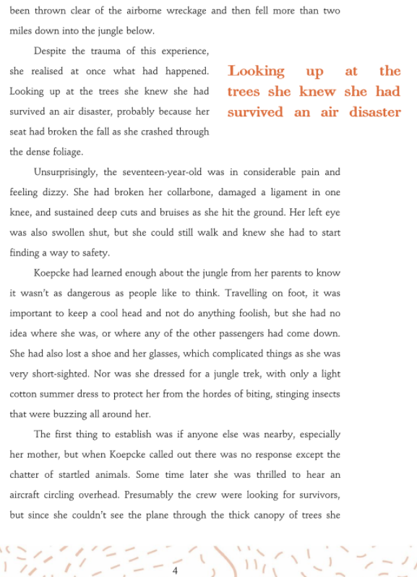
Listen to the next bit with your eyes closed and try to visualise the scene.
What images did you see? Discuss.

Slide 10
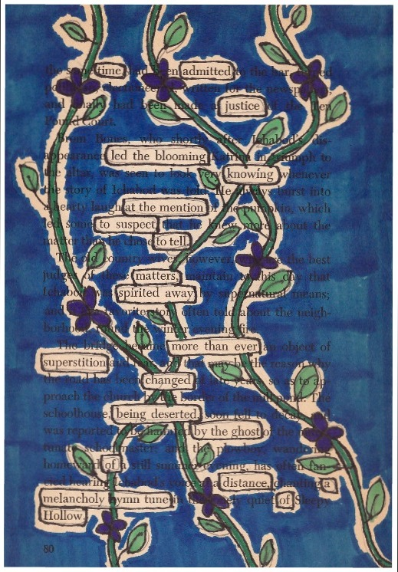
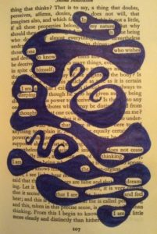
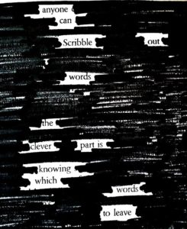
Black out poetry

Slide 11
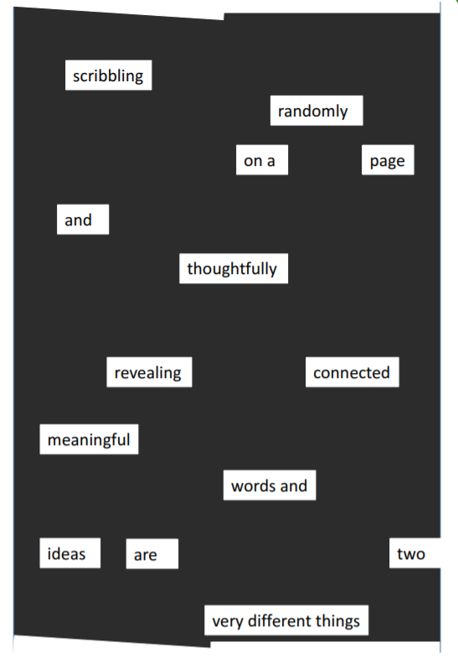
What is a black out poem?
A blackout poem is when a poet takes a marker (usually black marker) to already established text--like in a newspaper--and starts redacting words until a poem is formed. The key thing with a blackout poem is that the text AND redacted text form a sort of visual poem.

Slide 12
|Task
You will be creating a blackout poem of your own from page 3 of the book today. The content and impact of the poem is entirely your choice.
  First, read through the page and begin lightly circling words (with pencil) which evoke the feelings or thoughts you would like the reader to experience. Then copy these out onto note paper, in order, and decide where they might like some linking words, new ideas or replacements. You can then revisit the text, rub out circled words you no longer need and circle additional words you would like to use.

Slide 13
Survivors
Extraordinary tales from the wild and beyond
Day Two

Slide 14

What physical state do you think Juliane might be in?
What mental state might she be in?
How do the you think she has managed to survive the fall?
What might happen next?

Slide 15
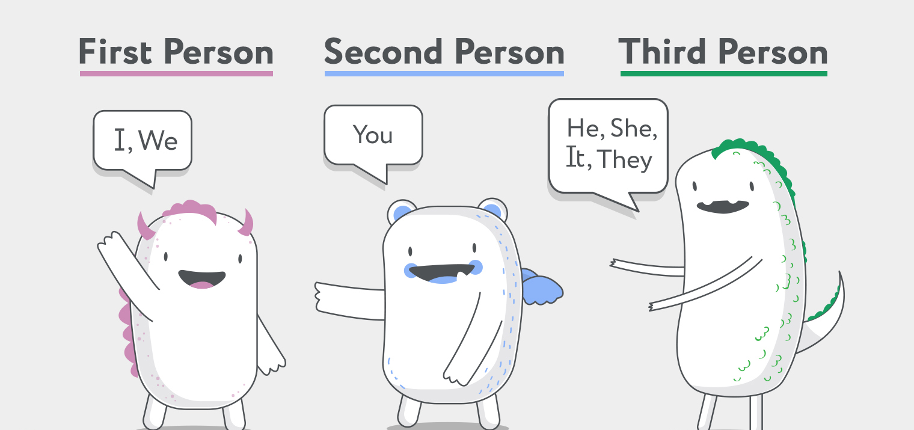
LC: Can I plan a retelling of events from a different POV?
Toolkit

Slide 16
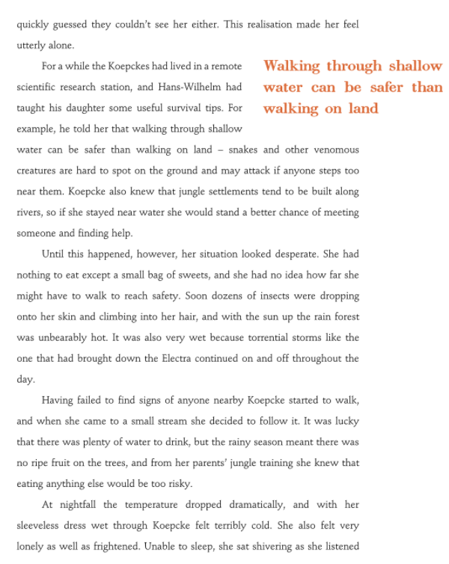
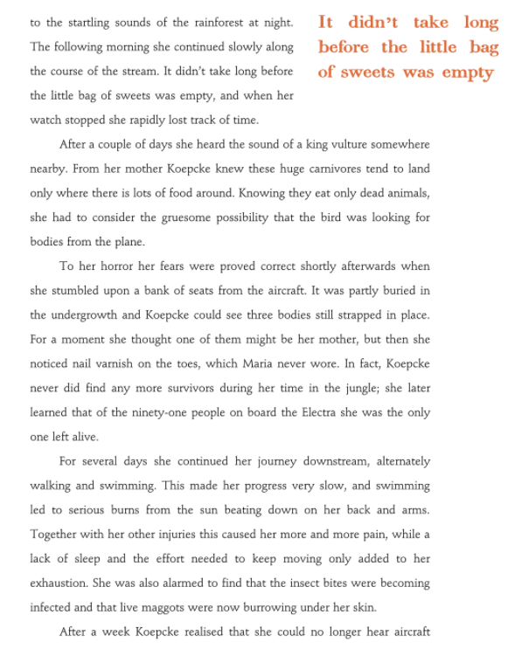
Pages 5 and 6

Slide 17

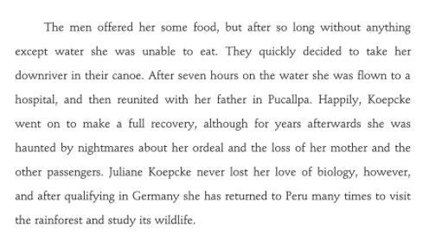
Pages 8 and 9

Slide 18
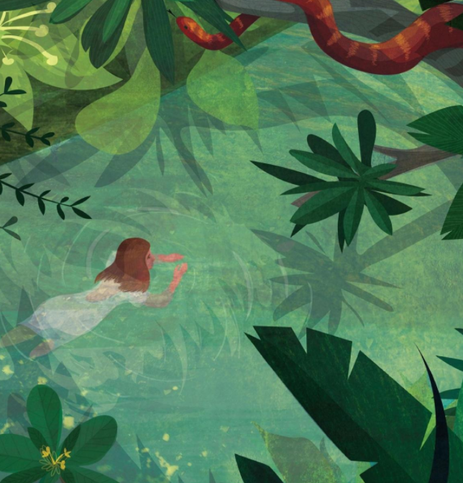
In a jungle, there is a very delicate balance of life.
Plant life is eaten by herbivores which often act as seed spreaders to ensure the ongoing success of the forest and herbivores are often eaten by carnivores. In this way, the carnivores keep control of the number of herbivores which could, if ungoverned, eat too many plants. The trees provide shelter, food and safety for insects, reptiles, mammals and birds. Many creatures and plants depend on each other for survival. The jungle is in some ways like one, big organism (it can even control its own weather) and this is how we are going to imagine it during this lesson. We will be writing a recount of Juliane’s dramatic fall into and trek through the jungle, from the perspective of the jungle.

Slide 19
How we might give the jungle a voice and how the jungle’s retelling of events would be different to Juliane’s recollections.
What could she be unaware of that the jungle sees? (e.g. a food source she narrowly missed, a plant which would have deterred insects, a predator stalking her, her shouting out and flailing in her fitful sleep)
How can you make the jungle sound knowledgeable? (she would be better nesting in the trees at night to stay dry etc.)
What would the jungle respect her for? (her determination matched that of the soldier ant)
In what ways could it be fearful of her? (better that she find her way out than droves of people with weapons come crashing in to find her)

Slide 20
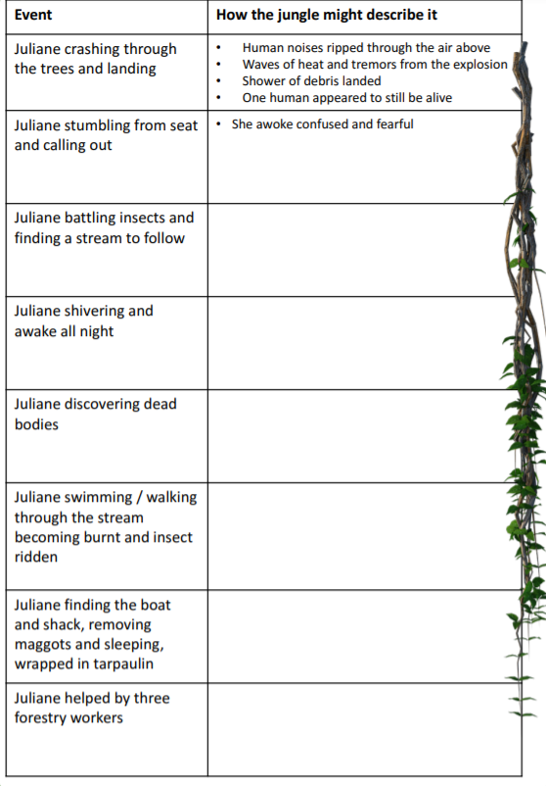
|Task, plan
Develop a clear ‘jungle voice’ that runs through your notes e.g. the jungle uses lots of comparisons with animals when considering Julian’s actions or the jungle is very philosophical and not emotionally attached to Juliane but merely interested in her journey.

Slide 21
Survivors
Extraordinary tales from the wild and beyond
Day Three

Slide 22
LC: Can I retell events from a different POV?
Toolkit

Slide 23
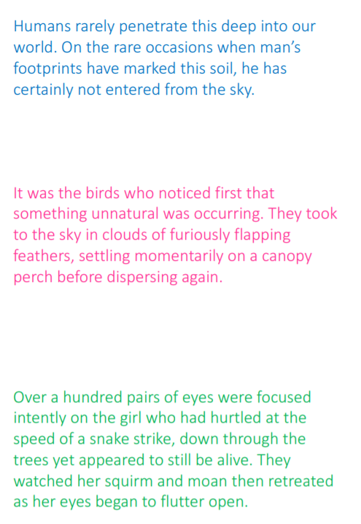
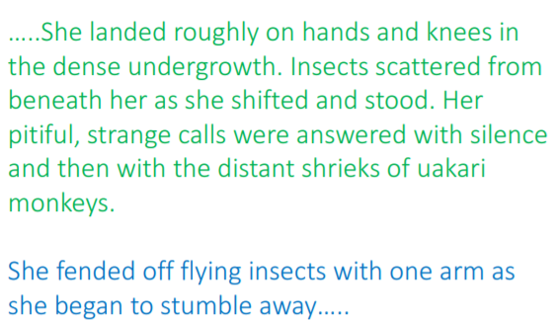
Do the you think these paragraphs flow well? Why? Why not? What information could be missing here (e.g. time elapsed)

Slide 24
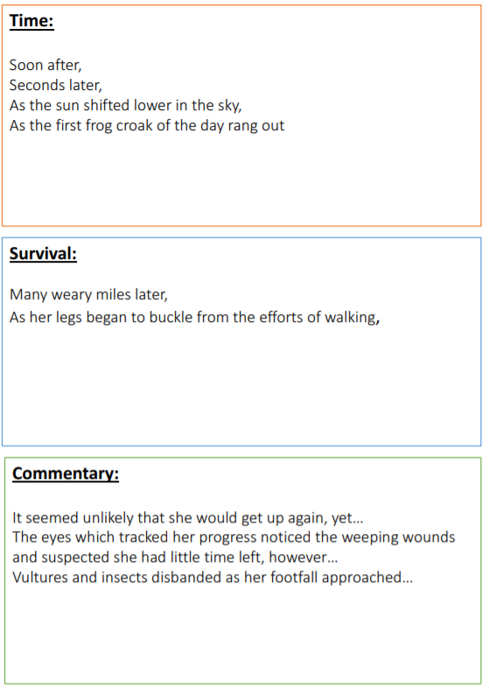
What is the difference between each category?
Which can they imagine being useful for their own retelling?
Whilst you are retelling Juliane Koepcke’s remarkable survival story from the POV of the jungle, it will help them to have a bank of connecting ideas which they can select from to ensure their writing flows effectively. These might be used within or at the start of new paragraphs
Add further ideas of your own to each box

Slide 25
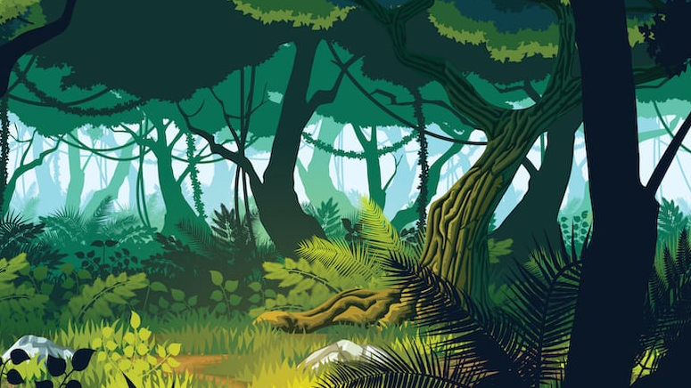
|Task
Rewrite the introduction you drafted in boxes for day 2. You should then retell Juliane Koepcke’s survival story from the perspective of the jungle, drawing upon your notes and connecting ideas.

Slide 26
If you have an extra minute…
How might the jungle conclude the survival story?
Carefully consider your concluding sentence(s). What do they think the jungle’s impression of Juliane is? Can you make this clear at the end?

Slide 27
Survivors
Extraordinary tales from the wild and beyond
Day Four

Slide 28
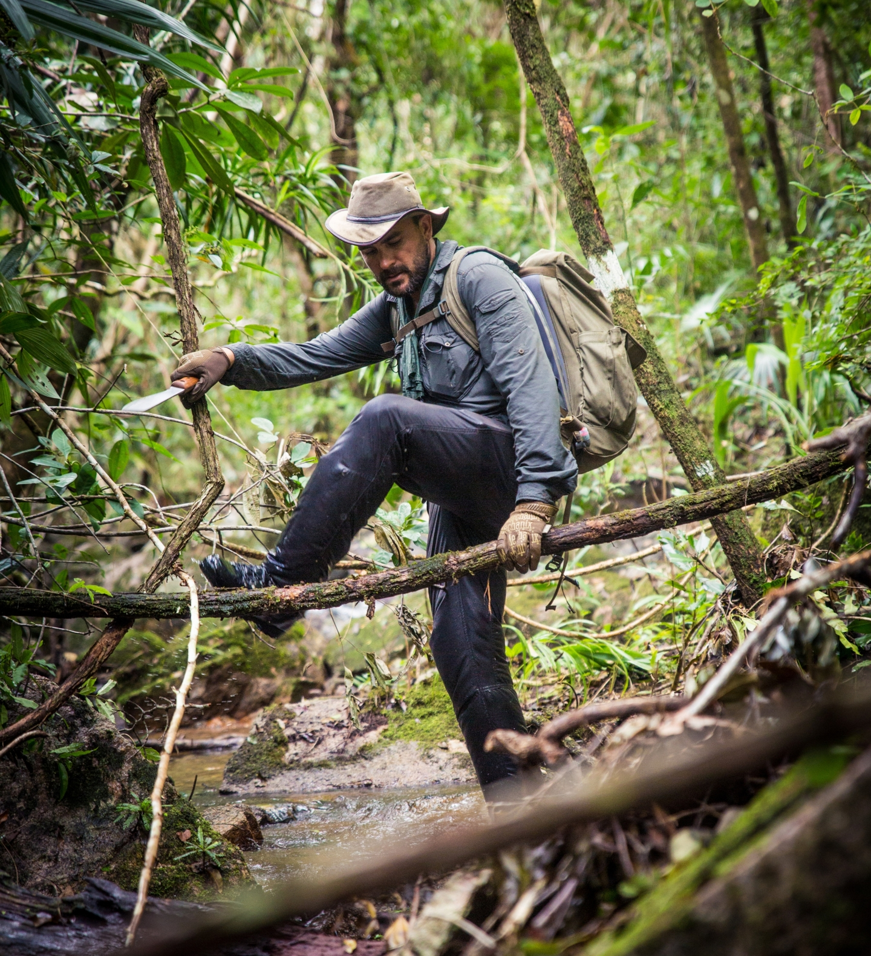
LC: Can I plan an information text which gives advice about how to survive in the jungle?
Toolkit

Slide 29
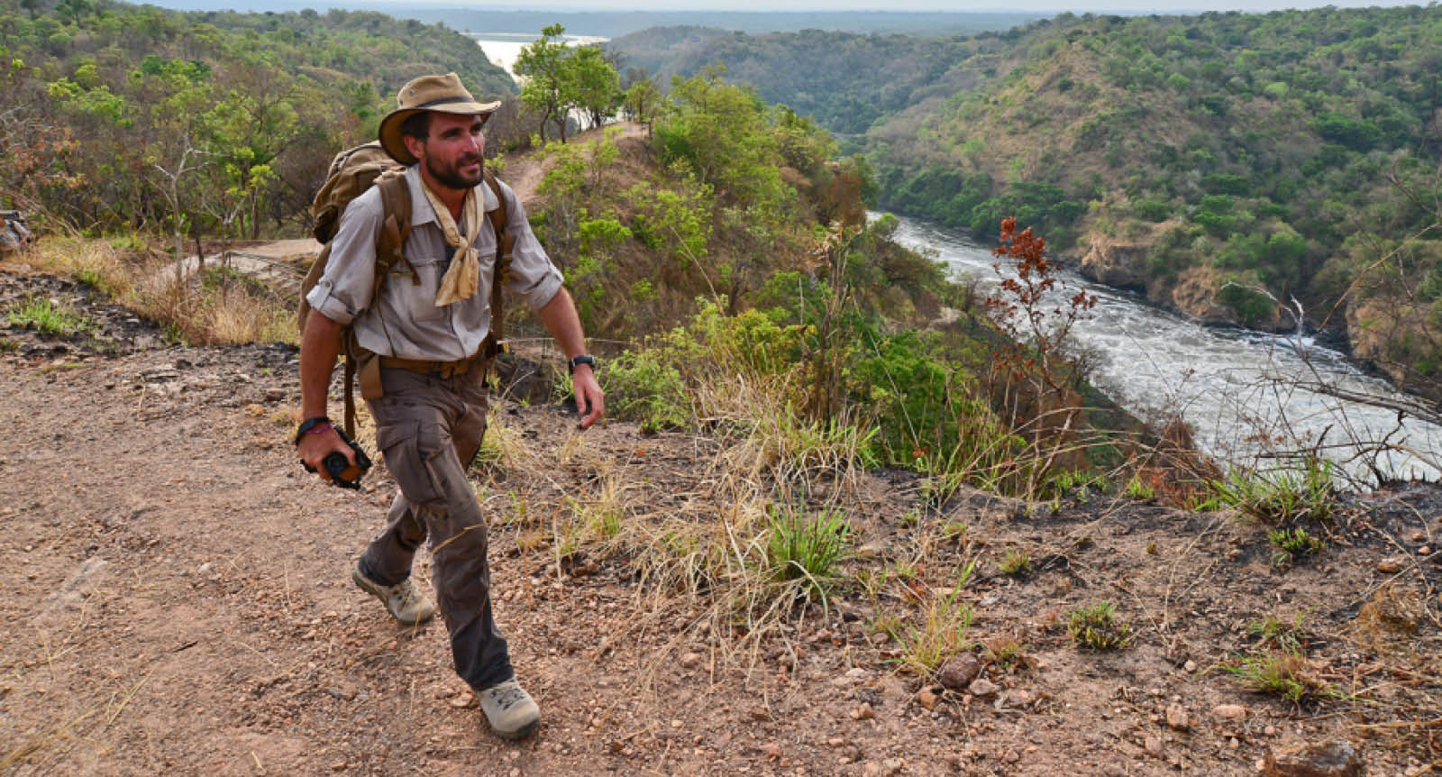
Surviving in a jungle 101
Note on whiteboards three pieces of jungle knowledge that you believe helped Juliane to survive.
Which piece of knowledge was the most crucial? Explain why.
Collect these and list them.
Now, work together in pairs to group them into named categories in your beige notebooks.

Slide 30
What three items Juliane would have chosen to have on her person to help her survival if she could choose any three.

Slide 31
Scuba diving for beginners
In what ways might scuba diving pose similar dangers to being lost in dense jungle?
How are the dangers different?
Underline all referenced dangers referenced in the text. What are they?
Based upon Juliane’s survival story, the task is to produce a safety pamphlet like the Scuba Diving example for adventurous people, like Levison Wood, planning to trek through unchartered jungle. Look at how the Scuba diving pamphlet is organised (introduction, preparation, first dive).
Discuss together what type of preparation might be useful prior to a jungle trek (hiking with backpack, bushcraft, first aid, plant and animal ID etc.) and what information is useful for the trek itself (what to remember in adverse weather, how to stay with buddy, application of bug spray, sun protection, finding water etc.)

Slide 32
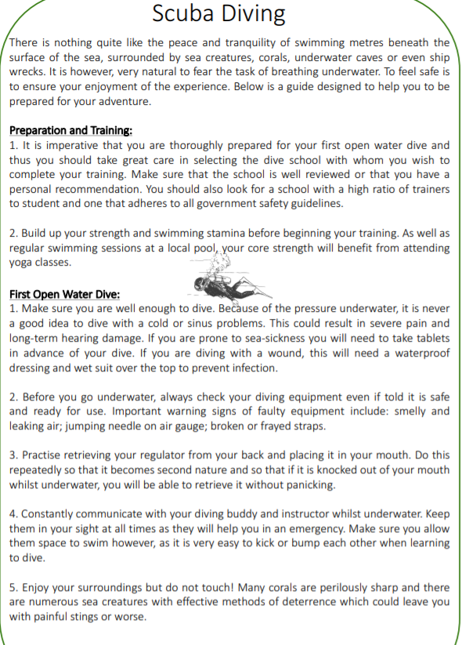

Slide 33
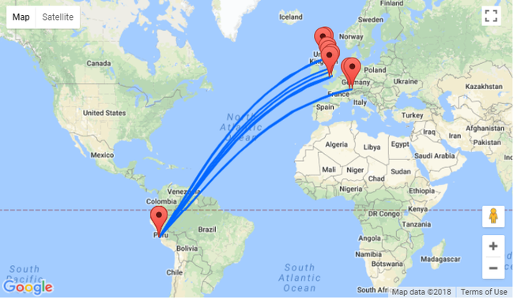
|Task
Make bullet point notes on the plan or layout of own choice for ‘Preparation and Training’ and ‘First Jungle Trek’. Consider the order of the information and whether all dangers experienced in Juliane’s story have been addressed.
Hurry up, I’m about to book flights.

Slide 34
Survivors
Extraordinary tales from the wild and beyond
Day Five

Slide 35
LC: Can I write an information text which gives advice about how to survive in the jungle?
Toolkit

Slide 36
Mini task
Highlight all sentence openers, conjunctions and words / phrases which could be useful in your own writing today.
How formal do you think this text is? (language and sentence structure) Why?
It is important that a text like this is written formally in order to give it credibility.

Slide 37
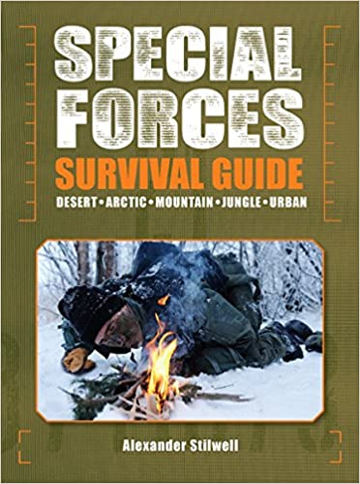
|Task
Follow your plans and use draft introduction notes you made in the last lesson to write a safety guide to trekking in a jungle. This is important as the most recent survival guide, written by A Stillwell, is more than fifteen years old and would be considered out of date in the eyes of any would-be explorer.
Once you have written your guide reread the story to identify which areas of jungle survival you have neglected.

