Slide 1
LC: Can I describe the functions of electrical components?
Toolkit:

Slide 2
What are electrical components?

Slide 3
What are electrical components?
They are the different parts which make up
electrical circuits. Electrical components are
made up of different parts and have different
functions.
Some common electrical components include:
switches, bulbs, buzzers and motors.
https://classroom.thenational.academy/lessons/what-are-the-different-components-in-an-electrical-circuit-cdk34d

Slide 4
Symbols
When we draw an electrical circuit, we use a set
of symbols which are easy to recognise. Each
component has its own symbol.
The symbol for an electrical wire is ______ .

Slide 5

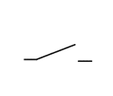
Switches
These allow a circuit to be open or closed. They
work by bridging a gap in the circuit. When the
switch is open, electricity cannot flow around
the circuit and the components cannot function.
When the switch is closed, the circuit is
completed and electricity can flow around it. We
use switches to turn devices on and off.

Slide 6

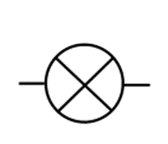
Bulbs
These contain very thin pieces of wire called
filaments. When electricity passes through the
filament, energy is released in the form of light.
The filament is covered by transparent glass
which allows light to pass through.

Slide 7
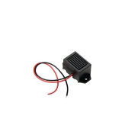
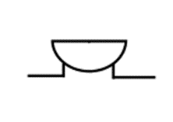
Buzzers
They create a sound when electricity passes
through. The sound can be different depending
on the type of buzzer.

Slide 8
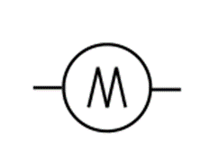
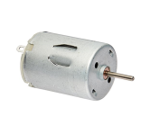
Motors
They convert electrical power into mechanical
power (movement). They work by using
electromagnets (magnets powered by
electricity) to move a magnetic rotor around an
axis.

Slide 9
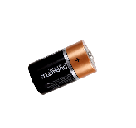
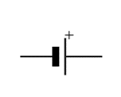
Cells
Cells convert chemical energy into electricity.
They contain two chemical substances which
react to each other. This creates a flow of
electrons. Electrons flow out of the negative
terminal of the battery (cell) and around the
circuit allowing other components to function.

Slide 10
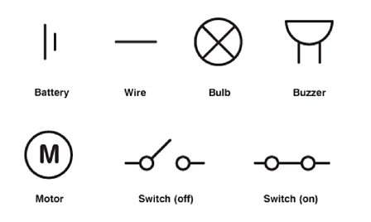
Task
Create your own description of each component.
Include:
Its role in the circuit
Its symbol

