Slide 1
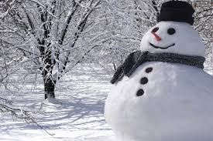

Winter themed poetry

Slide 2
Lesson 1

Slide 3
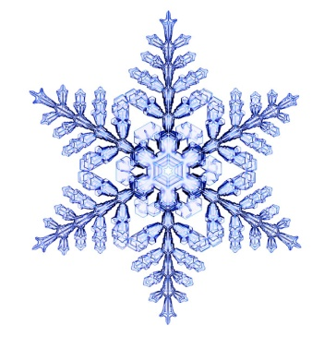
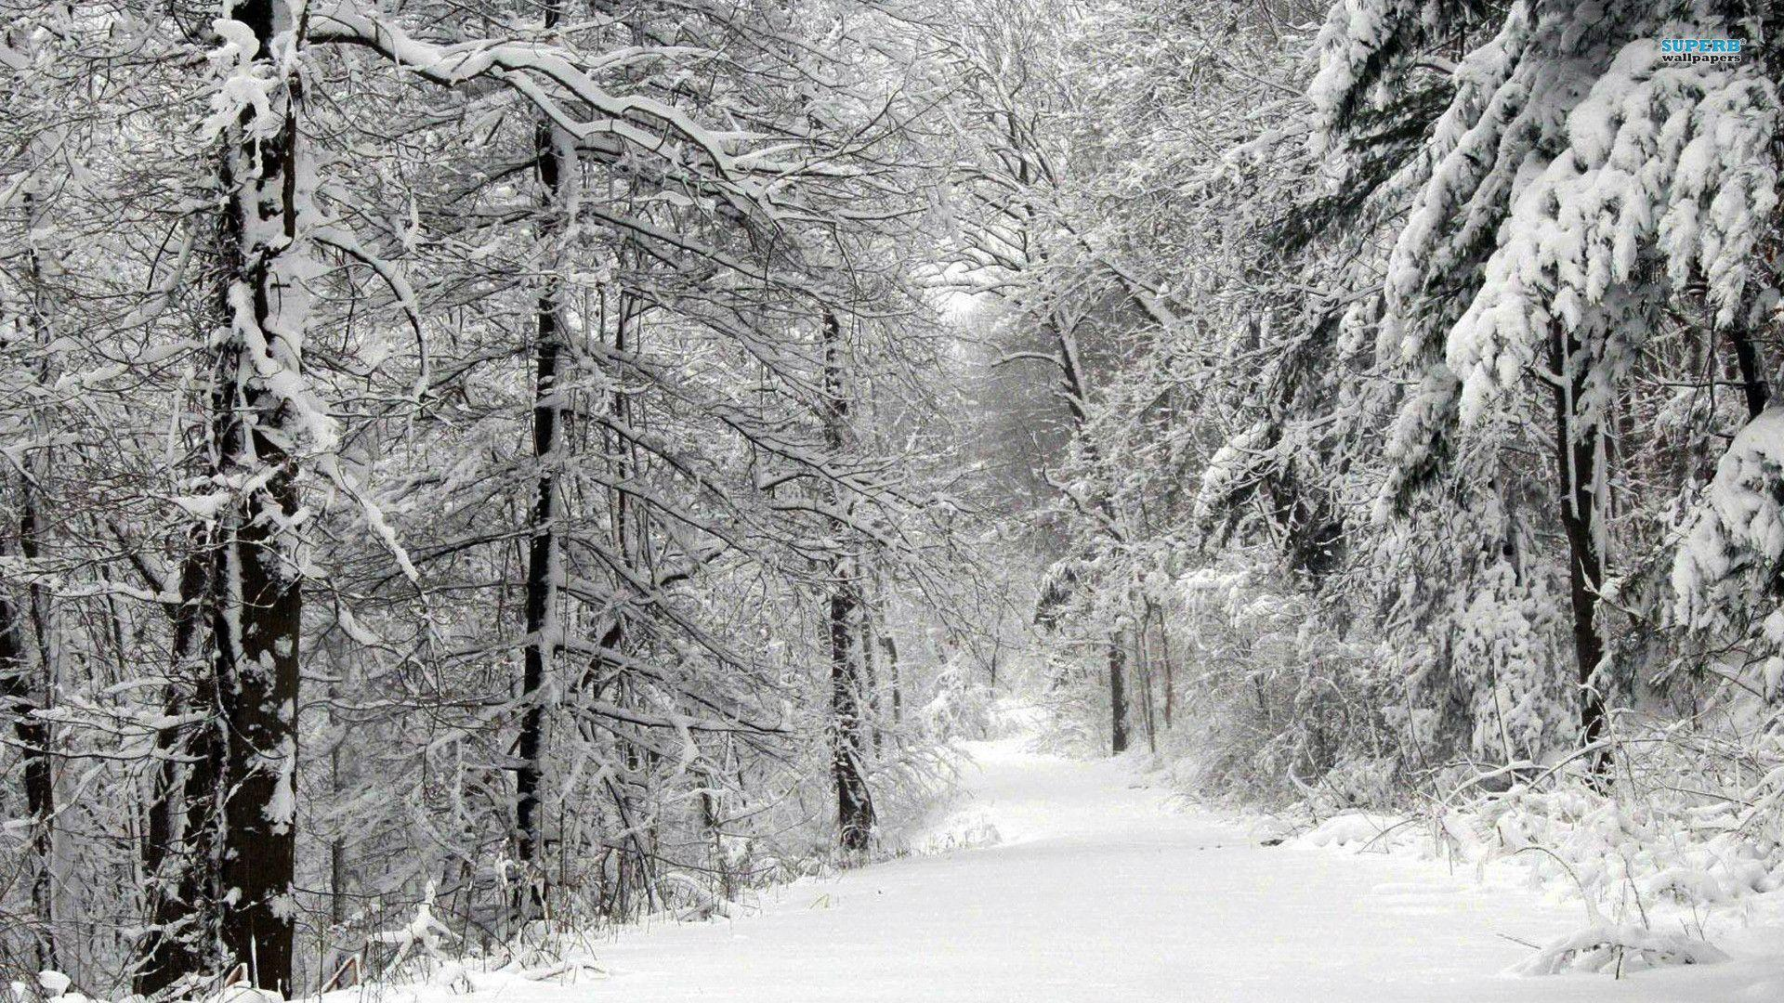
Lesson 1
First of all, let’s enjoy sharing some winter-themed poems.
Remember, poems sometimes rhyme but a poem does not have to rhyme.
Take a look at how these poems are arranged. Some have lines which are organised into verses.

Slide 4
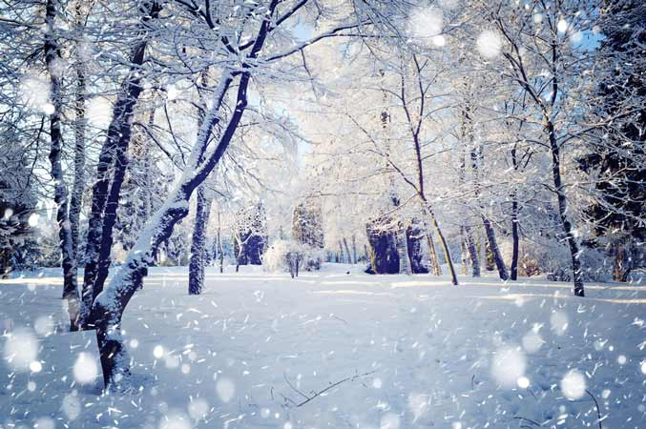
Lesson 1
Falling Snow
See the pretty snowflakes
Falling from the sky;
On the wall and housetops
Soft and thick they lie.
On the window ledges,
On the branches bare;
Now how fast they gather,
Filling all the air.
Look into the garden,
Where the grass was green;
Covered by the snowflakes,
Not a blade is seen.
Now the bare black bushes
All look soft and white,
Every twig is laden,
What a pretty sight!
by anonymous

Slide 5
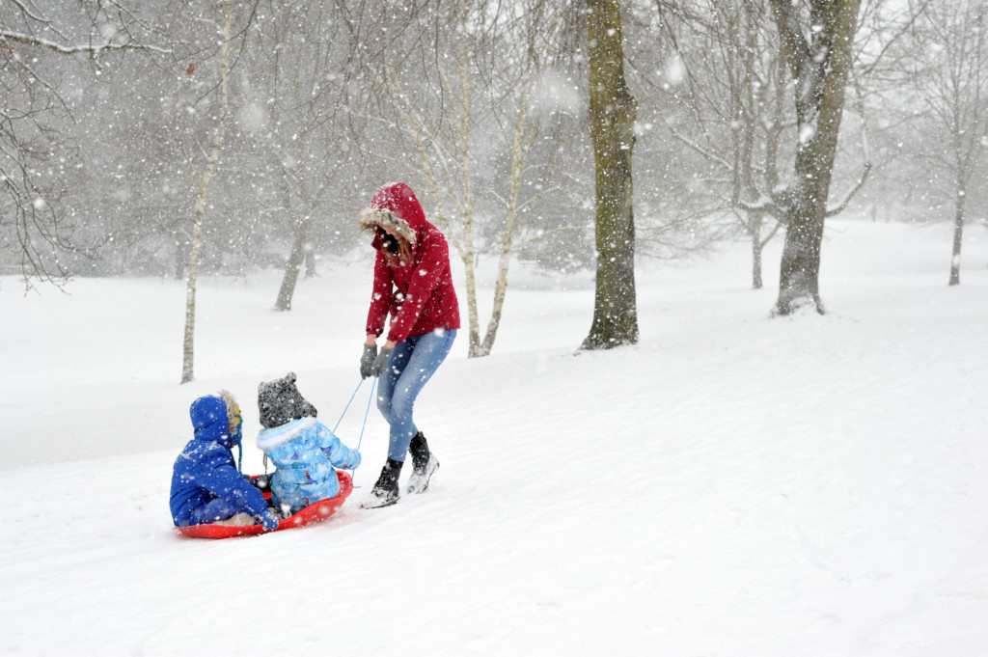
Lesson 1
Coasting Down the Hill
Frosty is the morning;
But the sun is bright,
Flooding all the landscape
With its golden light.
Hark the sounds of laughter
And the voices shrill!
See the happy children
Coasting down the hill.
There are Tom and Charley,
And their sister Nell;
There are John and Willie,
Kate and Isabel –
Eyes with pleasure beaming,
Cheeks with health aglow;
Bless the merry children,
Trudging through the snow!
Now I hear them shouting,
"Ready! Clear the track!"
Down the slope they're rushing,
Now they're trotting back.
Full of fun and frolic,
Thus they come and go.
Coasting down the hillside,
Trudging through the snow.

Slide 6
Lesson 1
Jack Frost
The door was shut, as doors should be,
Before you went to bed last night;
Yet Jack Frost has got in, you see,
And left your window silver white.
He must have waited till you slept;
And not a single word he spoke,
But pencilled o'er the panes and crept
Away again before you woke.
And now you cannot see the hills
Nor fields that stretch beyond the lane;
But there are fairer things than these
His fingers traced on every pane.
Rocks and castles towering high;
Hills and dales, and streams and fields;
And knights in armour riding by,
With nodding plumes and shining shields.
And here are little boats, and there
Big ships with sails spread to the breeze;
And yonder, palm trees waving fair
On islands set in silver seas,
And butterflies with gauzy wings;
And herds of cows and flocks of sheep;
And fruit and flowers and all the things
You see when you are sound asleep.
For, creeping softly underneath
The door when all the lights are out,
Jack Frost takes every breath you breathe,
And knows the things you think about.
He paints them on the window-pane
In fairy lines with frozen steam;
And when you wake you see again
The lovely things you saw in dream.
by Gabriel Setoun

Slide 7
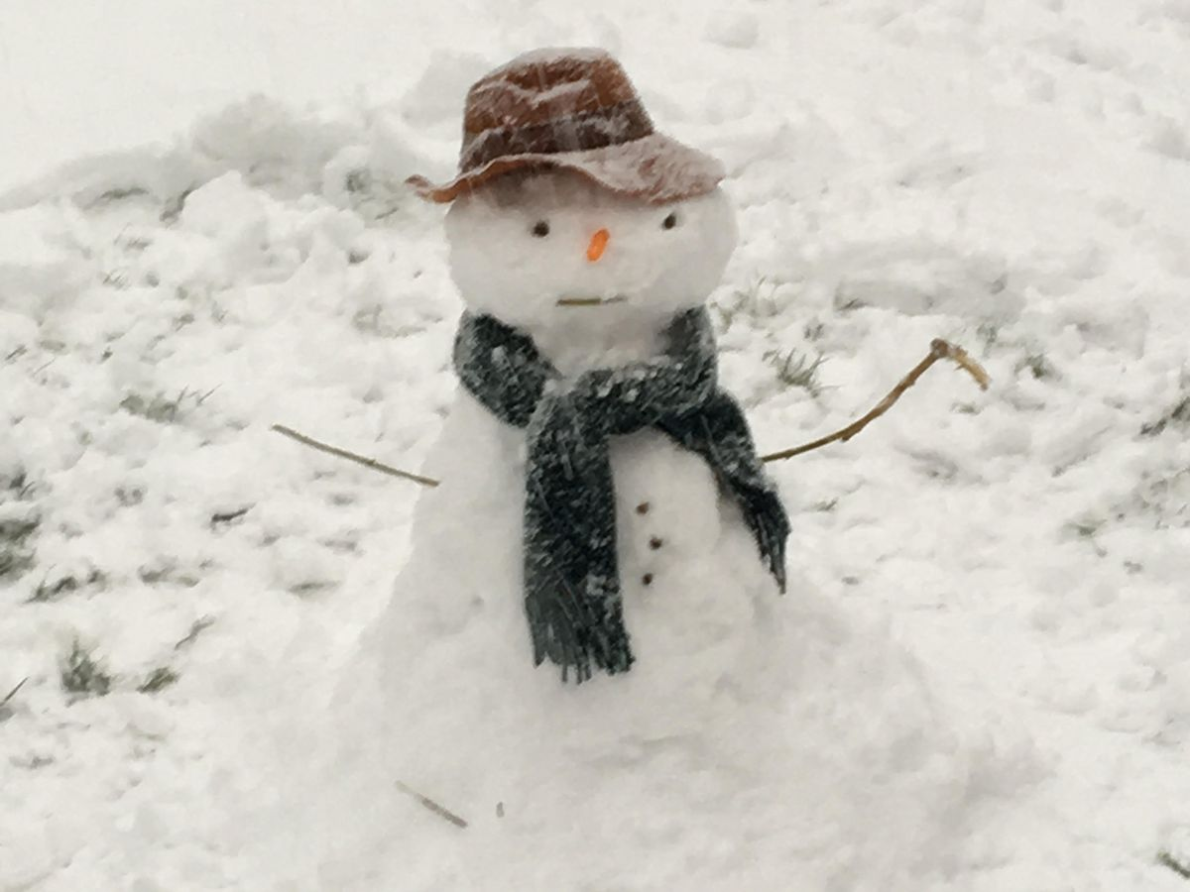
Lesson 1
Winter Poem
Icy fingers, icy toes,
Bright red cheeks and bright red nose.
Watch the snowflakes as they fall,
Try so hard to count them all.
Build a snowman way up high,
See if he can touch the sky.
Snow forts, snowballs, angels, too,
In the snow, so white and new.
Slip and slide and skate so fast.
Wintertime is here at last.
Mary Ryer

Slide 8
Poetry structure
Lesson 1
I can see the pretty snowflakes falling from the sky. They look soft and thick as they land on the wall and housetops. The snowflakes land on the window ledges and the bare branches. They begin to gather faster, filling the air.
See the pretty snowflakes
Falling from the sky;
On the wall and housetops
Soft and thick they lie.
On the window ledges,
On the branches bare;
Now how fast they gather,
Filling all the air.
V
Discuss!

Slide 9
Lesson 1
Poetic Language
Can you paint
a picture with words?

Slide 10
Lesson 1
Listen whilst the following passage is read to you by your teacher or another adult. Try to picture in your head / imagine what is happening and what you would see if this was a real place being described. You may find it helpful to close your eyes.

Slide 11
Lesson 1
It was a cold, frosty, winter morning. The sky was a blanket of fog and mist. A single star remained in the far distance, glistening and glimmering like a diamond. All across the fields lay a carpet of cotton wool, sprinkled with a morning frost like glitter. Two tall, bare trees loomed, creating dark shadows on the ground beneath. From the lowest branch dangled long, jagged icicles as sharp as a tiger’s tooth. As the warm sun began to rise, droplets of melted ice drip like tears from these icy fingers. High up in the branches, a tiny, round, fluffy robin chirps cheerfully, welcoming the new day. Fragile, sparkly snowflakes float gracefully to the ground like leaves falling in autumn. A snowman, built the day before, stands lonely in the middle of the field. Only one arm, made from a twig, remains whilst the other lies beneath, half buried by the freezing cold snow. His plain, red, woollen scarf is as stiff as cardboard, covered in cobwebs of frost. His multicoloured hat has slipped to one side of his cheeky, round face. Paw prints can be seen marching from tree to tree.

Slide 12
Lesson 1
Task:
Listen again as the passage is re-read ( you may need it re-reading a few times) or read the passage yourself.
It may help you to underline some of the different things (nouns) that are described as well as the words used to describe them.
Now, have a go at drawing the scene that you imagined in your head. Pay close attention to the position of things e.g. Where does the passage state that the robin is? What is it doing? Consider the colour of things e.g. The snowman’s scarf.
Once you have completed your picture, re-read/re-listen to the passage using it like a checklist – Did you remember to include everything? Did you choose the right position, colour? etc.

Slide 13
Lesson 2

Slide 14
We can use a variety of descriptive vocabulary when writing a poem
Lesson 2

Slide 15
Lesson 2
Let’s look at some of the different types of vocabulary we could use.
Over the next 2 days you will have 2 ongoing tasks.
Task 1: As we study each type of vocabulary, add a key and underline/highlight these types of words in the passage we used in the previous lesson.
Task 2: Add examples of the different vocabulary types to your planning sheet. Note- you will be using this to support you when you write your poem so the more ideas you write down now, the better!

Slide 16

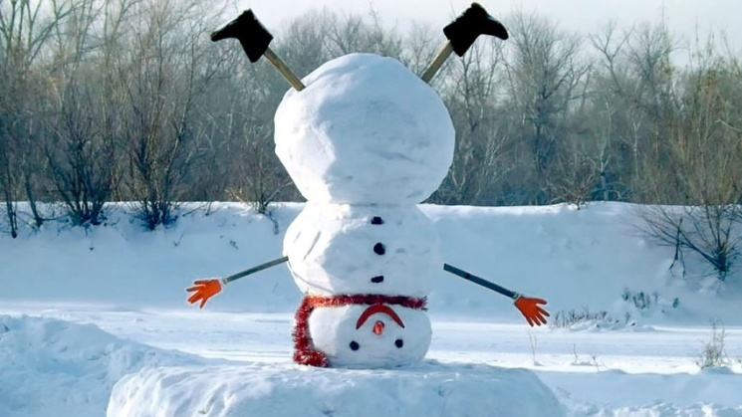
Common Nouns
Lesson 2
Quick reminder – these are things!!!
You have 3 minutes to write down as many winter-related ‘things’ in your nouns column on your planning sheet e.g snowman, robin, snowflake: 3....2...1... GO!!!!

Slide 17
Common Nouns
Lesson 2
Now, take a look at the passage – can you find the nouns in this text? Choose a colour and underline all the ‘nouns’ in the same colour.
Can you create a key to match?
Are there any new word you
can add to your nouns list?
As we move through the other slides, each time you spot a new noun – add it to your list!

Slide 18
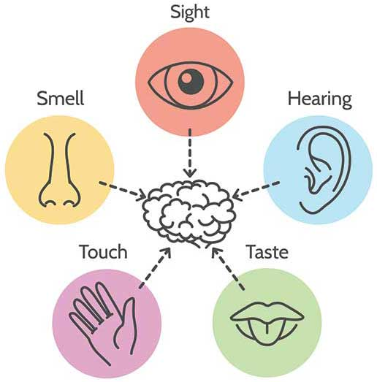
Adjectives
Lesson 2
We have already done lots of work on adjectives and how these are used to describe nouns (things).
We often use our senses
to provide a range of
words.

Slide 19
Let’s have a go at using our senses to generate some adjectives to match these winter pictures.
Lesson 2

Slide 20
Lesson 2
As we move through the slides, add some adjectives to your planning table.
You may wish to try and add them alongside your nouns or just make a long list.

Slide 22
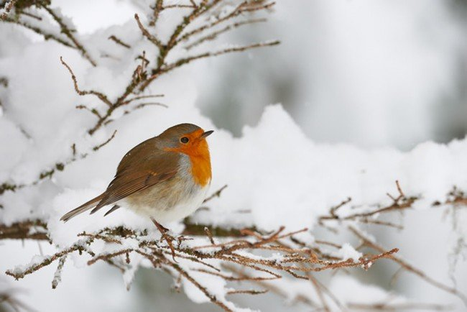

Slide 23
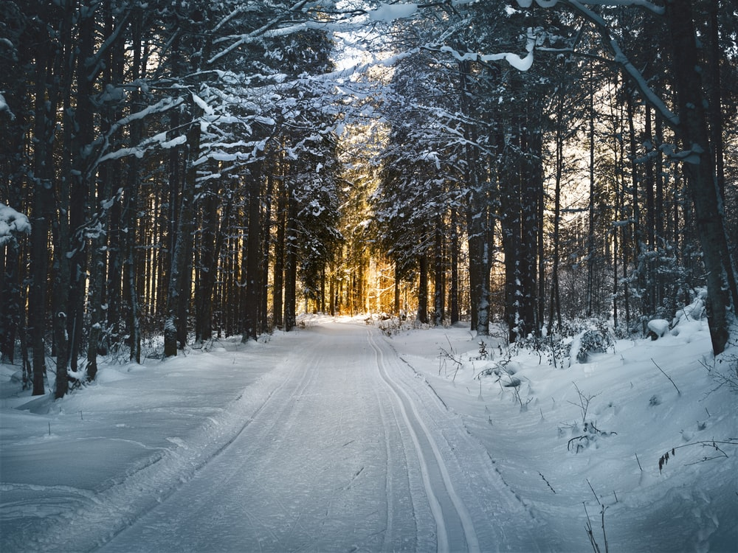

Slide 24
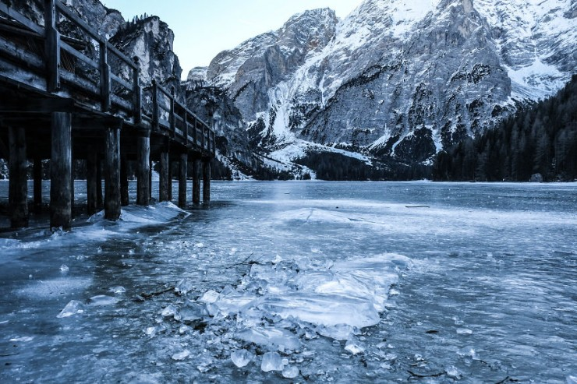

Slide 25
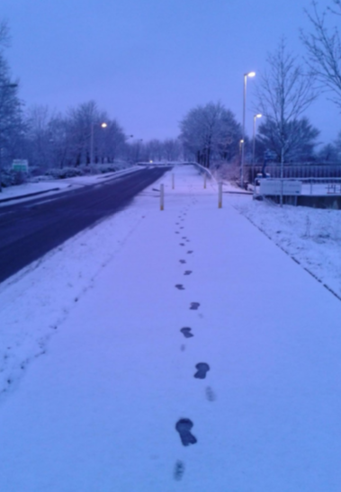
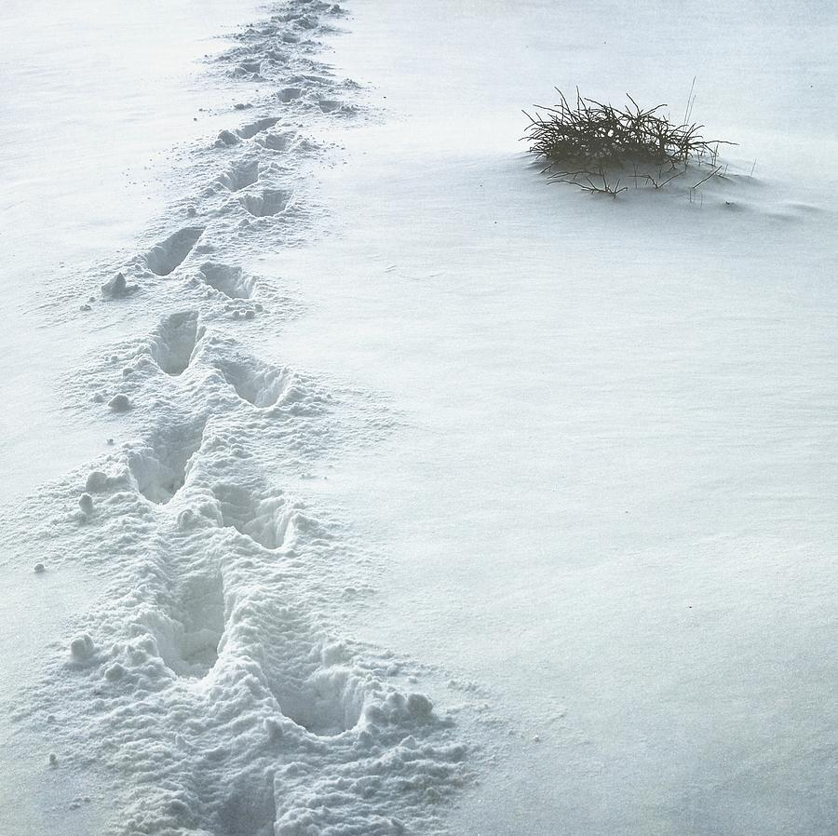

Slide 26
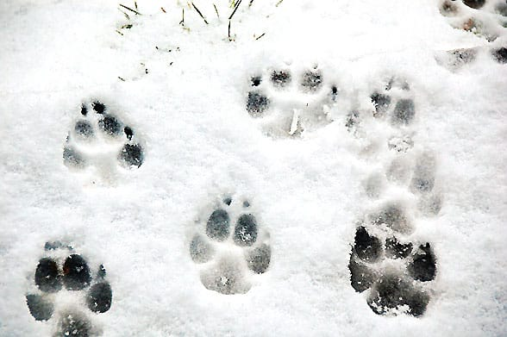

Slide 27
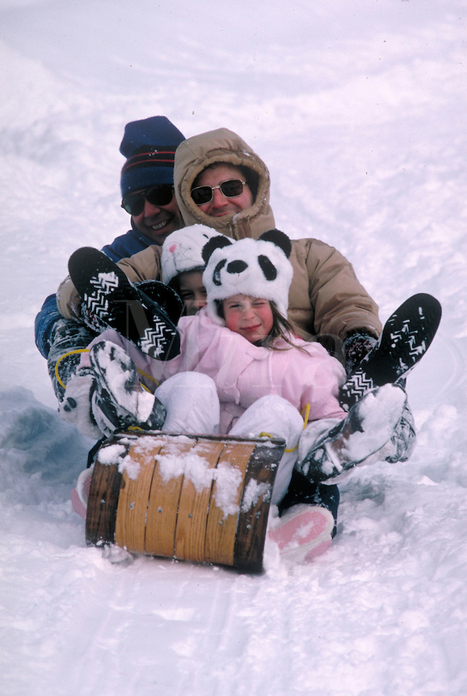

Slide 28
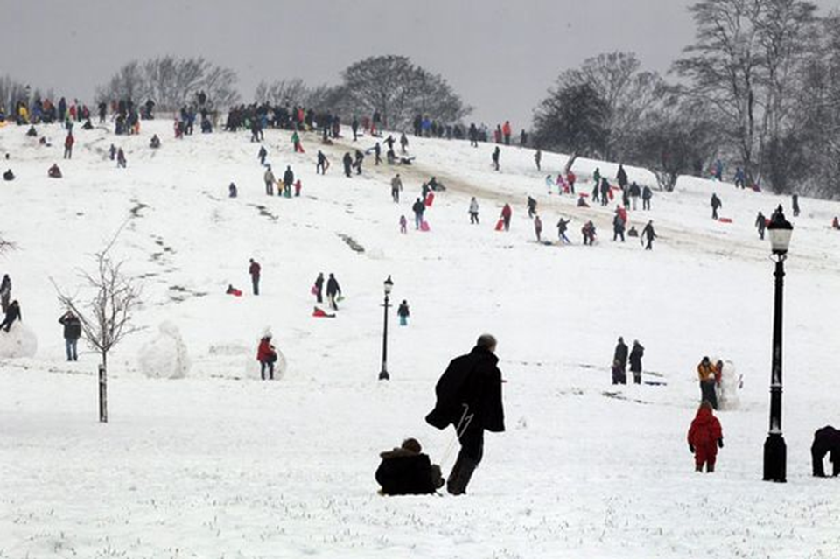

Slide 29
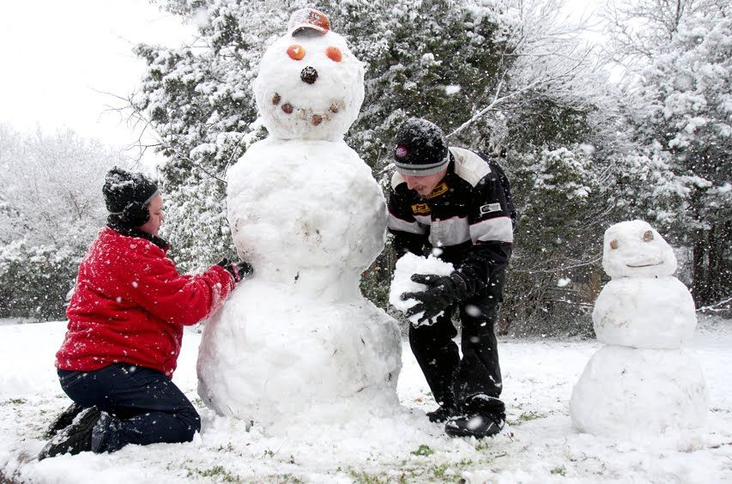

Slide 30
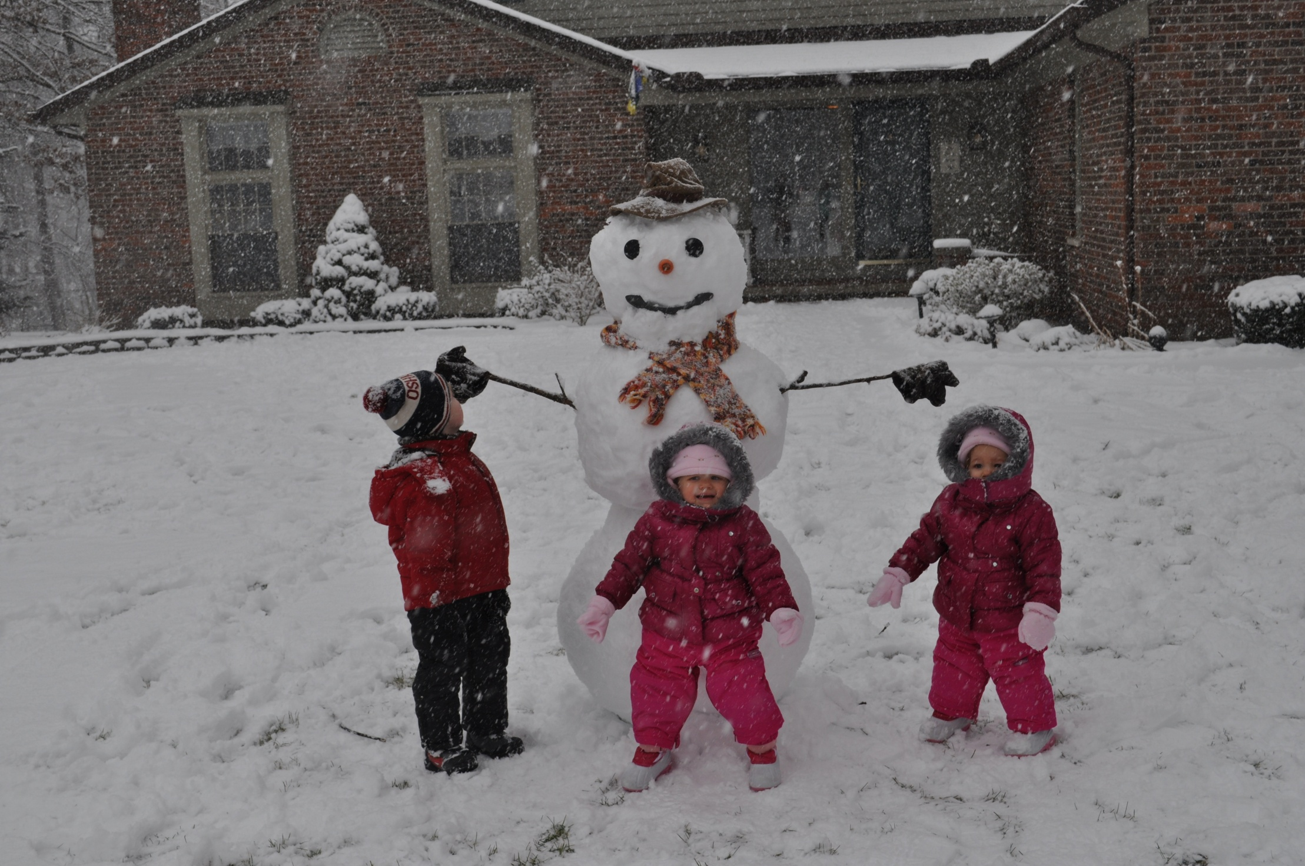

Slide 31
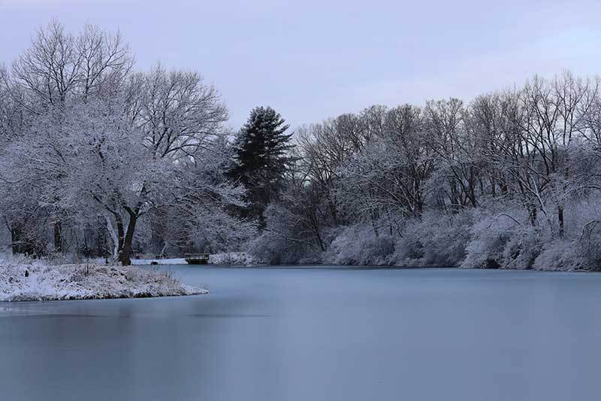

Slide 32
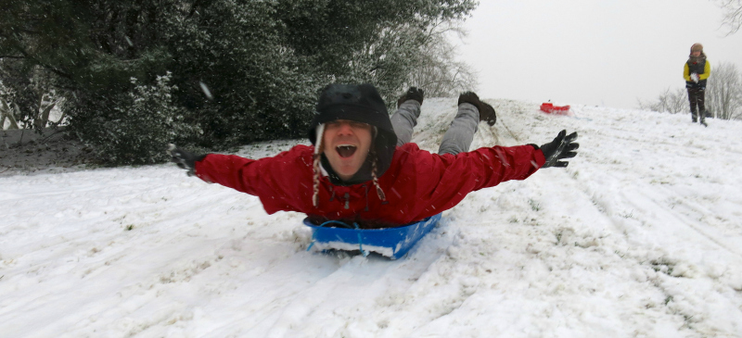
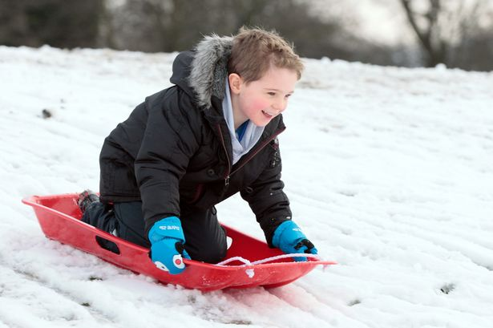
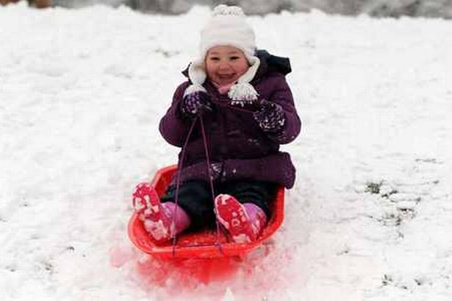

Slide 33
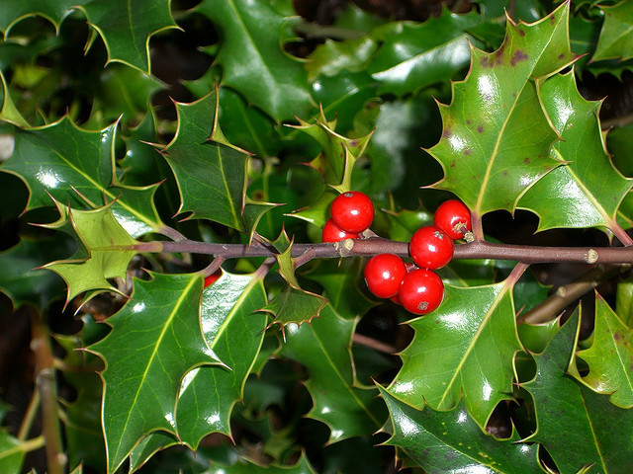
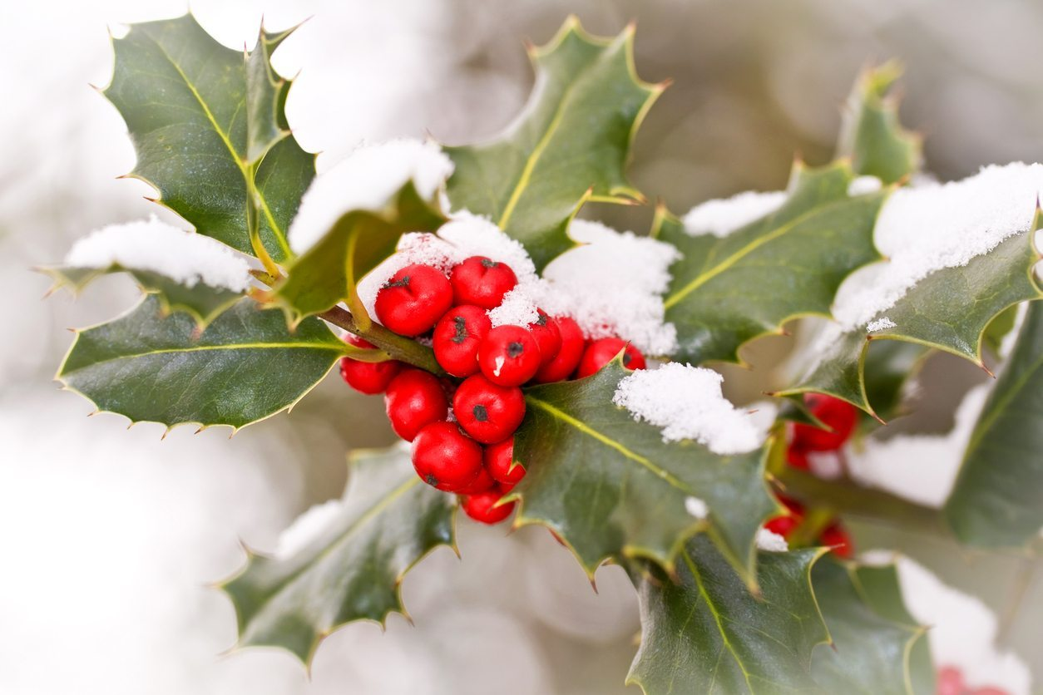

Slide 34
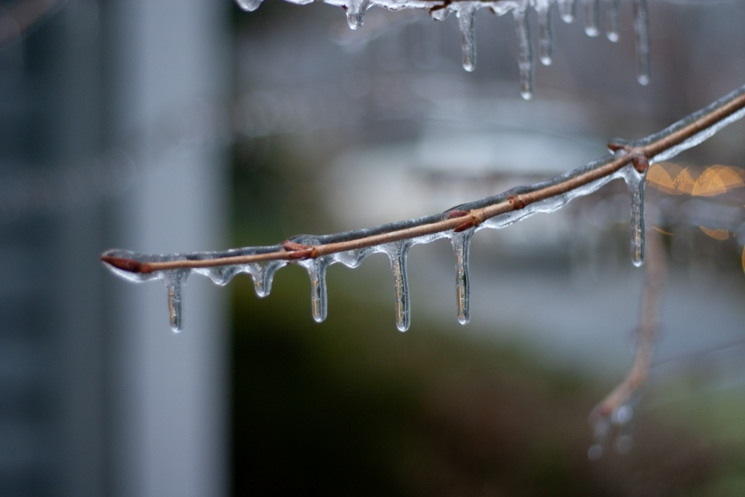
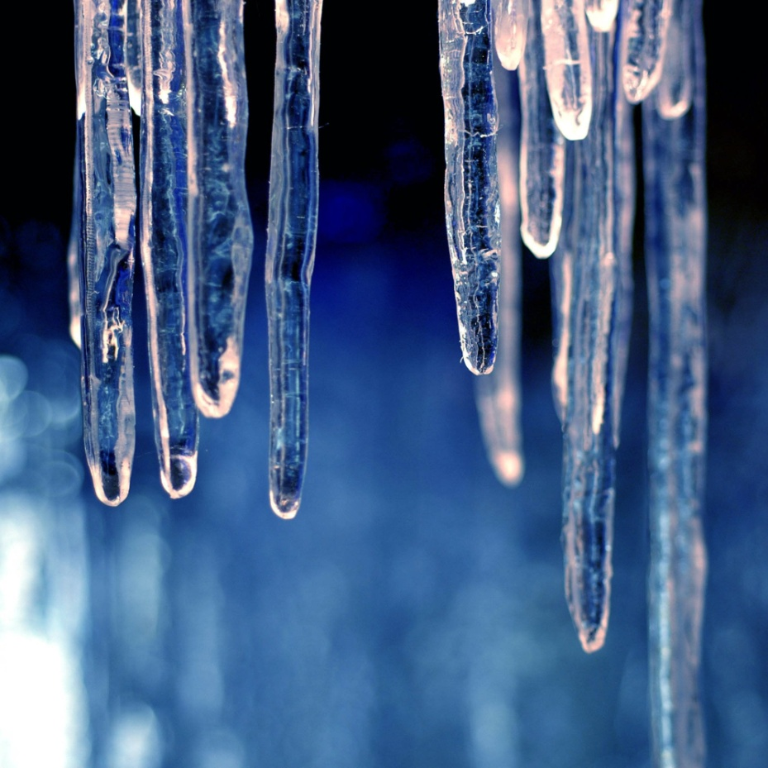
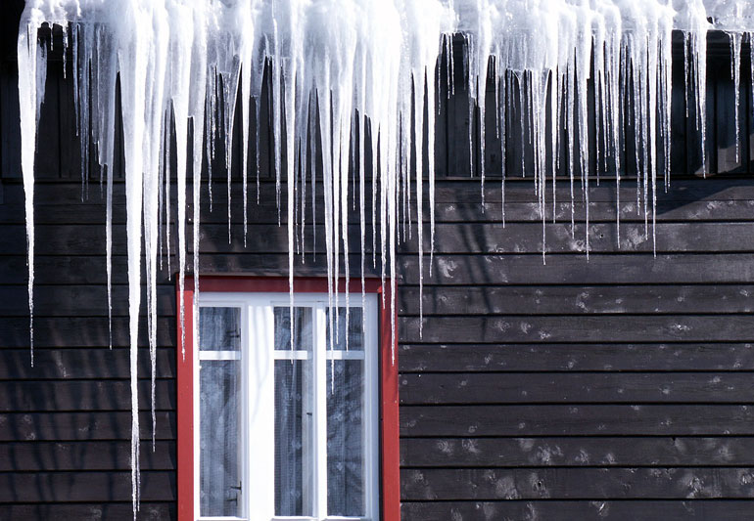

Slide 35
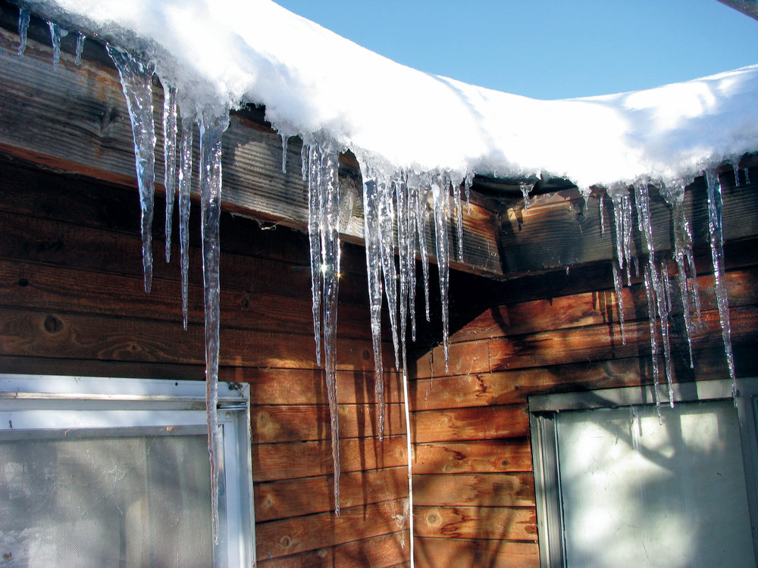

Slide 36
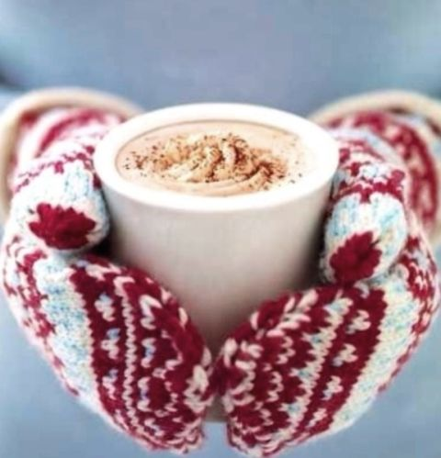

Slide 37
Lesson 2
Now that we have had a good reminder about what adjectives are, re-read your passage, choose a new colour and underline any adjectives using the same colour.
Does the passage provide any adjectives you haven’t yet added to your list? Maybe you could add those?
Extension: Take a look through your long list of adjectives. Think about all the different senses. Do you have some examples for each? Remember, some like 'taste', are harder than others but try to have some variety and not all about what you can ‘see’.

Slide 38
Lesson 3

Slide 39
Let’s quickly recap our learning from yesterday
Lesson 3
Re-read your passage
Re-read your list of nouns – what is a noun?
Re-read your list of adjectives
- what is an adjective?
- what are the 5 senses you should use?
What is our end goal?
To write a poem, about winter,
using our vocabulary lists.

Slide 40
Lesson 3
Similes
When something is similar to something else: ‘as’ or ‘like’

Slide 41
Lesson 3
Winter
Wonderland
Similes

Slide 42
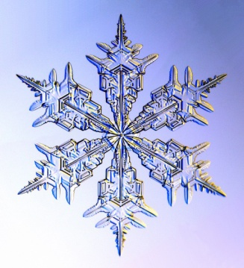
As ........as.....
Lesson 3
Like....

Slide 43
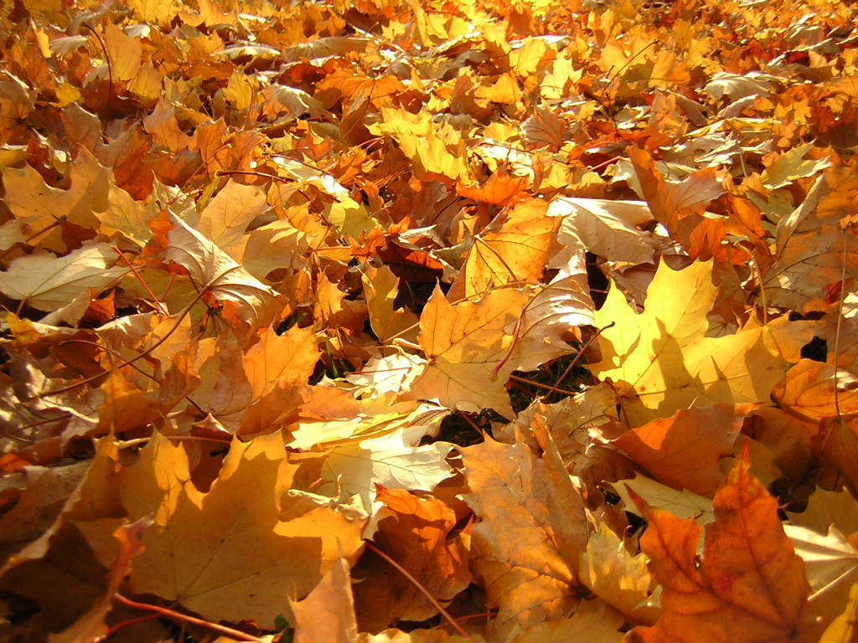
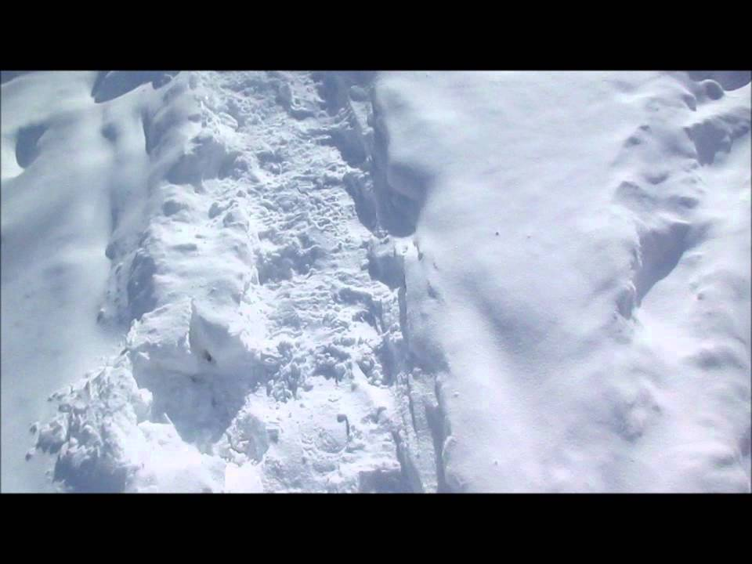
Snow as crunchy as crisp autumn leaves.
Lesson 3
Snow crunchy like crisp, dry
Autumn leaves.

Slide 44
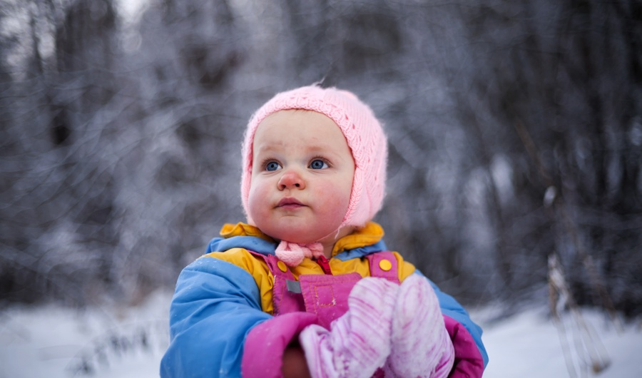
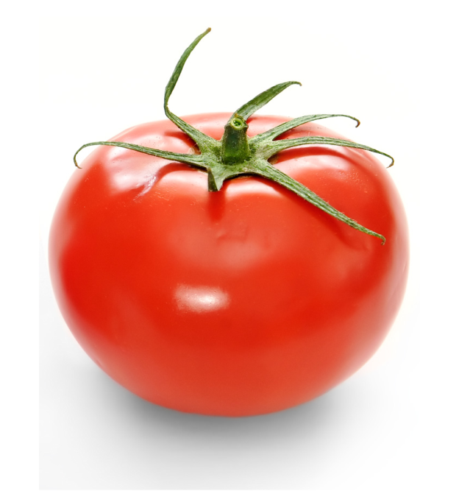
Lesson 3
Noses as red as a juicy, ripe tomato.
Noses red like a juicy, ripe tomato.

Slide 45
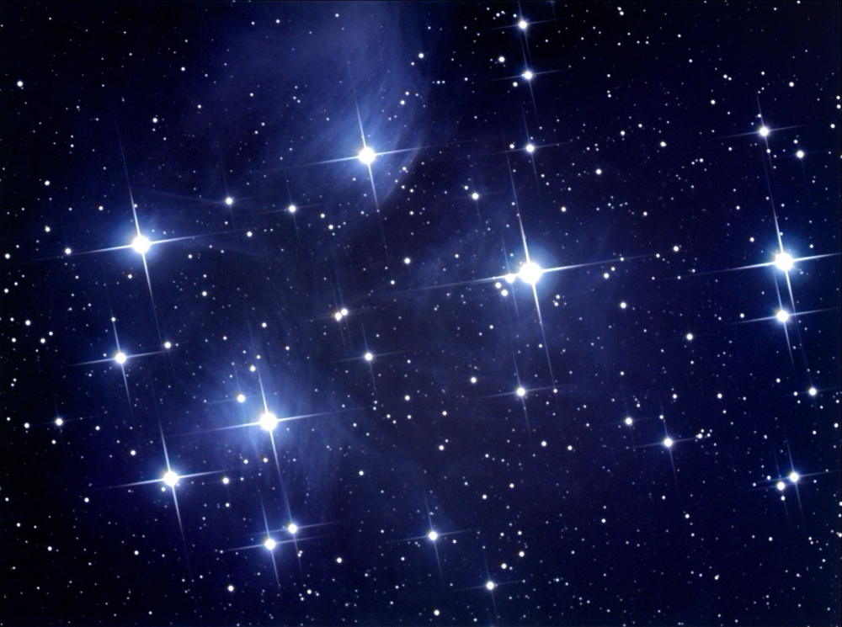
Lesson 3
Pavements as sparkly as the
distant bright stars.
Pavements glistening like the brightest star.

Slide 46
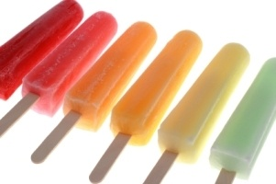
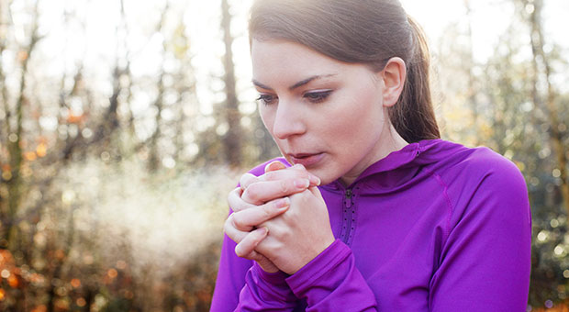
Lesson 3
Fingers cold like a freezing ice-lolly.
Fingers as cold as freezing ice lollies

Slide 47
Lesson 3
The scarf was as warm as hot chocolate.
Snow is like a feather falling down.
The hill was like a blanket of snow.
I slid down the hill like a leaf falling in the breeze.
The hill was as slippery as a banana peel.
The ice was as cold as steel.
Snow is like Santa's bushy white beard.
The ice was as hard as cement.
My nose was red like a cherry.

Slide 48
Tasks:
Can you complete the simile matching activity?
Are there any similes in your passage?
Can you add some similes to your planning sheet?
Lesson 3

Slide 49
Onomatopoeia
Lesson 3
Sound words- words that make the sound of the thing they describe……
Snowy, icy themed onomatopoeia could include:
squidge squish
splosh crunch
drip drop slip

Slide 50
Alliteration
Lesson 3
The repetition of the same sound, usually at the beginning of words…..
Soft, slippery snow.

Slide 51
We can also still think about using
Lesson 3
Verbs & Adverbs
Remember these can relate to a living thing
e.g. A robin chirping cheerfully. Children laughing happily.
But they can also be used for nouns
e.g. Snowflakes drifting gracefully. Icicles melting quickly.
Task: Keep adding ideas to your planning list and highlighting
your passage.
Return to the winter scene photos earlier in the week (slide 21).
Discuss each picture in terms of verbs (action / doing words) and adverbs (describing the verb -ly words).

Slide 52
Lesson 4

Slide 53
LC Can you write a winter themed poem?
Lesson 4
Today, we will be combining all of our hard work this week into writing a poem.
You will need your planning sheet ready to help you.

Slide 54
Lesson 4
Your teacher will support you to decide which pattern you will follow for your poem.
Once you have agreed your pattern , you will follow this pattern for each line of your poem.
Your pattern can follow one of many. The following slides provide a few examples.
You will then be required to apply this pattern several times, starting a new ‘line’ each time you restart your pattern.
These lines will all build up to create a poem. You may even choose to arrange your poem into 2 line or 4 line verses.

Slide 55
Lesson 4
adjective noun verb
Glistening snowflakes fall.
Happy children play.
Steaming cocoa sipped

Slide 56
Lesson 4
Adjective, adjective noun verb
Glistening, delicate snowflakes fall.
Happy, cheerful children play.
Steaming, hot coco sipped

Slide 57
Lesson 4
Adjective, adjective noun verb adverb
Glistening, delicate snowflakes fall gently.
Happy, cheerful children play merrily.
Steaming, hot cocoa sipped gratefully.

Slide 58
Lesson 4
Onomatopoeia adjective, adjective noun verb adverb
Crunch! Thick, white snow flattened smoothly.
Splosh! Slushy, wet ice melting quickly.
Whizz! Excited, cheerful children sledge energetically.

Slide 59
There are so many different patterns that you could follow to create a wonderful poem.
Lesson 4
Let’s see all of your wonderful ideas!

Slide 60
Additional Learning

Slide 61
Can you self-assess your poem?
Using the pattern that you set yourself as a key/checklist, highlight the different word types.
- Did you follow your pattern?
- Did your repeat any words? If so, can you alter them to a different word?
- Did you choose to split your poem into verses? If not, can you now see where you could do this?
It would be lovely to re-write in best or even type up your completed poem and add some appropriate illustrations.
We could display some of these on the classroom wall.

