Slide 1
Soft ‘g’
Y2 Phonics – Spring 1 - Week 1
LC: Can you recognise the soft ‘g’ sound?
The letter g makes the sound/j/ when followed by e-i-y

Slide 2
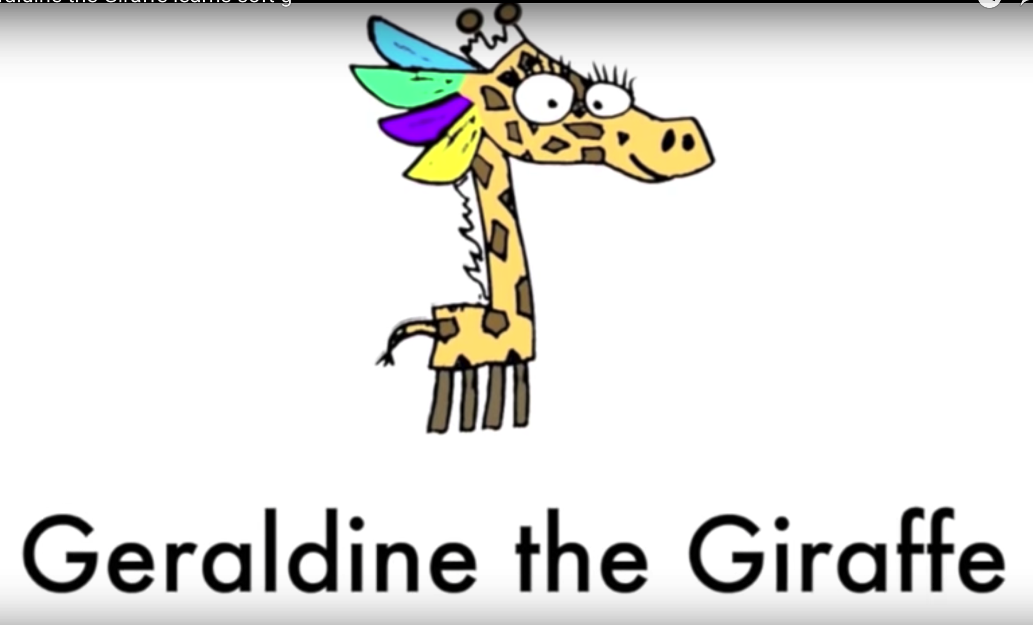
Let’s watch Geraldine the Giraffe
https://www.youtube.com/watch?v=xL4WykIuCRw

Slide 3
Soft g rule:
The letter g makes the sound /j/ when followed by e-i-y

Slide 4
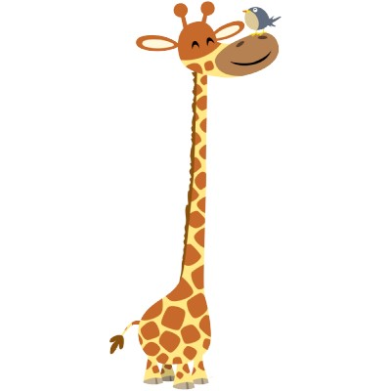
giraffe

Slide 5
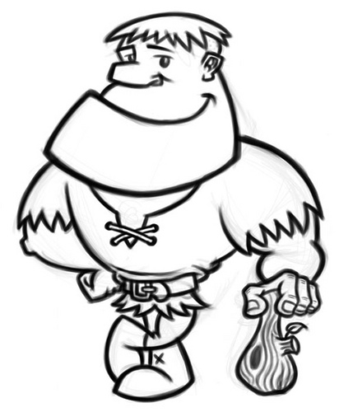
giant

Slide 6
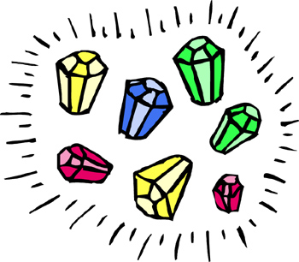
gems

Slide 7
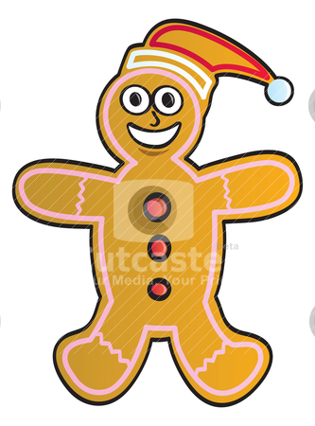
gingerbread man

Slide 8
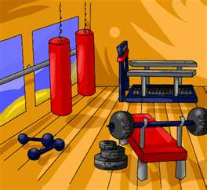
gym

Slide 9
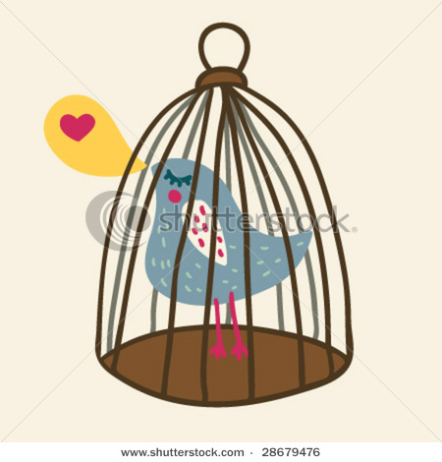
cage

Slide 10
Can you remember the rule?
Soft g rule:
The letter g makes the sound /?/ when followed by ?-?-?

Slide 11
Review
giraffe
giant
gems
gingerbread man
gym
cage
Can you think of anymore soft ‘g’ words?

