Slide 1
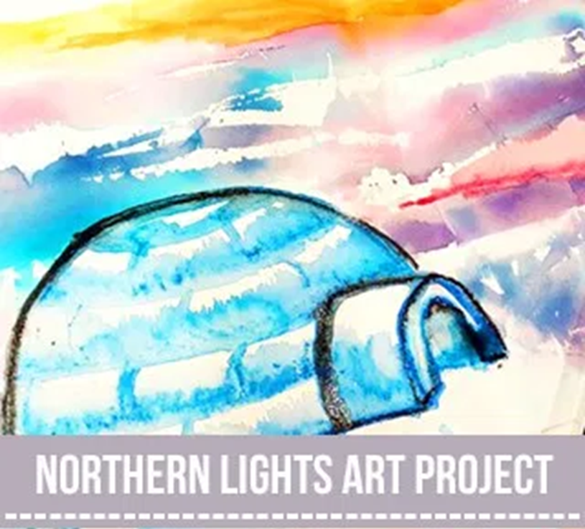
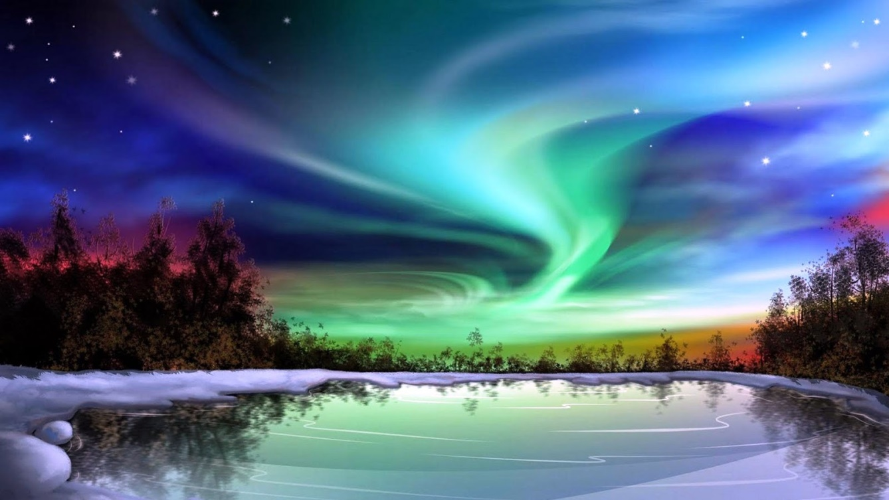
Northern Lights Art

Slide 2
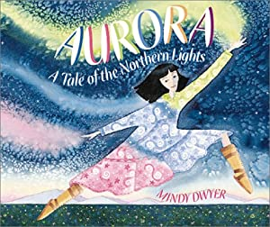
Our art this week is linked to our new Arctic topic. Click on the book below to hear a reading of ‘Aurora: A tale of the northern lights’ by Mindy Dwyer

Slide 3
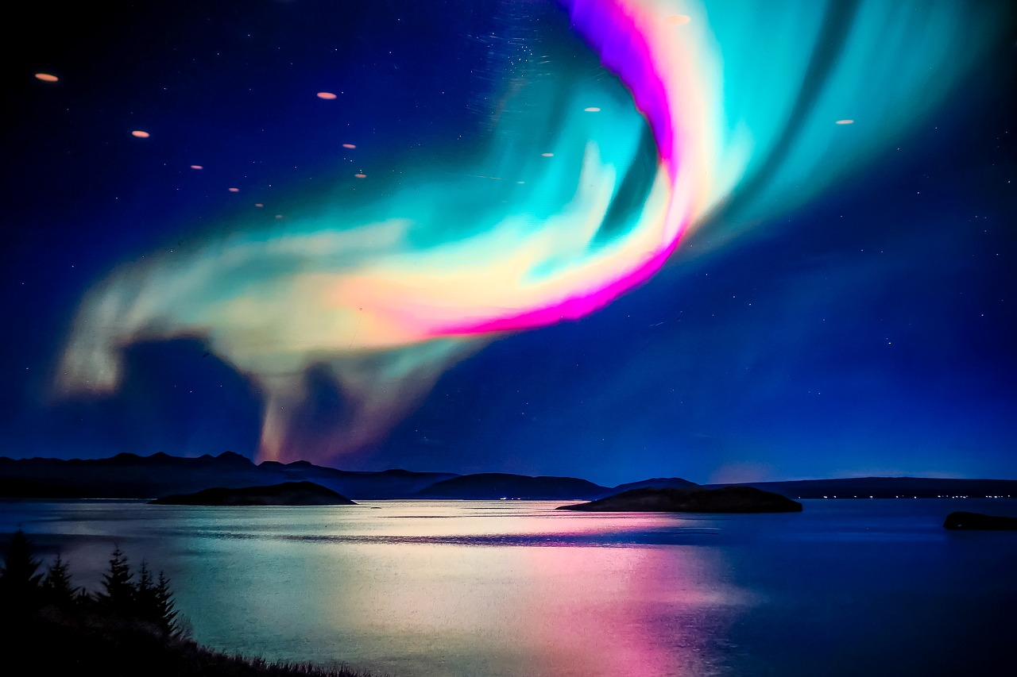
Did you enjoy the story? Why? Why not?
How did the story make you feel?
What did you learn?
Have you been lucky enough to see the northern lights? If not, would you like to see them?

Slide 4
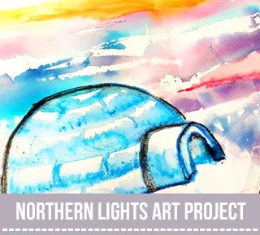
Have a go at creating your own northern lights art!
In school we will be creating our art
using bleeding watercolour tissue
paper and watercolour paints and
pencils. If you’re working from
home you could use any medium
you like to re-create the beautiful
swirling lights. I have provided you
with an igloo template if you need
it but see if you can have a go on
your own first.
The following instructions show what we will be doing in school but you will be able achieve similar effects with paints, colouring pencils, crayons, felt-tips etc. You could also glue on normal tissue paper.
ENJOY! ☺

Slide 5
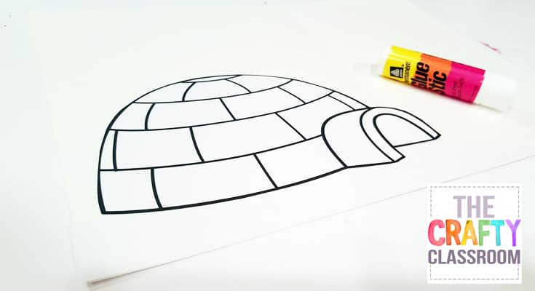
STEP 1
Draw your igloo or cut out your igloo template and glue lightly to your art paper.

Slide 6
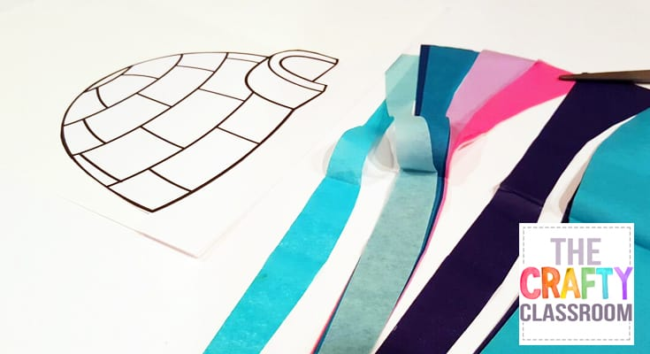
STEP 2
Cut your bleeding tissue paper into thin strips.

Slide 7
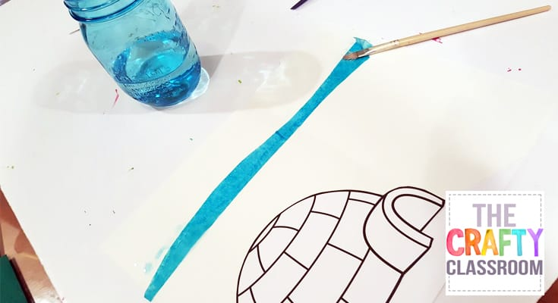
STEP 3
Using water and a paintbrush, begin to wet your paper and lay down strips of tissue paper. Wet the top of the tissue paper as well.

Slide 8
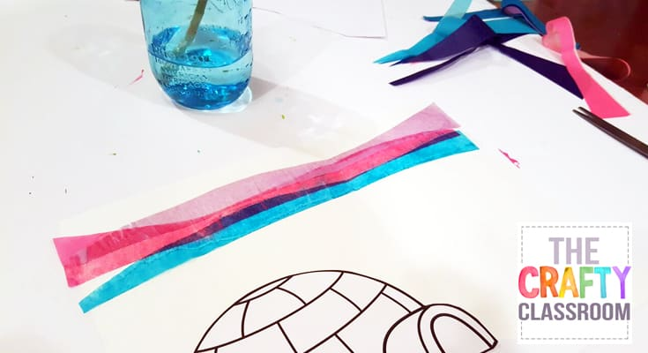
STEP 4
Layer your tissue paper to blend the colours. Continue to wet the paper as you go.

Slide 9
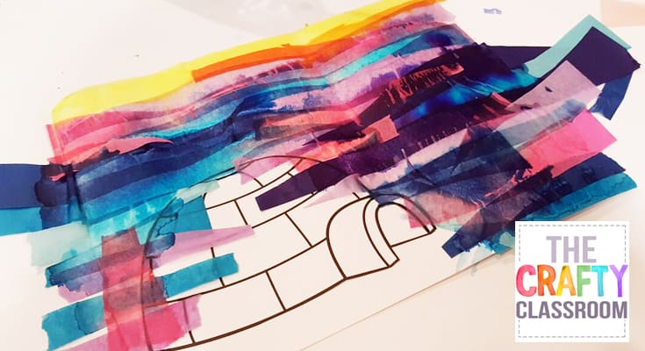
STEP 5
Fill your paper with tissue paper strips.
Allow to dry.

Slide 10
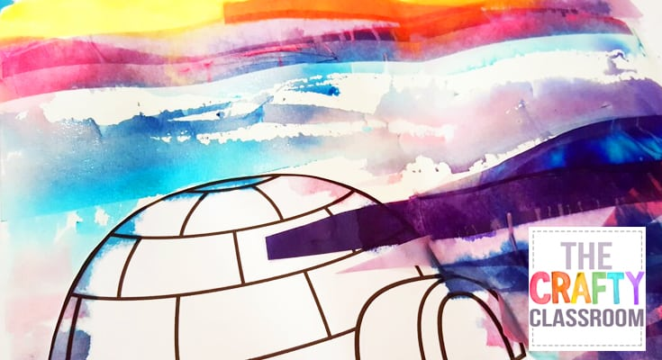
STEP 6
When dry, carefully peel back your tissue strips to reveal the colour patterns below.

Slide 11
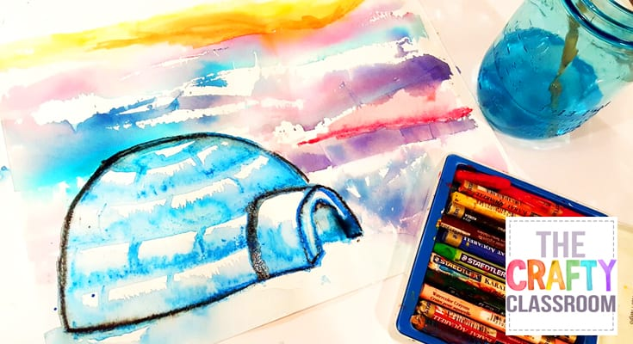
STEP 7
Use watercolour crayons (or watercolour paints) to add some colour to your igloo.

Slide 12
Evaluation
What did you enjoy about making this art?
What did you find difficult?
How did you solve any problems?
What would you do differently next time?
What have you learnt?

