Slide 1
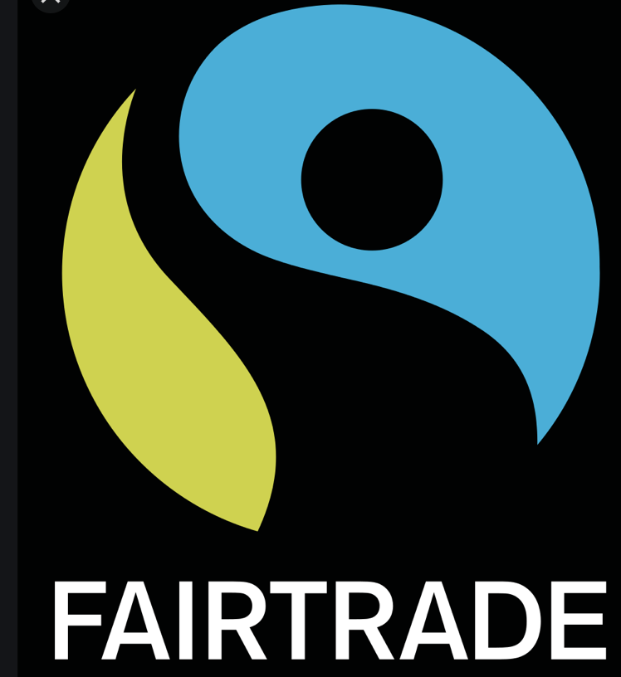
PSHE – Fairtrade
Spring 1
Lesson 1
LC: Can you describe what Fairtrade is?

Slide 2

Where have you seen this symbol before?
What does it mean?
FAIRTRADE

Slide 3
FAIRNESS
To cooperate with others and develop empathy with other peoples’ situation around the world.
Treating someone in a way that is right or reasonable, or treating a group of people equally and not allowing personal opinions to influence your judgement.

Slide 4
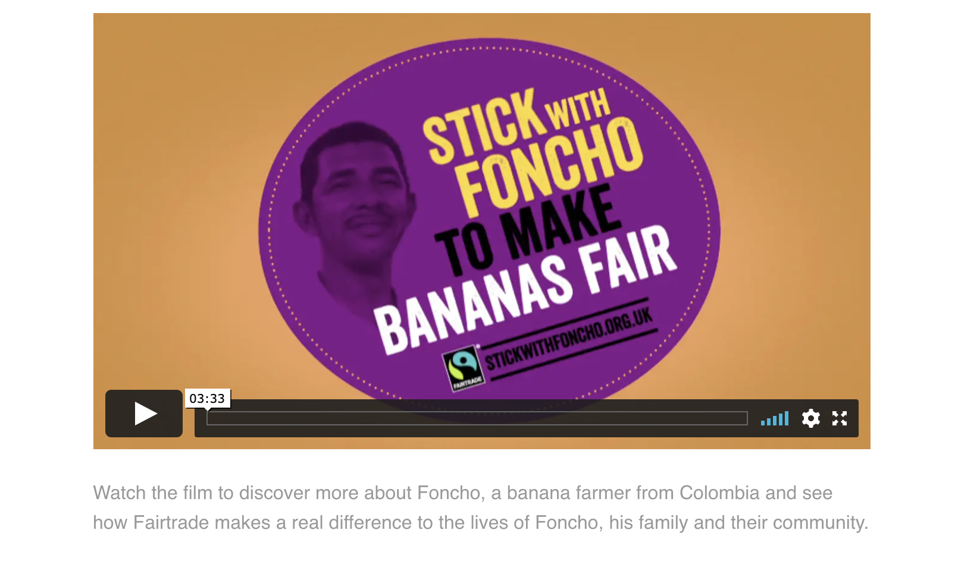
https://schools.fairtrade.org.uk/teaching-resources/make-bananas-fair-a-film-for-schools/

Slide 5
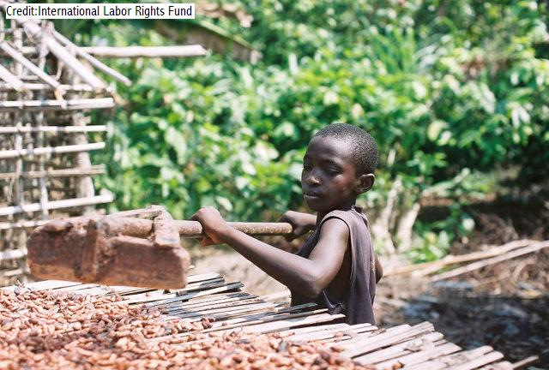
Unfair trade
Child or forced labour
Poor working conditions
Low wage, not enough to cover the cost of production
Increased poverty for producers in the third world
Negative impact on the environment

Slide 6
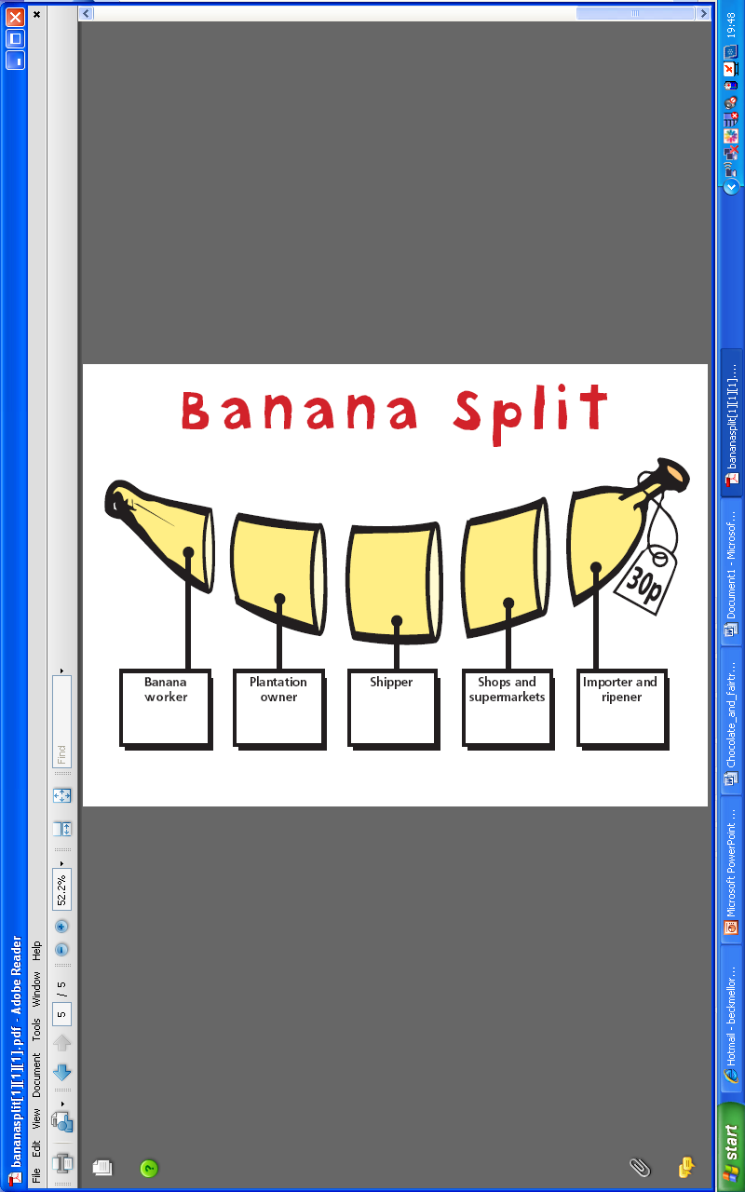
Many different people help to bring bananas to our supermarkets.
For a non-Fairtrade banana, how much do you think each gets out of the 30p?

Slide 7
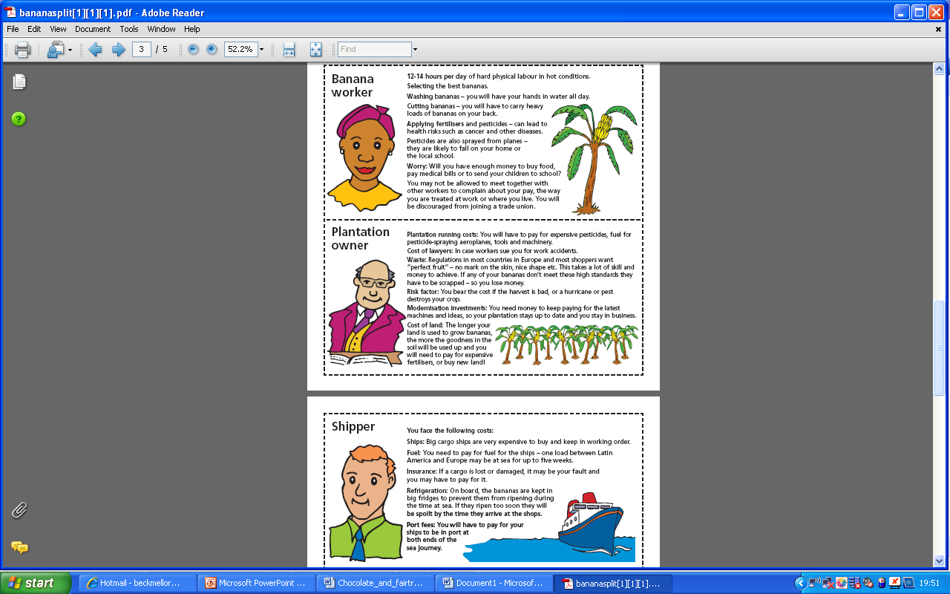
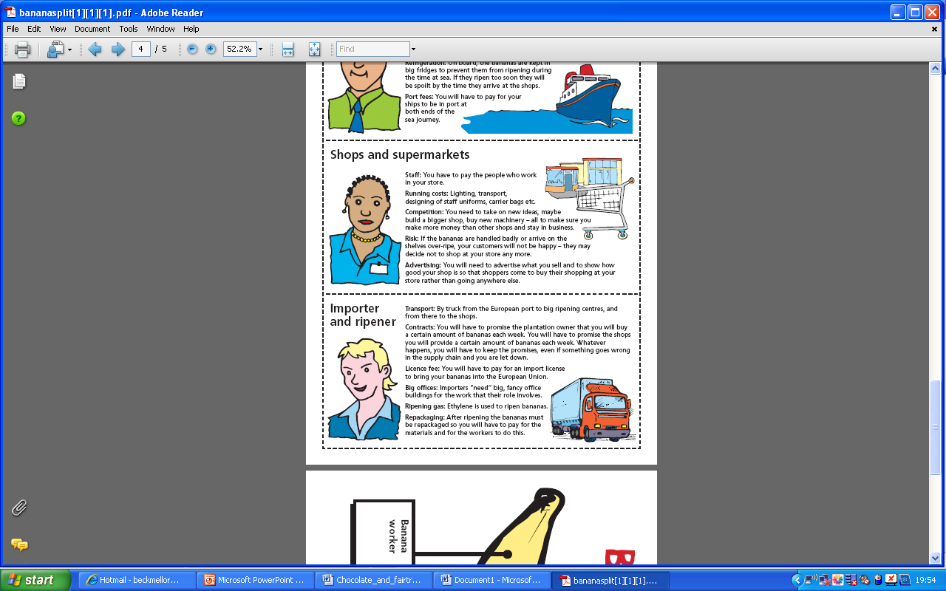
Supermarkets
Works 12-14 hours a day. Picks, carries and washes heavy loads of bananas.
Uses chemicals that make the bananas grow but can make the worker ill.
Runs the farm.
Has to pay for expensive machinery and chemicals.
Loses money if the bananas do not grow properly.
Transports the bananas using massive ships.
Buys the ships and pays for the fuel.
Loses money if the bananas go mouldy on the ship.
Sells the bananas.
Pays staff wages, heating and lighting bills in the shop and advertising bills.
Has to sell the best bananas at the best price to beat the competition.

Slide 8
Who gets what?
Do you think it’s fair?
15p
7p
6p
2p

Slide 9
What is Fairtrade?
A group that makes sure workers from developing countries receive a decent wage.
Ensures good working conditions.
Makes sure that only adults are employed to work- not children.
Helps villages in developing countries to live healthily and happily without needing charity or hand-outs.
Looks after the environment. Farmers are paid fairly so don’t need to use harmful chemicals to grow more food, faster.

Slide 10
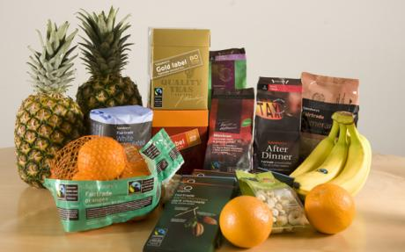

Slide 11
Fairtrade
Fairtrade products are usually more expensive than non-Fairtrade.
This is to make sure that everyone is paid a good wage for the work they do.
Do you think it is worth it?
Notes:
11

