Slide 1

RE – 4th December 2020
BIG QUESTION - How are important events remembers in ceremonies?
Key questions for today
Why has light been used in ancient civilisation festivals?
Why has light always been a good representation of culture or religion?

Slide 2
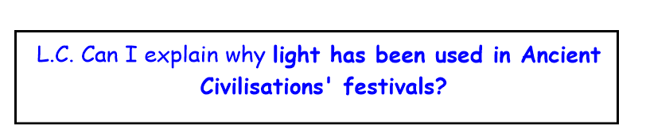
Today, we are going to look at some Ancient civilisations and how they used light.
We will discover how some festivals use light as a representation of hope, joy, remembrance and reflection.

Slide 3
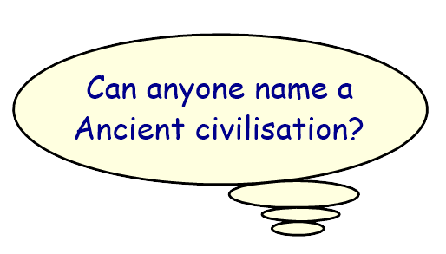
Ancient Egypt Inca Ancient Rome Mayan Ancient Greece

Slide 4
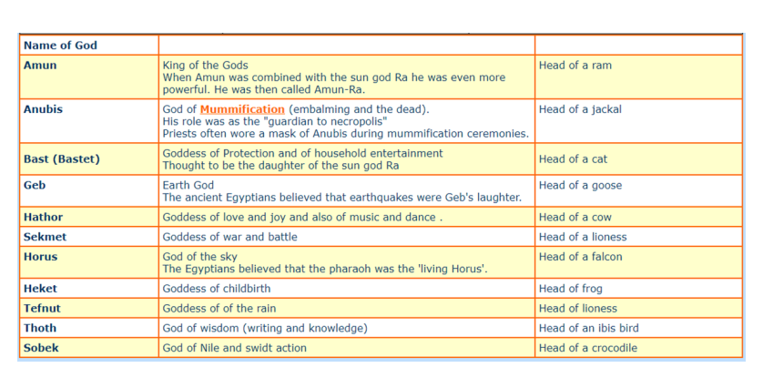
The Ancient Egyptian gods

Slide 5
Ra the God of the Sun.
Ra was the most important God. He was the lord of all the gods. He was usually shown in human form with a falcon head, crowned with the sun disc encircled by the a sacred cobra.
Ra sailed across the heavens in a boat called the 'Barque of Millions of Years'. At the end of each day Ra was thought to die and sailed on his night voyage through the Underworld, leaving the Moon to light the world above

Slide 6
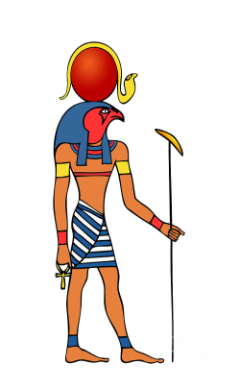
Ra was the god of sun, why might the Ancient Egyptians have worshiped him?
Think about what the Sun does.

Slide 7
BBC video clip about the beliefs of those in Ancient Egypt
http://www.bbc.co.uk/education/clips/zwfvr82

Slide 8
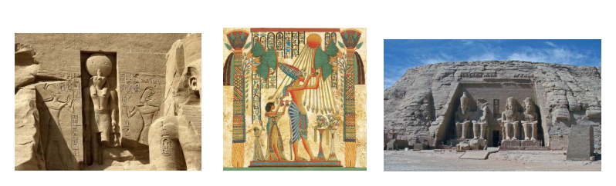
How did Ancient Egyptians worship Ra?
Sculptures
Paintings
Temple of RA

Slide 9
Do any countries still celebrate the sun?
Inti Raymi, or the “Festival of the Sun,” falls on June 21 or 22, the date of the southern hemisphere’s winter solstice, the shortest day of the year. Indigenous communities throughout the Andean highland countries of South America celebrate the winter solstice with ceremonies designed to bring the Sun back and shorten the longest night. Incan in origin, Inti Raymi honored the sun as the source of light, heat, and life, and celebrated the start of a new planting season. The name Inti Raymi comes from the Quechua language: inti means “sun” and raymi means “festival.” The largest festival takes place in Cuzco, Peru, the ancient capital of the Incan civilization and empire.
https://www.youtube.com/watch?v=Q3qz3Ly0SGQ&vl=en

Slide 10
L.C. Can I explain why light been used in Ancient Civilisations?
Prepare an information leaflet about Ra or about the ‘Festival of the sun’ and how light is related worship.
Be prepared to use some of the information that you have found out in class tomorrow.

Slide 11
Why has light (and the sun) has
always been a representation in
culture/religion?
What might it be used to represent?

