Slide 1
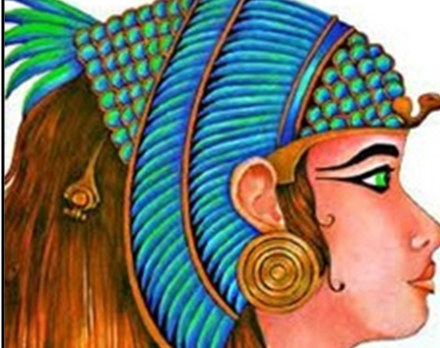
The Egyptian Cinderella
This week you have been planning your own version of this story.

Slide 2

In class tomorrow, we will be using all of the ideas that you have created this week to being our story writing.
Before we start our writing we need to make sure that we are prepared.
Please make sure if you haven’t already, that you have sent your planning work through from English this week as you will need it for your writing tomorrow.

Slide 3
Year 3 – L.C Can I use capital letters accurately in my independent writing?
Year 4 – Can I use fronted adverbials accurately in my writing?

Slide 4
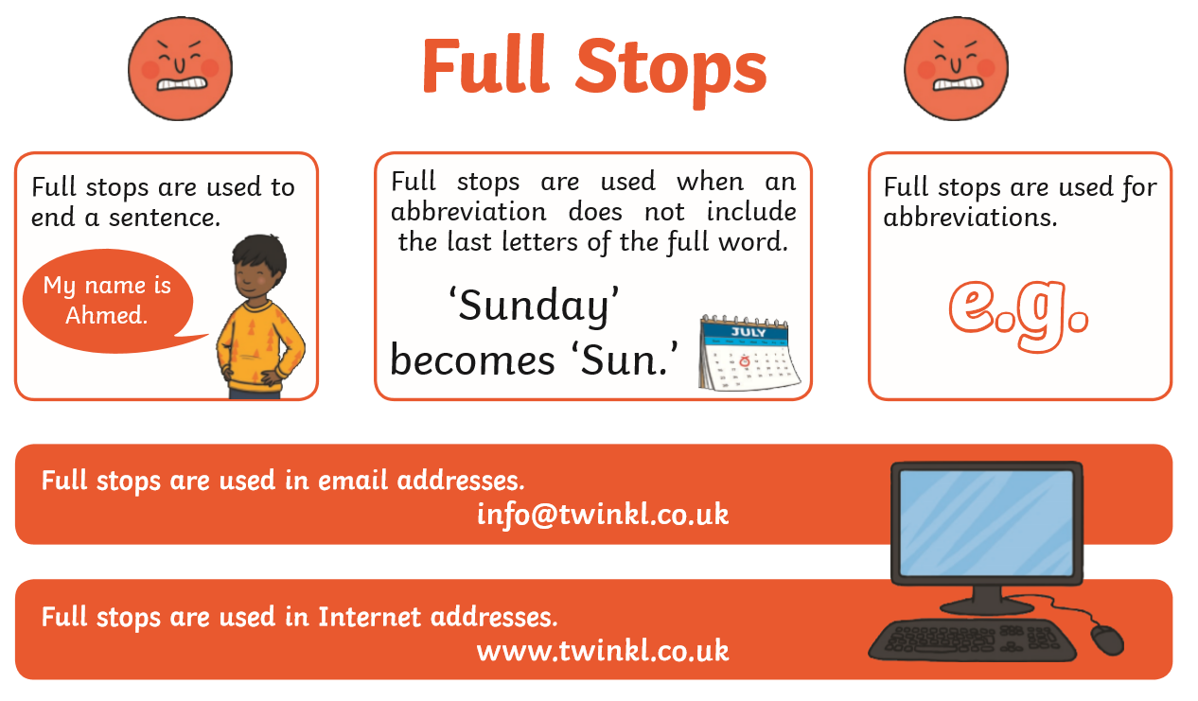
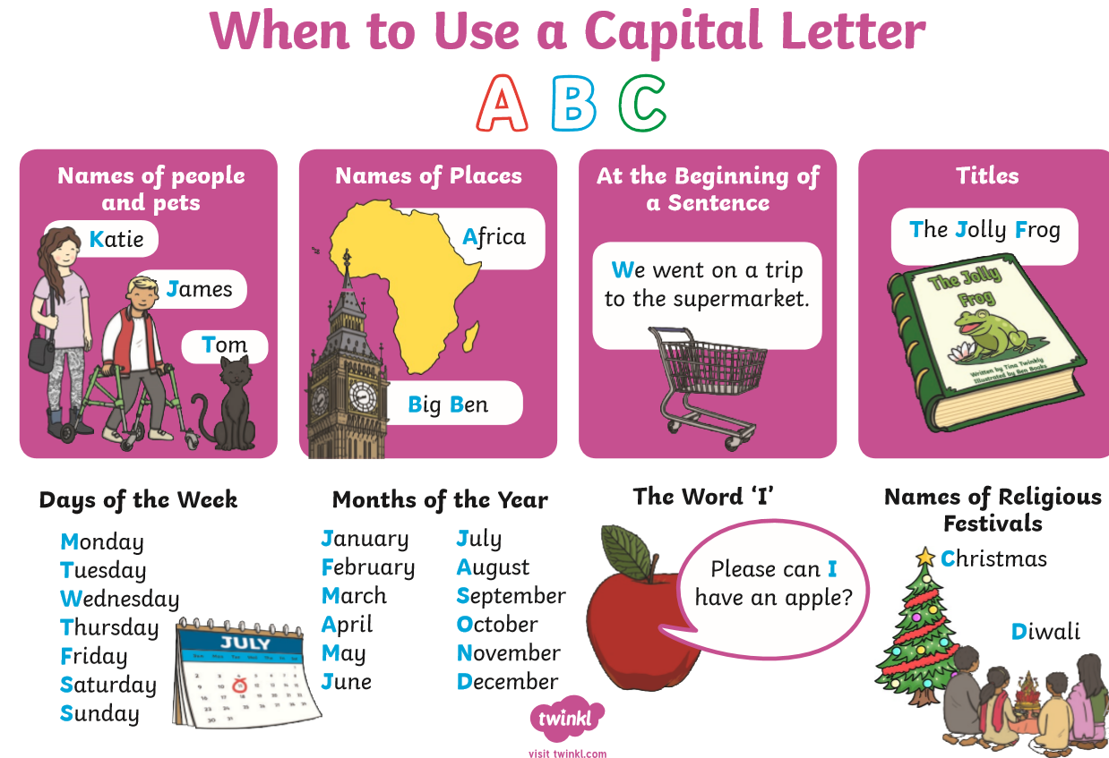
Using Full Stops
Using Capital Letters

Slide 5
Where should we use capital
letters in our writing?

Slide 6
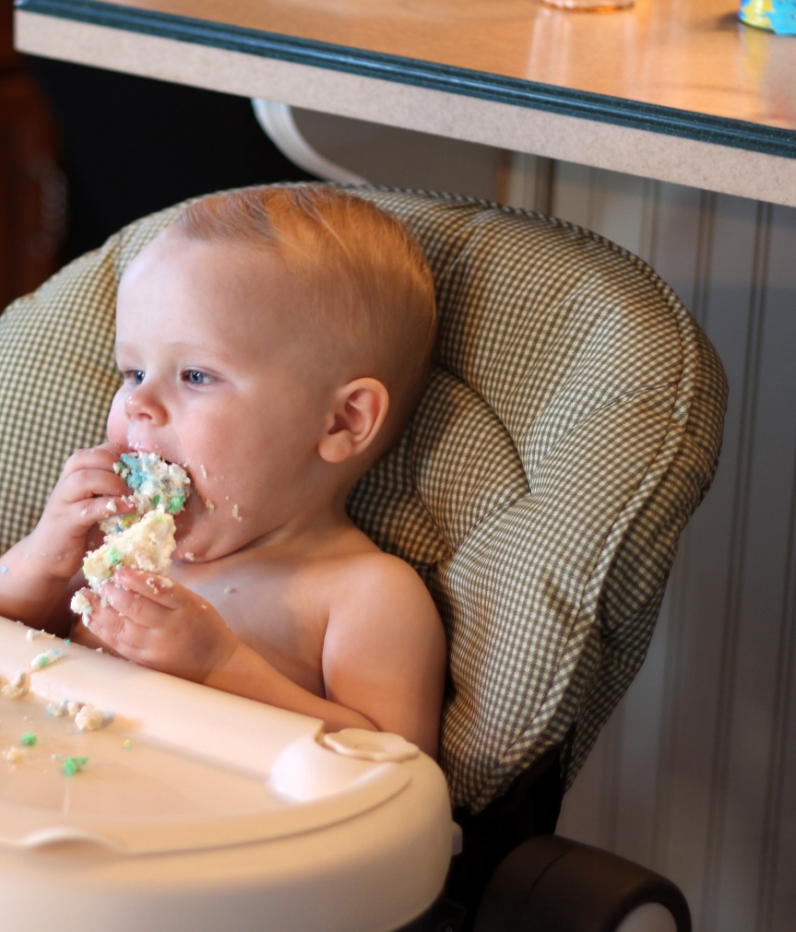
Capital letters are always used to start sentences
Can you tell me a sentence for this picture?
Where would you use a capital letter?

Slide 7
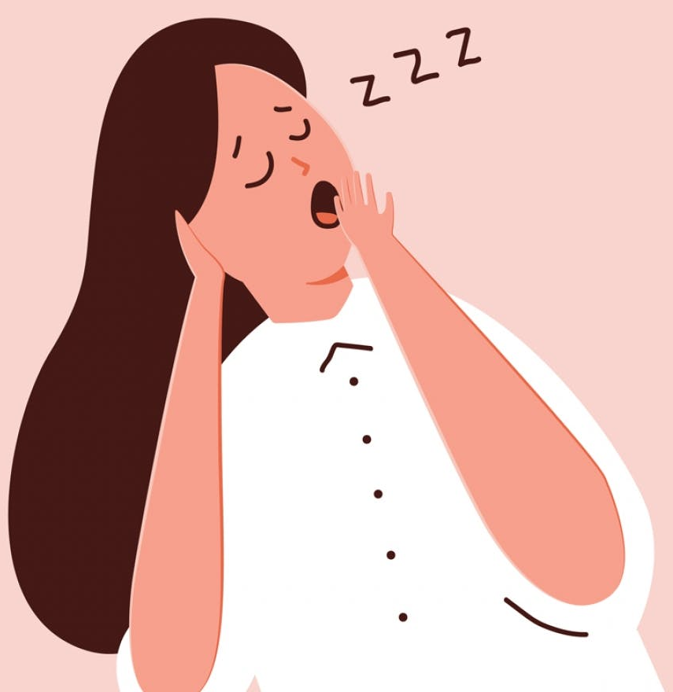
Capital letters are always used to start sentences
Can you tell me a sentence for this picture?
Where would you use a capital letter?

Slide 8
Proper Nouns
What are proper nouns?
Proper nouns are naming words for individual people, places, days of the week and months of the year.
Proper nouns all need capital letters.
Common Nouns | Proper Nouns
girl | Lisa
country | Egypt
city | Leeds
football team | Nottingham Forest
day/month | Monday/September

Slide 9
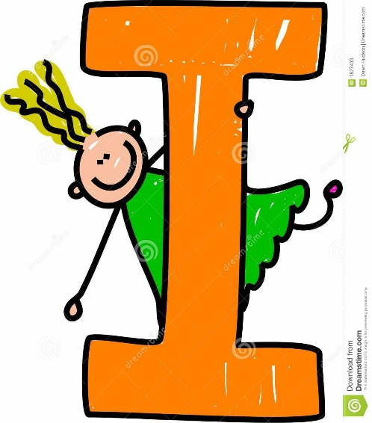
The Personal Pronoun ‘I’
When we are writing about ourselves we use the
personal pronoun ‘I’
The personal pronoun ‘I’ always needs a capital letter.

Slide 10
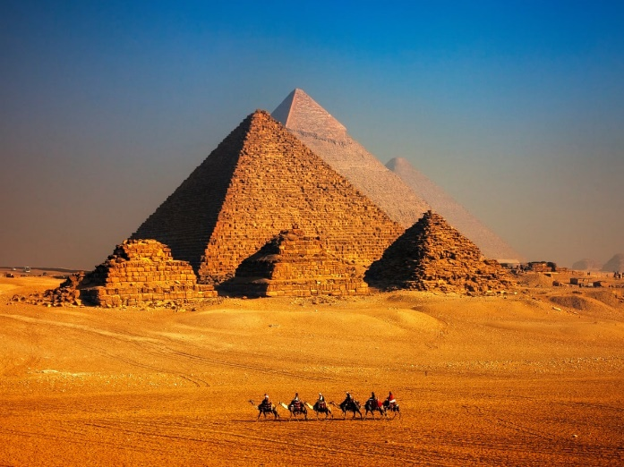
Task – In your Home learning books
Can you spot the proper nouns and the personal pronoun ‘I’ in these sentences and add
capital letters to the beginning of them?
martin and susan went to egypt for their holidays.
it is always sunny in egypt.
owen supports greece united fc.
rodophis and charaxos went to the shops in memphis.
on monday, we are going to see the pharaoh.
Pharaoh amasis was sitting on his throne in egypt
the servant girls teased rodophis down by the river
i am going to egypt for two weeks in june this year.

Slide 11
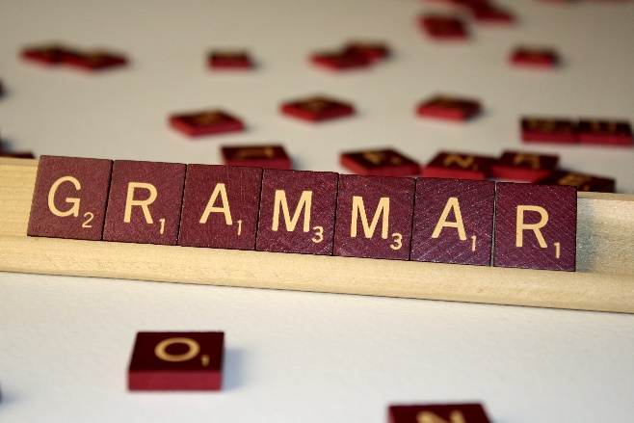
Year 4
Year 4 – Can I use fronted adverbials accurately in my writing?
https://www.bbc.co.uk/bitesize/topics/zwwp8mn/articles/zp937p3#:~:text=A%20fronted%20adverbial%20is%20when,today'%20is%20a%20fronted%20adverbial.
Click on this website link to watch a short video on fronted adverbials.

Slide 12
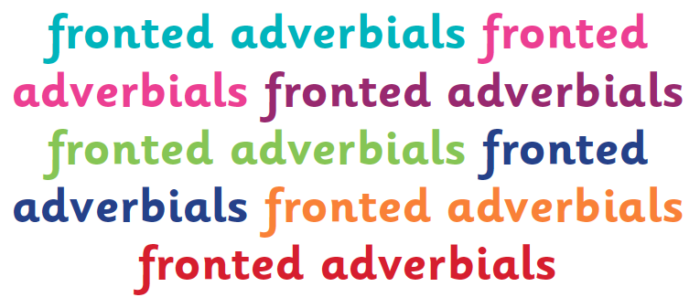
An adverbial is a word, phrase or clause that is used, like an adverb, to modify a verb or a clause. Adverbs can be used as adverbials, but many other types of words, phrases and clauses can be used in this way, including prepositional phrases and subordinate clauses.
When an adverbial is used at the beginning of a sentence, they are often called ‘fronted adverbials’.

Slide 13
Fronted adverbials are used to describe…
the time something happens,
e.g. Before sunrise, Darius crept into the beast’s cave.
the frequency (how often) something happens,
e.g. Every so often, Darius could hear the beast’s ferocious snore.
the place something happens,
e.g. At the back of the cave, the terrifying creature began to stir.
the manner something happens,
e.g. As quick as a flash, Darius bounded behind a nearby rock.
the possibility (how likely) something will/has happen(ed),
e.g. Almost certainly, the deadly beast would find Darius.

Slide 14
Did you notice how the fronted adverbials were punctuated?
Every fronted adverbial word, phrase or clause needs to be followed by a comma to separate it from the main clause of the sentence.
Where should the comma go in this fronted adverbial sentence?
Slowly and carefully they released the juvenile badger back into the wild.
,
Does the fronted adverbial describe the time, frequency, manner, place or possibility of the action in the main clause?

Slide 15
Where should the comma go in this fronted adverbial sentence?
On Tuesday Class 12 are visiting
The Imperial War Museum.
,
Does the fronted adverbial describe the time, frequency, manner, place or possibility of the action in the main clause?

Slide 16
Where should the comma go in this fronted adverbial sentence?
,
Out in the field the horse and
her new foal galloped.
Does the fronted adverbial describe the time, frequency, manner, place or possibility of the action in the main clause?

Slide 17
Can you spot the fronted adverbials in this piece of text? Do they describe the time, frequency, manner, place or possibility of the action in the main clause?
Against all the odds, Rodophis got to the river before the other slave girls found her. Back in the safety of her animal friends, she removed her shoes and began to dance on the edge of the river. Suddenly, there was a loud swoosh in the trees. The falcon must have caught up with her. Feeling intimidated, Rodophis quickly ran towards her beautiful shoes. Almost certainly, the falcon would steal them from under her nose if se didn’t get to the quickly enough. With a trembling heart, she leaped forwards for them.
She missed!
Seconds later, the falcon was in the air but something was wrong. It’s claws couldn’t hold on any longer and the shoes began to slip. Squawking noisily, the falcon released the shoes from its grip. What was the Rodophis going to do?
Against all the odds, Rodophis got to the river before the other slave girls found her. Back in the safety of her animal friends, she removed her shoes and began to dance on the edge of the river. Suddenly, there was a loud swoosh in the trees. The falcon must have caught up with her. Feeling intimidated, Rodophis quickly ran towards her beautiful shoes. Almost certainly, the falcon would steal them from under her nose if se didn’t get to the quickly enough. With a trembling finger, she leaped forwards for them.
She missed!
Seconds later, the falcon was in the air but something was wrong. It’s claws couldn’t hold on any longer and the shoes began to slip. Squawking noisily, the falcon released the shoes from its grip. What was the Rodophis going to do?

Slide 18






Using ISPACE can help you remember six different ways to create fronted adverbials...
I
I
-Ing word
e.g. Shaking with fear, ...
S
S
Simile
e.g. Like a raging bull, ...
P
P
Preposition
e.g. Behind the clouds, ...
A
A
Adverb
e.g. Anxiously, ...
C
C
Conjunction
e.g. After he opened his eyes, ...
E
E
-Ed word
e.g. Exhausted, ...

Slide 19
Quick Quiz: Question 1
Where should the commas be in these sentences to separate the fronted adverbials from the main clauses?
Clumsily the waitress dropped all of the plates on the restaurant floor.
Like an erupting volcano Mum suddenly lost her temper.
Although it was raining the children still went on the school trip.

Slide 20
Quick Quiz: Question 2
Can you think of appropriate fronted adverbials to describe the action in these main clauses?
the children bought Mum a bunch of flowers.
the witch stirred the potion.
Don’t forget the punctuation!

Slide 21
Year 4 – Task
In your home learning books.
Can you use your story plan to come up with at least 5 sentences which use fronted adverbials?
These sentences, you will use in your story write ups in class tomorrow.

