Slide 1


Slide 2

Click on the image below to play the video.

Slide 4
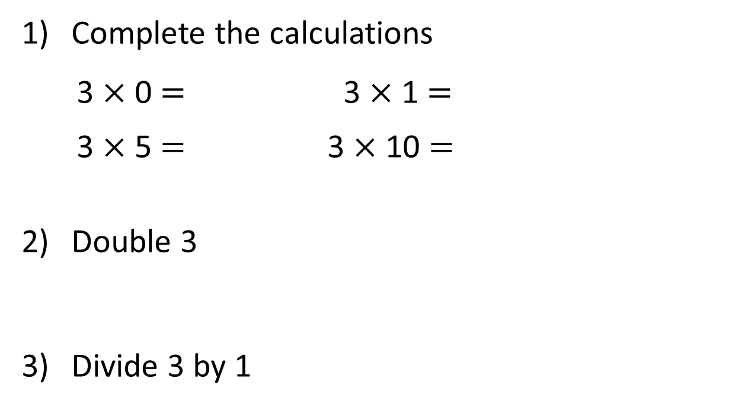
Complete the calculations
3 $×$ 0 $=$ 3 $×$ 1 $=$
3 $×$ 5 $=$ 3 $×$ 10 $=$
Double 3
Divide 3 by 1

Slide 5
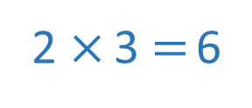
Complete the calculations
3 $×$ 0 $=$ 3 $×$ 1 $=$
3 $×$ 5 $=$ 3 $×$ 10 $=$
Double 3
Divide 3 by 1
0
3
15
30
2 $×$ 3 $=$ 6
3

Slide 7



Complete the missing numbers.
5
3
There are ____ equal groups of ____
3
3
15
$+ + + + =$
3
3
3
$× =$
5
3
15
$× =$
3
5
15

Slide 8




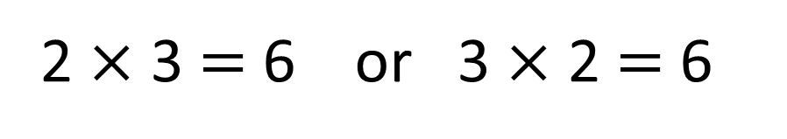
Which number story matches the picture?
2 $×$ 3 $=$ 6 or 3 $×$ 2 $=$ 6
Have a think
Whitney plants 2 pots of flowers with 3 flowers in each pot.
She plants 6 flowers altogether.
Whitney plants 3 pots of flowers with 2 flowers in each pot.
She plants 6 flowers altogether.

Slide 9
Have a go at question
1 on the ‘Multiply by 3’ worksheet

Slide 10
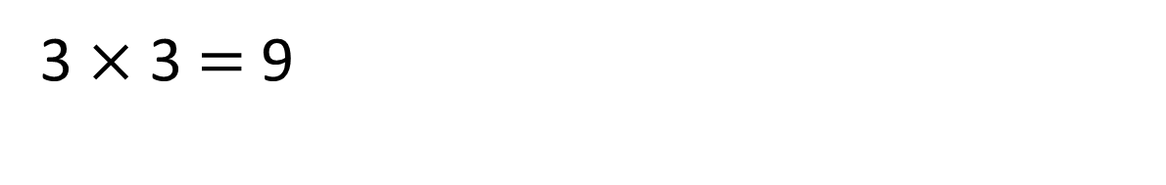
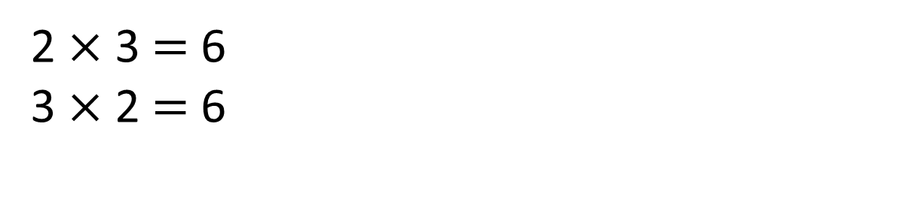
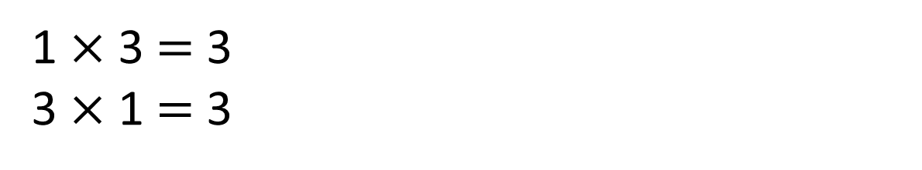
3
1 $×$ 3 $=$ 3
3 $×$ 1 $=$ 3
0
3
3
3
2 $×$ 3 $=$ 6
3 $×$ 2 $=$ 6
0
3
6
3
3
3
3 $×$ 3 $=$ 9
0
3
6
9

Slide 11

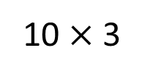

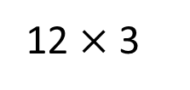
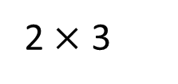
12 $×$ 3 $=$ 10 $×$ 3 $+$ 2 $×$ 3
Is Jack correct?
12 $×$ 3
10 $×$ 3
2 $×$ 3
Have a think

Slide 12
Have a go at the rest of the ‘Multiply by 3’ worksheet

Slide 13







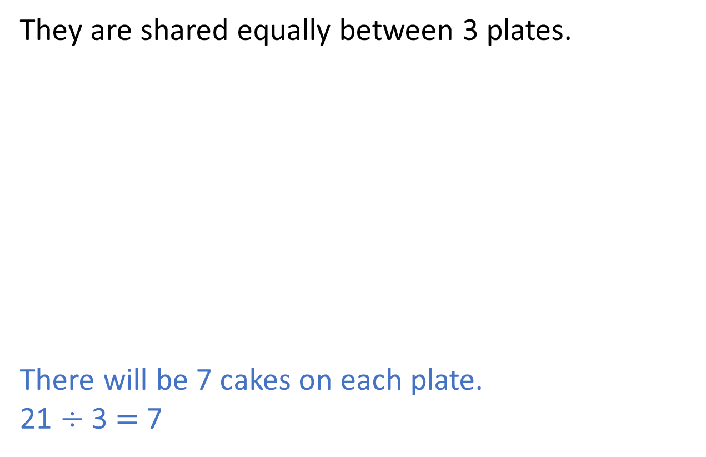
Here are 21 cakes.
They are shared equally between 3 plates.
There will be 7 cakes on each plate.
21 $÷$ 3 $=$ 7

Slide 14
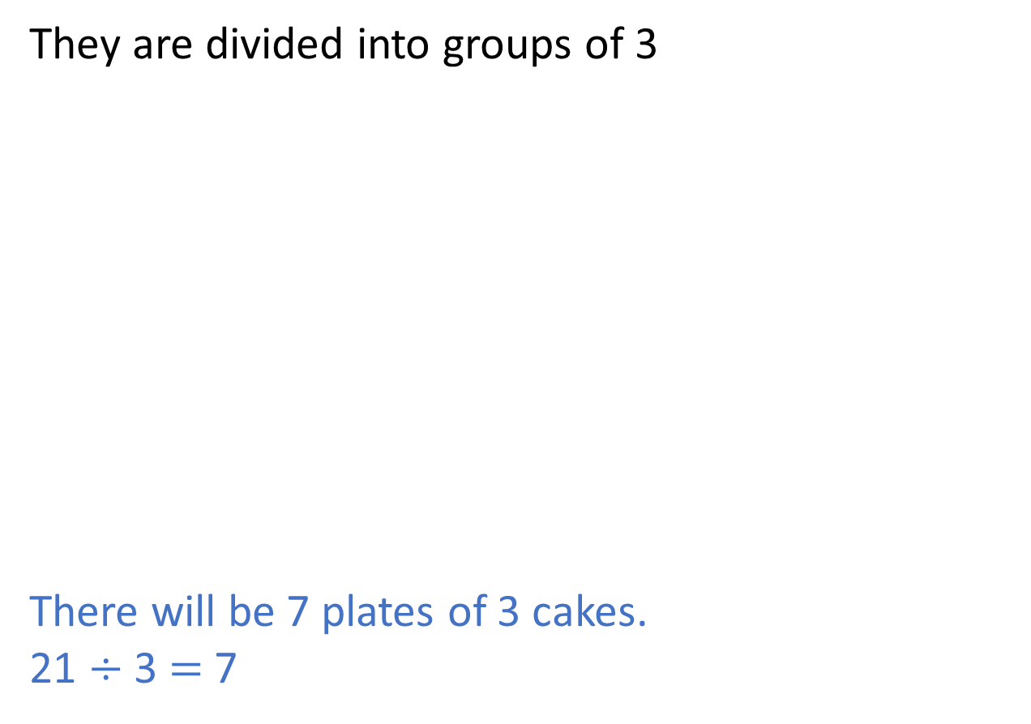
Here are 21 cakes.
They are divided into groups of 3
There will be 7 plates of 3 cakes.
21 $÷$ 3 $=$ 7

Slide 15
Have a go at questions
1 – 3 on the ‘Divide by 3’ worksheet

Slide 16
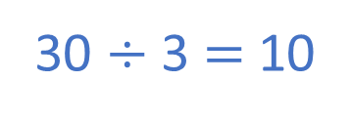
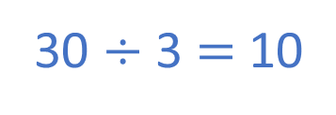
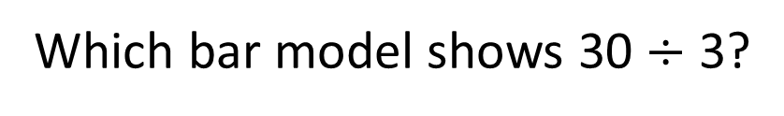
Which bar model shows 30 $÷$ 3?
30
3 | 3 | 3 | 3 | 3 | 3 | 3 | 3 | 3 | 3
30 divided into 10 groups of 3
30 $÷$ 3 $=$ 10
30
10 | 10 | 10
30 divided into 3 equal groups
30 $÷$ 3 $=$ 10

Slide 17



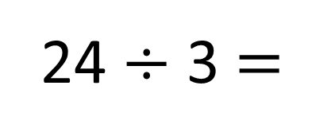
24 $÷$ 3 $=$
A baker has 24 tarts.
She puts 3 tarts into each box.
How many boxes can she fill?
8
$+$ 3
0
3
6
9
12
15
18
21
24
$−$ 3
0
3
6
9
12
15
18
21
24

Slide 18
Have a go at the rest of the ‘Divide by 3’ worksheet

