Slide 1
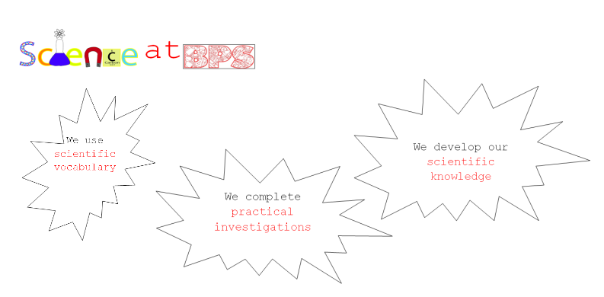

Slide 2
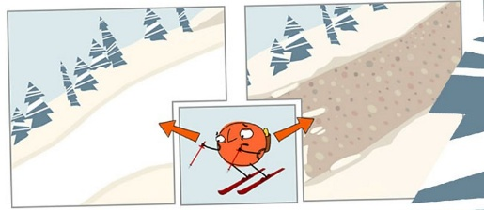
On Monday, we looked at how forces are either push or pull forces. What did we discover happened to the car that was pushed along different surfaces?
The surfaces had different textures and some of the surfaces caused the car to slow down quicker through a force called friction.
Friction is a force between two surfaces that are sliding, or trying to slide, across each other. For example, when you try to push a book along the floor, friction makes this difficult. Friction always works in the direction opposite to the direction in which the object is moving, or trying to move. Friction always slows a moving object down.

Slide 3

Today we are going to start thinking about contact and non-contact forces.
If a ball is thrown or kicked into the air using a push force, (contact with a hand or foot) then it is pulled back down to the ground by gravity but nothing touched it to pull it back down (non-contact force).

Slide 4
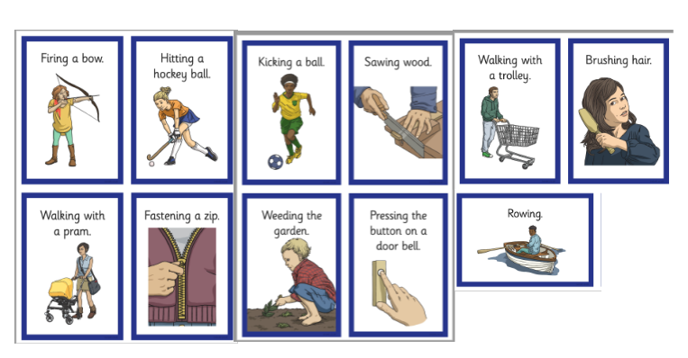

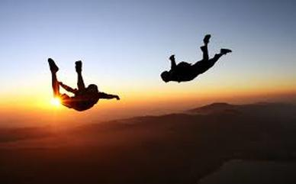

Now look at these activities (you can think of others). Split your page into contact and non-contact forces. Identify which you think forces that involve contact and which do not.

Slide 5
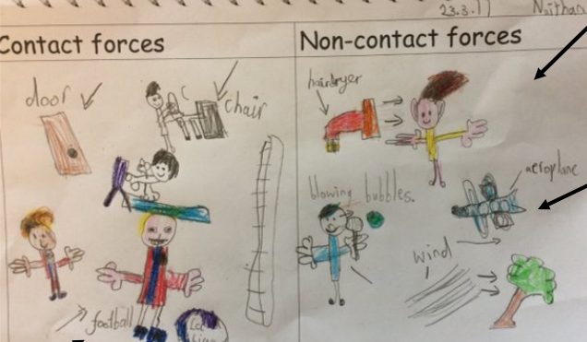
Your table may have looked like this..
The objects which are being moved by air are actually being moved by a contact force. The air is making contact with the object to make it move. Now we will look at a non-contact force.

Slide 6
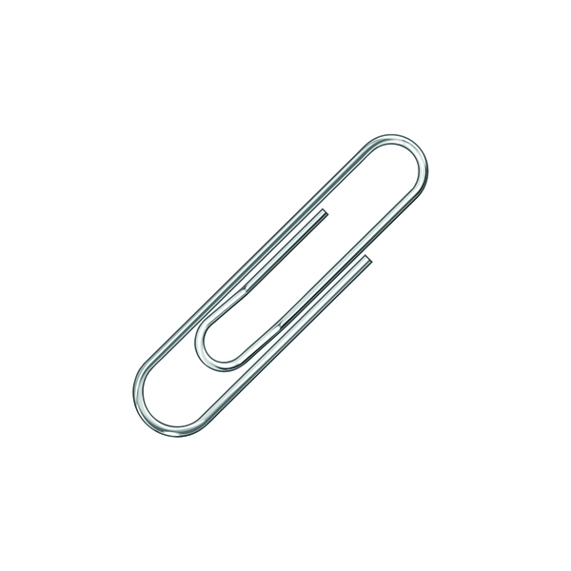
Today's task!
Step one
You will need some paperclips and pieces of card.
Investigate how you can make the paper clip move on the card without touching or making contact directly with the paperclip.
Note down anything that worked.

Slide 7
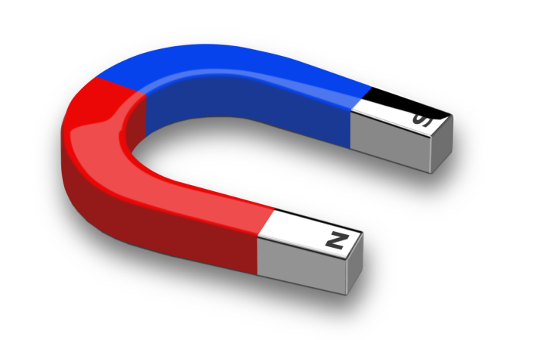
Step two – think about these questions
Did you tilt the paper?
Did you blow the paperclip?
Were these forces contact or non-contact?
What would happen if you used a magnet?

Slide 8
Step 3 – ask yourself...
What do we know about how magnets work?
At home, hopefully you have been able to find a magnet this morning.
I want you to have a go at making the magnets 'work'.
Have a think about how the magnets work.
Do they have to make contact to work (like a force) or can magnets still work without making contact?

Slide 9
Step 4 (Optional)
Write an explanation of how a magnet works.
Things to think about:
What forces did you use on the paperclip? Were they contact or non contact?
What happened when the magnet was introduced to the paperclip?
Can you try to explain how it 'worked'?
Now feel free to investigate magnetic materials around your house!

