Slide 1
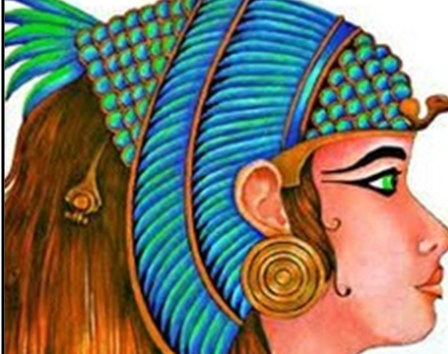
The Egyptian Cinderella
This week we will be planning and writing, editing our own versions of the story.

Slide 2
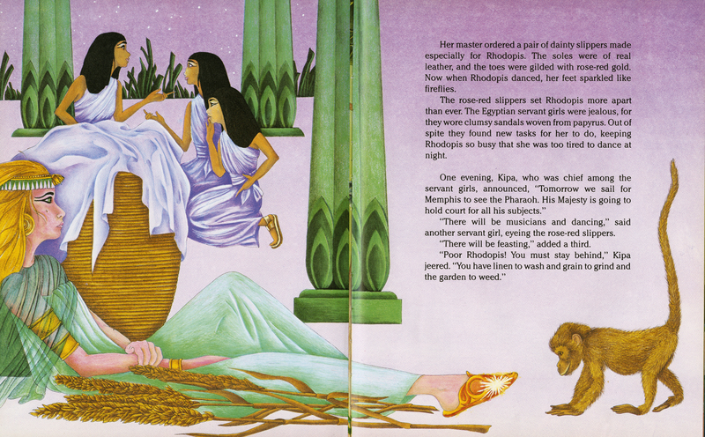
Warm-up
Think of one part of the story that you have changed and made it your own e.g. characters, special item.....
Virtual Lollypop Sticks!

Slide 3
LC: Can I plan my story?
Today you will need to think about all the elements of the story and how you want to change them.
Remember:
You are still in Egypt
You need a special item that goes missing/is stolen
You should include an Egyptian God or Goddess

Slide 4
Planning
Let’s talk through the planning sheet step by step.
Remember it is only notes you are making.
You do not need to write the story yet.

Slide 5
Planning
Beginning
Description
Where is it set?
Introduce
Who is the main character?
What shall we add in this box?
Use ideas from yesterday!

Slide 6
Planning
What shall we add in this box?
Build up
Who is unkind to the main character and what do they do?
Who are the main character’s animal friends?

Slide 7
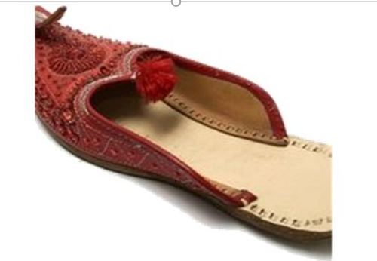
Planning
Problem
What is the problem within the story?
What is stolen/goes missing?
Introduce the God/Goddess who takes the item.
Who finds it? Introduce your royal character.
What shall we add in this box?

Slide 8
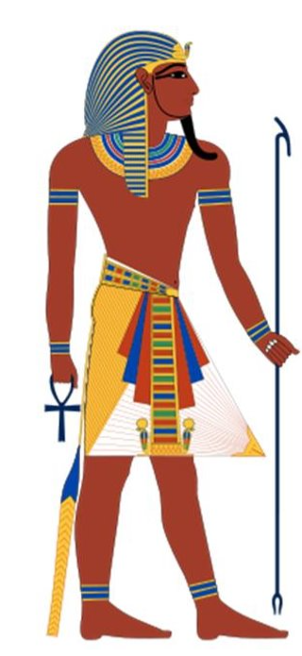
Planning
Action
Where does the royal character go and what do they do?
What shall we add in this box?

Slide 9
Planning
Resolution
How is the problem of the missing item solved?
What shall we add in this box?

Slide 10
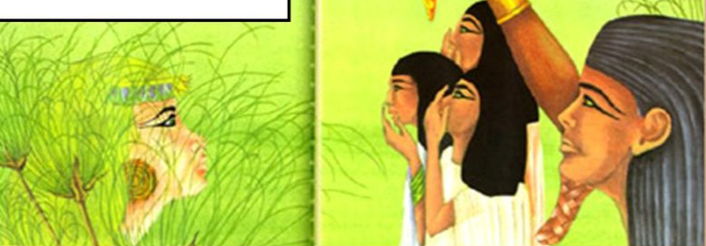
Planning
What shall we add in this box?
Ending
How does the story end?
Does it end happily?
Is there a twist to the plot?

Slide 11
Independent Task
Using your ideas from Monday, please complete your story plan.
Use the prompts on the planning page to help guide you.
The more detail you add today, the easier it will be to think of ideas when it comes to writing.
This can be done on the sheet or in your remote learning book. Please submit.

Slide 12
You should have a complete story plan now.
Challenge
For those of you who would like to add more detail to your plan at this stage:
Are there any special words you want to add so you remember them? (adjectives, verbs, similes)
Do you know where you might add a little bit of speech?
Have you thought about where you could ask a question?
Have you got some description?
Does your story make sense?

