Slide 1


Slide 2


Slide 4
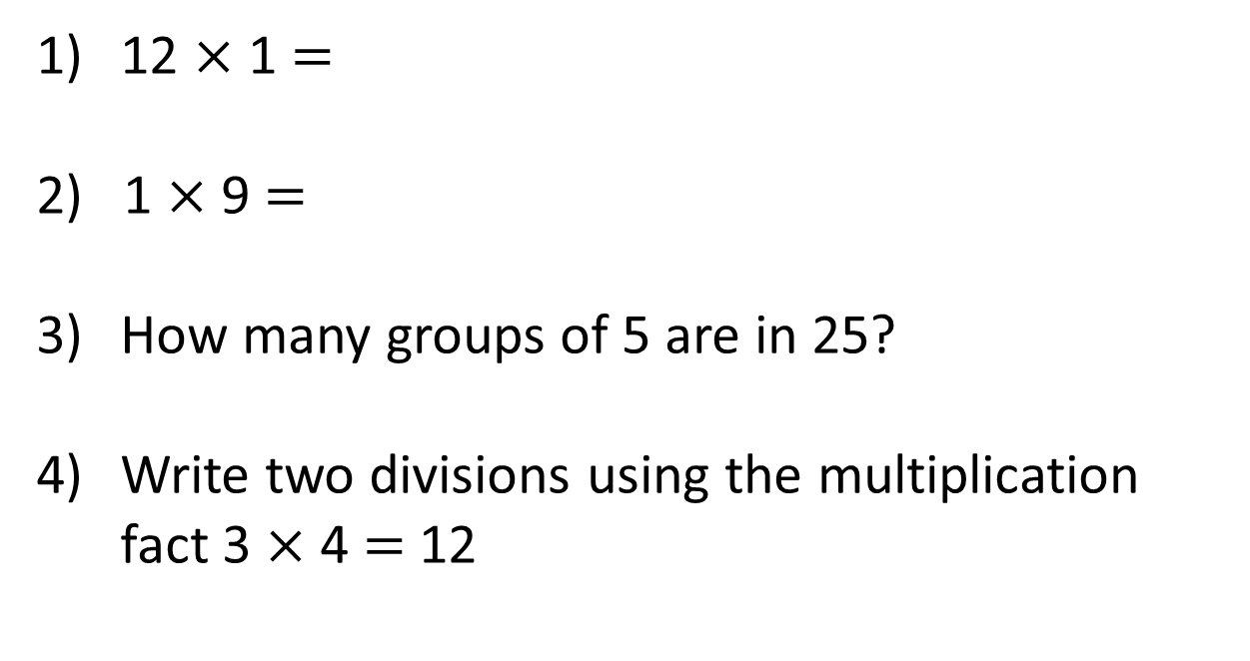
12 $×$ 1 $=$
2) 1 $×$ 9 $=$
How many groups of 5 are in 25?
Write two divisions using the multiplication fact 3 $×$ 4 $=$ 12

Slide 5
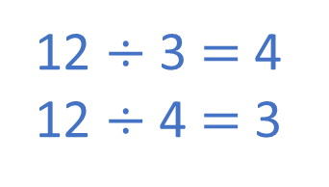
12 $×$ 1 $=$
2) 1 $×$ 9 $=$
How many groups of 5 are in 25?
Write two divisions using the multiplication fact 3 $×$ 4 $=$ 12
12
9
5
12 $÷$ 3 $=$ 4
12 $÷$ 4 $=$ 3

Slide 7


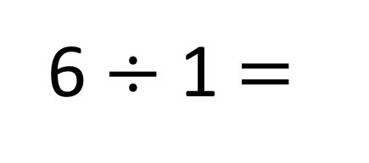
6 $÷$ 1 $=$
6
Sharing
Grouping

Slide 8


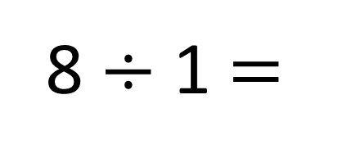
8 $÷$ 1 $=$
8
Have a think
Sharing
Grouping

Slide 9
Have a go at question 1 on the worksheet

Slide 10








Here is a bunch of 4 bananas.
The bananas are shared between 4 children.
4
$$÷$$
4
$$=$$
1
Number of bananas altogether
Number of children
Number of bananas per child

Slide 11


Here is a bag of 3 apples.
The apples are shared between 3 children.
3
$$÷$$
3
$$=$$
1
Number of apples altogether
Number of children
Number of apples per child

Slide 12
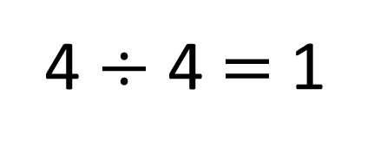
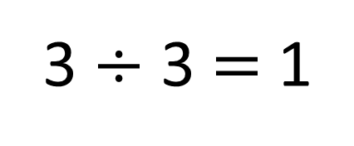
3 $÷$ 3 $=$ 1
4 $÷$ 4 $=$ 1
What do you notice?
A number is being divided by itself.
The answer is 1

Slide 13

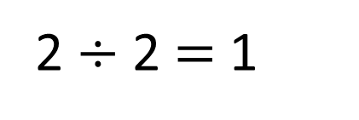
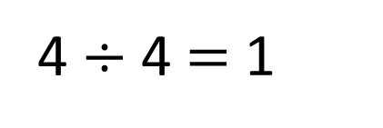
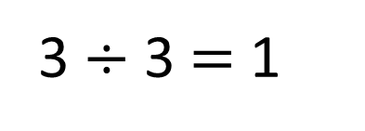
There is 1 group of 2 in 2
2 $÷$ 2 $=$ 1
There is 1 group of 3 in 3
3 $÷$ 3 $=$ 1
There is 1 group of 4 in 4
4 $÷$ 4 $=$ 1
When you divide a number by itself, the answer is 1

Slide 14
Have a go at questions
2 – 5 on the worksheet

Slide 15

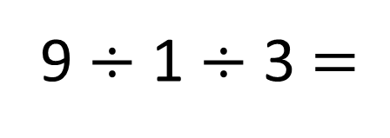
9 $÷$ 1 $÷$ 3 $=$
3
Have a think
I only need to divide 9 by 3 to calculate the answer.
Do you agree?
When you divide by 1, the number remains the same.

Slide 16




When you divide by 1, the number remains the same.
When you divide a number by itself, the answer is 1
Complete the fact family.
7 $×$ 1 $=$ 7
1
7
7
__ $×$ __ $=$ __
7
1
7
__ $÷$ __ $=$ __
7
7
1
__ $÷$ __ $=$ __

Slide 17
Have a go at the rest of the worksheet

