Slide 1


Slide 2


Slide 4



1) How many cookies?
2) How many pencils?
3) Here is an array.
How many groups of 3 are there?

Slide 5
1) How many cookies?
2) How many pencils?
3) Here is an array.
How many groups of 3 are there
9
18
4

Slide 7






What do you see?
3
3
There are ____ equal groups of ____
$+ + =$
3
3
3
9
$× =$
3
3
9

Slide 8



What do you see?
5
3
There are ____ equal groups of ____
3
3
15
$+ + + + =$
3
3
3
$× =$
5
3
15
$× =$
3
5
15

Slide 9


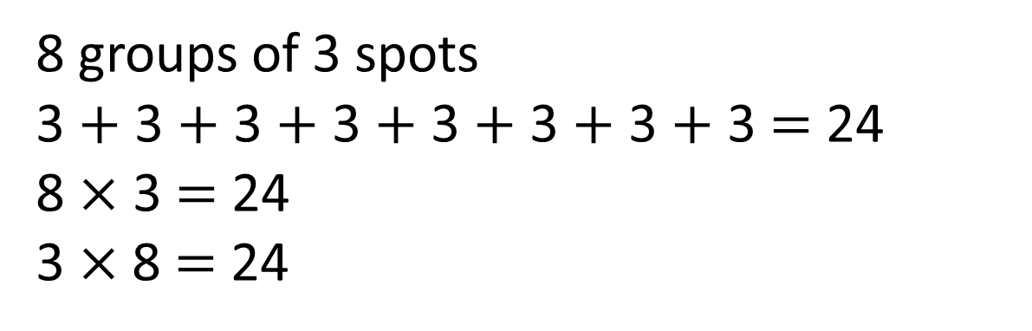
What do you see?
Have a think
8 groups of 3 spots
3 $+$ 3 $+$ 3 $+$ 3 $+$ 3 $+$ 3 $+$ 3 $+$ 3 $=$ 24
8 $×$ 3 $=$ 24
3 $×$8 $=$ 24

Slide 10
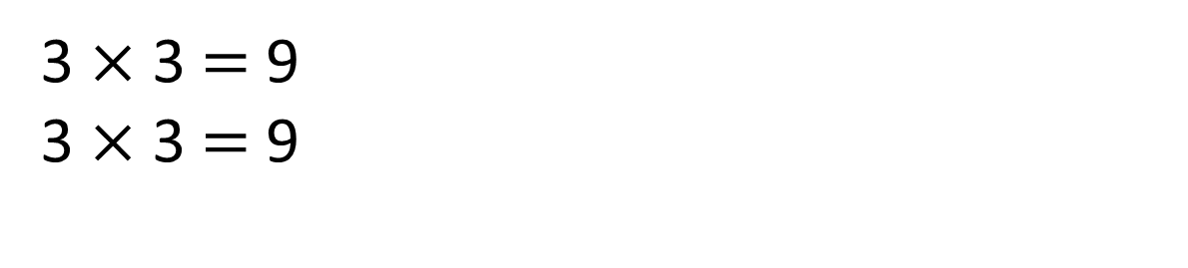
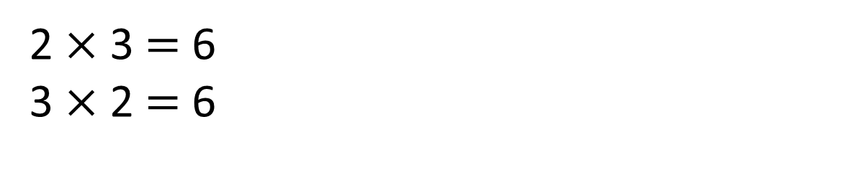
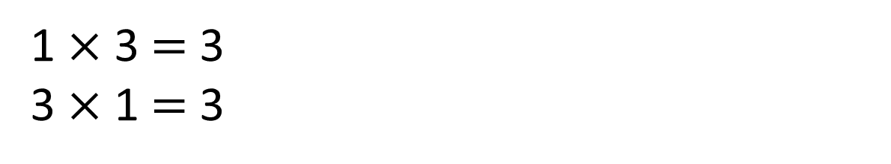
3
1 $×$ 3 $=$ 3
3 $×$ 1 $=$ 3
Have a think
0
3
3
3
2 $×$ 3 $=$ 6
3 $×$ 2 $=$ 6
0
3
6
3
3
3
3 $×$ 3 $=$ 9
3 $×$ 3 $=$ 9
0
3
6
9

Slide 11
Have a go at questions
1 and 2 on the worksheet

Slide 12



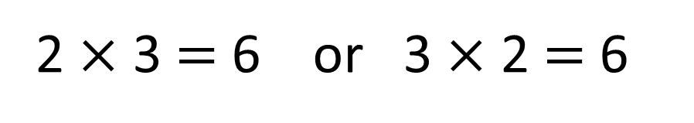
Which number story matches the picture?
2 $×$ 3 $=$ 6 or 3 $×$ 2 $=$ 6
Have a think
Whitney plants 2 pots of flowers with 3 flowers in each pot.
She plants 6 flowers altogether.
Whitney plants 3 pots of flowers with 2 flowers in each pot.
She plants 6 flowers altogether.

Slide 13


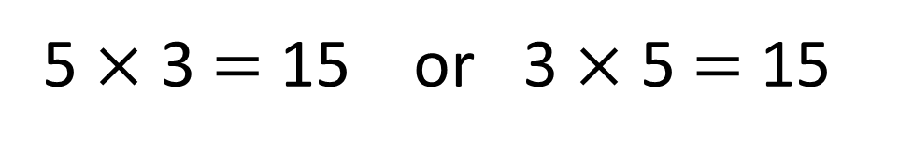
Draw a picture to represent each number story.
5 $×$ 3 $=$ 15 or 3 $×$ 5 $=$ 15
Have a think
Amir has 3 pots of pencils. There are 5 pencils in each pot.
Amir has 5 pots of pencils. There are 3 pencils in each pot.

Slide 14

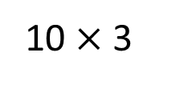

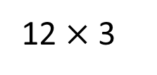
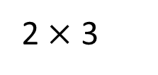
12 $×$ 3 $=$ 10 $×$ 3 $+$ 2 $×$ 3
Is Jack correct?
12 $×$ 3
10 $×$ 3
2 $×$ 3
Have a think

Slide 15


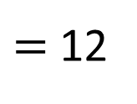

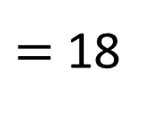


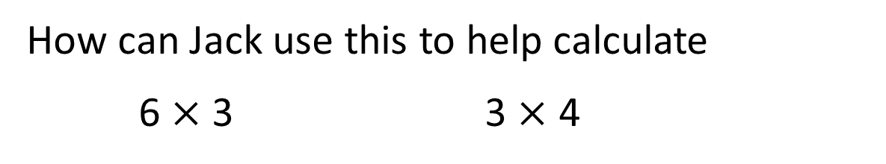




I know 5 $×$ 3 $=$ 15
How can Jack use this to help calculate
6 $×$ 3 3 $×$ 4
$=$ 18
$=$ 12
5 $×$ 3
$$+$$
1 $×$ 3
3 $×$ 5
$$−$$
3 $×$ 1
Have a think
15
$$+$$
3
15
$$−$$
3

Slide 16
Have a go at the rest of the questions on the worksheet

