Slide 1


Slide 2
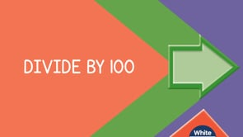

Slide 4
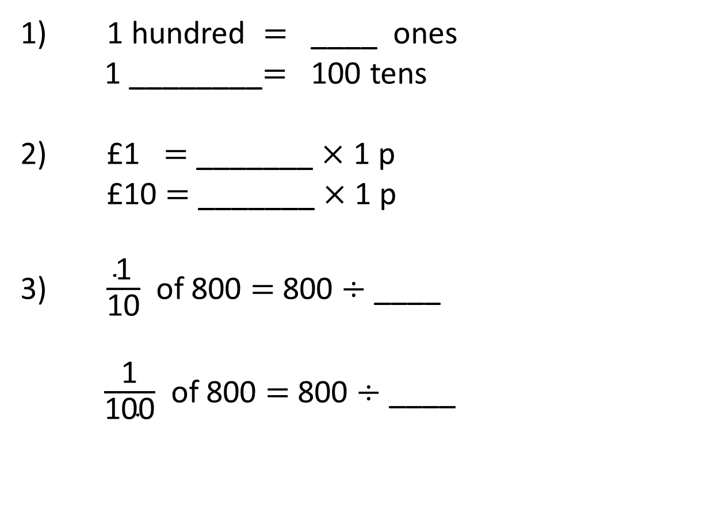
1) 1 hundred = ____ ones
1 ________$=$ 100 tens
2) £1 = _______ $×$ 1 p
£10 $=$ _______ $×$ 1 p
3) $\frac{\text{1}}{\text{10}}$ of 800 $=$ 800 $÷$ ____
$\frac{\text{1}}{\text{100}}$ of 800 $=$ 800 $÷$ ____

Slide 5
100
1) 1 hundred = ____ ones
1 ________$=$ 100 tens
2) £1 = _______ $×$ 1 p
£10 $=$ _______ $×$ 1 p
3) $\frac{\text{1}}{\text{10}}$ of 800 $=$ 800 $÷$ ____
$\frac{\text{1}}{\text{100}}$ of 800 $=$ 800 $÷$ ____
thousand
100
1,000
10
100

Slide 7

3
300 ÷ 100 = ___
300 = 3 groups of 100
7
700 ÷ 100 = ___
700 = 7 groups of 100
1,000 ÷ 100 = ___
10
1,000 = 10 groups of 100
30
3,000 ÷ 100 = ___
3,000 = 30 groups of 100

Slide 8
Have a go at questions
1 and 2 on the worksheet

Slide 9
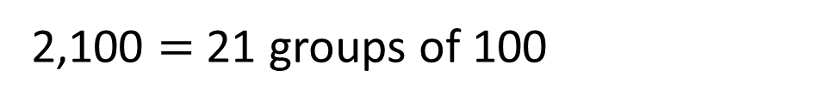
21
2,100 ÷ 100 = ___
2,100 = 2 thousands + 1 hundred
1 thousand = 10 hundreds
2 thousands = 20 hundreds
There are 21 hundreds altogether.
2,100 $=$ 21 groups of 100

Slide 10


Eva has three hundred 1p coins.
How many £1 coins is this equal to?
3
300p
100p
100p
100p
300 ÷ 100 = 3

Slide 11
Have a go at questions 3 and 4 on the worksheet

Slide 12
Th | H | T | O
100 times
the size
100 times
the size

Slide 13
Th | H | T | O
One hundredth
the size
One hundredth
the size
To find one hundredth, we divide by 100

Slide 14




$×$ 100
$×$ 100
Th | H | T | O
$÷$ 100
$÷$ 100

Slide 15

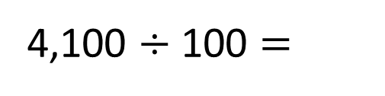

Th | H | T | O
$÷$ 100
$÷$ 100
4,100 $÷$ 100 =
4
1
41 is one hundredth the size of 4,100

Slide 16
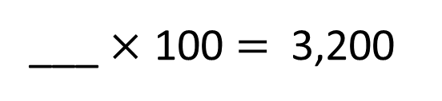

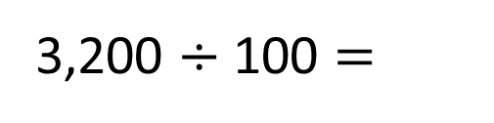

Th | H | T | O
$÷$ 100
$÷$ 100
32
___ $×$ 100 = 3,200
32
3,200 $÷$ 100 =
32 is one hundredth the size of 3,200

Slide 17


Th | H | T | O
$×$ 100
$×$ 100
32
___ $×$ 100 = 3,200
32
3,200 $÷$ 100 =
32 is one hundredth the size of 3,200
3,200 is one hundred times the size of 32

Slide 18
Have a go at the rest of the worksheet

