Slide 1
What do you think the book might be about?
What genre do you think the book is?
What key information might you find in this book?

Slide 2
Here is the blurb:
Stunning, large scale illustrations capture some of the most thrilling places to visit in the world. Broad in its vision and range, this incredible Atlas includes both natural and man made places. Readers can be amazed by Pantanal, the astonishing tropical Brazilian wetland with its vibrant and original wildlife. And they can be equally impressed by the Great Wall of China or Machu Picchu, two man made structures that have survived over hundreds of years.

Slide 3

Vocabulary
Teeming with – full of (usually life/species)
Uluru – Large rock at the heart of an ancient land in Australia
Formed – created/made
Indigenous – originating, native

Slide 4
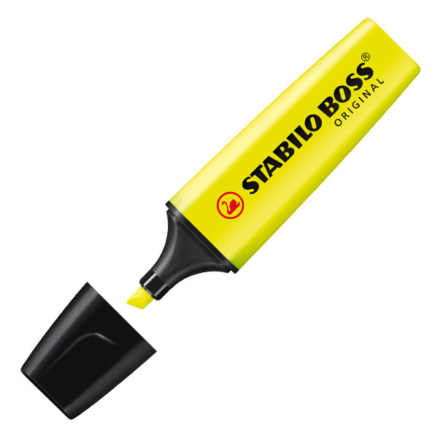
Remember: For your questions today, we want you to use your highlighters to locate the answer in a text.
If you can't print the text, just read on screen.
Text is quite small so may need to zoom!

Slide 5
Today’s questions will include retrieval questions. We will also ask you to interpret key facts. The extract you will need is about ULURU (Page 6).

Slide 6
Questions: Me
Why is it hard to imagine anything living here?

Slide 7
Questions: Me
..because it is located in the middle of a desert and in an area which has little water which would make it hard for life to exist.

Slide 8
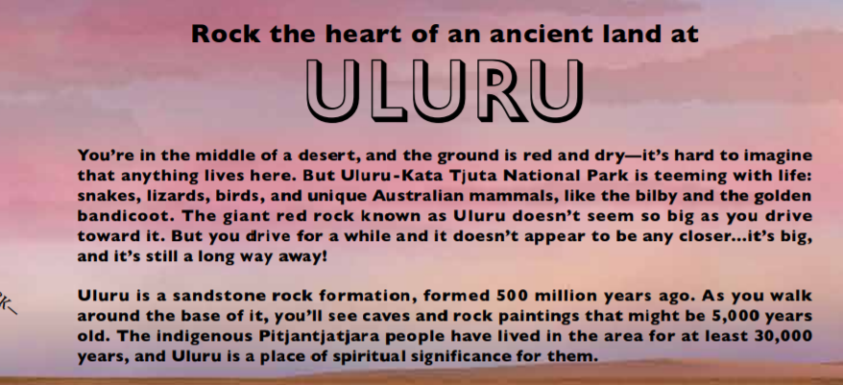
Questions: Us
Name 3 types of animals you might find there.

Slide 9
Questions: Us
3 of the following: Snakes, lizards, birds, Australian mammals.

Slide 10
Questions: Us
What does the author mean by ‘unique’ Australian mammals?

Slide 11
Questions: Us
Mammals that are found only in Australia.

Slide 12
Answers in the main Text
Q1. When was Uluru formed?
Q2. Name 2 things you will find around the base of it.
Q3. What does the phrase ‘might be 5,000 years old’ tell us about when they were created?
Q4 Find the 2 words which show how important Uluru is to the Indigenous Pitjantjatjara people.
Answers in key facts across the rest of the image
Q5. Why are people not allowed to climb Uluru?
Q6. Uluru is as tall as the Eiffel Tower - True or False.
Q7 What did Uluru used to be called?
Chilli Challenge
Q7. Why might people want to visit Uluru?
Q8. What do you think the main challenges would be when you visit Uluru?
Q9 Describe a place which is of significance to you.

Slide 13
Please complete these questions in your remote learning book. Answers will be shared this afternoon.

