Slide 1
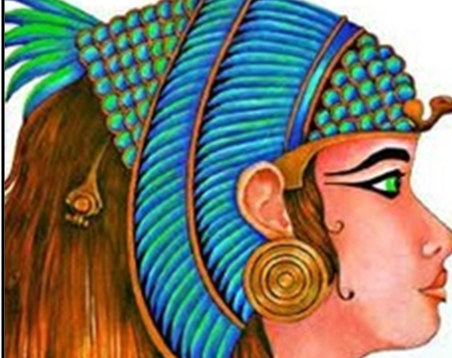
The Egyptian Cinderella
This week we will be planning and writing our own version of the story.

Slide 2
LC: Can I create ideas for my own version of a story?
Today we are going to use all of the ideas you have come up with together as a class to help you create your own version of the story.
You have a copy of the original story you can access.
Also remember this is an adaptation of Cinderella!

Slide 3
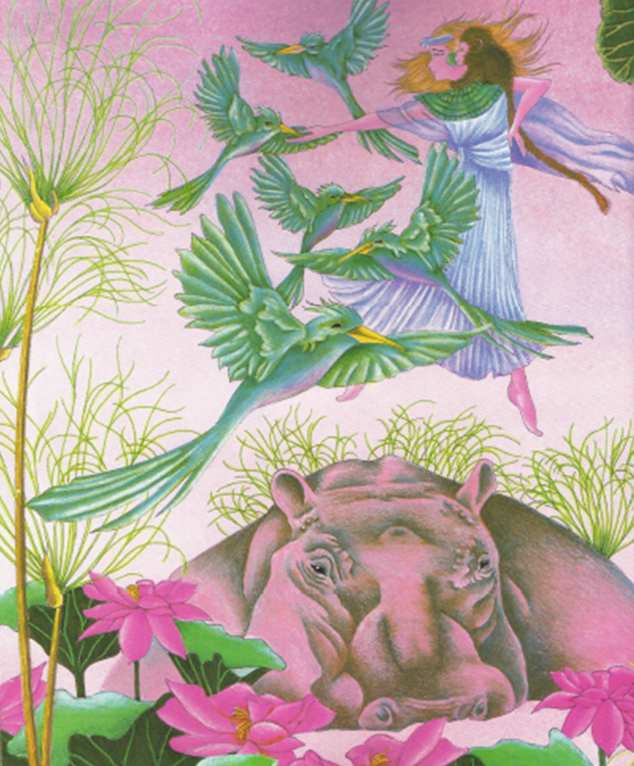
Pen and paper ready……. Quick Write
(How many different ideas can you come up with in a minute?)
Characters

Slide 4
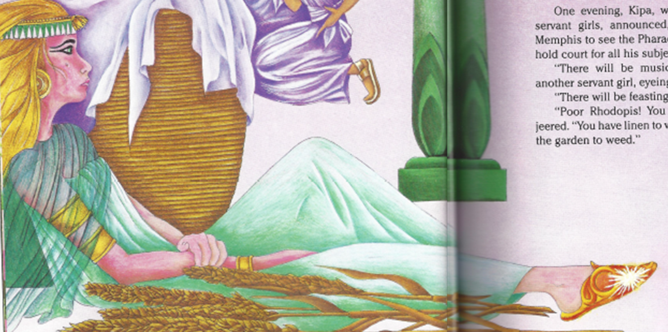
Quick Write
Special Object

Slide 5
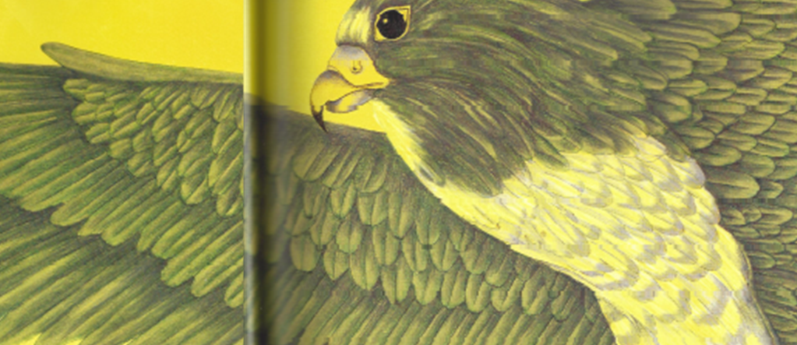
Quick Write
Fairy Godmother Character

Slide 6
Independent Task
Map out your version of Egyptian Cinderella
You could:
Draw a story map
Comic strip your ideas
Make notes/draw characters and ideas/mind map
Plan out your story however you like but be clear on characters, object, problem and ending.
See next slides for ideas…

Slide 7
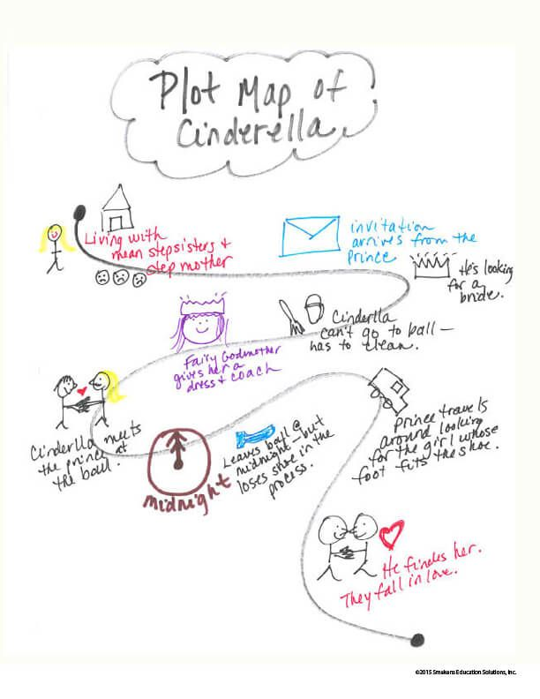
Story Map

Slide 8
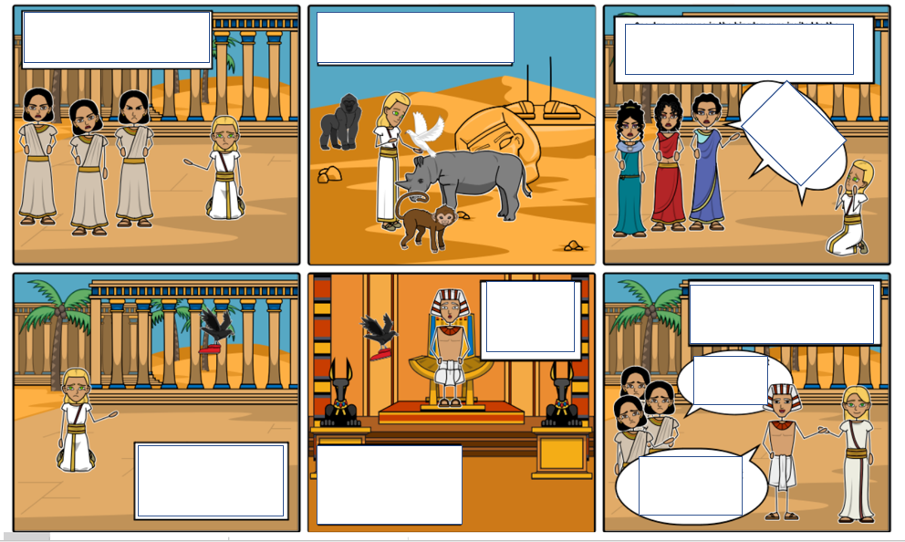
Comic Strip

