Slide 1


Slide 2
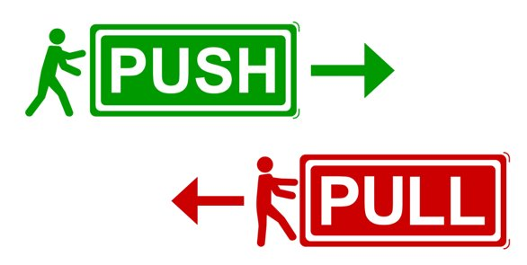
LC: Can I compare how things move on different surfaces?
Last week, we started to explore forces and described the different forces used to enable objects to move/change shape/change speed. ​
​
We discovered that every force had either a push or a pull. ​

Slide 3
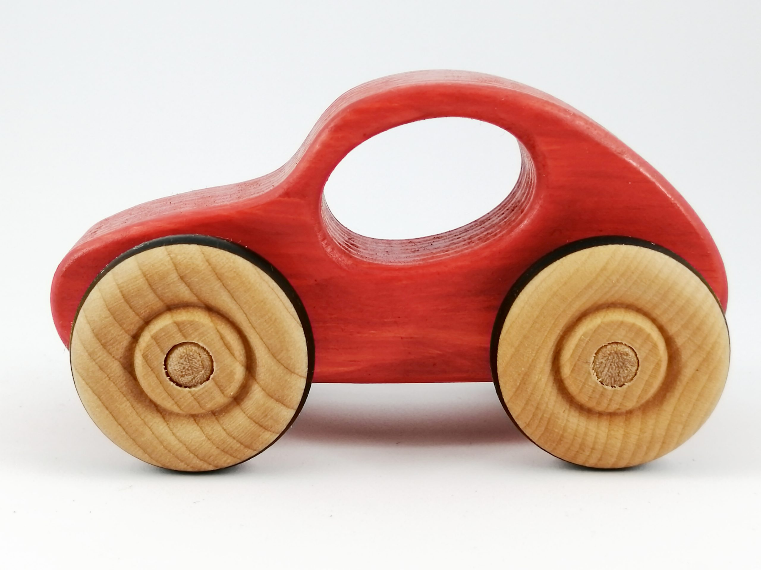
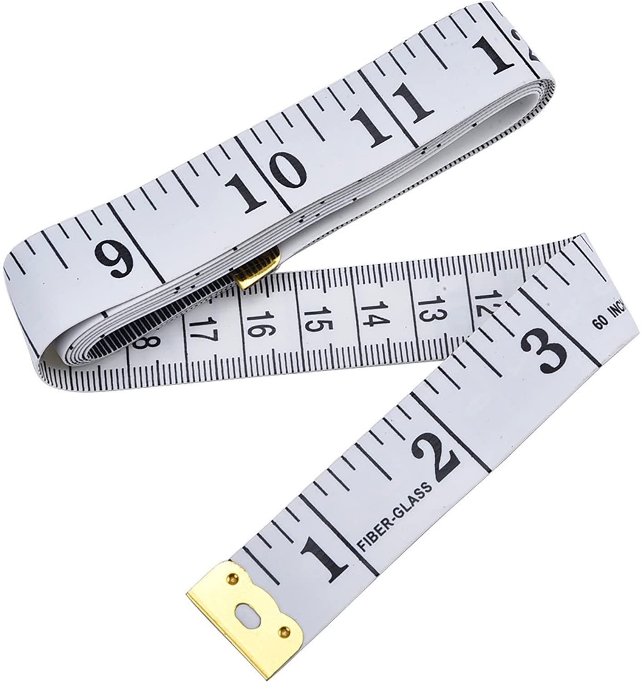
Today we are going to conduct an investigation to compare how an object moves on different surfaces.
You will need:
A toy with wheels
A tape measure or something you can use to compare distance like a piece of string

Slide 4
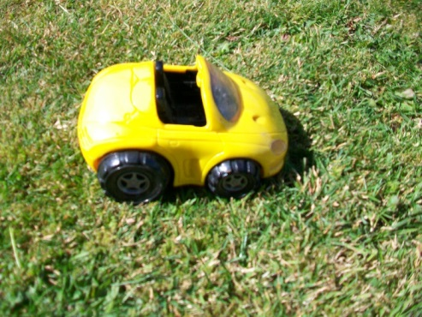
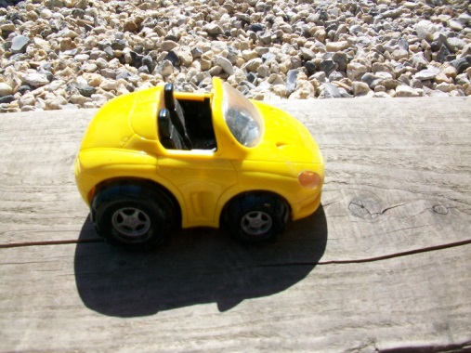
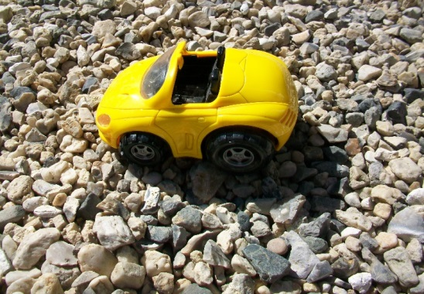
Investigation
We are going to investigate pushing a toy car along different surfaces and see the effect of those surfaces on that force. What change in movement might we see?
Which car will need the greatest force (push) to start moving?
a.
b.
c.
Why do you think that?
Let’s discuss!

Slide 5
Task
Use a toy car (or something that rolls!) and investigate how far the car will travel along different surfaces.
- carpet
- grass
- table
- pavement
Any other ideas?

Slide 6
Task
Conduct your investigation and complete the investigation sheet.
When you have your results of your investigation, try to explain your results and compare results on the different surfaces.
Please submit work.
Any photos to share with the rest of the class would be great!

