Slide 2

RE – 27th November 2020
BIG QUESTION - How are important events remembers in ceremonies?
Key questions for today
Why do Hindus celebrate Diwali?
Why is light important in this festival?
Why is light a good representation of good overcoming evil?
Are there any other religions who observe the festival of Diwali?

Slide 3
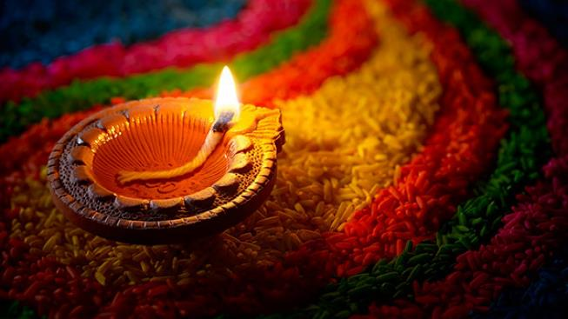

Listen to the following story. You might remember this story from some of the work you completed in KS1
https://www.youtube.com/watch?v=jCNNwPaVIaU
Lets see what actually happens during Divali from someone a very similar age to you.
https://www.bbc.co.uk/newsround/15451833

Slide 4
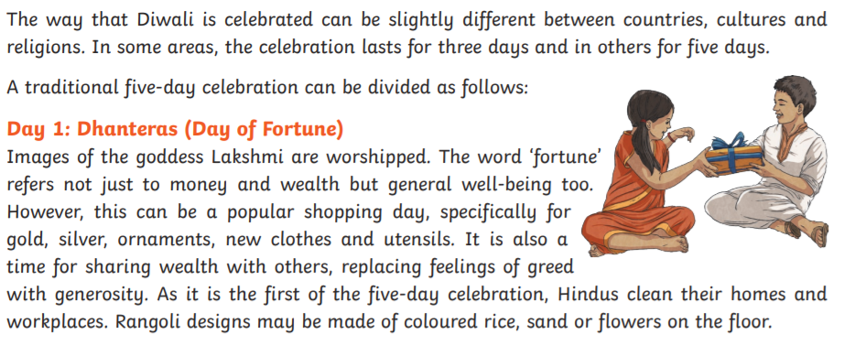
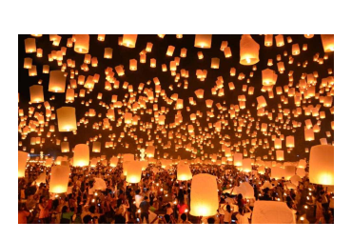

Slide 5
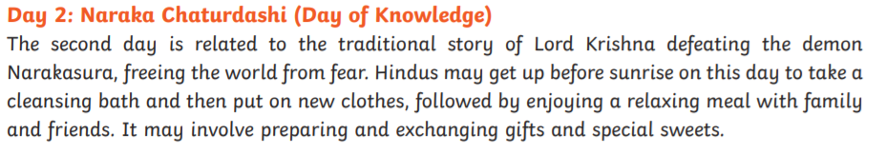
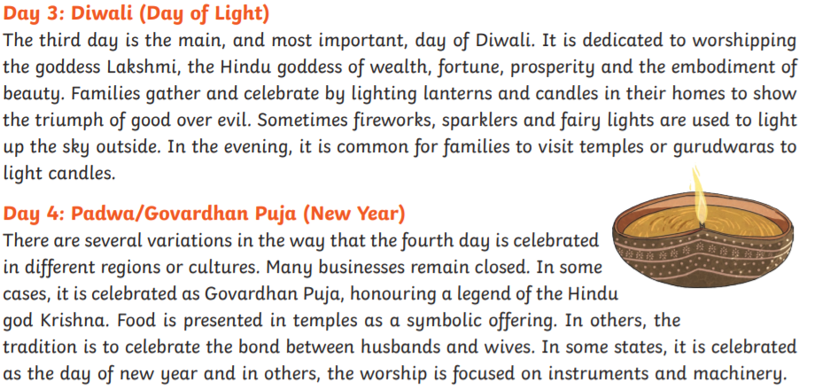

Slide 6
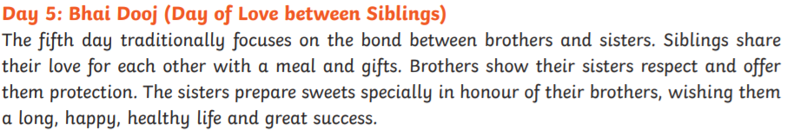
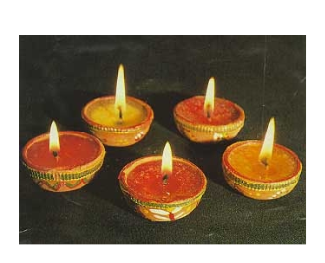
Divali means "rows of lighted
lamps".
People light lots of small oil lamps called diyas.
They are placed around the home and in gardens
to remember how Rama and Sita were
welcomed home. Hindus believe that by
lighting these lamps, the goddess Lakshmi will
visit them and bring them wealth.

Slide 7
Why is light important in this festival?
When is it used?
Why is it used?

Slide 8
Why do Hindus and Sikhs celebrate Diwali?
Use the outlines of different light forms to create your own word cloud for Diwali.
Put key words or sentences into
your word cloud which are important and represent what Diwali means to Hindus and other religions such as Sikhism.
Home Learning
You can draw this on plain paper and stick it into your home learning books or you could create something on the computer to print off and stick in.
Lets have a look at some examples

Slide 9
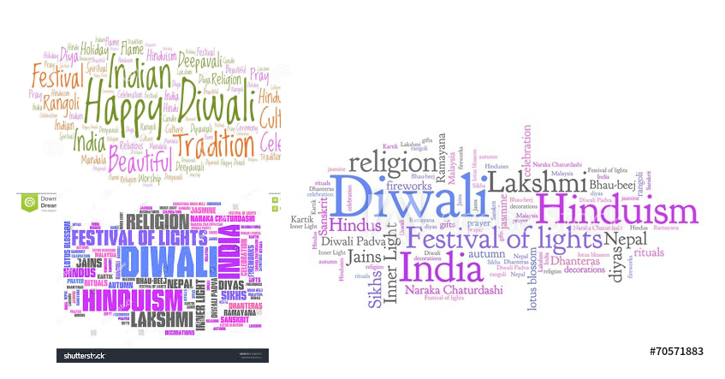

Slide 10
Time for a Q and A!
We are going to have a special visitor. Who do you think it could be?
Today, we were going to have a special visitor who could tell you first hand all about celebrating Diwali. As we are at home and cannot do this as we would like, we have come up with another solution. The visitor will still come into class but this has been postponed until we are back in school.
In preparation for this, after you have completed your word clouds, I would like you to write some questions in your home learning book that you might like to ask about Diwali and how this festival is celebrated.

Slide 11
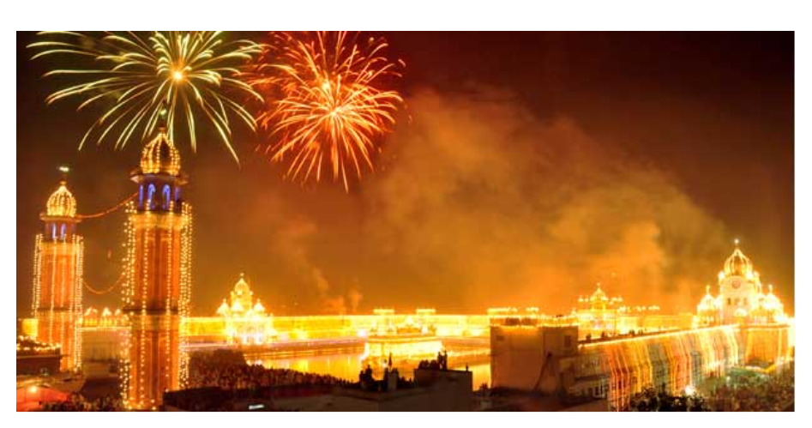
What might Hindus be reminded of as they see the sky lit in celebration?

