Slide 1


Slide 3
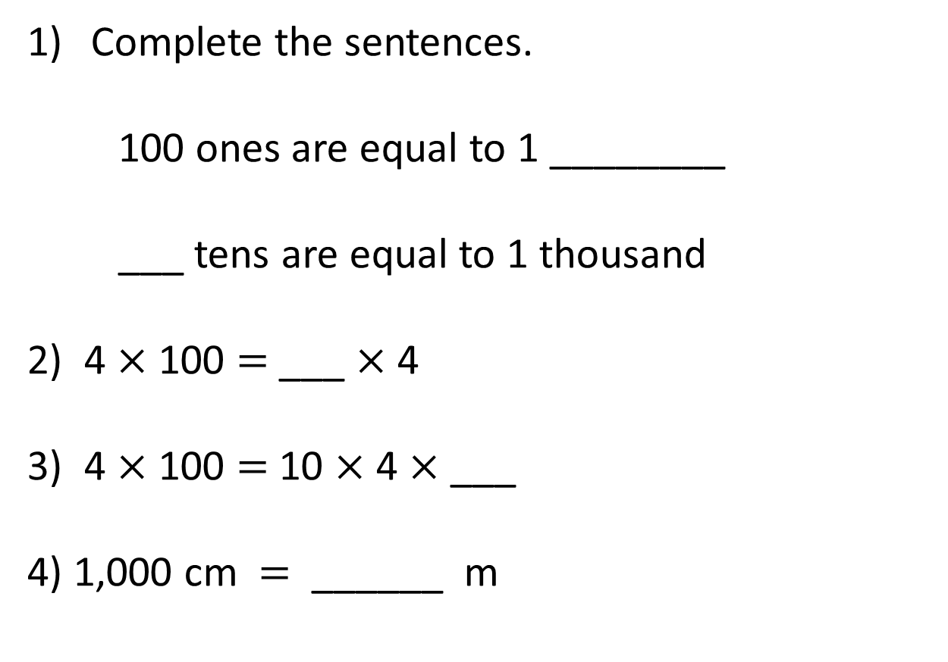
Complete the sentences.
100 ones are equal to 1 ________
___ tens are equal to 1 thousand
2) 4 $×$ 100 $=$ ___ $×$ 4
3) 4 $×$ 100 $=$ 10 $×$ 4 $×$ ___
4) 1,000 cm $=$ ______ m

Slide 4
Complete the sentences.
100 ones are equal to 1 ________
___ tens are equal to 1 thousand
2) 4 $×$ 100 $=$ ___ $×$ 4
3) 4 $×$ 100 $=$ 10 $×$ 4 $×$ ___
4) 1,000 cm $=$ ______ m
hundred
100
100
10
10

Slide 6


4 groups of 100
100 | 100 | 100 | 100
4 × 1 hundred =
4 hundreds
4 × 100 =
400
100 × 4 =
400

Slide 7

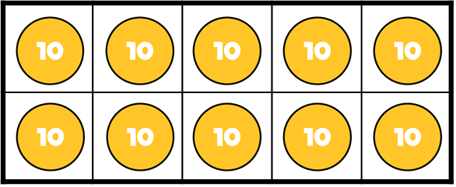
4 groups of 100
10 × 1 ten =
10 tens
40 × 1 ten =
40 tens
10 tens = 1 hundred
40 tens = 4 hundreds
10 × 10 =
100
40 × 10 =
400

Slide 8
4 groups of 100
100 | 100 | 100 | 100
4 × 1 hundred =
4 hundreds
4 × 100 =
400
40 × 1 ten =
40 tens
40 × 10 =
400

Slide 9
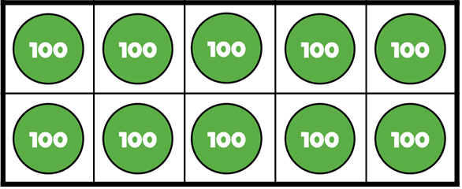
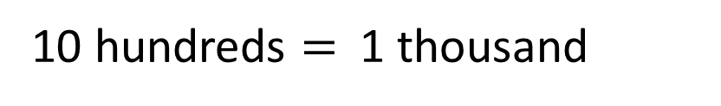
10 × 1 hundred =
10 hundreds
10 hundreds $=$ 1 thousand
10 × 100 =
1,000
100 × 10 =
1,000

Slide 10

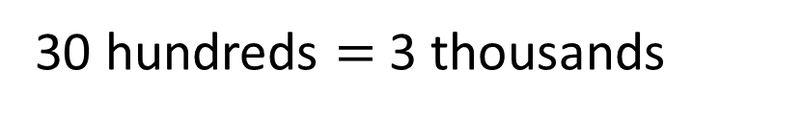
Have a think
30 × 1 hundred =
30 hundreds
30 hundreds $=$ 3 thousands
30 × 100 =
3,000
100 × 30 =
3,000

Slide 11
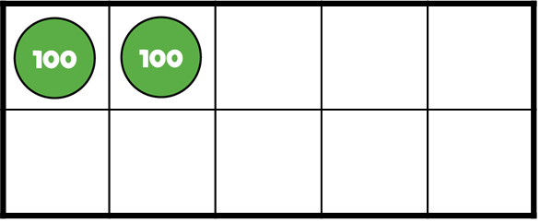
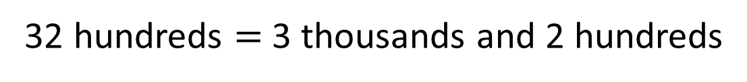
32 × 1 hundred =
32 hundreds
32 hundreds $=$ 3 thousands and 2 hundreds
32 × 100 =
3,200
100 × 32 =
3,200

Slide 12
Have a go at questions
1 - 4 on the worksheet

Slide 13
1 hundred is 100 times the size of 1 one
1 thousand is 100 times the size of 1 ten

Slide 14
Th | H | T | O
100 times
the size
100 times
the size
13 × 100 =
1,
3
0
0

Slide 15
Have a think
Th | H | T | O
100 times
the size
100 times
the size
32 × 100 =
3,
2
0
0

Slide 16
Have a go at the rest of the worksheet

