Slide 1
Our enquiry question this lesson:
LC: Can I explain the role of religion to the Ancient Egyptians?

Slide 2
Role of religion
Religion was very important to the ancient Egyptians and they worshipped a range of gods and goddesses (this is known as polytheism).
They believed that the gods were representative of natural forces including the sun, moon, and river Nile.
In addition, the gods had both human and animal features.

Slide 3
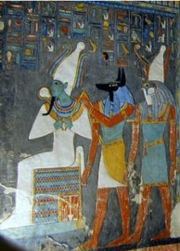
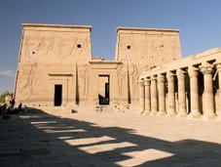
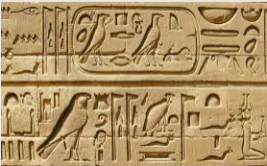

How do we know it was important?
What types of evidence do we have?

Slide 4
Ancient Egyptian Religion
Worship was considered the main focus of everyday life
They believed in many gods / goddesses - POLYTHEISTIC
They believed that gods represented natural forces (floods, the moon and the sun)
They believed that gods took on human characteristics when they visited Earth; some were represented with human bodies and animal heads
They believed that the gods were involved with all aspects of life. The gods caused the rain, controlled the growth of crops, determined birth and death, and ultimately were behind everything. Nothing happened by chance – very similar to the Ancient Greeks (Yr4 may remember from last year).

Slide 5
Gods / Goddesses
Many Egyptian gods find their origin in several of the Egyptian creation myths
Here are some of them.
Ra - sun god, god of the underworld
Osiris - god of the Nile
Anubis – god of the after life
Horus – god of the sky
The Ancient Greeks believed that the Greek gods were ancestors from the Egyptian gods.

Slide 6
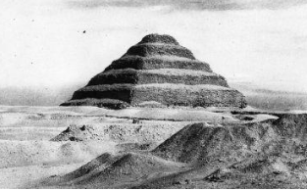
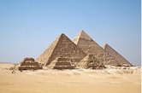
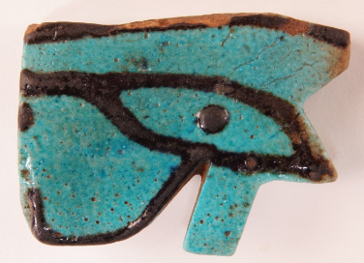
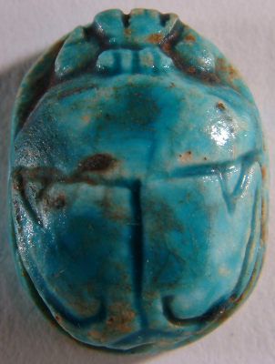
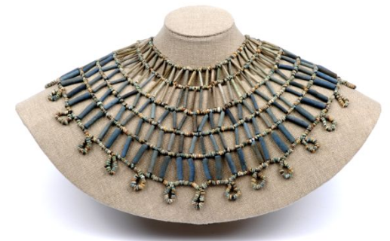
Pyramids
The pyramids were built as burial places and monuments to the Pharaohs.
The Egyptians believed that the Pharaoh needed certain things to succeed in the afterlife.
Deep inside the pyramid the Pharaoh would be buried with all sorts of items and treasure that he may need to survive in the afterlife.

Slide 7
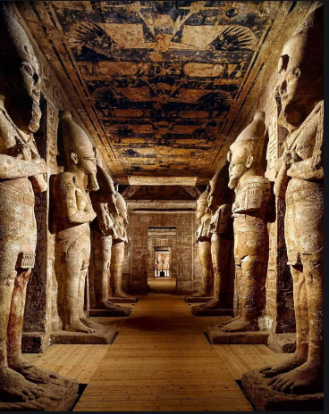
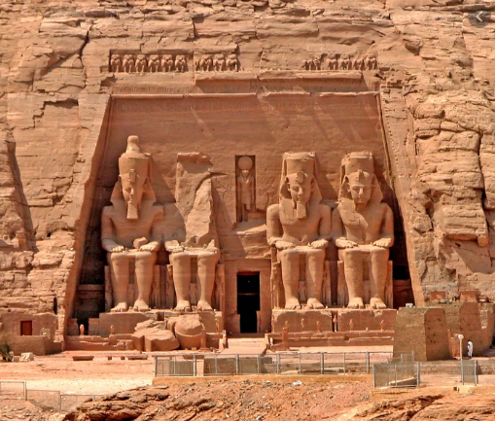
Temples
This is Abu Simbel – a huge temple built by Rameses II.

Slide 8
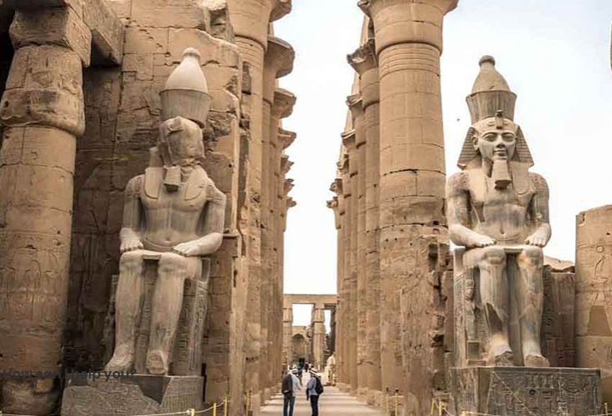
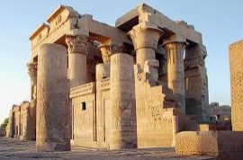
Temples were built to honour the gods and Pharaohs. They were built from stone in order to be long lasting.
The Valley of the Kings became the main burial sites for Pharaohs once they'd stopped building pyramids.

Slide 9
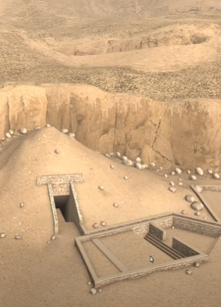
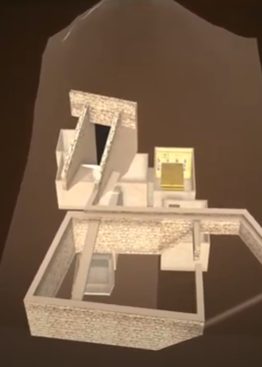
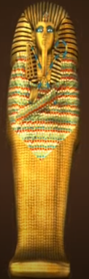
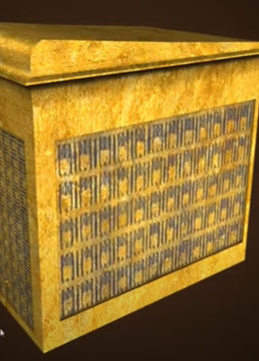
Look at these pictures – what do you think is going on here?

Slide 10
These images are 3D models of Tuthankhamun's burial chamber in the Valley of the Kings

Slide 11
Belief in the After Life
The Egyptians believed in life after death.
They thought that people had two important parts: a "ka", or life force that they only had while alive, and a "ba" which was more like a soul.
If the "ka" and "ba" could be united in the afterworld the person would live in the afterlife.
They believed that the body needed to be preserved for this to happen.
This is why the Egyptians used mummification, to preserve the dead.

Slide 12
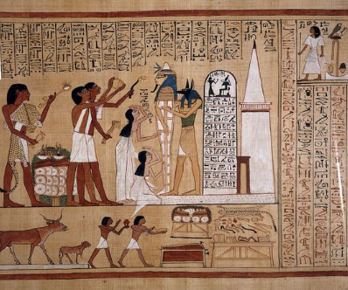
What can you see on this painting?

Slide 13
It shows a mummy being prepared during a religious ceremony called 'The Opening of the Mouth'.

Slide 14
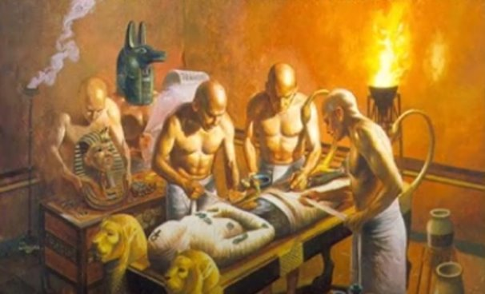
Mummification
https://www.bbc.co.uk/teach/class-clips-video/history-social-studies-ks2-mummification-in-ancient-egypt/zdcrkmn
Remember this picture from lesson 2? After watching the video, we understand a bit more about what is happening here.

Slide 15
This processs wasn't for everybody – what you see below would have been very expensive and only important members of Egyptian society would have had this.
The majority of Egyptian citizens would have been mummified in sand and it would have been much cheaper and quicker.

Slide 16
Task
In your home learning book, you are going to create a mind map (or a double page spread) explaining why religion was important to the Egyptians and how we know.
Include -
  Gods / Goddesses
  Pyramids / Temples / Tombs
  Belief in the Afterlife/Mummification
Please make sure you put todays date and your L.C. These both need to be underlined. This work, I would like you to send into me so please make sure you present your work neatly so that I can print it off to stick in your school book.

