Slide 2
Reported Speech vs.
Direct Speech
Reported speech summarises or paraphrases what has been said. It does not usually directly quote the words spoken, so does not need any special punctuation.
For example:
The goats said that they wanted to eat the green grass on the other side of the bridge.
The troll shouted to the goats to stay on their own side of the stream.

Slide 3


Reported Speech vs.
Direct Speech
When a text uses direct speech, some specific punctuation conventions are required to separate what is said from the rest of the text; this enables the reader to follow what is going on.

Slide 4
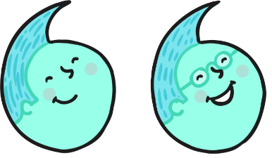

Inverted Commas
The most important rule in punctuating direct speech is that all words spoken must be enclosed by inverted commas.
In British English, a single inverted comma may be used:
‘Get off my bridge.’
However a double inverted comma may also be used:
“Get off my bridge.”
Whichever style you choose, use it consistently across a text.

Slide 5

Punctuation Inside
Inverted Commas
All commas, full stops, question marks and exclamation marks must also be enclosed by inverted commas.
For example:
‘That grass looks delicious,’ said the smallest Billy Goat Gruff.
‘Hey, goat!’ shouted the troll. ‘You are not allowed to cross my bridge.’
‘How can we get to the other side?’ asked the Biggest Goat Gruff.
NOT: ‘Get off my bridge ’ ! shouted the troll.

Slide 6
Commas
Commas are another important tool to help the reader separate direct speech from the rest of the text.
Where direct speech precedes a verb, and does not end in a question mark or exclamation mark, a comma must be used.
For example:
‘We need to get to the other side,’ moaned the goats.
‘Those goats are always disturbing my sleep,’ muttered the troll.

Slide 7

Commas
Where the direct speech before a verb ends in a question mark or exclamation mark however, this punctuation replaces the comma.
For example:
‘Who goes there ?’ shouted the troll.
NOT:
‘Who goes there ?,’ shouted the troll.

Slide 8

Commas
Where the direct speech follows a verb, a comma must be used after the verb to indicate that direct speech is about to begin.
Note: in this context, the direct speech must always begin with a capital letter.
For example:
The smallest Billy Goat Gruff said, ‘I’ll go first.’
The Troll shouted, ‘Who goes there?’
The biggest Billy Goat Gruff shouted, ‘Oh no you won’t!’

Slide 9





Punctuation Inside
Inverted Commas
In addition, where the direct speech follows the verb, a full stop, exclamation mark or question mark must be used inside the inverted commas to signal the end of the speech.
For example:
The smallest Billy Goat Gruff said, ‘I’ll go first.’
The Troll shouted, ‘Who goes there?’
The biggest goat shouted, ‘Oh no you won’t!’

Slide 10
Punctuating ‘Split’
Direct Speech
If the direct speech is one sentence broken up by information about who is speaking, you need a comma (or a question mark or exclamation mark) to end the first piece of speech and another comma before the concluding part of the sentence (before the inverted comma or commas).
For example:
‘I’m light and quiet,’ said the smallest Billy Goat Gruff, ‘so I’ll go first.’
In this context, use a lower case letter to start the second part of the direct speech.

Slide 11


Punctuating ‘Split’
Direct Speech
If the direct speech is two discrete sentences separated by information about who is speaking, you need a comma (or a question mark or exclamation mark) to end the first piece of speech and full stop after the information about the speaker. The second sentence then begins with a capital letter.
For example:
‘You’re right,’ agreed the Biggest Billy Goat Gruff. ‘We can’t let the Troll beat us.’

Slide 12
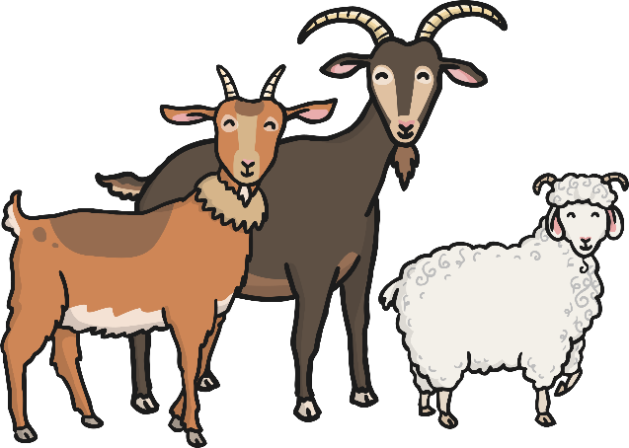
New Speaker, New Line
If the direct speech in a text involves more than one speaker, a new line must be used for each new speaker. This helps the reader to follow what is being said.
For example:
‘We can’t let him win! He’s just a grumpy troll!’ said the smallest Billy Goat Gruff.
‘You’re right,’ agreed the biggest Billy Goat Gruff.
The medium-sized Billy Goat Gruff said, ‘So what shall we do?’

Slide 13

Reporting Clauses
Reporting clauses tell us who is speaking, or who said what. Reporting clauses can be found in both reported speech and direct speech.
For example:
The troll said the goats should get off his bridge. (reported speech)
‘Who goes there?’ shouted the Troll. (direct Speech)
‘That grass looks so green and delicious,’ bleated the Smallest Billy Goat Gruff. (direct speech)

Slide 14


Two-Minute Challenge
Consider the following example:
The troll said, ‘Get off my bridge,’ and the goat said, ‘No!’
Technically, this example is correct; however, it is clumsy.
Talk to a partner to find two ways that this example could be improved. You have two minutes!
Start
End
Click start and the timer is up when it fades to red.

Slide 15

Two-Minute Challenge
How did you improve this example?
The troll said, ‘Get off my bridge,’ and the goat said, ‘No!’
You could use the rule ‘new speaker, new line’:
The troll said, ‘Get off my bridge.’
‘No!’ said the goat.
You could use reported speech instead of direct speech.
The troll told the goat to get off his bridge, but the goat refused.
Click start and the timer is up when it fades to red.
Start
End

Slide 16
Summary
Context | Punctuation
All reported speech | No extra punctuation.
All direct speech | Must be enclosed in inverted commas.
Direct speech punctuation | Must be enclosed in inverted commas.
Direct speech before a verb | Use a comma after the direct speech (inside the inverted commas), verb begins with inverted comma and lower case letter.
Direct speech after a verb | Use a comma after the verb (outside the inverted commas), direct speech begins with inverted comma and a capital letter.
Split direct speech – one sentence | Use a comma/exclamation/question mark inside inverted comma to conclude first part of speech. Verb starts with lower case letter, followed by comma outside inverted commas. Direct speech resumes with an inverted comma and a lower case letter.
Split direct speech – two sentences | Use a comma/exclamation/question mark inside inverted comma to conclude first part of speech. Verb starts with lower case letter, followed by full stop. Direct speech resumes with an inverted comma and a capital letter.

